Slide 1
Lecture 27: Network Security
CS 105

Slide 2
Networking Stack
7 - Application
Deliver content
HTTP
6 - Presentation
Manage encoding
5 - Session
Manage sessions
TLS/SSL
4 - Transport
Deliver (un)reliably
TCP/UDP
3 - Network
Deliver globally
IP
2 - Data Link
Deliver locally
Ethernet
1 - Physical
Deliver signals
0s and 1s

Slide 3
Denial of Service Attacks
Goal: violate availability by making system unable to respond to requests from legitimate users
  Resource-saturation attacks
  Vulnerability-based attacks

Slide 4
Ping
The Internet Control Message Protocol (ICMP) is a network-layer support protocol used to pass operational information and error messages
ping: test reachability of a host in an IP network
  sends ICMP echo request packet to target host and waits for ICMP echo reply
  Uses CPU, network bandwidth
traceroute: display path to a host in an IP network
Notes:
Man traceroute
Traceroute IP from ipinfo.io (timesout)
Traceroute IP from ifconfig (allowed)
Watch with htop
Whois IP from traceroute

Slide 5
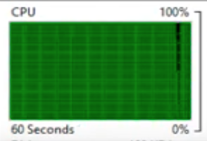
Ping Flood
ping -f
Notes:
https://www.youtube.com/watch?v=xGhB1Kp7Eow

Slide 6
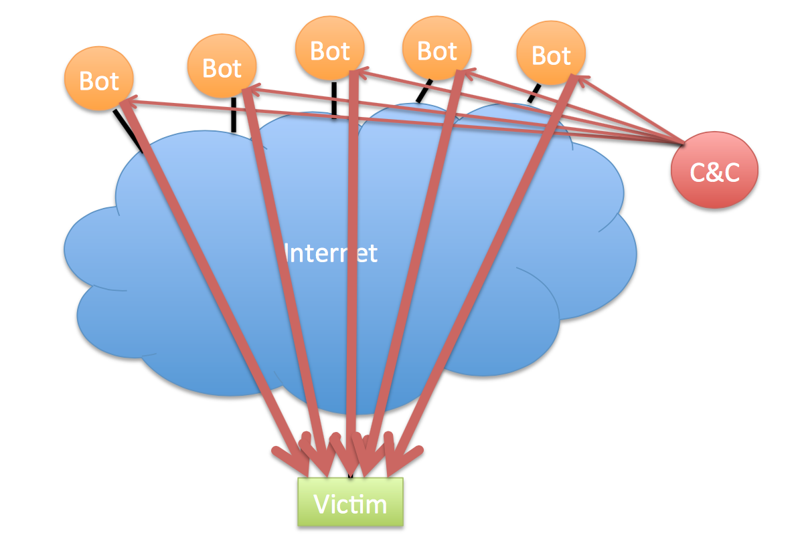
Ping Flood

Slide 7
Defenses against Ping Floods
Disable ICMP functionality
Non-centralized firewalls

Slide 8
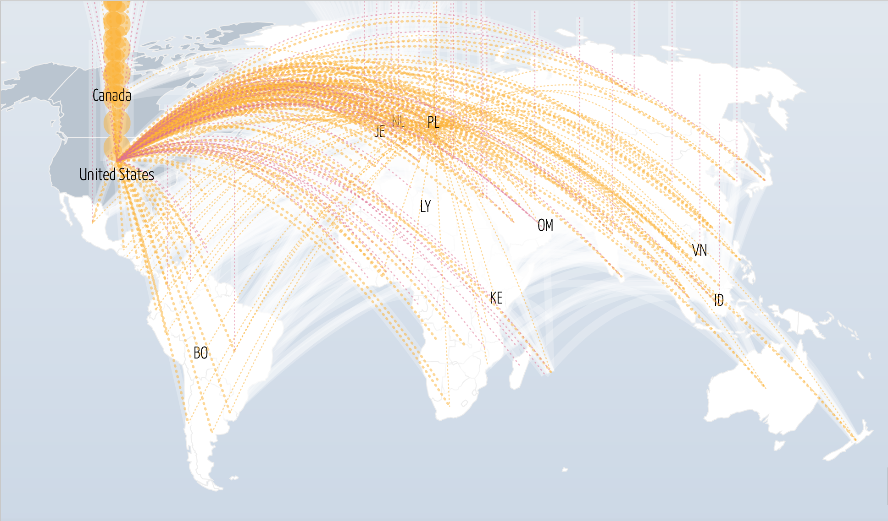
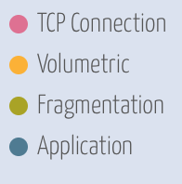

DNS Flood
Notes:
The Dyn DDOS attack was accomplished through a large number of DNS lookup requests from tens of millions of IP addresses
October 21, 2016
Victims include Airbnb, BBC, CNN, Comcast, Fox News, The Guardian, GitHub, Netflix, Paypal, Reddit, Slack, Tumbler, Twitter, Verizon, Visa, Yelp
cat /etc/resolv.conf
https://www.iana.org/assignments/iana-ipv4-special-registry/iana-ipv4-special-registry.xhtml
Whois 8.8.8.8

Slide 9
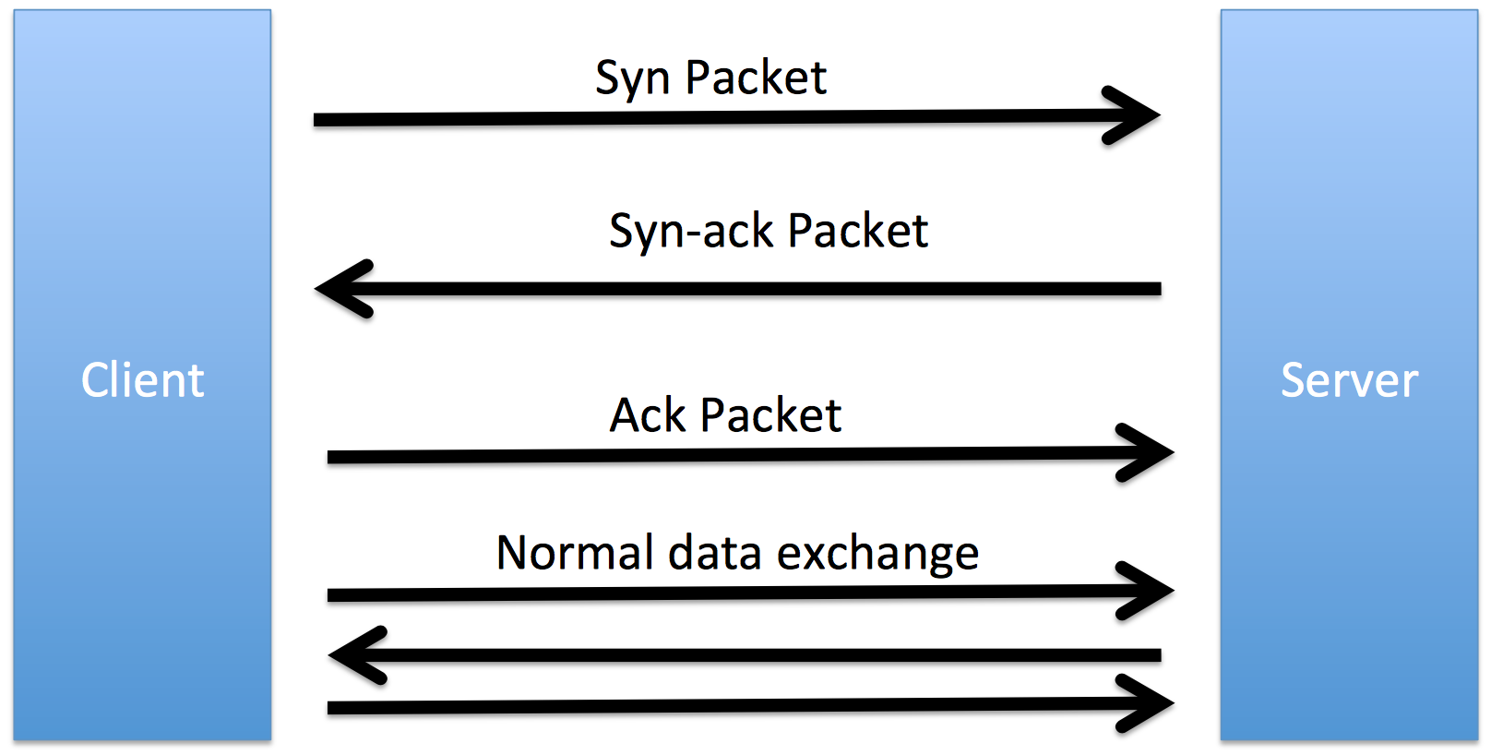
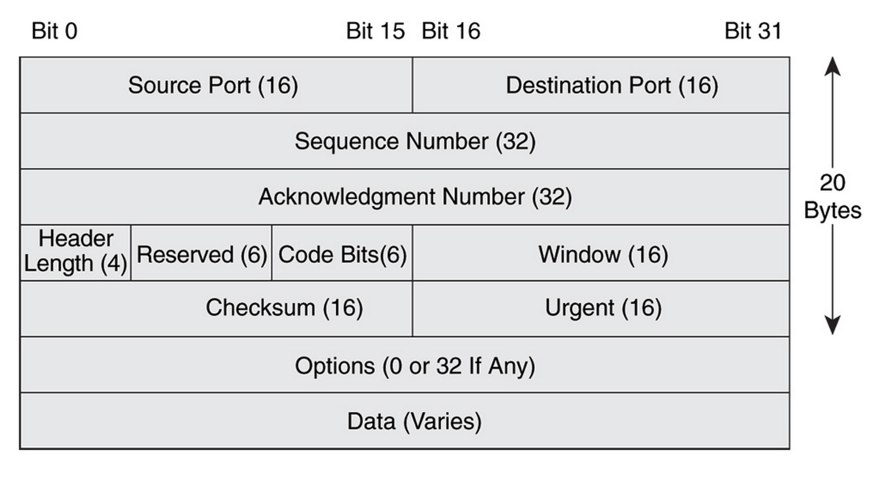
TCP
Reliable
  acknowledgement
  checksum
  sequence number
In-order
  sequence number
Congestion control
  slow start
  congestion avoidance
  fast retransmit
  fast recovery
Notes:
Receive queue for buffered communication

Slide 10
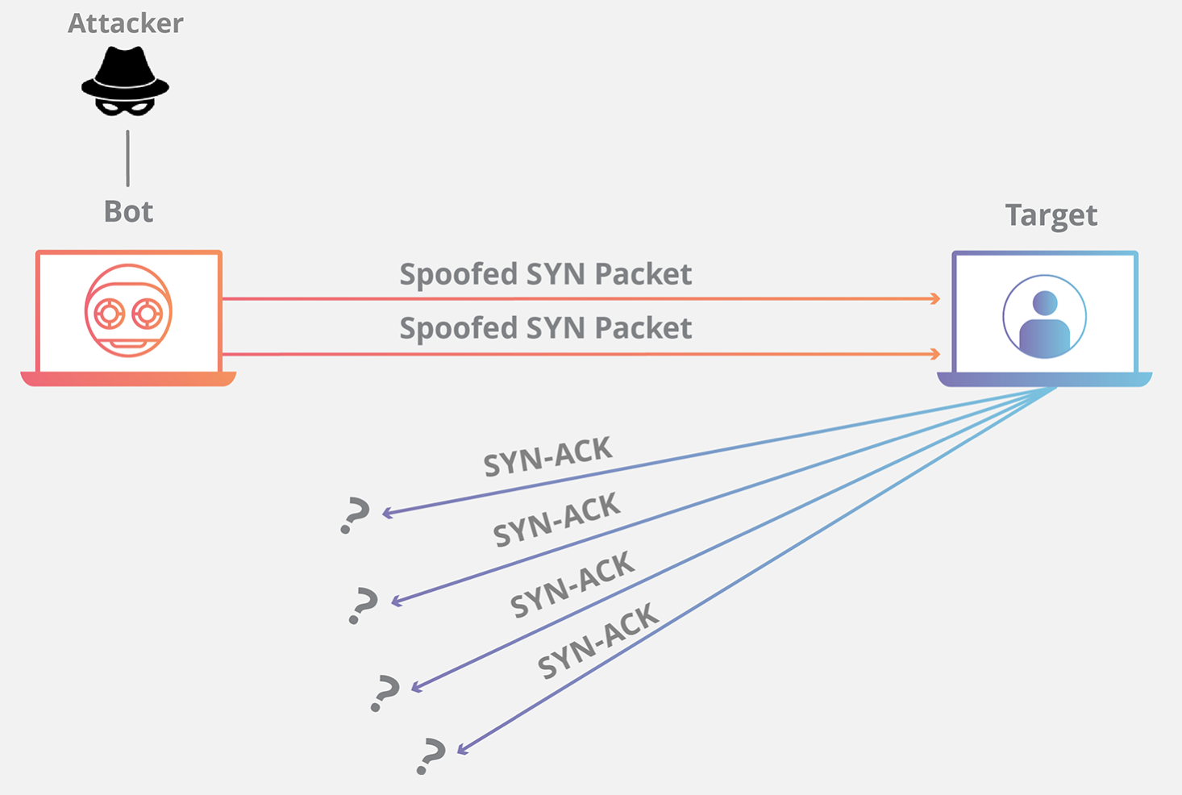
SYN Flood
Notes:
A syn flood is a form of DDoS attack that takes advantage of how TCP handles sessions. Recall that a session is established with a three-way TCP hand- shake: the source sends a SYN (synchronize) packet to the destination, the destination sends back a SYN+ACK packet, and the source completes the handshake by sending an ACK (acknowledge). The destination maintains a SYN RECV queue that keeps track handshakes in progress (those for which it has sent a SYN+ACK response but not yet received the final ACK). The default queue size on most modern machines is 1024 (machines with low memory have smaller queues); pending handshakes typically time out after minutes. A SYN flood proceeds by sending SYN packets but never completing the TCP handshake, filling up the queue and leaving the target unable to respond to additional incoming requests.
SYN floods are so common that TCP supports a special-purpose defense designed to mitigate this threat: SYN cookies. The idea is to eliminate the need to store pending SYN packets by encoding the necessary information in the sequence number using a pseudorandom function (more specifically, and HMAC). This prevents the SYN RECV queue from filling up, mitigating the thread of SYN floods. However, SYN cookies do not support all of the options available in the full TCP spec and are therefore officially recommended only as a last resort.

Slide 11
Defending Against SYN Floods
Increase RECV queue size
  Attackers might have enough resources to fill
Recycle oldest half-open connections
  What happens if the attacker quickly sends a lot of syns?
SYN cookies
  No longer storing a queue of connections

Slide 12
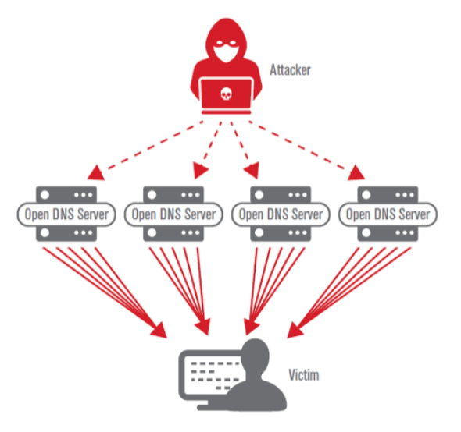
DNS Reflection Attacks

Slide 13


DDOS Attacks
Notes:
AWS 2.3 Tbps February 2020
Google 2.5 Tbps September 2017 (announced October 2020)

Slide 14
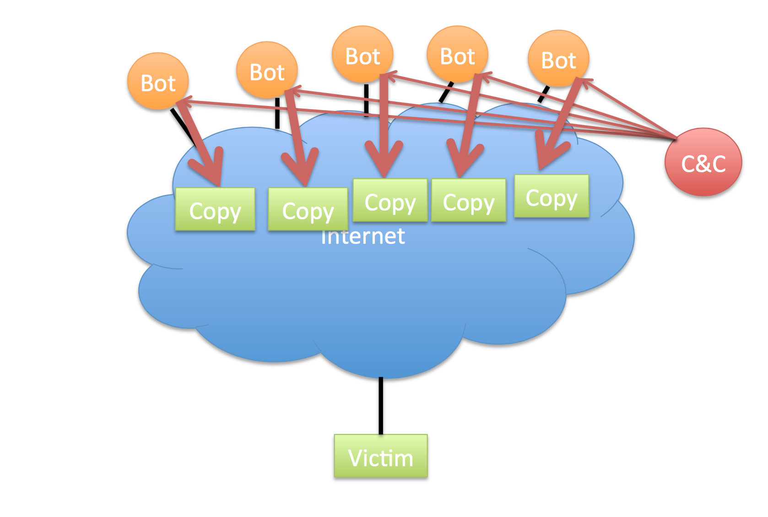

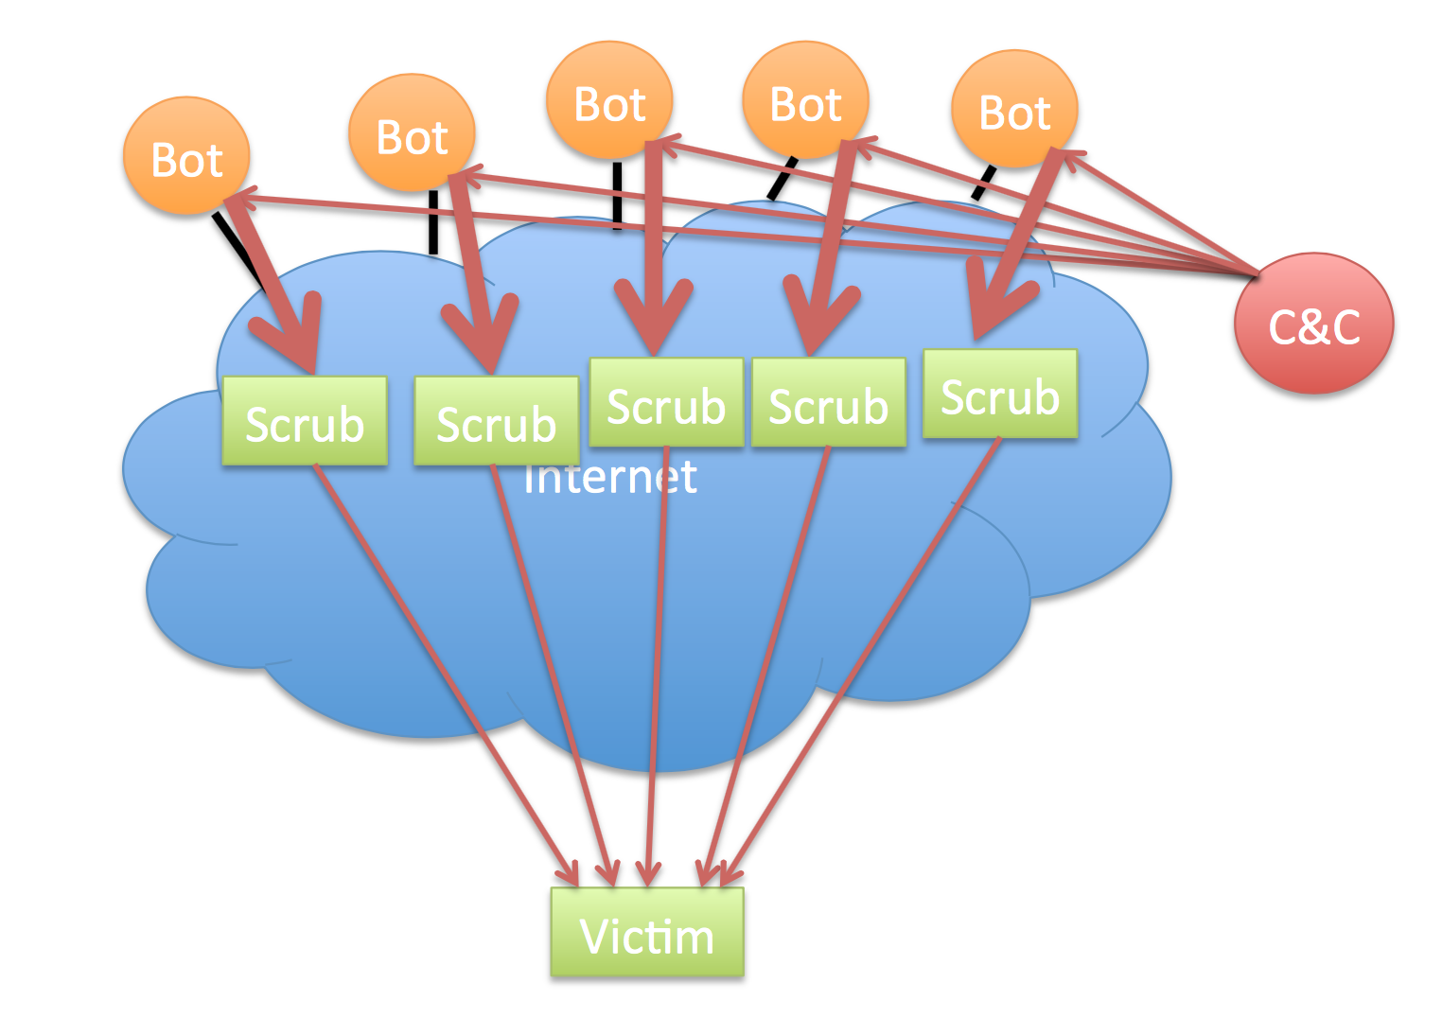

Mitigating DoS Attacks
Notes:
DDoS-mitigation strategies include content distribution (increasing the number of available replicas), distributed scrubbing (a distributed reverse proxy identifies and drops malformed or suspicious traffic), traffic shaping (buffering and rate-limiting incoming traffic), and egress filtering (preventing outgoing traffic from being used in a DDoS attack). As a general rule, DDoS mitigation depends on deploying extensive defensive resources and can be bypassed by a sufficiently determined and resourceful adversary.

Slide 15
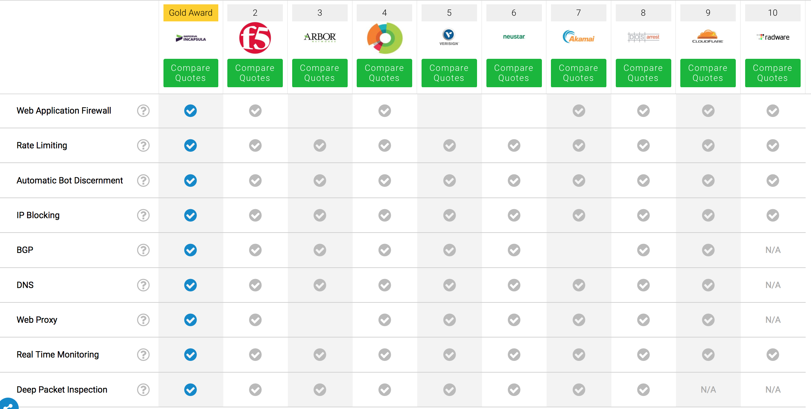
Mitigating DoS Attacks
Notes:
Mitigating denial of service attacks is a complex and evolving art. Several companies (Akamai, CloudFlare, Google Shield) offer DDoS mitigation as a service, and their precise techniques are generally a closely-guarded trade secret.

Slide 16




Botnets
Storm
Chameleon
Mirai
Notes:
https://github.com/0x27/linux.mirai/blob/master/mirai/bot/scanner.c
creates botnet, controlled 2.5 million machines at peak
password map: https://krebsonsecurity.com/wp-content/uploads/2016/10/IoTbadpass-Sheet1.pdf
owners identified January 2017, arrested, pled guilty December 2017
clones (eg., Darkai) still operational
Cat /etc/services | grep 23

Slide 17

DDoS as a Service
Notes:
https://krebsonsecurity.com/2018/04/ddos-for-hire-service-webstresser-dismantled/
Specify target, duration, method, pay with Paypal or bitcoin
WebStresser.org taken offline in April 2018, but many others do (and will) exist

Slide 18
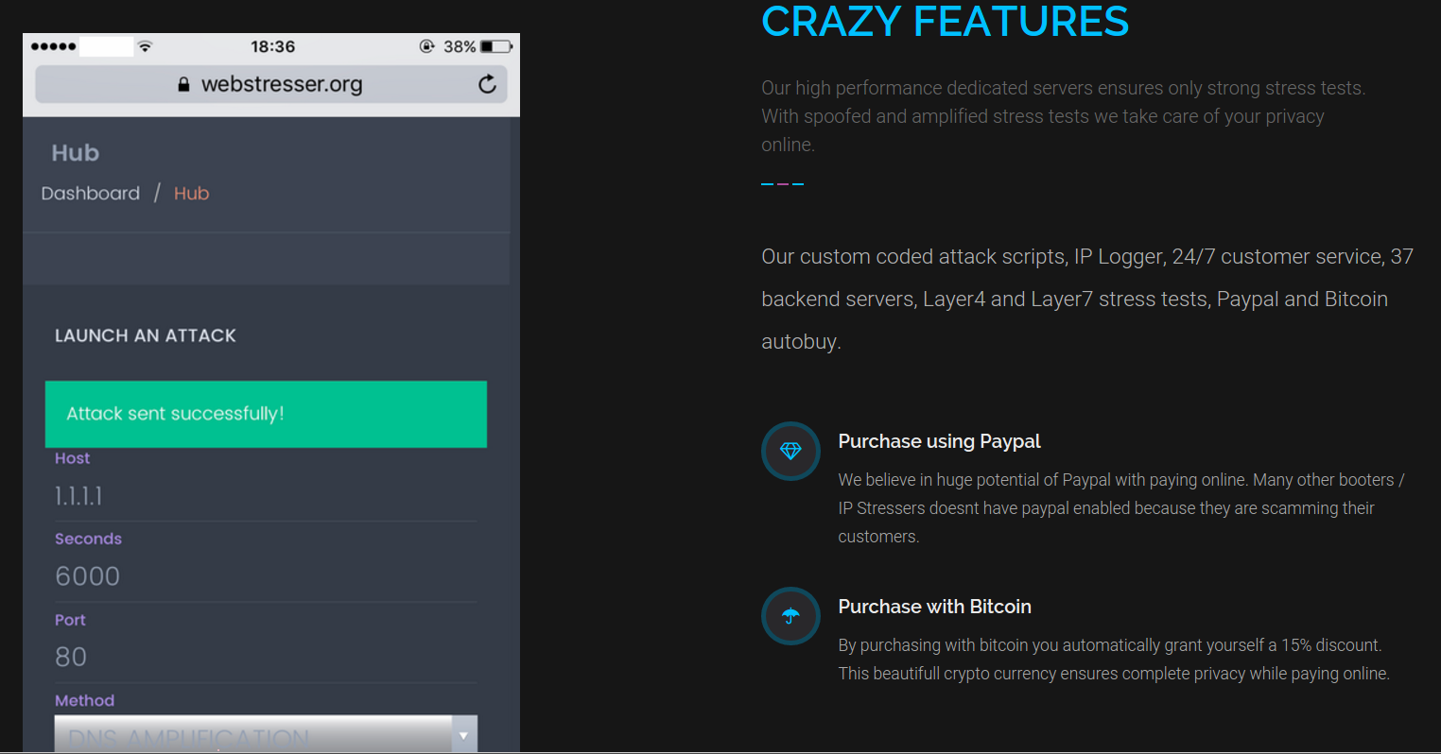
DDoS as a Service
Notes:
$7 to 25

Slide 19
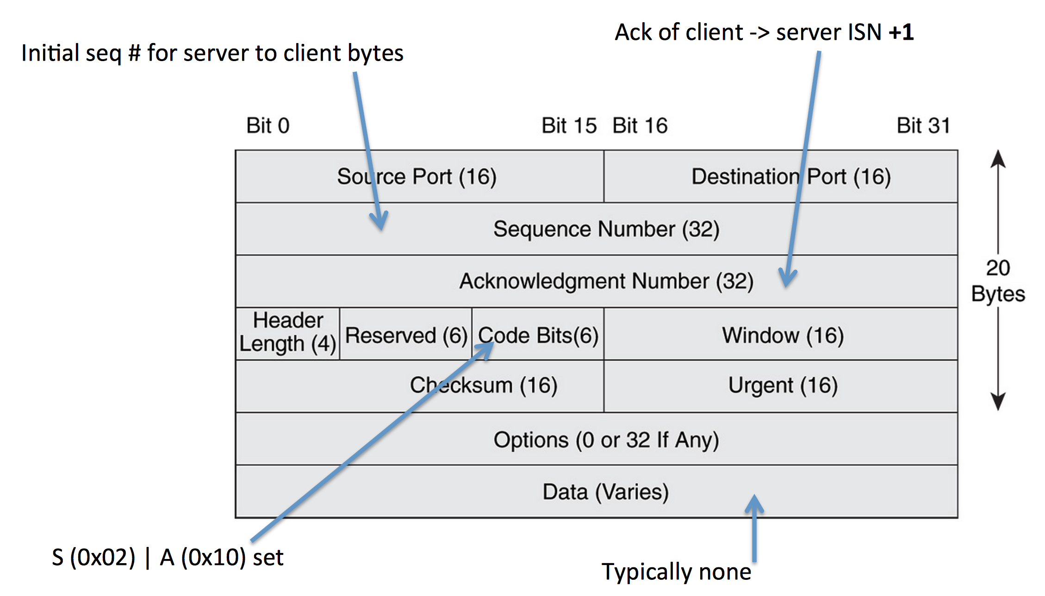
Remote Requests
Port Open
Port Closed
No machine
  ICMP response from router
Machine but port closed
  TCP reset packet
Intercepted
  Silence (depends on config)

Slide 20


Port Scanning and Ransomware
Starting Nmap 7.40 ( https://nmap.org ) at 2017-03-18 21:43 EDT
Nmap scan report for scanme.nmap.org (45.33.32.156)
Host is up (0.12s latency).
Other addresses for scanme.nmap.org (not scanned): 2600:3c01::f03c:91ff:fe18:bb2f
Not shown: 993 closed ports
PORT STATE SERVICE VERSION
21/tcp open ftp
22/tcp open ssh OpenSSH 6.6.1p1 Ubuntu 2ubuntu2.8 (Ubuntu Linux; protocol 2.0)
80/tcp open http Apache httpd 2.4.7 ((Ubuntu))
554/tcp open rtsp
7070/tcp open realserver
9929/tcp open nping-echo Nping echo
31337/tcp open Elite
Device type: general purpose
Running (JUST GUESSING): Linux 3.X (85%)
OS CPE: cpe:/o:linux:linux_kernel:3.13
Aggressive OS guesses: Linux 3.13 (85%)
No exact OS matches for host (test conditions non-ideal).
Network Distance: 13 hops
Service Info: OS: Linux; CPE: cpe:/o:linux:linux_kernel
Nmap done: 1 IP address (1 host up) scanned in 20.31 seconds
Notes:
Computer Fraud and Abuse Act of America Section 1030(a)(5)(B). This act applies against anyone who “intentionally accesses a protected computer without authorization, and as a result of such conduct, causes damage” (and meets other requirements).

Slide 21



Random Scanning
Notes:
https://www.theregister.co.uk/2017/02/28/cloudpets_database_leak/
unauthenticated access to mongodb instance on port 2701
ransomware scheme
https://www.sophos.com/en-us/medialibrary/PDFs/technical-papers/SamSam-The-Almost-Six-Million-Dollar-Ransomware.pdf
https://portswigger.net/daily-swig/iranian-duo-charged-with-samsam-ransomware-slinging-campaign
SamSam ransomware: exploits vulnerability in Remote Desktop Protocol (RDP) by scanning for port 3389, then performs privilege escalation attack
Estimated $6 million in revenue over three years
https://hackaday.com/2018/04/18/fix-your-insecure-amazon-fire-tv-stick/
Port 5555 is used for Android Debug Bridge (ADB)
https://github.com/0x27/linux.mirai/blob/master/mirai/bot/scanner.c
creates botnet, controlled 2.5 million machines at peak
password map: https://krebsonsecurity.com/wp-content/uploads/2016/10/IoTbadpass-Sheet1.pdf
owners identified January 2017, arrested, pled guilty December 2017
clones (eg., Darkai) still operational

Slide 22

Firewalls

Slide 23
Packet Filtering
Protocol | Source IP | Dest. IP | Dest. Port | Action
TCP | * | 192.168.1.* | 25 | Permit
UDP | * | 192.168.1.* | 69 | Permit
TCP | 192.168.1.* | * | 80 | Permit
TCP | * | 192.168.1.18 | 80 | Permit
TCP | * | 192.168.1.* | * | Deny
TCP | * | 192.168.1.* | * | Deny

Slide 24
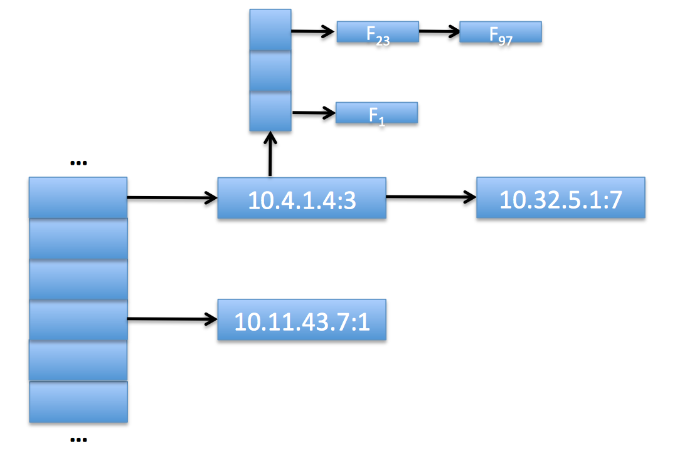
Stateful Inspection
Notes:
Discussion: how to detect/mitigate a port scan
SYN frequency: use keyed hash table & count SYNs, problem: attacker learns limit
sequential behavior: store last dest & count increment-by-1, problem: randomize order
diversity: count unique ip-port pairs, problem: complicated
failures: track failure/success ratio
anomaly detection: dest ip-port has probability P(d), high (5-10%) for popular dests, low for weird ones), accumulate anomaly score –log (P(d))

Slide 25

Deep-Packet Inspection
alert tcp $EXTERNAL_NET any -> $HOME_NET 53 (msg:"OS-LINUX OS-LINUX x86 Linux overflow attempt"; flow:to_server,established; content:"1|C0 B0 02 CD 80 85 C0|uL|EB|L^|B0|"; metadata:ruleset community, service dns; classtype:attempted-admin; sid:264; rev:13;)

Slide 26
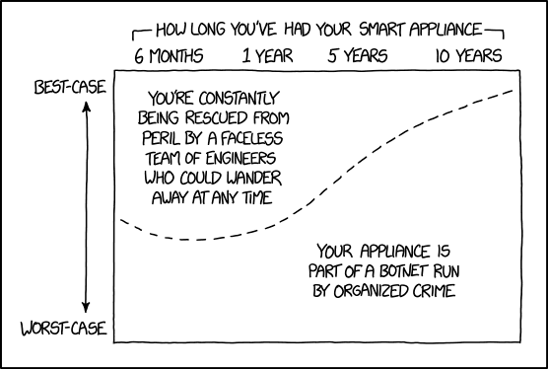
Network Security

Slide 27
Feedback
Rate how well you think this recorded lecture worked
  Better than an in-person class
  About as well as an in-person class
  Less well than an in-person class, but you still learned something
  Total waste of time, you didn't learn anything
How much time did you spend on this video lecture?
Do you have particular questions you’d like me to address in class?
Do you have any other comments or feedback?

