Slide 1
Lecture 26: TCP
CS 105

Slide 2
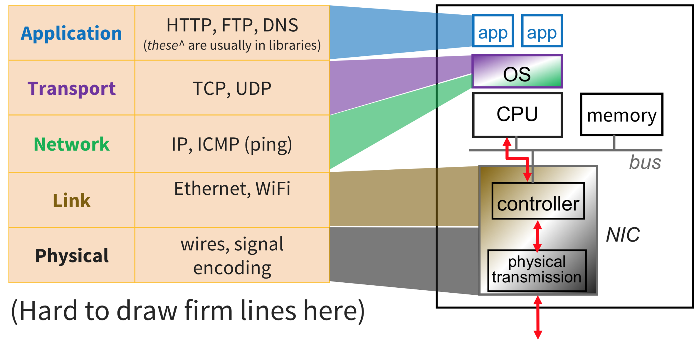
OSI Network Model
Notes:
http://www.cs.cornell.edu/courses/cs4410/2018sp/schedule/slides/09-networking.pdf

Slide 3
Transport Layer Protocols
User Datagram Protocol (UDP)
Transmission Control Protocol (TCP)
unreliable
unordered delivery
connectionless
best-effort, segments might be lost, delivered out-of-order, duplicated
reliability handled by app
reliable
in-order delivery
connection setup
flow control
congestion control
Notes:
flow control = don't overwhelm the receiver
congestion control = don't swamp the network
Note: neither guarantees latency or bandwidth

Slide 4
Sockets Interface
1. Start server
socket
bind
socket
listen
Connection
request
connect
accept
Client / Server
Session
write
read
Await connection
request from
next client
read
write
close
EOF
read
close

Slide 5
Sockets Interface: socket
Clients and servers use the socket function to create a socket descriptor
Example:
Protocol specific! Best practice is to use getaddrinfo to generate the parameters automatically, so that code is protocol independent.
int socket(int domain, int type, int protocol)
int clientfd = Socket(AF_INET, SOCK_STREAM, 0);
Indicates that we are using 32-bit IPV4 addresses
Indicates that the socket will be the end point of a connection

Slide 6
Sockets Interface: bind
A server uses bind to ask the kernel to associate the server’s socket address with a socket descriptor:
The process can read bytes that arrive on the connection whose endpoint is addr by reading from descriptor sockfd.
Similarly, writes to sockfd are transferred along connection whose endpoint is addr.
Best practice is to use getaddrinfo to supply the arguments addr and addrlen.
int bind(int sockfd, SA *addr, socklen_t addrlen);

Slide 7
Sockets Interface: listen
By default, kernel assumes that descriptor from socket function is an active socket that will be on the client end of a connection.
A server calls the listen function to tell the kernel that a descriptor will be used by a server rather than a client:
Converts sockfd from an active socket to a listening socket that can accept connection requests from clients.
backlog is a hint about the number of outstanding connection requests that the kernel should queue up before starting to refuse requests.
int listen(int sockfd, int backlog);

Slide 8
Sockets Interface: accept
Servers wait for connection requests from clients by calling accept:
Waits for connection request to arrive on the connection bound to listenfd, then fills in client’s socket address in addr and size of the socket address in addrlen.
Returns a connected descriptor that can be used to communicate with the client via Unix I/O routines.
int accept(int listenfd, SA *addr, int *addrlen);

Slide 9
Connected vs. Listening Descriptors
Listening descriptor
  End point for client connection requests
  Created once and exists for lifetime of the server
Connected descriptor
  End point of the connection between client and server
  A new descriptor is created each time the server accepts a connection request from a client
  Exists only as long as it takes to service client
Why the distinction?
  Allows for concurrent servers that can communicate over many client connections simultaneously
    E.g., Each time we receive a new request, we fork a child to handle the request

Slide 10
Sockets Interface
1. Start server
socket
bind
2. Start client
socket
listen
Connection
request
connect
accept
Client / Server
Session
write
read
Await connection
request from
next client
read
write
close
EOF
read
close

Slide 11
Sockets Interface: connect
A client establishes a connection with a server by calling connect:
Attempts to establish a connection with server at socket address addr
  If successful, then clientfd is now ready for reading and writing.
  Resulting connection is characterized by socket pair
  (x:y, addr.sin_addr:addr.sin_port)
    x is client address
    y is ephemeral port that uniquely identifies client process on client host
Best practice is to use getaddrinfo to supply the arguments addr and addrlen.
int connect(int clientfd, SA *addr, socklen_t addrlen);

Slide 12
accept Illustrated
listenfd(3)
Client
Server
1. Server blocks in accept, waiting for connection request on listening descriptor listenfd
clientfd
Connection
request
listenfd(3)
Client
Server
2. Client makes connection request by calling and blocking in connect
clientfd
listenfd(3)
3. Server returns connfd from accept. Client returns from connect. Connection is now established between clientfd and connfd
Client
Server
clientfd
connfd(4)

Slide 13
TCP Connections
TCP is connection-oriented
A connection is initiated with a three-way handshake
Recall: server will typically create a new socket to handle the new connection
SYN
SYN, ACK
ACK
…

Slide 14
Exercise 1: TCP Handshake
Explain why three messages are required to set up a TCP connection
Notes:
Need to
Request
Agree
Acknowledge all messages

Slide 15
Sockets Interface
1. Start server
socket
bind
2. Start client
socket
listen
Connection
request
connect
accept
3. Exchange
data
Client / Server
Session
write
read
Await connection
request from
next client
read
write
close
EOF
read
close

Slide 16
Reliable Transport
Each SYN segment will include a randomly chosen sequence number
Sequence number of each segment is incremented by data length
Receiver sends ACK segments acknowledging latest sequence number received
Sender maintains copy of all sent but unacknowledged segments; resends if ACK does not arrive within timeout
Timeout is dynamically adjusted to account for round-trip delay
SYN
SYN, ACK
ACK
data (Seq = 47)
ACK 47
data (Seq = 48)
ACK 48
data (Seq = 49)
Send Timeout
data (Seq = 49)
ACK 49

Slide 17
Transport-Layer Segment Formats
UDP
TCP
Source Port #
Dest. Port #
Source Port #
Dest. Port #
application message (payload)
sequence number
acknowledgement number
HL
U
A
P
R
S
F
receive window
checksum
U data pointer
options
application message (payload)
Notes:
S,A,F flags used to manage connection
sequence number and acknowledgement number (+ A flag) are used to implement reliable transport

Slide 18
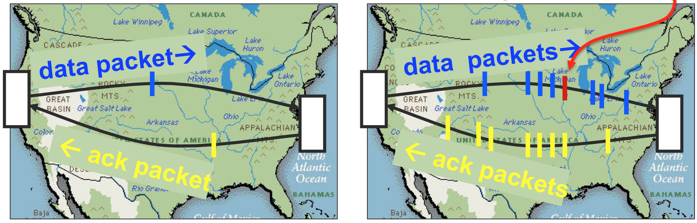
Pipelined Protocols
Pipelining allows sender to send multiple "in-flight", yet-to-be-acknowledged packets
  increases throughput
  needs buffering at sender and receiver
how big should the window be?
what if a packet in the middle goes missing?

Slide 19
Example: Window Size = 4
sender can have up to 4 unacknowledged messages
when ACK for first message is received, it can send another message
data (Seq = 47)
data (Seq = 48)
data (Seq = 49)
data (Seq = 50)
ACK 47
ACK 48
ACK 49
ACK 50
data (Seq = 51)
data (Seq = 52)
data (Seq = 53)
data (Seq = 54)

Slide 20
TCP Fast Retransmit
Receiver always acks the last id it successfully received
Sender detects loss without waiting for timeout, resends missing packet
data (Seq = 47)
data (Seq = 48)
data (Seq = 49)
data (Seq = 50)
ACK 47
ACK 47
ACK 47
data (Seq = 51)
data (Seq = 48)
data (Seq = 48)
ACK 47
ACK 51
ACK 51

Slide 21
Exercise 2: TCP Sequence Numbers
Consider the sequence of transmitted messages shown on the right
What will be the next ACK number sent by the server?
What will be the next Seq number sent by the client?
data (Seq = 13)
data (Seq = 14)
data (Seq = 15)
data (Seq = 16)
ACK 13
ACK 13
data (Seq = 17)

Slide 22
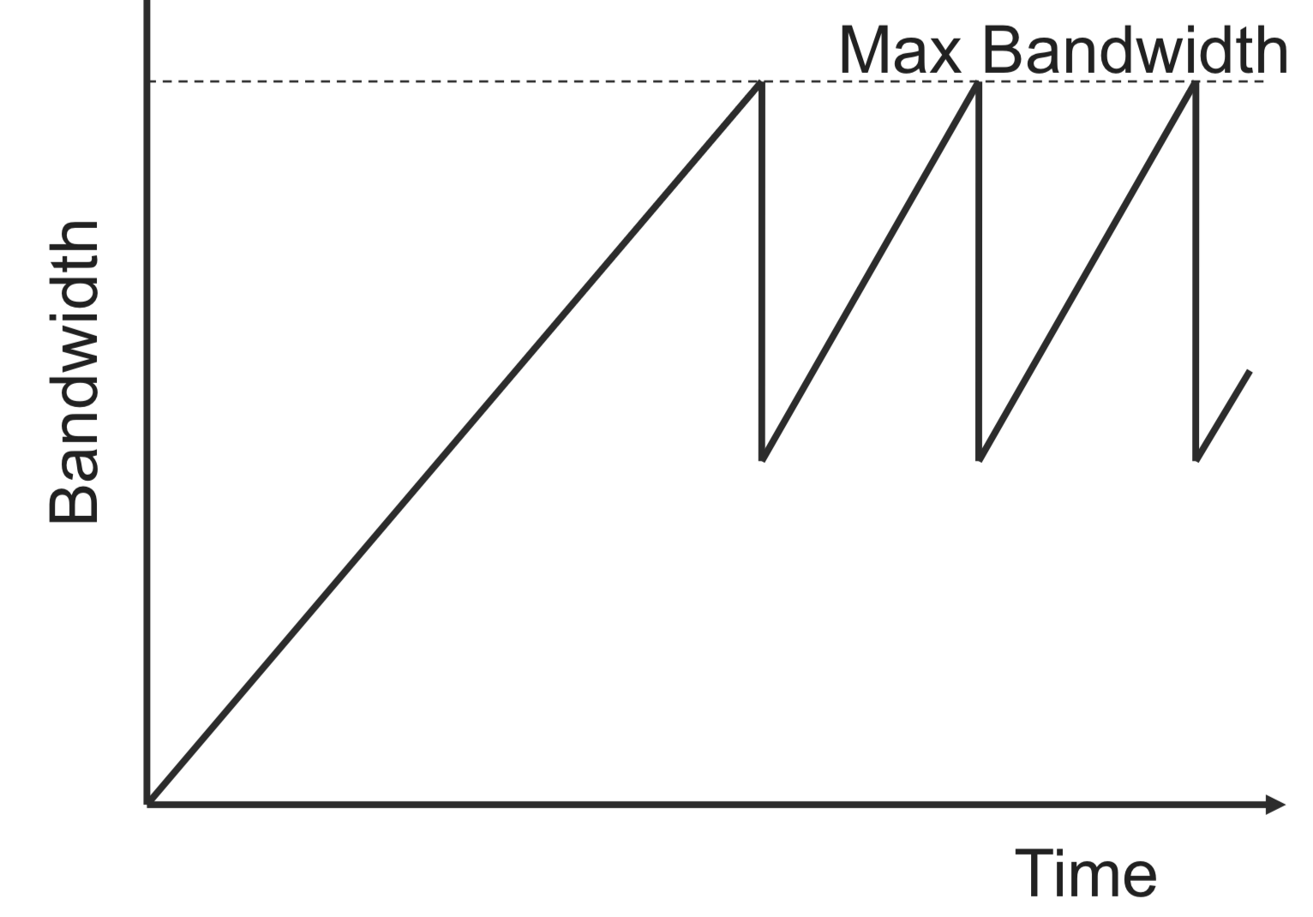
TCP Congestion Control
TCP operates under a principle of additive increase-multiplicative decrease
  window size++ every RTT if no packets lost
  window size/2 if a packet is dropped

Slide 23
TCP Fairness
Goal: if k TCP sessions share same bottleneck link of bandwidth R, each should have average rate of R/k
R
Loss: decreases throughput proportional to current bandwidth
Connection 2 Throughput
Congestion avoidance: increases throughput linearly (evenly)
Connection 1 Throughput
R

Slide 24
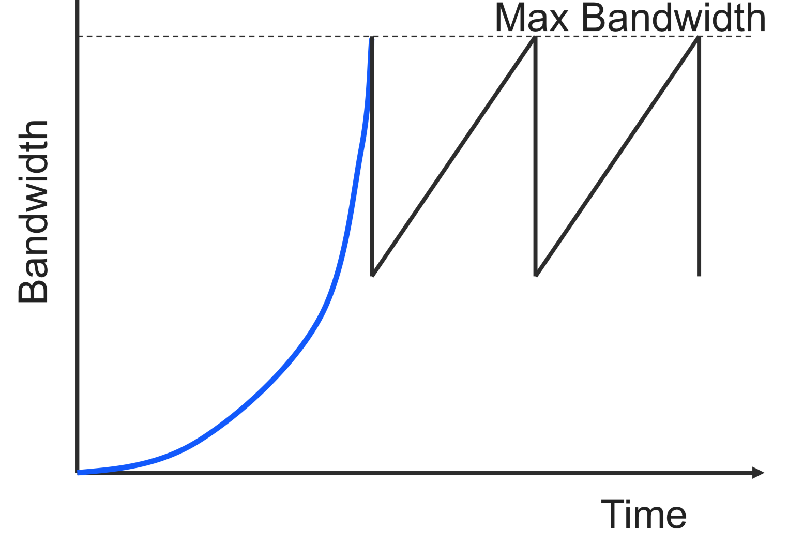
TCP Slow Start
Problem: linear increase takes a long time to build up a decent window size, and most transactions are small
Solution: allow window size to increase exponentially until first loss

Slide 25
Exercise 3: TCP Window Size
Assume someone changes the code of their TCP client by modifying the congestion avoidance as follows:
  instead of increasing the window size by 1 each time an ACK is received,
  they double the window size each time an ACK is received (like in the slow-start phase).
What would be the pros and cons of this modification?
Notes:
Pro: get to have more bandwidth
Con: no longer have fairness

Slide 26
Sockets Interface
1. Start server
socket
bind
2. Start client
socket
listen
Connection
request
connect
accept
3. Exchange
data
Client / Server
Session
write
read
Await connection
request from
next client
read
write
4. Disconnect client
EOF
5. Drop client
close
read
close

Slide 27
TCP Connections
TCP is connection-oriented
A connection is initiated with a three-way handshake
Recall: server will typically create a new socket to handle the new connection
FIN works (mostly) like SYN but to teardown a connection
SYN
SYN, ACK
ACK
…
FIN
ACK

Slide 28
TCP Summary
Reliable, in-order message delivery
Connection-oriented, three-way handshake
Transmission window for better throughput
  timeouts based on link parameters (e.g., RTT, variance)
Congestion control
  Linear increase, exponential backoff
Fast adaptation
  Exponential increase in the initial phase

Slide 29
Exercise 4: Feedback
Rate how well you think this recorded lecture worked
  Better than an in-person class
  About as well as an in-person class
  Less well than an in-person class, but you still learned something
  Total waste of time, you didn't learn anything
How much time did you spend on this video lecture?
Do you have any comments or suggestions for future classes?

