Slide 1
Lecture 24: File Systems
CS 105

Slide 2
Review: File Systems 101
Long-term information storage goals
  should be able to store large amounts of information
  information must survive processes, power failures, etc.
  processes must be able to find information
  needs to support concurrent accesses by multiple processes
Solution: the File System Abstraction
  interface that provides operations involving
    files
    directories (a special kind of file)

Slide 3
Review: The File System Abstraction
interface that provides operations on data stored long-term on disk
a file is a named sequence of stored bytes
  name is defined on creation
  processes use name to subsequently access that file
a file is comprised of two parts:
  data: information a user or application puts in a file
    an array of untyped bytes
  metadata: information added and managed by the OS
    e.g., size, owner, security info, modification time
two types of files
  normal files: data is an arbitrary sequence of bytes
  directories: a special type of file that provides mappings from human-readable names to low-level names (i.e., file numbers)

Slide 4
Review: The File System Stack
Application
user level
Language Libraries (e.g.,fopen, fread, fwrite, fclose,…)
POSIX API (open, read, write, close, …)
File System
Generic Block Interface (block read/write)
kernel mode
Generic Block Layer
Specific Block Interface (protocol-specific read/write)
Device Driver

Slide 5
File System Challenges
Performance: despite limitations of disks
Flexibility: need to support diverse file types and workloads
Persistence: store data long term
Reliability: resilient to OS crashes and hardware failures

Slide 6
File System Properties
Most files are small
  need strong support for small files (optimize the common case)
  block size can't be too big
Directories are typically small
  usually 20 or fewer entries
Some files are very large
  must handle large files
  large file access should be reasonably efficient
File systems are usually about half full
Notes:
Agrawal, Bolosky, Douceur, Lorch. A Five Year Study of File-System Metadata. FAST 2007.

Slide 7
Implementation Basics
Directories: file name -> low-level names (i.e., file numbers)

Slide 8
Multiple human-readable names
Many file systems allow a given file to have multiple names
Hard links are multiple file directory entries that map different path names to the same file number
Symbolic Links or soft links are directory entries that map one name to another (effectively a redirect)

Slide 9
Implementation Basics
Directories: file name -> low-level names (i.e., file numbers)
Index structures: file number -> block

Slide 10
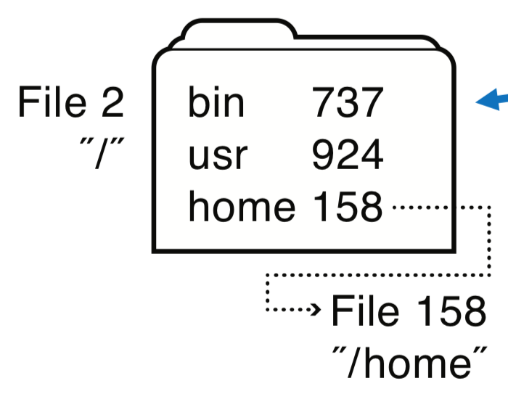
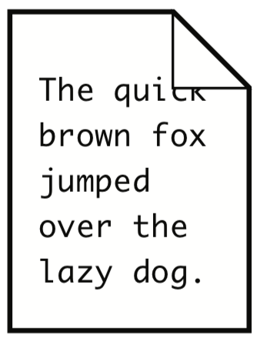
Directories
a directory is a file that provides mappings from human-readable names to low-level names (i.e., file numbers):
  a list of human-readable names
  a mapping from each name to a specific underlying file or directory
OS uses path name to find directories and files
ada 682
eleanor 818
rett 830
File 158
"/home"
File 818
"/home/eleanor"
music 320
work 219
foo.txt 871
File 871
"/home/eleanor/foo.txt"

Slide 11
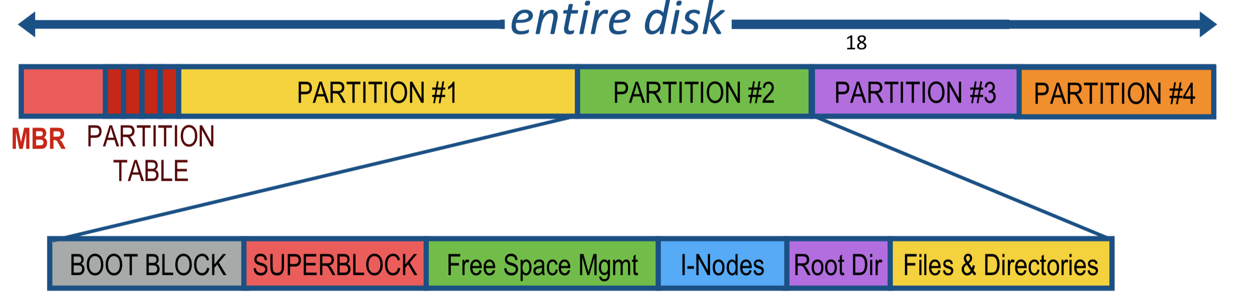
File System Layout
File systems are stored on disks
  disks can be divided into one or more partitions
Sector 0 of disk called Master Boot Record
  executable boot loader
  end of MBR: partition table (contains partitions' start & end addr.)
Remainder of disk divided into partitions
  First block of each partition is boot block (loaded by MBR on boot)
  The rest of the partition stores the file system
Notes:
MBR contains information on how partitions are organized + executable boot loader

Slide 12
Storing Files
Possible ways to allocate files:
Continuous allocation: all bytes together, in order
Linked structure: each block points to the next block
Indexed structure: index block points to many other blocks
Log structure: sequence of segments, each containing updates
Which is the best?
For sequential access?
For random access?
For small files?
For large files?

Slide 13

Continuous Allocation
All bytes together, in order
Simple: state required per file = start block & size
Efficient: entire file can be read with one seek
Fragmentation: external is bigger problem
Usability: user needs to know size of file at time of creation
Notes:
Used in CDs, DVDs

Slide 14
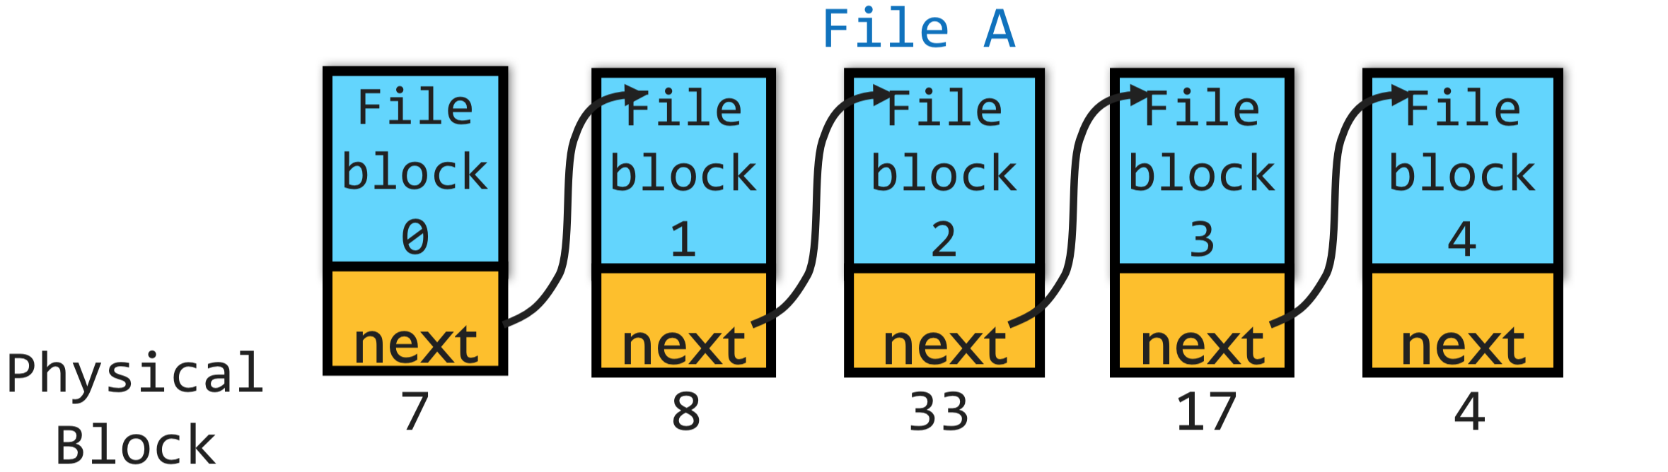
Linked Allocation
Each file is stored as linked list of blocks: First word of each block points to next block, rest of disk block is file data
Simple: only need to store 1st block of each file
Space Utilization: no space lost to external fragmentation
Performance: random access is slow
Space Utilization: overhead of pointers

Slide 15
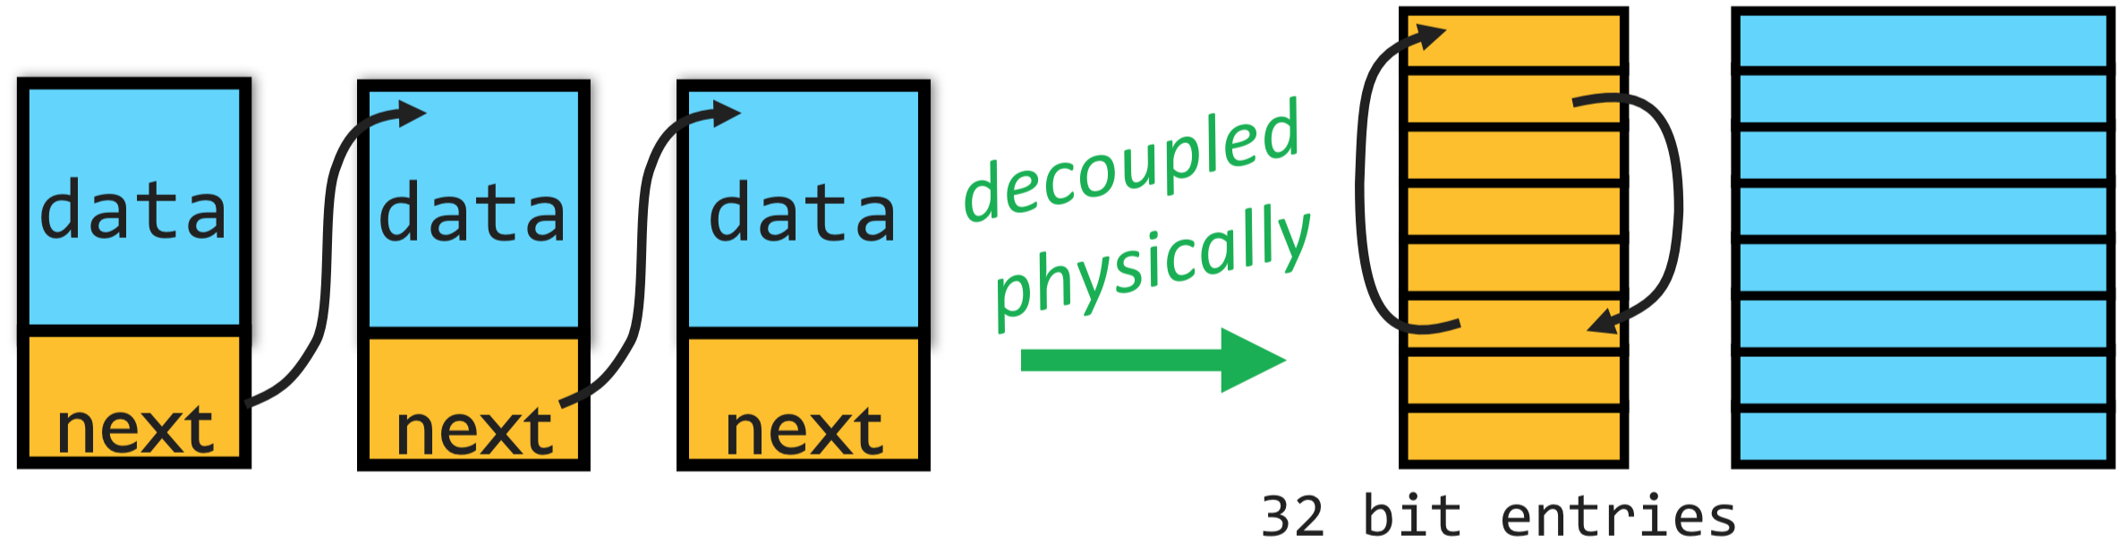

Linked Allocation: File Allocation Table (FAT)
Developed by Microsoft for MS-DOS
Still widely used for flash drives, camera cards, etc.
Fat-32 supports $2^{28}$ blocks and files of $2^{32}−1$ bytes
File table:
  Linear map of all blocks on disk
  Each file a linked list of blocks

Slide 16
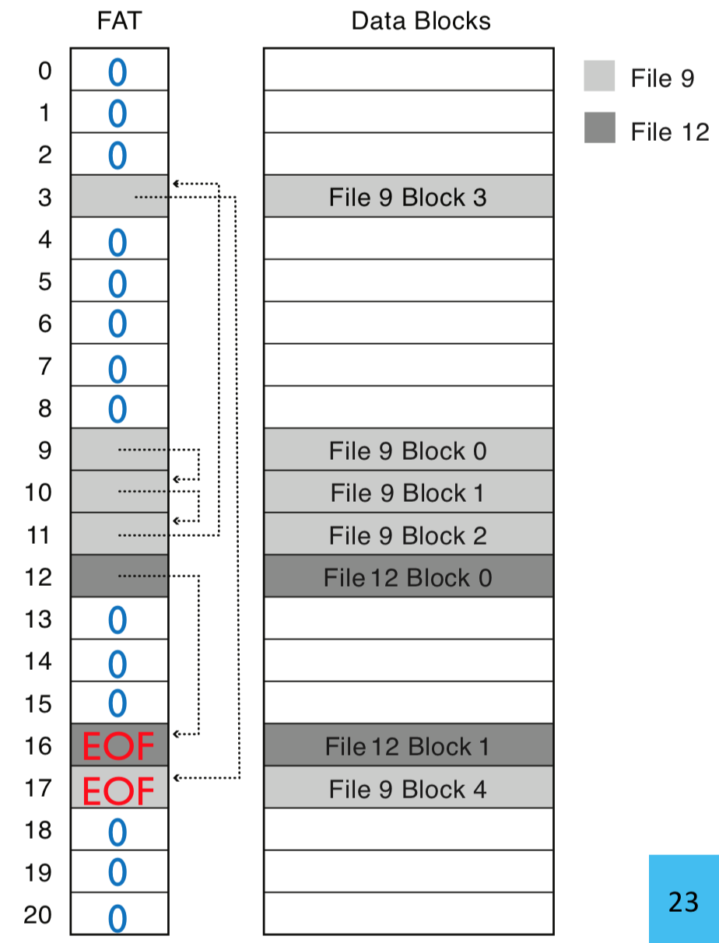
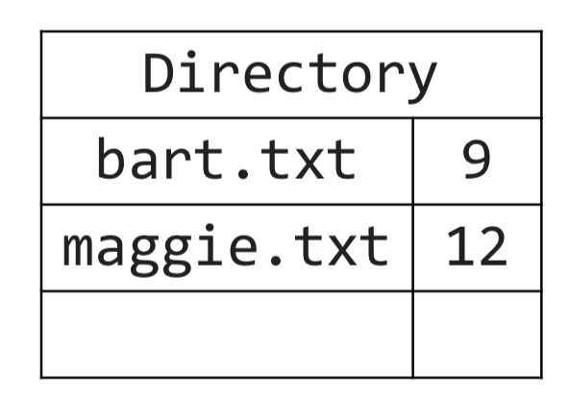
FAT File System
1 entry per block
EOF for last block
0 indicates free block
low-level name = FAT index of first block in file

Slide 17
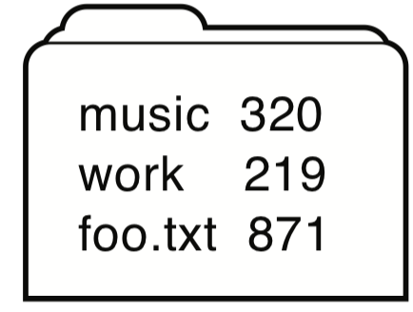
FAT Directory Structure
Folder: a file with 32-byte entries
Each Entry:
8 byte name + 3 byte extension (ASCII)
creation date and time
last modification date and time
first block in the file (index into FAT)
size of the file
Notes:
Long and Unicode file names take up multiple entries

Slide 18

Exercise 1: Linked Allocation
How many disk reads would be required to read (all of) a $2^{15}$ byte file named /foo/bar/baz.txt
  assume 4096 byte (4 KB or $2^{12}$ byte) blocks
  assume that all directories are small enough to fit in one block

Slide 19
Exercise 1: Linked Allocation
How many disk reads would be required to read (all of) a $2^{15}$ byte file named /foo/bar/baz.txt
  assume 4096 byte (4 KB or $2^{12}$ byte) blocks
  assume that all directories are small enough to fit in one block
read / directory block, find foo’s file number
read foo directory block, find bar’s file number
read bar’s directory block, find baz.txt’s file number
read baz.txt’s block 0
read ptr to block 1 in FAT
read baz.txt’s block 1
read ptr to block 2 in FAT
…
read ptr to block 6 in FAT
read baz.txt’s block 6
read ptr to block 7 in FAT
read baz.txt’s block 7
read EOF ptr in FAT

Slide 20
Exercise 2: Symbolic Links
How could we implement symbolic links in the FAT file system?

Slide 21
Evaluating FAT
How is FAT good?
Simple: state required per file: start block only
Widely supported
No external fragmentation
block used only for data
How is FAT bad?
Poor locality
Many file seeks (unless entire FAT in memory)
Poor random access
Limited metadata
Limited access control
Limitations on volume and file size
No support for reliability techniques

Slide 22
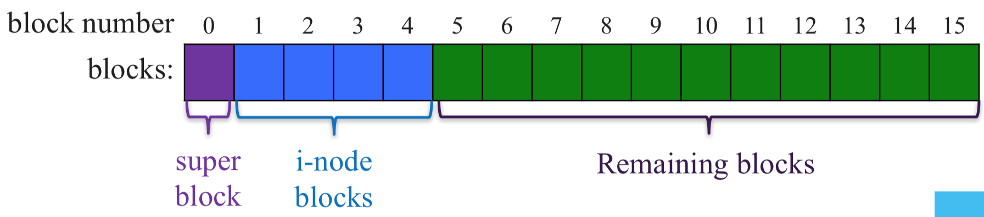
Indexed Allocation: Fast File System (FFS)
tree-based, multi-level index
superblock identifies file system's key parameters
inodes store metadata and pointers
datablocks store data

Slide 23
FFS Superblock
Identifies file system’s key parameters:
  type
  block size
  inode array location and size
  location of free list

Slide 24
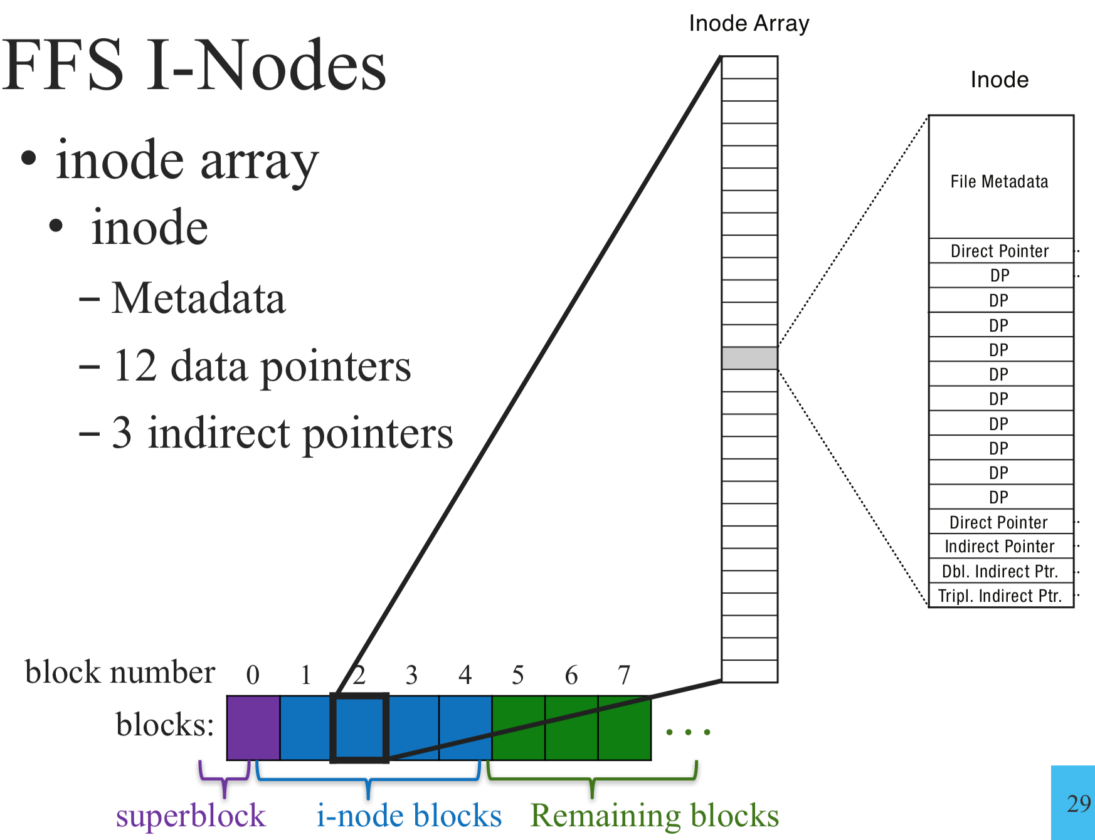
FFS inodes
inode blocks contain an array of inodes
each inode contains:
  Metadata
  12 data pointers
  3 indirect pointers

Slide 25
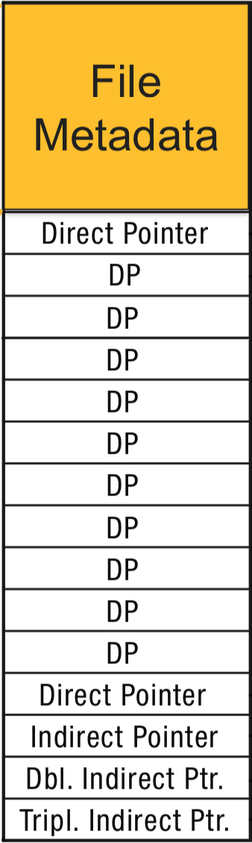
inode Metadata
Type
  ordinary file
  directory
  symbolic link
  special device
Size of the file (in #bytes)
# links to the i-node
Owner (user id and group id)
Protection bits
Times: creation, last accessed, last modified

Slide 26
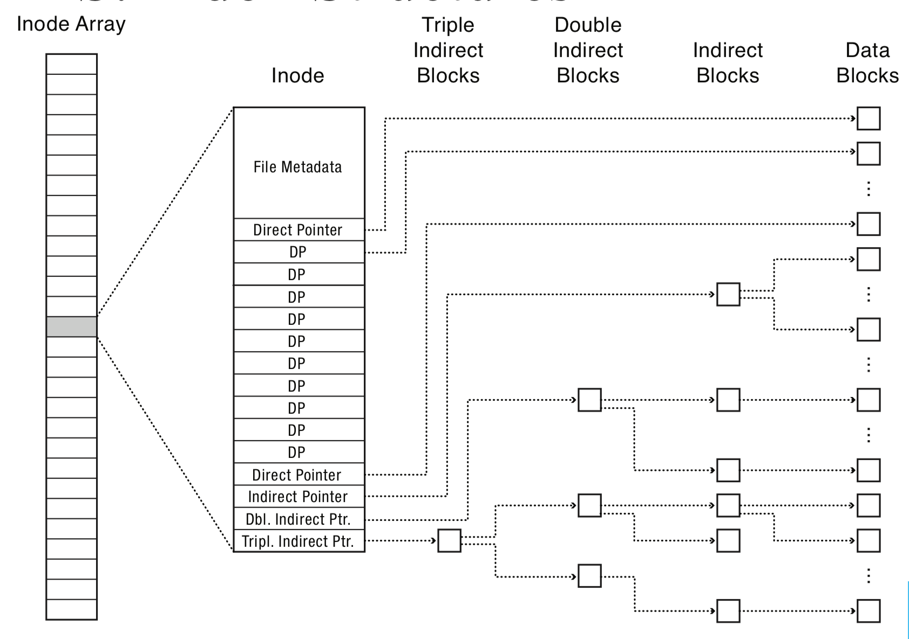
FFS Index Structures

Slide 27
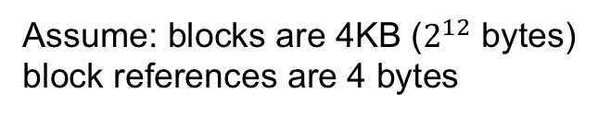


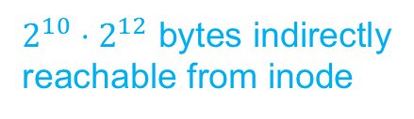
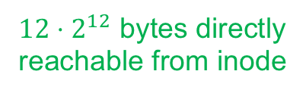
FFS Index Structures
$12⋅2^{12}$ bytes directly
reachable from inode
$2^{10}⋅2^{12}$ bytes indirectly
reachable from inode
$2^{20}⋅2^{12}$ bytes doubly indirect
Assume: blocks are 4KB ($2^{12}$ bytes)
block references are 4 bytes
$2^{30}⋅2^{12}$ bytes triply indirect
Notes:
48KB direct
4MB indirect
4GB doubly
4TB triply

Slide 28
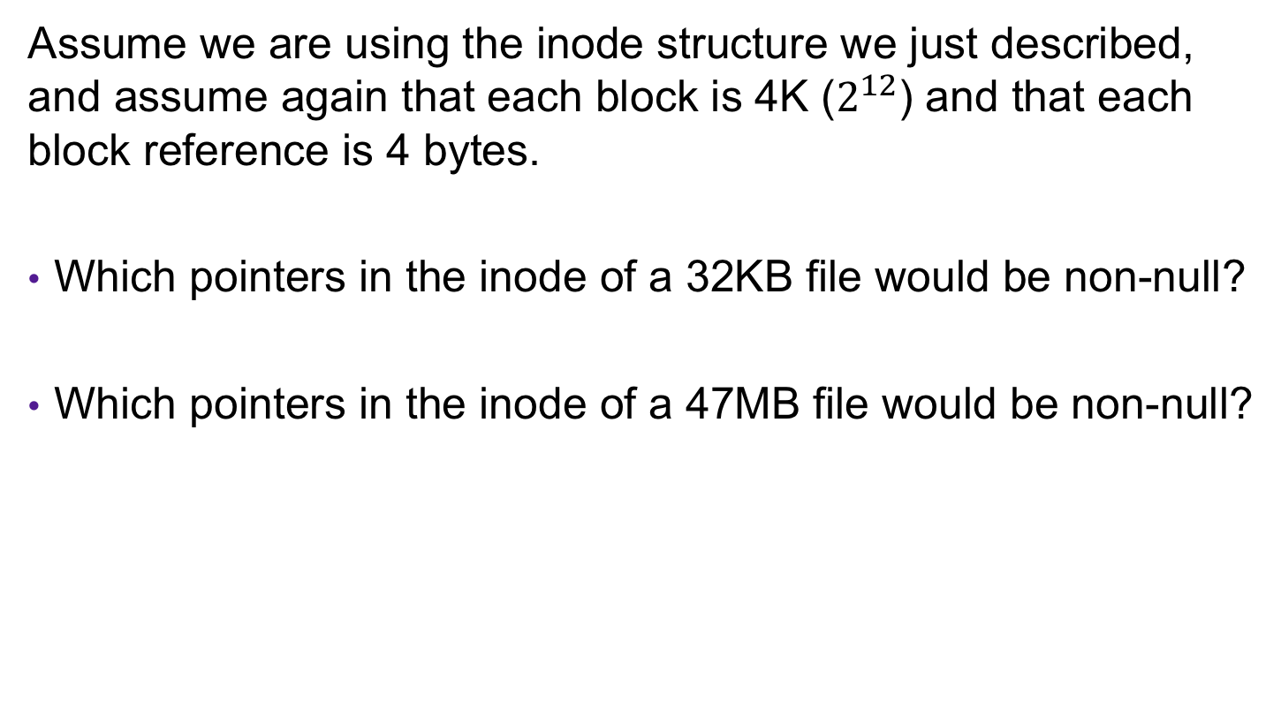
Exercise 2: Inode Structures
Assume we are using the inode structure we just described, and assume again that each block is 4K ($2^{12}$) and that each block reference is 4 bytes.
Which pointers in the inode of a 32KB file would be non-null?
Which pointers in the inode of a 47MB file would be non-null?

Slide 29
Exercise 2: Inode Structures
Assume we are using the inode structure we just described, and assume again that each block is 4K ($2^{12}$) and that each block reference is 4 bytes.
Which pointers in the inode of a 32KB file would be non-null?
Which pointers in the inode of a 47MB file would be non-null?
the first 8 direct pointers
all 12 direct pointers, the indirect pointer,
and the doubly-indirect pointer

Slide 30
FFS Directory Structure
Originally: array of 16 byte entries
  14 byte file name
  2 byte i-node number
Now: implicit list. Each entry contains:
  4-byte inode number
  Full record length
  Length of filename
  Filename
First entry is “.”, points to self
Second entry is “..”, points to parent inode

Slide 31
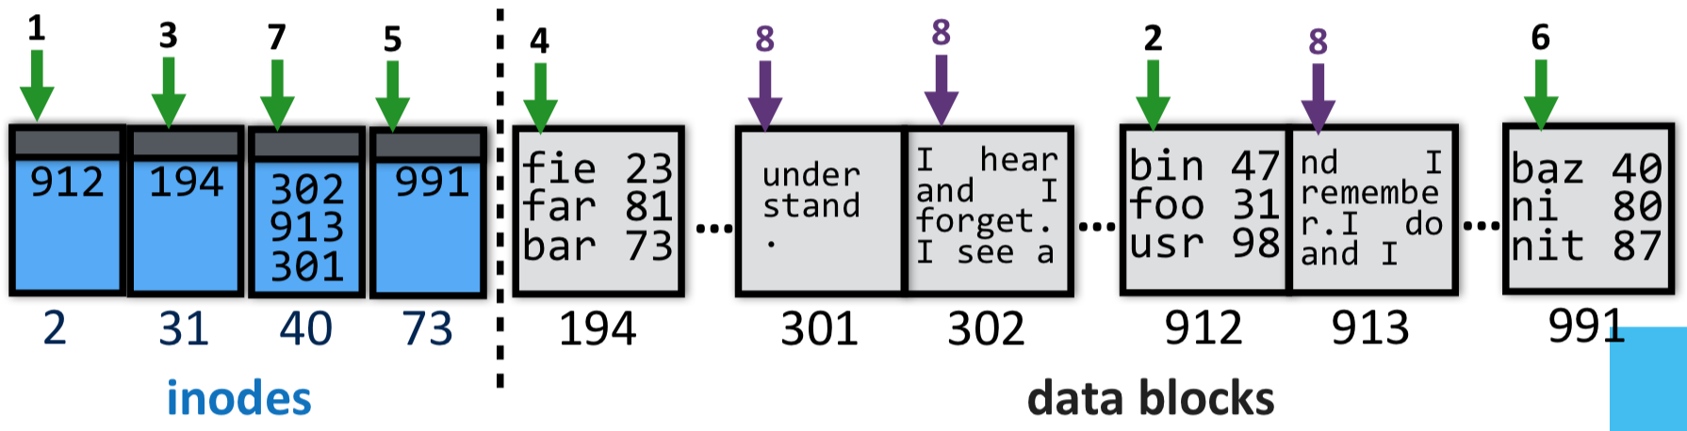
Exercise 3: Indexed Allocation
Which inodes and data blocks would need to be accessed to read (all of) file /foo/bar/baz?

Slide 32
Exercise 3: Indexed Allocation
Which inodes and data blocks would need to be accessed to read (all of) file /foo/bar/baz?
inode #2 (root always has inumber 2), find root’s blocknum (912)
root directory (in block 912), find foo’s inumber (31)
inode #31, find foo’s blocknum (194)
foo (in block 194), find bar’s inumber (73)
inode #73, find bar’s blocknum (991)
bar (in block 991), find baz’s inumber (40)
inode #40, find data blocks (302, 913, 301)
data blocks 302
data block 913
data block 301

Slide 33
Key Characteristics of FFS
Tree Structure
  efficiently find any block of a file
High Degree (or fan out)
  minimizes number of seeks
  supports sequential reads & writes
Fixed Structure
  implementation simplicity
Asymmetric
  not all data blocks are at the same level
  supports large files
  small files don’t pay large overheads

Slide 34
Exercise 4: File organization
Imagine you are trying to organize your (large) collection of photographs. You consider two possible ways to store your files
  Put all the files in a directory called /photos/
    e.g., /photos/xyzstu.jpg, /photos/xeftuv.jpg, /photos/xywqre.jpg
  Organize the photos into nested subdirectories organized by the first three characters of the filename
    e.g., /photos/x/y/z/xyzstu.jpg, /photos/x/e/f/xeftuv.jpg, /photos/x/y/w/xywqre.jpg
What are the tradeoffs between these two approaches, and which one would you adopt?

Slide 35
Implementation Basics
Directories: file name -> low-level names (i.e., file numbers)
Index structures: file number -> block
Free space maps: find a free block (ideally nearby)

Slide 36
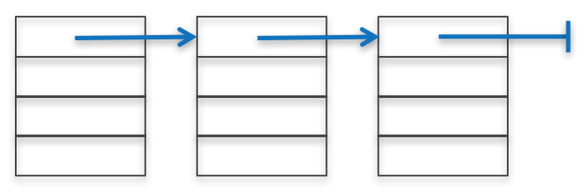
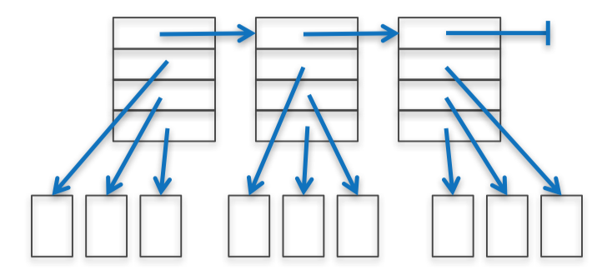

Free List
To write files, need to keep track of which blocks are currently free
How to maintain?
linked list of free blocks
  inefficient (why?)
linked list of metadata blocks that in turn point to free blocks
  simple and efficient
bitmap
  actually used

Slide 37
Problem: Poor Performance
In a naïve implementation of FFS, performance starts bad and gets worse
One early implementation delivered only 2% disk bandwidth
The root of the problem: poor locality
  data blocks of a file were often far from its inode
  file system would end up highly fragmented: accessing a logically continuous file would require going back and forth across the
Notes:
Note: this early implementation also had a block size that was too small (512 bytes), increasing the number of blocks per file aka number of seeks required to read/write a file

Slide 38
Implementation Basics
Directories: file name -> low-level names (i.e., file numbers)
Index structures: file number -> block
Free space maps: find a free block (ideally nearby)
Performance optimizations (e.g., locality heuristics)

Slide 39
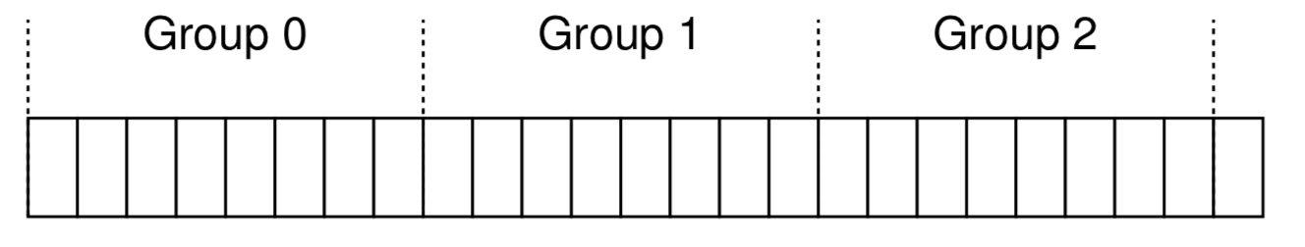
Solution 1: Disk Awareness
modern drives export a logical address space of blocks that are (temporally) close
modern versions of FFS (e.g., ext4) organize the drive into block groups composed of consecutive portions of the disk's logical address space

Slide 40
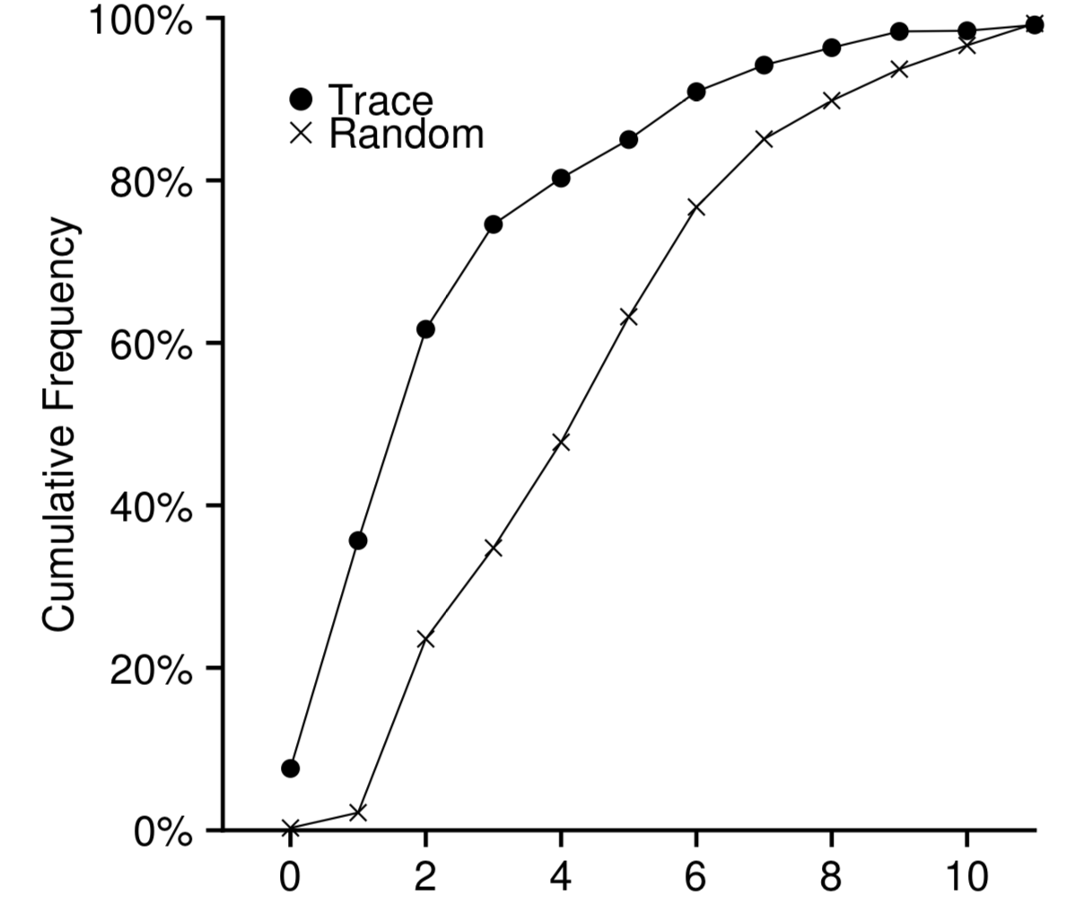
Allocating Blocks
FFS manages allocation per block group
A per-group inode bitmap (ib) and data bitmap (db)
Allocating directories:
  find a group with a low number of allocated directories & high number of free inodes; put the directory data + inode there
  OR group directories
Allocating files:
  place all file data in same group
  uses first-fit heuristic
  reserves ~10% space to avoid deterioration of first-fit
Defragmentation
ib
db
Notes:
actually, indirect blocks in different groups

Slide 41
Other Solutions
Page Cache: to reduce costs of accessing files, cache file contents in memory (e.g., device data, memory-mapped files)
Copy-on-write (COW): create new, updated copy at time of update
Write Buffering: buffer writes and periodically flush to disk

Slide 42
Exercise 4: Feedback
Rate how well you think this recorded lecture worked
  Better than an in-person class
  About as well as an in-person class
  Less well than an in-person class, but you still learned something
  Total waste of time, you didn't learn anything
How much time did you spend on this video lecture?
Do you have any particular questions you’d like me to address in this week’s problem session?
Do you have any other comments or feedback?

