Slide 1
Lecture 23: System I/O
CS 105

Slide 2
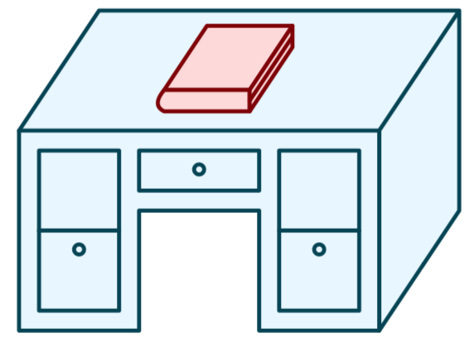
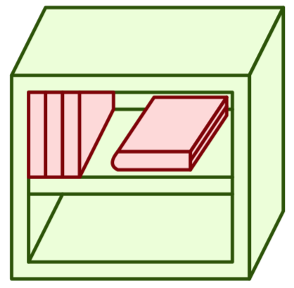

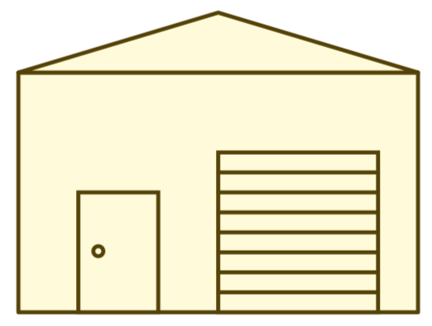
Memory Hierarchy
L0:
Regs
CPU registers hold words retrieved from the L1 cache.
L1:
L1 cache
(SRAM)
L1 cache holds cache lines retrieved from the L2 cache.
Smaller,
faster,
and
costlier
(per byte)
storage
devices
L2:
L2 cache
(SRAM)
L2 cache holds cache lines
retrieved from L3 cache
L3:
L3 cache
(SRAM)
L3 cache holds cache lines
retrieved from main memory.
L4:
Main memory
(DRAM)
Main memory holds
disk blocks retrieved
from local disks.
Larger,
slower,
and
cheaper
(per byte)
storage
devices
Local secondary storage
(local disks)
Local disks hold files retrieved from disks
on remote servers
L5:
L6:
Remote secondary storage
(e.g., cloud, web servers)

Slide 3
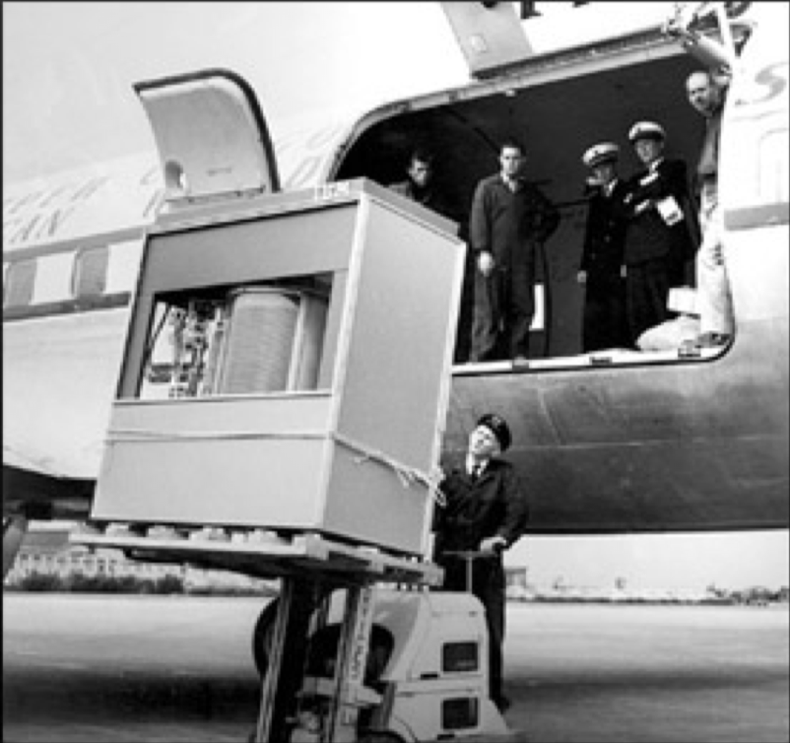
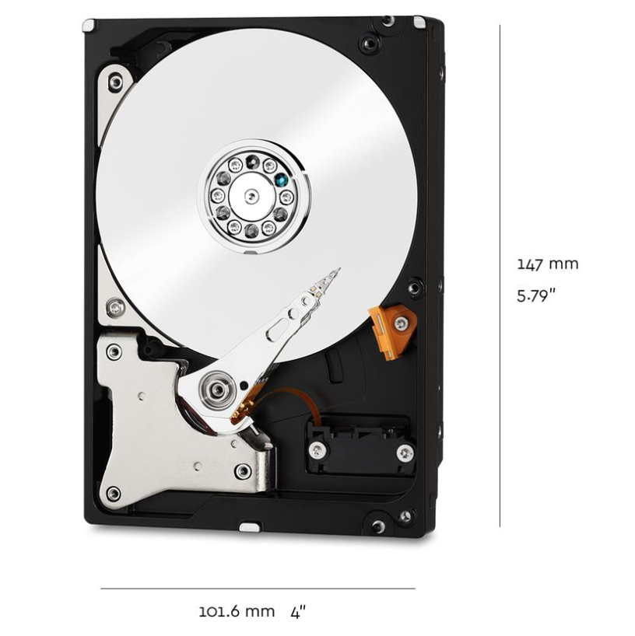
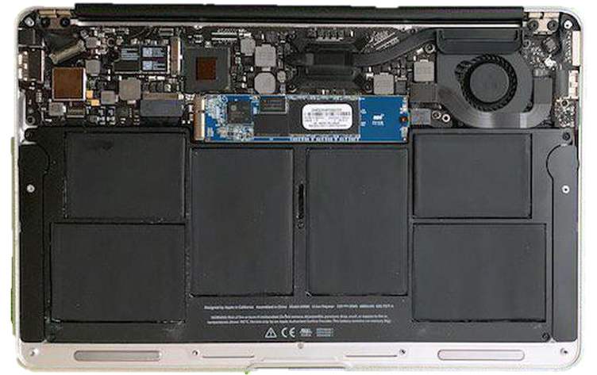
Storage Devices
1950s
IBM 350
5 MB
Magnetic Disks
  Storage that rarely becomes corrupted
  Large capacity at low cost
  Block-level random access
  Slow performance for random access
  Better performance for streaming access
Solid State Disks (Flash Memory)
  Storage that rarely becomes corrupted
  Capacity at moderate cost (50x magnetic disk)
  Block-level random access
  Good performance for random reads
  Comparatively lower performance for random writes
2021
WD Red
10 TB
2021
MacBook
512GB

Slide 4
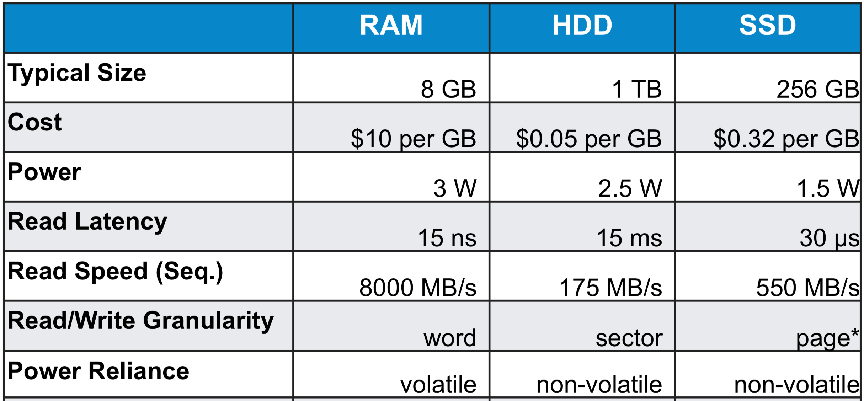
Comparing Storage Media

Slide 5
File Systems 101
Long-term information storage goals
  Should be able to store large amounts of information
  Information must survive processes, power failures, etc.
  Processes must be able to find information
  Needs to support concurrent accesses by multiple processes
Solution: the file system abstraction
  Interface that provides operations involving
    Files
    Directories (a special kind of file)

Slide 6
The File System Abstraction
Interface that provides operations on data stored long-term on disk
A file is a named sequence of stored bytes
  Name is defined on creation
  Processes use name to subsequently access that file
A file comprises two parts:
  Data: information a user or application puts in a file (an array of untyped bytes)
  Metadata: information added and managed by the OS (e.g., size, owner, security info, modification time)
Two types of files
  Normal files: data is an arbitrary sequence of bytes
  Directories: a special type of file that provides mappings from human-readable names to low-level names (i.e., File numbers)

Slide 7
Path Names
Each path from root is a name for a leaf
  /foo/foo.txt
  /bar/baz/baz.txt
Each UNIX directory contains 2 special entries
  "." = this directory
  ".." = parent directory
Absolute paths: path of file from the root directory
Relative paths: path from current working directory (stored as part of a process’s data)
/
foo
bar
foo.txt
bar.txt
baz
baz.txt
Notes:
current working directory stored in process control block (PCB)

Slide 8
Exercise 1: Path Names
I’ll create a file named example1.txt in the directory data, which is in the root directory.
You must
Specify an absolute path to the file example1.txt
Specify a relative path to the file example1.txt from your home directory
Create a file named example2.txt in your home directory.
Specify an absolute path to the file example2.txt
Specify a relative path to the file example2.txt from your home directory
Hint: you can always get back to your home directory with cd ~
Hint: the name of your home directory is your username
Notes:
Also $HOME

Slide 9
Exercise 1: Path Names
I’ll create a file named example1.txt in the directory data, which is in the root directory.
You must
Specify an absolute path to the file example1.txt
Specify a relative path to the file example1.txt from your home directory
Create a file named example2.txt in your home directory.
Specify an absolute path to the file example2.txt
Specify a relative path to the file example2.txt from your home directory
Hint: you can always get back to your home directory with cd ~
Hint: the name of your home directory is your username
/data/example1.txt
../../data/example1.txt
/home/ajcd2020/example1.txt
./example1.txt
Notes:
Echo ~
Echo “~”
Echo $HOME
Echo “$HOME”

Slide 10
Basic File System Operations
Create a file
Delete a file
Write to a file
Read from a file
Seek to somewhere in a file
How should we (the OS) implement this?

Slide 11
Unix I/O Interface
Elegant mapping of files to devices allows kernel to export simple interface:
  Opening a file
    open()and close()
  Reading and writing a file
    read() and write()
  Changing the current file position (seek)
    indicates next offset into file to read or write
    lseek()
B₀
B₁
• • •
B_{k-1}
B_{k}
B_{k+1}
• • •
Current file position = k

Slide 12
The File System Stack
Application
user level
Language Libraries (e.g.,fopen, fread, fwrite, fclose,…)
POSIX API (open, read, write, close, …)
File System
Generic Block Interface (block read/write)
kernel mode
Generic Block Layer
Specific Block Interface (protocol-specific read/write)
Device Driver

Slide 13
The File System Stack
Application
user level
Language Libraries (e.g.,fopen, fread, fwrite, fclose,…)
POSIX API (open, read, write, close, …)
File System
Generic Block Interface (block read/write)
kernel mode
Generic Block Layer
Specific Block Interface (protocol-specific read/write)
Device Driver

Slide 14
strace cat sync.c > tmp.txt

Slide 15
Opening Files
Opening a file informs the kernel that you are getting ready to access that file
Returns a small identifying integer file descriptor
  fd == -1 indicates that an error occurred
Each process created by a Linux shell begins life with three open files associated with a terminal:
  0: standard input (stdin)
  1: standard output (stdout)
  2: standard error (stderr)
int fd; /* file descriptor */
if ((fd = open("/etc/hosts", O_RDONLY)) < 0) {
perror("open");
exit(1);
}

Slide 16
Kernel Data Structures
Descriptor table
(table created on fork(),
one table
per process)
Open file table
(entry created on open,
shared by
all processes)
v-node table
(one per file,
shared by
all processes)
File A
stdin
fd 0
File access
stdout
fd 1
File pos
File size
stderr
fd 2
fd 3
refcnt=1
File type
fd 4
...
...
File B
File access
File pos
File size
refcnt=1
File type
...
...

Slide 17
Closing Files
Closing a file informs the kernel that you are finished accessing that file
Closing an already closed file is a recipe for disaster in threaded programs
Moral: Always check return codes, even for seemingly benign functions such as close()
int fd; /* file descriptor */
int retval; /* return value */
if ((retval = close(fd)) < 0) {
perror("close");
exit(1);
}

Slide 18
Reading Files
Reading a file copies bytes from the current file position to memory, and then updates file position
Returns number of bytes read from file fd into buf
  Return type ssize_t is signed integer
  nbytes < 0 indicates that an error occurred
  Short counts (nbytes < sizeof(buf) ) are possible and are not errors!
char buf[512];
int fd; /* file descriptor */
int nbytes; /* number of bytes read */
/* Open file fd ... */
/* Then read up to 512 bytes from file fd */
if ((nbytes = read(fd, buf, sizeof(buf))) < 0) {
perror("read");
exit(1);
}

Slide 19
Writing Files
Writing a file copies bytes from memory to the current file position, and then updates current file position
Returns number of bytes written from buf to file fd
  nbytes < 0 indicates that an error occurred
  As with reads, short counts are possible and are not errors!
char buf[512];
int fd; /* file descriptor */
int nbytes; /* number of bytes read */
/* Open the file fd ... */
/* Then write up to 512 bytes from buf to file fd */
if ((nbytes = write(fd, buf, sizeof(buf)) < 0) {
perror("write");
exit(1);
}

Slide 20
On Short Counts
Short counts can occur in these situations:
  Encountering (end-of-file) EOF on reads
  Reading text lines from a terminal
Short counts never occur in these situations:
  Reading from disk files (except for EOF)
  Writing to disk files
Best practice is to always allow for short counts.

Slide 21
Buffered Reads/Writes
Stream data is stored in a kernel buffer and returned to the application on request
Enables same system call interface to handle both streaming reads (e.G., Keyboard) and block reads (e.G., Disk)

Slide 22
Exercise 2: Reading and Writing
Assume the file foobar.txt consists of the six ASCII characters foobar. What gets printed when the following program is run?
int main(int argc, char ** argv){
int fd1 = open("foobar.txt", O_RDONLY);
int fd2 = open("foobar.txt", O_RDONLY);
char c;
read(fd1, &c, 1);
read(fd2, &c, 1);
printf("c = %c\n", c);
return 0;
}

Slide 23
Exercise 2: Reading and Writing
File descriptor table
Open file table
v-node table
foobar.txt
stdin
File access
0
stdout
1
File pos
File size
stderr
2
File type
fd1
refcnt=1
3
fd2
...
...
4
foobar.txt
File access
File pos
File size
refcnt=1
File type
...
...

Slide 24
Processes and Files
A child process inherits all file descriptors from its parent
File descriptor table
Open file table
v-node table
Parent's table
File A
fd 0
File access
fd 1
File pos
File size
fd 2
File type
fd 3
refcnt=2
fd 4
...
...
Child's table
File B
File access
fd 0
fd 1
File pos
File size
fd 2
refcnt=2
File type
fd 3
...
fd 4
...

Slide 25
Exercise 3: Processes and Files
Suppose the file foobar.txt consists of the six ASCII characters foobar. What is printed when the following program is run?
int main(int argc, char ** argv){
char c;
int fd1 = open("foobar.txt", O_RDONLY);
if(fork() == 0){
read(fd, &c, 1);
return 0;
} else {
wait();
read(fd, &c, 1);
printf("c = %c\n", c);
return 0;
}
}

Slide 26
Exercise 3: Processes and Files
File descriptor table
Open file table
v-node table
Parent's table
foobar.txt
fd 0
File access
fd 1
File pos
File size
fd 2
File type
refcnt=2
fd 3
refcnt=1
fd 4
...
...
Child's table
fd 0
fd 1
fd 2
fd 3
fd 4

Slide 27
I/O Redirection
Examples of I/O redirection
  a program can send output to a file: ./ringbuf 4 > testout.txt
  a program can read input from a file: ./ringbuf 4 < testin.txt
  output of one program can be input to another: cpp file.c | cparse | cgen | as > file.o
I/O redirection uses a function called dup2
returns file descriptor if OK, -1 on error
int dup2(int oldfd, int newfd);
Notes:
a pipe is a kernel buffer with two file descriptors, one for writing (to put data into the pipe) and one for reading (to pull data out of the pipe)
output of one program can be input to another: cpp file.c | cparse | cgen | as

Slide 28
I/O Redirection
Descriptor table
(one table
per process)
Open file table
(shared by
all processes)
v-node table
(shared by
all processes)
File A
fd 0
File access
fd 1
File pos
File size
fd 2
File type
fd 3
refcnt=0
fd 4
...
...
File B
File access
File pos
File size
refcnt=2
File type
...
...

Slide 29
Exercise 4: I/O Redirection
Suppose the file foobar.txt consists of the six ASCII characters foobar. What is printed when the following program is run?
int main(){
char c;
int fd1 = open("foobar.txt",O_RDONLY);
int fd2 = open("foobar.txt",O_RDONLY);
read(fd2, &c, 1);
dup2(fd2, fd1);
read(fd1, &c, 1);
printf("c = %c\n", c);
return 0;
}

Slide 30
Exercise 3: I/O Redirect
File descriptor table
Open file table
v-node table
foobar.txt
stdin
File access
0
stdout
1
File pos
File size
stderr
2
File type
refcnt=0
fd1
refcnt=1
3
fd2
...
...
4
foobar.txt
File pos
refcnt=2
refcnt=1
...

Slide 31
System I/O as a Uniform Interface
Operating systems use the System I/O commands as an interface for all I/O devices
The commands to read and write to an open file descriptor are the same no matter what type of "file" it is
Types of files include
  file
  keyboard
  screen
  pipe
  device
  network

Slide 32
Exercise 4: Feedback
Rate how well you think this recorded lecture worked
  Better than an in-person class
  About as well as an in-person class
  Less well than an in-person class, but you still learned something
  Total waste of time, you didn't learn anything
How much time did you spend on this video lecture?
Do you have any particular questions you’d like me to address in this week’s problem session?
Do you have any other comments or feedback?

