Slide 1
Lecture 19: Virtual Memory
CS 105

Slide 2
Multiprocessing: The Illusion
Memory
Memory
Memory
Stack
Stack
Stack
Heap
Heap
…
Heap
Data
Data
Data
Code
Code
Code
CPU
CPU
CPU
Registers
Registers
Registers
Process provides each program with two key abstractions:
  Logical control flow
    Each program seems to have exclusive use of the CPU
    Provided by kernel mechanism called context switching
  Private address space
    Each program seems to have exclusive use of main memory.
    Provided by kernel mechanism called virtual memory
Notes:
Each process has its own registers, memory, I/O resources, "thread of control"

Slide 3
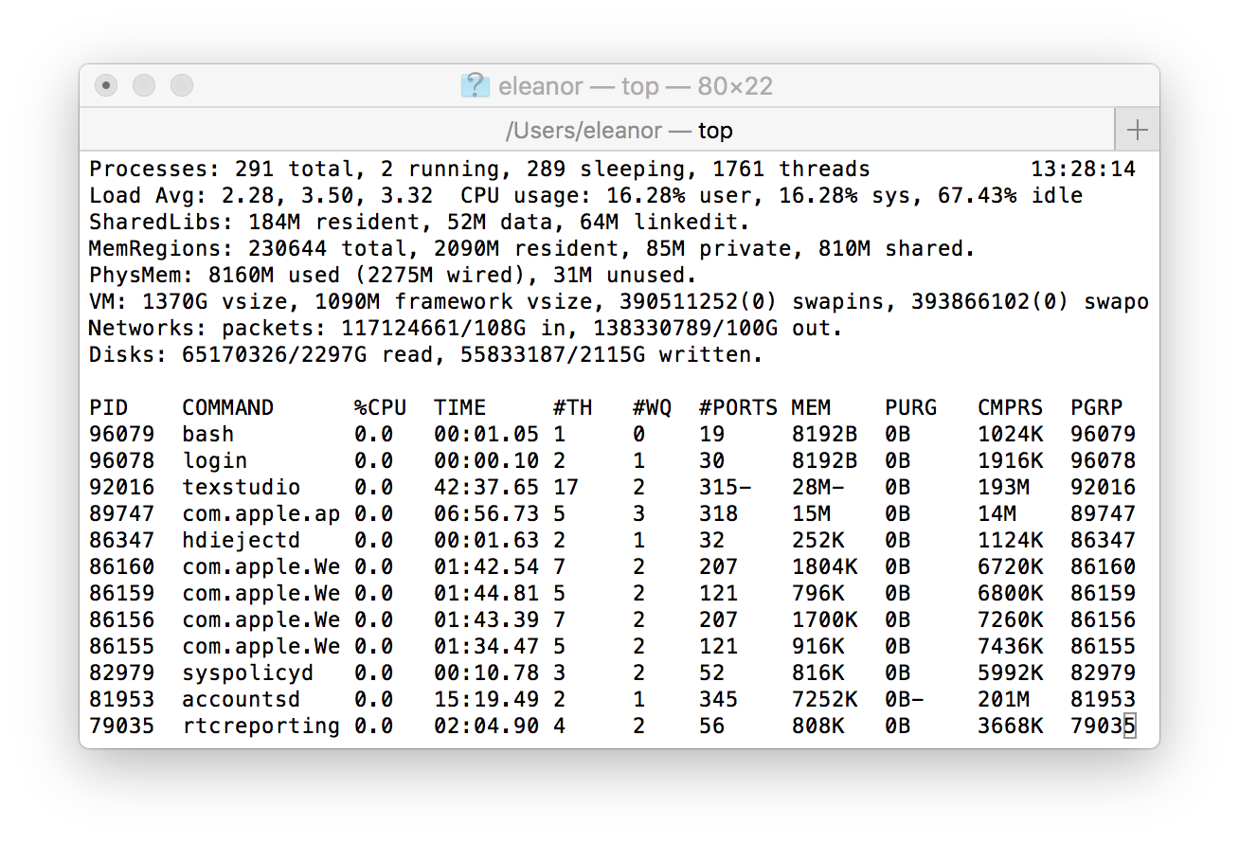
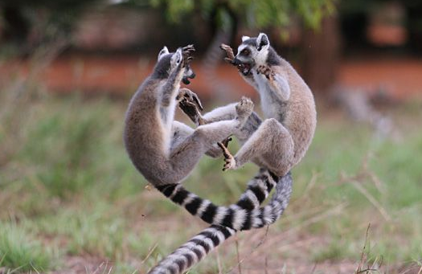
Multiprocessing: The Reality
Computer runs many processes simultaneously
Running program “top” on Mac
  System has 123 processes, 5 of which are active
  Identified by Process ID (PID)
Notes:
What happens when there are multiple processes/threads? OS has to manage resources
%Possible considerations:
%fairness
%efficiency/optimize resources
%security

Slide 4
Virtual Memory Goals
Stack
Isolation: don’t want different process states collided in physical memory
Efficiency: want fast reads/writes to memory
Sharing: want option to overlap for communication
Utilization: want best use of limited resource
Virtualization: want to create illusion of more resources
Heap
Data
Code

Slide 5
Process View vs. OS View
Notes:
What the process thinks
vs
The reality

Slide 6

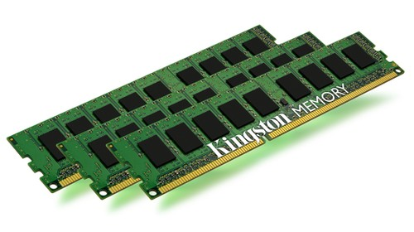
Address Translation
Stack
MMU
Virtual Address
invalid
Exception
Heap
Data
Code
Physical Address
Data
Notes:
Define MMU

Slide 7
Possibilities
Let’s look at some good and bad possibilities
Base-and-bound
Segmentation
Paging

Slide 8
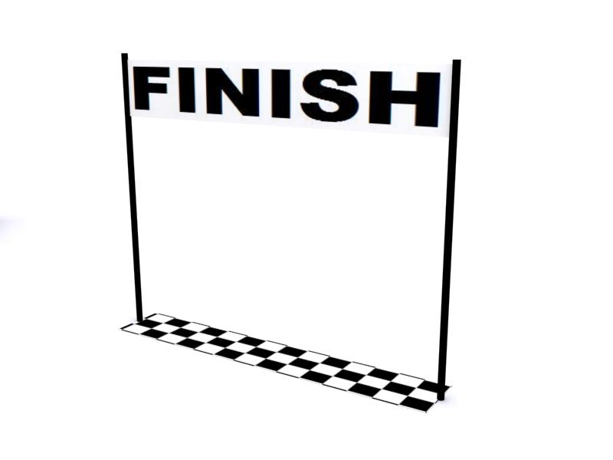

Base-and-Bound
Physical Memory
Virtual Memory
Stack
Bound
Heap
Data
Code
Base
Notes:
Similar to pointer aliasing (base and bound vs address and length)

Slide 9
Base-and-Bound
Stack
MMU
vaddr
Base | Bound
vaddr > Bound
Heap
Exception
Data
Code
paddr = vaddr + Base
Data
Notes:
Define MMU

Slide 10
Exercise 1: Base-and-Bound
Assume that you are currently executing a process P with Base 0x1234 and Bound 0x100.
What is the physical address that corresponds to the virtual address 0x47?
What is the physical address that corresponds to the virtual address 0x123?

Slide 11
Exercise 1: Base-and-Bound
Assume that you are currently executing a process P with Base 0x1234 and Bound 0x100.
What is the physical address that corresponds to the virtual address 0x47?
What is the physical address that corresponds to the virtual address 0x123?
0x127b
invalid

Slide 12


Evaluating Base-and-Bound
Isolation: don’t want different process states collided in physical memory
Efficiency: want fast reads/writes to memory
Sharing: want option to overlap for communication
Utilization: want best use of limited resource
Virtualization: want to create illusion of more resources

Slide 13

Segmentation
Physical Memory
DBound
DBase
Virtual Memory
Stack
Heap
HBound
Data
HBase
Code
SBound
SBase
CBound
CBase

Slide 14
Segmentation
MMU
Stack
Base | Bound | Access
 |  | R,W
 |  | R,W
 |  | R,W
 |  | R,X
offset > Bound[idx]
or access not allowed
idx
offset
vaddr
Heap
Exception
Data
Code
paddr = Base[idx] + offset
Data
Notes:
Define MMU

Slide 15
Exercise 2: Segmentation
Assume that you are currently executing a process P with the following segment table:
What is the physical address that corresponds to the virtual address 0x001?
What is the physical address that corresponds to the virtual address 0xD47?
Base | Bound | Access
0x4747 | 0x080 | R,W
0x2424 | 0x040 | R,W
0x0023 | 0x080 | R,W
0x1000 | 0x200 | R,X

Slide 16
Exercise 2: Segmentation
Assume that you are currently executing a process P with the following segment table:
What is the physical address that corresponds to the virtual address 0x001?
What is the physical address that corresponds to the virtual address 0xD47?
Base | Bound | Access
0x4747 | 0x080 | R,W
0x2424 | 0x040 | R,W
0x0023 | 0x080 | R,W
0x1000 | 0x200 | R,X
00
0000000001
0x4748
11
0101000111
0x1147

Slide 17

Evaluating Segmentation
Isolation: don’t want different process states collided in physical memory
Efficiency: want fast reads/writes to memory
Sharing: want option to overlap for communication
Utilization: want best use of limited resource
Virtualization: want to create illusion of more resources

Slide 18
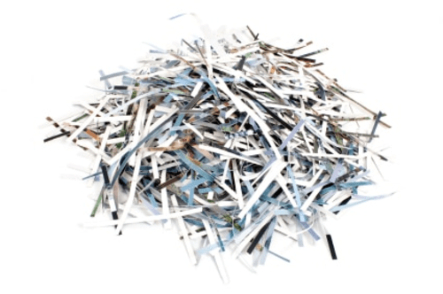
Paging
Physical Memory
Frame 17
Virtual Memory
Frame 16
Page 7
Stack
Frame 15
Page 6
Frame 14
Page 5
Frame 13
Page 4
Frame 12
Page 3
Frame 11
Page 2
Heap
Frame 10
Page 1
Data
Frame 9
Page 0
Code
Frame 8
Frame 7
Frame 6
Frame 5
Frame 4
Frame 3
Frame 2
Frame 1
Frame 0

Slide 19
Paging
MMU
Stack
Frame | Access
47 | R,W
NULL | R,W
13 | R,W
42 | R,X
page#
offset
access not allowed
vaddr
Exception
Heap
Data
…
Code
paddr =
Frame[page#]
offset
Data
Notes:
Page table
No bound → impossible for offset to go beyond page

Slide 20
Exercise 3: Paging
Assume that you are currently executing a process P with the following page table on a system with 16-byte pages:
What is the physical address that corresponds to the virtual address 0x147?
What is the physical address that corresponds to the virtual address 0x16E?
…
Frame | Access
0x47 | R,W
0xF4 | R,W
NULL | R,W
0x23 | R,X
0x17
0x16
0x15
0x14
…

Slide 21
Exercise 3: Paging
Assume that you are currently executing a process P with the following page table on a system with 16-byte pages:
What is the physical address that corresponds to the virtual address 0x147?
What is the physical address that corresponds to the virtual address 0x16E?
…
Frame | Access
0x47 | R,W
0xF4 | R,W
NULL | R,W
0x23 | R,X
0x17
0x16
0x15
0x14
…
00010100
0111
0x237
00010110
1110
0xF4E

Slide 22

Exercise 3: Paging
Assume that you are currently executing a process P with the following page table on a system with 16-byte pages:
Physical Memory
…
Frame | Access
0x47 | R,W
0xF4 | R,W
NULL | R,W
0x23 | R,X
Frame 0xF5
0x17
Page 22
Frame 0xF4
0x16
Frame 0xF3
Frame 0xF2
0x15
Frame 0xF1
0x14
Frame 0xF0
…
Virtual Memory
…
Page 0x17
Frame 0x48
Page 0x16
Page 23
Frame 0x47
0x147 $→$ 0x237
Page 0x15
Frame 0x46
Page 0x14
Frame 0x45
…
Frame 0x25
Frame 0x24
Page 20
Frame 0x23
Frame 0x22

Slide 23
Memory as a Cache
Each page table entry has a valid bit
For valid entries, frame indicates physical address of page in memory
A page fault occurs when a program requests a page that is not currently in memory
  takes time to handle, so context switch
  evict another page in memory to make space (which one?)
MMU
v | Frame | Access
1 | 47 | R,W
0 | NULL | R,W
0 | 13 | R,W
1 | 42 | R,X
…

Slide 24
Page Replacement Algorithms
Random: Pick any page to eject at random
  Used mainly for comparison
FIFO: The page brought in earliest is evicted
  Ignores usage
OPT: Belady’s algorithm
  Select page not used for longest time
LRU: Evict page that hasn’t been used for the longest
  Past could be a good predictor of the future
MRU: Evict the most recently used page
LFU: Evict least frequently used page

Slide 25
Thrashing
Working set is the collection of a pages a process requires in a given time interval
If the working set doesn't fit in memory, then the program will thrash
There are no OS solutions to this problem

Slide 26
Exercise 4: Paging
Assume that you are currently executing a process P with the following page table on a system with 256-byte pages:
What is the physical address that corresponds to the virtual address 0xF947?
What is the physical address that corresponds to the virtual address 0xF700?
…
v | Frame | Access
1 | 0x47 | R,W
1 | 0x24 | R,W
0 | NULL | R,W
0 | 0x23 | R,X
0xFA
0xF9
0xF8
0xF7
…

Slide 27
Exercise 4: Paging
Assume that you are currently executing a process P with the following page table on a system with 256-byte pages:
What is the physical address that corresponds to the virtual address 0xF947?
What is the physical address that corresponds to the virtual address 0xF700?
…
v | Frame | Access
1 | 0x47 | R,W
1 | 0x24 | R,W
0 | NULL | R,W
0 | 0x23 | R,X
0xFA
0xF9
0xF8
0xF7
…
0xF9
0x47
0x2447
0xF7
0x00
0x2300
Page fault

Slide 28
Evaluating Paging
Isolation: don’t want different process states collided in physical memory
Efficiency: want fast reads/writes to memory
Sharing: want option to overlap for communication
Utilization: want best use of limited resource
Virtualization: want to create illusion of more resources
Notes:
Pros: easy allocation (keep bitmap of free frames), no external fragmentation, still allows access permissions, still allows sharing, easy to grow
Cons: internal fragmentation, slower (size of page tables etc -> multiple lookups)
Common page size: 4KB

Slide 29
Exercise 5: Feedback
Rate how well you think this recorded lecture worked
  Better than an in-person class
  About as well as an in-person class
  Less well than an in-person class, but you still learned something
  Total waste of time, you didn't learn anything
How much time did you spend on this video (including exercises)?
Do you have any particular questions you’d like me to address in this week’s problem session?
Do you have any other comments or feedback?

