Slide 1
CPU Scheduling
CS 105

Slide 2
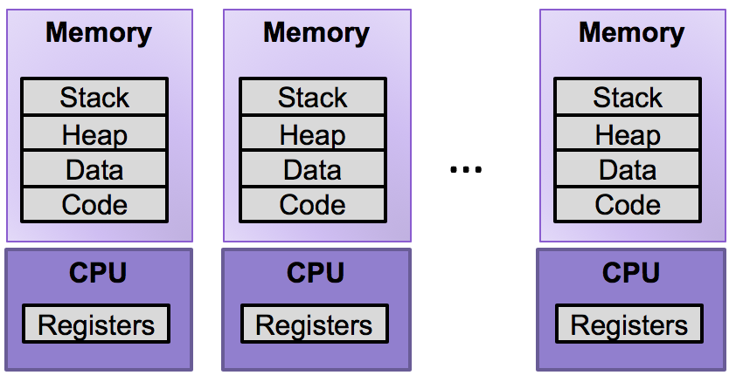
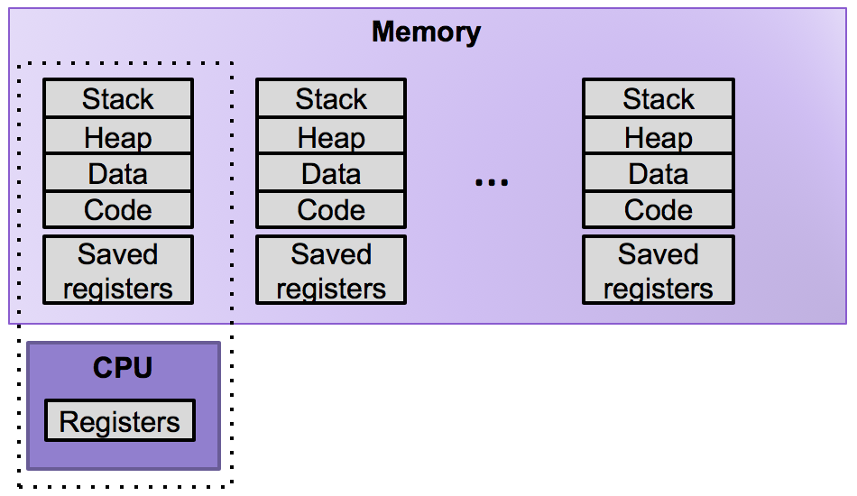
Review: Multiprocessing
The Illusion
The Reality
Abstraction: logical control flow within a process
Context switching b/n processes
User cannot predict how instructions will interleave

Slide 3
Real-world Examples
Restaurants handling orders
DMV handling customers
Students handling assignments
Hospitals handling patients

Slide 4
Possible Metrics
Latency: how much time between when a job is requested and when a job is completed
Response time: how much time between when a job is requested and when you start processing the job
Throughput: the rate at which jobs are completed

Slide 5
Simplifying Assumptions (for now)
Once you start a job, you complete that job before beginning the next job
The run-time of each job is known in advance
All jobs only use the CPU

Slide 6
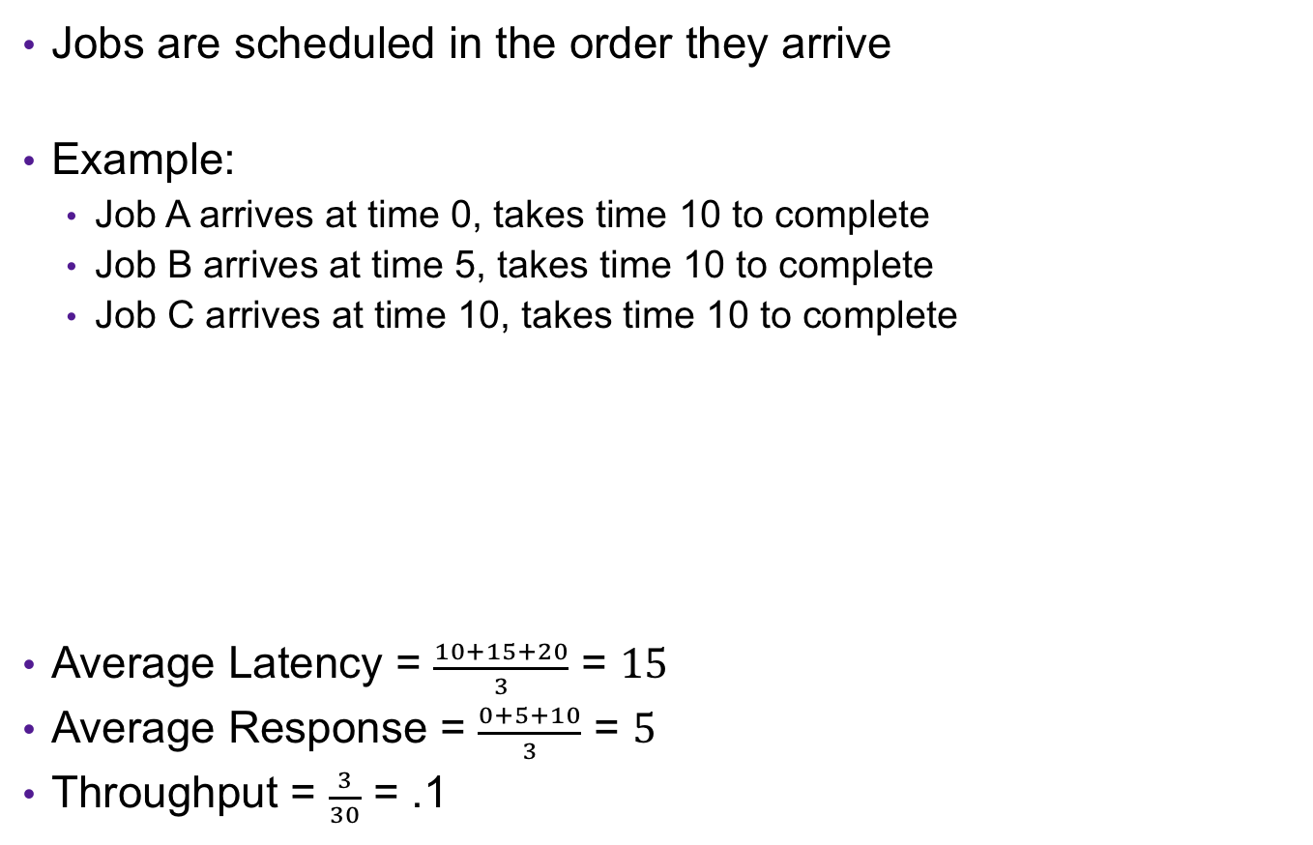
First In, First Out (FIFO)
Jobs are scheduled in the order they arrive
Example:
  Job A arrives at time 0, takes time 10 to complete
  Job B arrives at time 5, takes time 10 to complete
  Job C arrives at time 10, takes time 10 to complete
Average Latency = $\frac{10+15+20}{3}$ = $15$
Average Response = $\frac{0+5+10}{3}$ = $5$
Throughput = $\frac{3}{30}$ = .1
A
B
C
Time
0
20
40
60
80
100
120

Slide 7

Exercise 1: First In, First Out (FIFO)
Jobs are scheduled in the order they arrive
Example:
  Job A arrives at time 0, takes time 100 to complete
  Job B arrives at time 5, takes time 10 to complete
  Job C arrives at time 10, takes time 10 to complete
Average Latency = $\frac{100+105+110}{3}$ = $105$
Average Response = $\frac{0+95+100}{3}$ = $65$
Throughput = $\frac{3}{120}$ = .025
A
B
C
Time
0
20
40
60
80
100
120

Slide 8

Shortest Job First (SJF)
Jobs are scheduled in order of length (shortest first)
Example:
  Job A arrives at time 0, takes time 10 to complete
  Job B arrives at time 5, takes time 100 to complete
  Job C arrives at time 10, takes time 10 to complete
Average Latency = $\frac{10+115+10}{3}$ = $45$
Average Response = $\frac{0+15+0}{3}$ = $5$
Throughput = $\frac{3}{120}$ = .025
A
C
B
Time
0
20
40
60
80
100
120

Slide 9

Exercise 2: Shortest Job First (SJF)
Jobs are scheduled in order of length (shortest first)
Example:
  Job A arrives at time 0, takes time 100 to complete
  Job B arrives at time 5, takes time 10 to complete
  Job C arrives at time 10, takes time 10 to complete
Average Latency = $\frac{100+105+110}{3}$ = $105$
Average Response = $\frac{0+95+100}{3}$ = $65$
Throughput = $\frac{3}{120}$ = .025
A
B
C
Time
0
20
40
60
80
100
120

Slide 10
Simplifying Assumptions (for now)
Once you start a job, you complete that job before beginning the next job
The run-time of each job is known in advance
All jobs only use the CPU

Slide 11
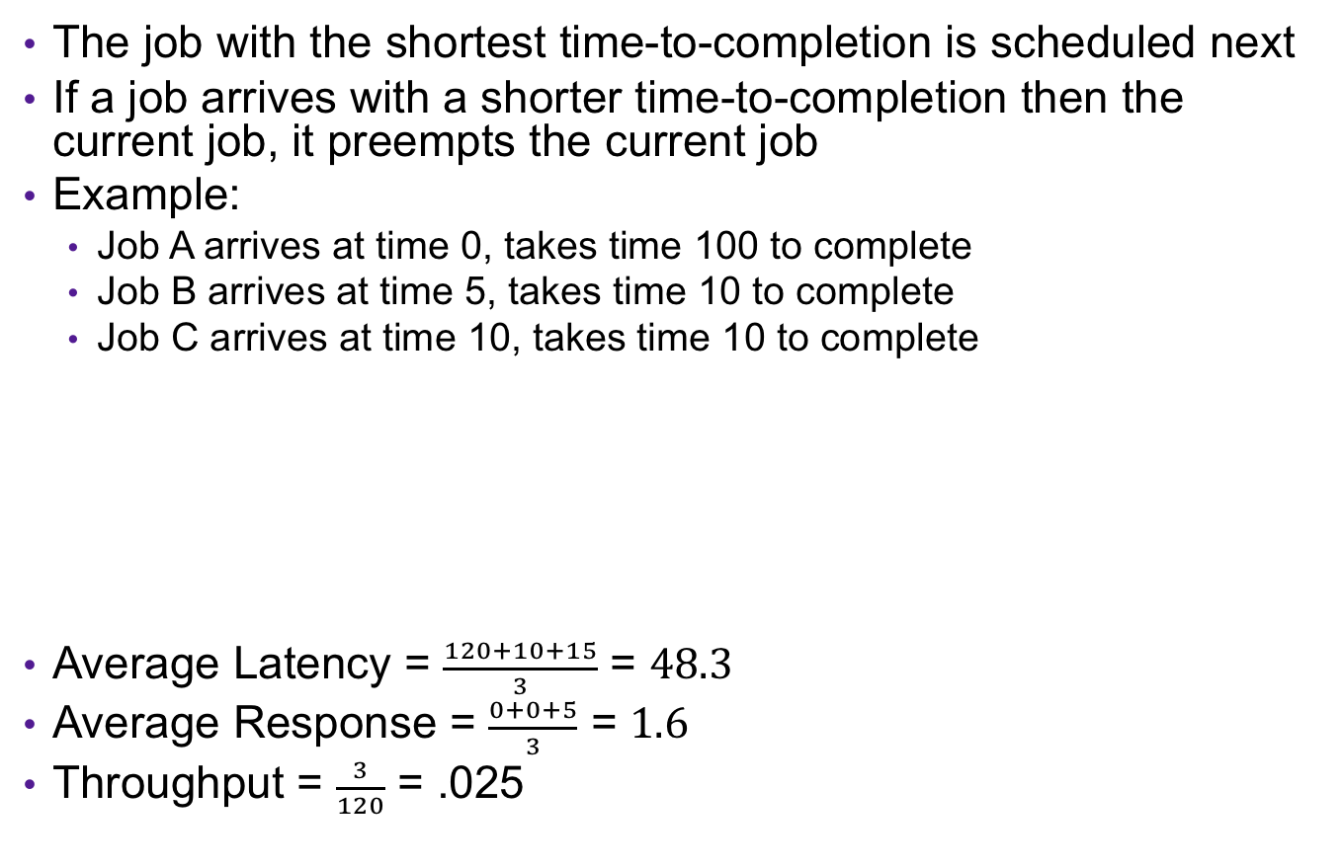
Shortest Time-to-Completion First (STCF)
The job with the shortest time-to-completion is scheduled next
If a job arrives with a shorter time-to-completion then the current job, it preempts the current job
Example:
  Job A arrives at time 0, takes time 100 to complete
  Job B arrives at time 5, takes time 10 to complete
  Job C arrives at time 10, takes time 10 to complete
Average Latency = $\frac{120+10+15}{3}$ = $48.3$
Average Response = $\frac{0+0+5}{3}$ = $1.6$
Throughput = $\frac{3}{120}$ = .025
A
B
C
A
Time
0
20
40
60
80
100
120
Notes:
Problems: responsiveness, fairness, starvation, assumption 4

Slide 12
Simplifying Assumptions (for now)
Once you start a job, you complete that job before beginning the next job
The run-time of each job is known in advance
All jobs only use the CPU

Slide 13

Round Robin (RR)
Run jobs for a fixed time slice (e.g., 2), cycle through all job that are not yet completed
Example:
  Job A arrives at time 0, takes time 10 to complete
  Job B arrives at time 0, takes time 10 to complete
  Job C arrives at time 0, takes time 10 to complete
Average Latency = $\frac{26+28+30}{3}$ = $28$
Average Response = $\frac{0+2+4}{3}$ = $2$
Throughput = $\frac{3}{30}$ = .1
A
B
C
A
B
C
A
B
C
A
B
C
A
B
C
Time
0
20
40
60
80
100
120

Slide 14

Exercise 3: Round Robin (RR)
Run jobs for a fixed time slice (e.g., 2), cycle through all job that are not yet completed
Example:
  Job A arrives at time 0, takes time 100 to complete
  Job B arrives at time 10, takes time 10 to complete
  Job C arrives at time 10, takes time 10 to complete
Average Latency = $\frac{120+26+28}{3}$ = $58$
Average Response = $\frac{0+0+2}{3}$ = $.6$
Throughput = $\frac{3}{120}$ = .025
A
B
C
A
B
C
A
B
C
A
B
C
A
B
C
A
Time
0
20
40
60
80
100
120

Slide 15
Simplifying Assumptions (for now)
Once you start a job, you complete that job before beginning the next job
The run-time of each job is known in advance
All jobs only use the CPU

Slide 16
Processes are not all the same
CPU-bound processes use a lot of CPU
  e.g., compiling, scientific computing applications, mp3 encoding
I/O-bound processes use CPU in short bursts
  e.g., browsing small webpages, indexing a file system
Balanced processes are somewhere in between
  e.g., playing videos, moving windows around
A
Time
0
20
40
60
80
100
120
A
A
A
A
A
A
A
Time
0
20
40
60
80
100
120

Slide 17
Comparing Scheduling Algorithms
FIFO
  works well if jobs are short
  otherwise bad latency and bad response time
STCF
  good latency
  very uneven response time (bad fairness)
  assumes run-time of each job is known in advance
RR
  good response time
  bad latency + overhead of context switching
  poor fairness for mixes of CPU-bound and I/O-bound

Slide 18
Multi-level Feedback Queues
Goal: optimize latency while minimizing response time for interactive jobs without knowing run-time of jobs in advance
General idea: maintain multiple queues, each with a different priority level
Scheduling rules:
If Priority(A) > Priority(B), run A
If Priority(A) = Priority(C), run A and C Round Robin
When a job enters the system, it is place in the highest priority queue
Once a job uses up its time allotment at current priority level, it moves down one queue
After some time period, move all jobs in the system to the highest priority queue
Q5
A
C
D
Q4
Higher Priority
Q3
B
Q2
Q1

Slide 19
Schedulers in Operating Systems
CPU Scheduler selects next process to run from the runnable pool
Page Replacement Scheduler selects page to evict
Disk Scheduler selects next read/write operation to perform
Network Scheduler selects next packet to send/process

Slide 20
Exercise 4: Feedback
Rate how well you think this recorded lecture worked
  Better than an in-person class
  About as well as an in-person class
  Less well than an in-person class, but you still learned something
  Total waste of time, you didn't learn anything
How much time did you spend on this video (including exercises)?
Do you have any particular questions you’d like me to address in this week’s problem session?
Do you have any other comments or feedback?

