Slide 1
OS and Processes
CS 105

Slide 2



Intro to Operating Systems
the operating system is a piece of software that manages a computer's resources for its users and their applications
  Examples: OSX, Windows, Ubuntu, iOS, Android, Chrome OS
core OS functionality is implemented by the OS kernel
resource allocation
isolation
communication
access control
multiprocessing
virtual memory
reliable networking
virtual machines
user interface
file I/O
device management
process control

Slide 3
Operating System Goals
Reliability: they operating system should do what you want
Availability: the operating system should respond to user input
Security: the system should not be (easily) corrupted by an attacker
Portability: the operating system should be easy to move to new hardware platforms
Performance: the operating system should impose minimal overhead, the UI should be responsive
Adoption: people should use the operating system

Slide 4
Exercise 1: Operating Systems
What is an example of an operating system as:
  referee
  illusionist
  glue
  Try to be specific with your examples

Slide 5
Processes
A program is a file containing code + data that describes a computation
A process is an instance of a running program.
  One of the most profound ideas in computer science
  Not the same as “program” or “processor”
Memory
Stack
Heap
Data
Code
CPU
Registers
Notes:
a process is alive, same program can be run twice at the same time (two processes)

Slide 6
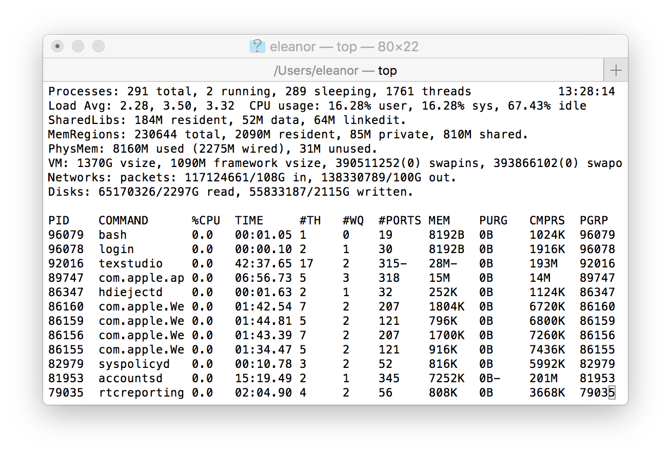
Multiprocessing
Computer runs many processes simultaneously
Running program “top” on Mac
  System has 123 processes, 5 of which are active
  Identified by Process ID (PID)
Notes:
Applications for one or more users
Web browsers, email clients, editors, …
Background tasks
Monitoring network & I/O devices

Slide 7
Multiprocessing: The Illusion
Memory
Memory
Memory
Stack
Stack
Stack
Heap
Heap
…
Heap
Data
Data
Data
Code
Code
Code
CPU
CPU
CPU
Registers
Registers
Registers
Process provides each program with two key abstractions:
  Logical control flow
    Each program seems to have exclusive use of the CPU
    Provided by kernel mechanism called context switching
  Private address space
    Each program seems to have exclusive use of main memory.
    Provided by kernel mechanism called virtual memory
Notes:
Each process has its own registers, memory, I/O resources, "thread of control"

Slide 8
Multiprocessing: The (Traditional) Reality
Memory
Stack
Stack
Stack
Heap
Heap
…
Heap
Data
Data
Data
Code
Code
Code
Saved registers
Saved registers
Saved registers
CPU
Registers
Single processor executes multiple processes concurrently
  Process executions interleaved (multitasking)
  Register values for nonexecuting processes saved in memory
  Address spaces managed by virtual memory system

Slide 9
Process Control Block (PCB)
To implement a context switch, OS maintains a PCB for each process containing:
  process table, which contains information about the process (id, user, privilege level, arguments, status)\
  location of executable on disk
  file table
  register values (general-purpose registers, float registers, pc, eflags…)
  memory state
  scheduling information
... and more!

Slide 10
Context Switching
Processes are managed by a shared chunk of memory-resident kernel code
  Important: the kernel code is not a separate process, but rather code and data structures that the OS uses to manage all processes
Control flow passes from one process to another via a context switch
Process A
Process B
user code
Time
kernel code
context switch
user code
kernel code
context switch
user code

Slide 11
Multiprocessing: The (Traditional) Reality
Memory
Stack
Stack
Stack
Heap
Heap
…
Heap
Data
Data
Data
Code
Code
Code
Saved registers
Saved registers
Saved registers
CPU
Registers
Save current registers to memory (in PCB)

Slide 12
Multiprocessing: The (Traditional) Reality
Memory
Stack
Stack
Stack
Heap
Heap
…
Heap
Data
Data
Data
Code
Code
Code
Saved registers
Saved registers
Saved registers
CPU
Registers
Save current registers to memory (in PCB)
Schedule next process for execution

Slide 13
Multiprocessing: The (Traditional) Reality
Memory
Stack
Stack
Stack
Heap
Heap
…
Heap
Data
Data
Data
Code
Code
Code
Saved registers
Saved registers
Saved registers
CPU
Registers
Save current registers to memory (in PCB)
Schedule next process for execution
Load saved registers and switch address space

Slide 14
Multiprocessing: The (Modern) Reality
Memory
Stack
Stack
Stack
Heap
Heap
…
Heap
Data
Data
Data
Code
Code
Code
Saved registers
Saved registers
Saved registers
CPU
CPU
Registers
Registers
Multicore processors
  Multiple CPUs on single chip
  Share main memory (and some of the caches)
  Each can execute a separate process
    Scheduling of processors onto cores done by kernel

Slide 15
Interrupts (Asynchronous Exceptions)
Caused by events external to the processor
  Indicated by setting the processor’s interrupt pin
  Handler returns to “next” instruction
Examples:
  Timer interrupt
    Every few ms, an external timer chip triggers an interrupt
    Used by the kernel to take back control from user programs
  I/O interrupt from external device
    Hitting Ctrl-C at the keyboard
    Arrival of a packet from a network
    Arrival of data from a disk

Slide 16
Exceptions
An exception is a transfer of control to the OS kernel in response to some event (i.e., change in processor state)
  Kernel is the memory-resident part of the OS
  Examples of events: timer interrupt, Divide by 0, page fault, I/O request completes, typing Ctrl-C
User code
Kernel code
Event
I_current
Exception
I_next
Exception processing
by exception handler
Return to I_current
Return to I_next
Abort

Slide 17
Exception Tables
Exception
numbers
Each type of event has a
unique exception number k
k = index into exception table
(a.k.a. interrupt vector)
Handler k is called each time
exception k occurs
Code for
exception handler 0
Exception
Table
Code for
exception handler 1
0
1
Code for
exception handler 2
2
...
n-1
...
Code for
exception handler n-1

Slide 18
Synchronous Exceptions
Caused by events that occur as a result of executing an instruction:
  Traps
    Intentional
    Examples: system calls, breakpoint traps, special instructions
    Returns control to “next” instruction
  Faults
    Unintentional but possibly recoverable
    Examples: page faults (recoverable), protection faults (unrecoverable), floating point exceptions
    Either re-executes faulting (“current”) instruction or aborts
  Aborts
    Unintentional and unrecoverable
    Examples: illegal instruction, parity error, machine check
    Aborts current program

Slide 19
Exercise 2: Context Switching
Explain the steps that an operating system goes through when the CPU receives an interrupt.
A hardware designer argues that there are now enough on-chip transistors to build a CPU with 1024 integer registers and 512 floating point registers. As a result, the compiler should almost never need to store anything on the stack. As a new operating systems expert, give your opinion of this design.

Slide 20
Process Life Cycle
Init
Terminated
fork
Runnable
Running
Stopped

Slide 21
Creating Processes
Parent process creates a new running child process by calling fork
int fork(void)
  Returns 0 to the child process, child’s PID to parent process
  Child is almost identical to parent:
    Child get an identical (but separate) copy of the parent’s virtual address space.
    Child gets identical copies of the parent’s open file descriptors
    Child has a different PID than the parent
fork is interesting (and often confusing) because
it is called once but returns twice

Slide 22
fork Example
Call once, return twice
Duplicate but separate address space
  x has a value of 1 when fork returns in parent and child
  Subsequent changes to x are independent
Shared open files
  stdout is the same in both parent and child
int main()
{
pid_t pid;
int x = 1;
pid = Fork();
if (pid == 0) { /* Child */
printf("child : x=%d\n", ++x);
return 0;
}
/* Parent */
printf("parent: x=%d\n", --x);
return 0;
}
fork.c
What are the possible outputs?
What if we want to fork a new program?
Notes:
e.g.,
linux> ./fork
parent: x=0
child : x=2

Slide 23
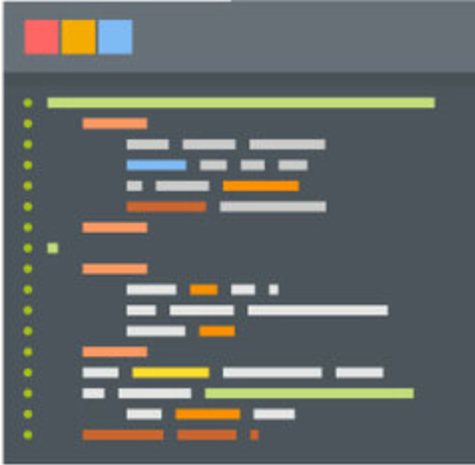

Parent Process
Child Process
fork()
execve()
wait()
exit()
exit()
Notes:
Fork, execve, wait, exit

Slide 24
execve: Loading and Running Programs
int execve(char *filename, char *argv[], char *envp[])
Loads and runs in the current process:
  Executable file filename
    Can be object file or script file beginning with #!interpreter (e.g., #!/bin/bash)
  …with argument list argv
    By convention argv[0]==filename
  …and environment variable list envp
    “name=value” strings (e.g., USER=droh)
    getenv, putenv, printenv
Overwrites code, data, and stack
  Retains PID, open files and signal context
Called once and never returns
  …except if there is an error

Slide 25
Linux Process Hierarchy
[0]
init [1]
Daemon
e.g. httpd
…
…
…
Login shell
Login shell
Child
Child
Child
Grandchild
Grandchild
Note: you can view the hierarchy using the Linux pstree command

Slide 26
pstree
Notes:
Sleep 10 &
pstree

Slide 27
pstree on pom-itb-cs2
[ebac2018@pom-itb-cs2 ~]$ pstree
systemd─┬─NetworkManager───2*[{NetworkManager}]
…
├─attacklab-repor
├─attacklab-reque
├─attacklab-resul
├─attacklab.pl
…
├─crond
├─cupsd
…
├─sshd─┬─sshd───sshd───bash───pstree
│ └─28*[sshd───sshd───sftp-server]
├─systemd-journal
├─systemd-logind
├─systemd-udevd
…
└─xdg-permission-───2*[{xdg-permission-}]

Slide 28
Process Life Cycle
Init
Terminated
interrupt, yield
fork
Runnable
Running
scheduled
Stopped

Slide 29
fork Example
Call once, return twice
Duplicate but separate address space
  x has a value of 1 when fork returns in parent and child
  Subsequent changes to x are independent
Shared open files
  stdout is the same in both parent and child
Concurrent execution
  Can’t predict execution order of parent and child
int main()
{
pid_t pid;
int x = 1;
pid = Fork();
if (pid == 0) { /* Child */
printf("child : x=%d\n", ++x);
return 0;
}
/* Parent */
printf("parent: x=%d\n", --x);
return 0;
}
fork.c
Notes:
What are the possible outputs?
e.g.,
linux> ./fork
parent: x=0
child : x=2

Slide 30
Modeling fork with Process Graphs
A process graph is a useful tool for capturing the partial ordering of statements in a concurrent program:
  Each vertex is the execution of a statement
  a -> b means a happens before b
  Edges can be labeled with current value of variables
  printf vertices can be labeled with output
  Each graph begins with a vertex with no inedges
Any topological sort of the graph corresponds to a feasible total ordering.
  Total ordering of vertices where all edges point from left to right

Slide 31
Process Graph Example
int main()
{
pid_t pid;
int x = 1;
pid = Fork();
if (pid == 0) { /* Child */
printf("child : x=%d\n", ++x);
return 0;
}
/* Parent */
printf("parent: x=%d\n", --x);
return 0;
}
x=2 2
Child
printf
x=1
x=0 0
Parent
main
fork
printf
fork.c

Slide 32
Interpreting Process Graphs
Original graph:
Relabeled graph:
x=2 2
Child
printf
x=1
x=0 0
Parent
main
fork
printf
Feasible total ordering:
e
a
b
e
c
a
b
c
Infeasible total ordering:
a
e
b
c

Slide 33
fork Example: Two consecutive forks
Bye
void fork1()
{
printf("L0\n");
fork();
printf("L1\n");
fork();
printf("Bye\n");
}
printf
L1
Bye
printf
fork
printf
Bye
printf
L0
L1
Bye
printf
fork
printf
fork
printf
Which of these outputs are feasible?
L0
L1
Bye
Bye
L1
Bye
Bye
L0
Bye
L1
Bye
L1
Bye
Bye
Notes:
1 Feasible
2. Infeasible

Slide 34
Exercise 3: Forks and Scheduling
For each of the following programs, draw the process graph and then determine which of the possible outputs are feasible
void fork2(){
printf("L0\n");
if (fork() != 0) {
printf("L1\n");
if (fork() != 0) {
printf("L2\n");
}
}
printf("Bye\n");
}
void fork3(){
printf("L0\n");
if (fork() == 0) {
printf("L1\n");
if (fork() == 0) {
printf("L2\n");
}
}
printf("Bye\n");
}
L0
L1
Bye
Bye
L2
Bye
L0
Bye
L1
Bye
Bye
L2
L0
Bye
L1
L2
Bye
Bye
L0
Bye
L1
Bye
Bye
L2

Slide 35
Exercise 3a
void fork2()
{
printf("L0\n");
if (fork() != 0) {
printf("L1\n");
if (fork() != 0) {
printf("L2\n");
}
}
printf("Bye\n");
}
Bye
Bye
printf
printf
L0
L1
L2
Bye
printf
fork
printf
fork
printf
printf
Which of these outputs are feasible?
L0
L1
Bye
Bye
L2
Bye
L0
Bye
L1
Bye
Bye
L2
Notes:
Feasible
Infeasible

Slide 36
Exercise 3b
void fork3()
{
printf("L0\n");
if (fork() == 0) {
printf("L1\n");
if (fork() == 0) {
printf("L2\n");
}
}
printf("Bye\n");
}
L2
Bye
printf
printf
L1
Bye
printf
fork
printf
L0
Bye
printf
fork
printf
Which of these outputs are feasible?
L0
Bye
L1
L2
Bye
Bye
L0
Bye
L1
Bye
Bye
L2

Slide 37
Process Life Cycle
Init
Terminated
interrupt, yield
fork
Runnable
Running
scheduled
process or
I/O completion
wait, I/O operation
Stopped

Slide 38
Reaping Children
Reaping
  Performed by parent on terminated child (using wait or waitpid)
  Parent is given exit status information
  Kernel then deletes zombie child process
int wait(int *child_status)
  Suspends current process until one of its children terminates
  Return value is the pid of the child process that terminated
  If child_status != NULL, then the integer it points to will be set to a value that indicates reason the child terminated and the exit status:
    Checked using macros defined in wait.h
      WIFEXITED, WEXITSTATIS, WIFSIGNALED, WTERMSIG, WIFSTOPPED, WSTOPSIG, WIFCONTINUED
      See textbook for details

Slide 39
wait Example
void fork6() {
int child_status;
if (fork() == 0) {
printf("HC: hello from child\n");
exit(0);
} else {
printf("HP: hello from parent\n");
wait(&child_status);
printf("CT: child has terminated\n");
}
printf("Bye\n");
}
HC
exit
printf
CT
Bye
HP
fork
printf
wait
printf
Feasible output:
HC
HP
CT
Bye
Infeasible output:
HP
CT
Bye
HC

Slide 40
Reaping Children
What if parent doesn’t reap?
  If any parent terminates without reaping a child, then the orphaned child will be reaped by init process (pid == 1)
  So, only need explicit reaping in long-running processes
    e.g., shells and servers

Slide 41
Process Life Cycle
Init
Terminated
interrupt, yield
fork
return from main,
exit, terminated
Runnable
Running
scheduled
process or
I/O completion
wait, I/O operation
Stopped

Slide 42
Terminating Processes
Process becomes terminated for one of three reasons:
  Returning from the main routine
  Receiving a signal whose default action is to terminate
  Calling the exit function
void exit(int status)
  Terminates with an exit status of status
  Convention: normal return status is 0, nonzero on error
  Another way to explicitly set the exit status is to return an integer value from the main routine
exit is called once but never returns.

Slide 43
Non-terminating Child
void fork4()
{
if (fork() == 0) {
/* Child */
printf("Running Child, PID = %d\n",
getpid());
while (1)
; /* Infinite loop */
} else {
printf("Terminating Parent, PID = %d\n",
getpid());
exit(0);
}
}
pid_t getpid(void)
  Returns PID of current process
pid_t getppid(void)
  Returns PID of parent process

Slide 44
void fork4()
{
if (fork() == 0) {
/* Child */
printf("Running Child, PID = %d\n",
getpid());
while (1)
; /* Infinite loop */
} else {
printf("Terminating Parent, PID = %d\n",
getpid());
exit(0);
}
}
linux> ./forks 4
Terminating Parent, PID = 6675
Running Child, PID = 6676
linux> ps
PID TTY TIME CMD
6585 ttyp9 00:00:00 tcsh
6676 ttyp9 00:00:06 forks
6677 ttyp9 00:00:00 ps
linux> kill 6676
linux> ps
PID TTY TIME CMD
6585 ttyp9 00:00:00 tcsh
6678 ttyp9 00:00:00 ps
Child process still active even though parent has terminated
Must kill child explicitly, or else will keep running indefinitely

Slide 45
Non-terminating Parent
void fork5() {
if (fork() == 0) {
/* Child */
printf("Terminating Child, PID = %d\n", getpid());
exit(0);
} else {
printf("Running Parent, PID = %d\n", getpid());
while (1)
; /* Infinite loop */
}
}
When process terminates, it still consumes system resources
  Examples: Exit status, various OS tables
Called a “zombie”
  Living corpse, half alive and half dead

Slide 46
void fork5() {
if (fork() == 0) {
/* Child */
printf("Terminating Child, PID = %d\n", getpid());
exit(0);
} else {
printf("Running Parent, PID = %d\n", getpid());
while (1)
; /* Infinite loop */
}
}
linux> ./forks 5 &
[1] 6639
Running Parent, PID = 6639
Terminating Child, PID = 6640
linux> ps
PID TTY TIME CMD
6585 ttyp9 00:00:00 tcsh
6639 ttyp9 00:00:03 forks
6640 ttyp9 00:00:00 forks <defunct>
6641 ttyp9 00:00:00 ps
linux> kill 6639
[1] Terminated
linux> ps
PID TTY TIME CMD
6585 ttyp9 00:00:00 tcsh
6642 ttyp9 00:00:00 ps
ps shows child process as “defunct” (i.e., a zombie)
Killing parent allows child to be reaped by init

Slide 47
Exercise 4: Feedback
Rate how well you think this recorded lecture worked
  Better than an in-person class
  About as well as an in-person class
  Less well than an in-person class, but you still learned something
  Total waste of time, you didn't learn anything
How much time did you spend on this video (including exercises)?
Do you have any particular questions you’d like me to address in this week’s problem session?
Do you have any other comments or feedback?

