Slide 1
CPU, Memory, and Assembly
Notes:
https://interrupt.memfault.com/blog/gnu-binutils
https://www.oreilly.com/library/view/programming-embedded-systems/0596009836/ch04.html
nm
objdump
readelf
strings (and strings -d)
hexyl -n4 EXE
OR xxd -l4 EXE
file EXE

Slide 2
Why?
Why should all CS majors learn about these low-level details?
Why not teach this information in an elective?
Notes:
Understand what happens underneath (avoid simple mistakes)

Slide 3
CPU Notes
We’ll focus on a useful (but not quite right) description
We’ll discuss how processors were first made
Newer processors “emulate” the PDP-11 experience (from the 70s), but they are much more complex
For example, they incorporate speculative execution and have 100s of instructions executing at the same time
Ever heard of Spectre or Meltdown?
https://www.cloudflare.com/learning/security/threats/meltdown-spectre/

Slide 4
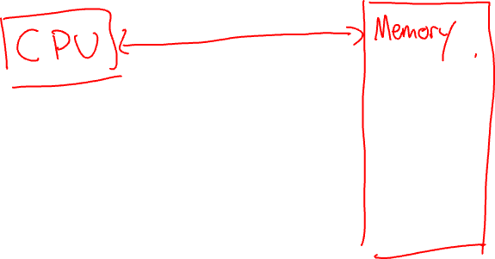
CPU and Memory High-Level Diagram
Notes:
Just CPU and Memory

Slide 5
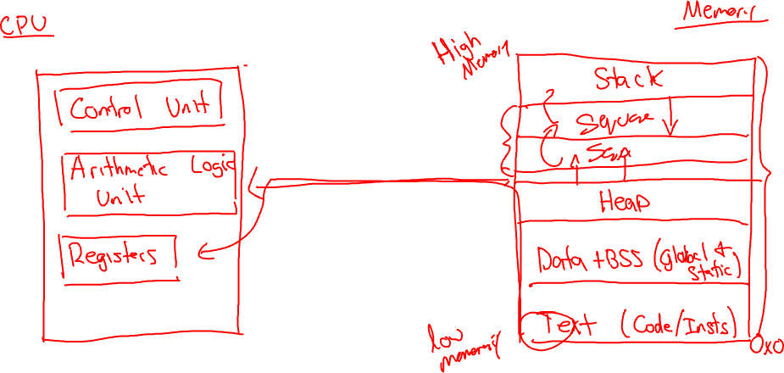
CPU and Memory Mid-Level Diagram
Notes:
CPU diagram
Control Unit
Arithmetic Logic Unit
Registers
Memory interface
Ignore cache
Ignore secondary storage
Ignore threads
Memory and Segments (start at bottom; ignoring virtual memory for now)
program arguments and environment
stack (grows downward)
heap (grows upward)
data+bss (initialized+uninitialized statics and globals)
instructions/text (code)

Slide 6
Code Demo
Notes:
-E, -S, -c, -o
File EXE
hexyl -n4 EXE
OR xxd -l4 EXE
size EXE | numfmt --to=iec-i --header=1 --field=1-3
add global (init and unint)
add static (init and unint)
add functions and static

Slide 7
https://godbolt.org/
Notes:
godbolt
- C (left pane)
- Output (right pane)
+ Demangle identifiers
- Filter
+ All but horizontal whitespace
int square(int num) {
return num * num;
}

Slide 8
Debugging Demo
Notes:
r2 -d EXE
afl (analyze functions)
s main (seek)
V (followed by pp)
R (to cycle through colors)
V (graph view, q to quit)
F2 for breakpoint on line
F9 to run to breakpoint
F7 to step
: to enter command mode
pf z @ VAR
iz to dump read-only segment
F8 step over

