Slide 1
Lecture 4: Floats
CS 105

Slide 2
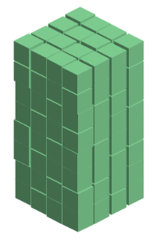
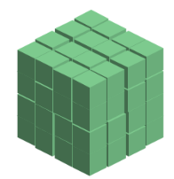
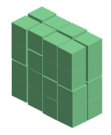





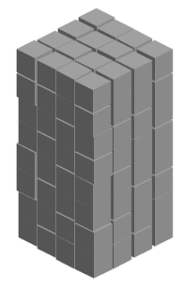
Representing Integers
unsigned:
signed (two's complement):
  Note: to compute –x for a signed int x, flip all the bits, then add 1
128 (2⁷) | 64 (2⁶) | 32 (2⁵) | 16 (2⁴) | 8 (2³) | 4 (2²) | 2 (2¹) | 1 (2⁰)
-128 (2⁷) | 64 (2⁶) | 32 (2⁵) | 16 (2⁴) | 8 (2³) | 4 (2²) | 2 (2¹) | 1 (2⁰)

Slide 3
Fractional binary numbers
What is 1001.101₂?
Notes:
Grade school version

Slide 4
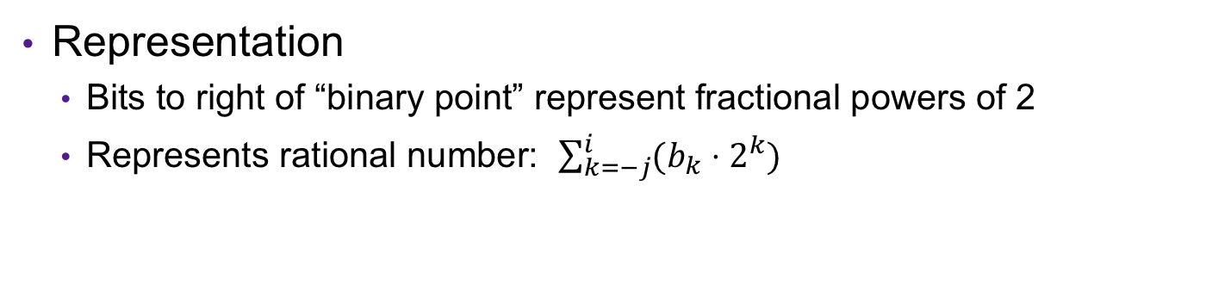
Fractional Binary Numbers
2^{i}
2^{i-1}
4
2
1
• • •
bi | bi-1 | ••• | b2 | b1 | b0 | b-1 | b-2 | b-3 | ••• | b-j
1/2
1/4
1/8
2^{-j}
• • •
Representation
  Bits to right of “binary point” represent fractional powers of 2
  Represents rational number: $\sum_{k=−j}^{i}{(b_{k}⋅2^{k})}$

Slide 5

Example: Fractional Binary Numbers
What is 1001.101₂?
$$=8+1+ …$$
Notes:
101.112
010.1112
001.01112

Slide 6
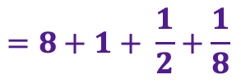
Example: Fractional Binary Numbers
What is 1001.101₂?
$$=8+1+ \frac{1}{2}+\frac{1}{8}$$
Notes:
101.112
010.1112
001.01112

Slide 7
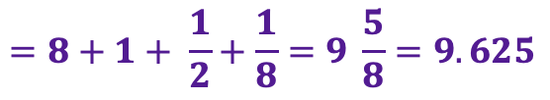
Example: Fractional Binary Numbers
What is 1001.101₂?
What is the binary representation of 13 9/16?
$$=8+1+ \frac{1}{2}+\frac{1}{8}=9 \frac{5}{8}=9.625$$
1101.
1001
Notes:
101.112
010.1112
001.01112

Slide 8
Exercise 1: Fractional Binary Numbers
Translate the following fractional numbers to their binary representation
  5 3/4
  2 7/8
  1 7/16
Translate the following fractional binary numbers to their decimal representation
  000.01100
  000.11000
  001.10000
Notes:
101.112
010.1112
001.01112

Slide 9
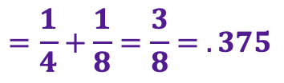
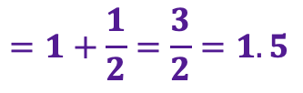
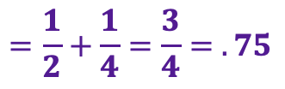
Exercise 1: Fractional Binary Numbers
Translate the following fractional numbers to their binary representation
  5 3/4
  2 7/8
  1 7/16
Translate the following fractional binary numbers to their decimal representation
  000.01100
  000.11000
  001.10000
101.11000
What do you notice about shifting?
010.11100
001.01110
$$=\frac{1}{4}+\frac{1}{8}=\frac{3}{8}= .375$$
$$=\frac{1}{2}+\frac{1}{4}=\frac{3}{4}= .75$$
$$=1+\frac{1}{2}=\frac{3}{2}=1.5$$
Notes:
Divide by 2 by shifting right (unsigned)
Multiply by 2 by shifting left
Numbers of form 0.111111…2 are just below 1.0
1/2 + 1/4 + 1/8 + … + 1/2^{i} + … ➙ 1.0

Slide 10
Representable Numbers
Limitation #1
  Can only exactly represent numbers of the form x/2^{k}
  Other rational numbers have repeating bit representations
  Value Representation
    1/3 0.0101010101[01]…2
    1/5 0.001100110011[0011]…2
    1/10 0.0001100110011[0011]…2
Limitation #2
  Just one setting of binary point within the w bits
  Limited range of numbers (Very small values? Imprecise values?)

Slide 11
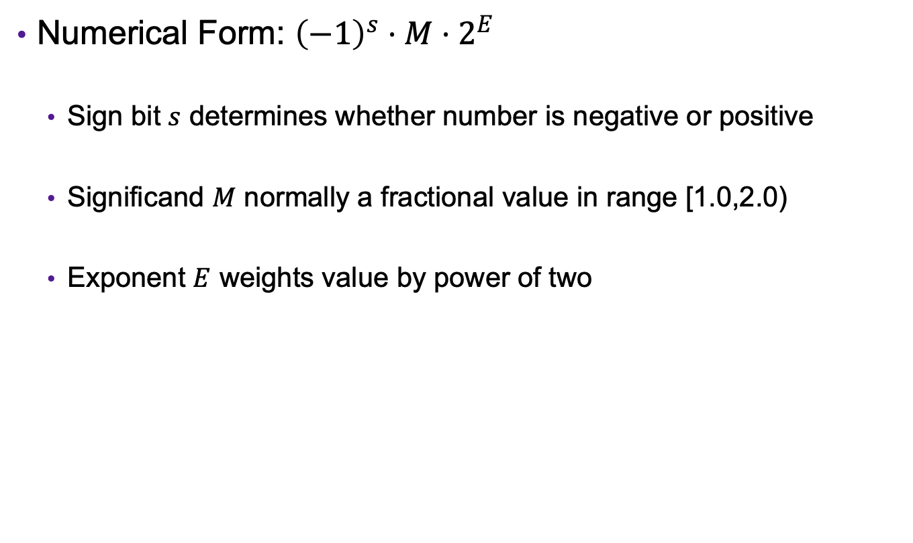
Floating Point Representation
Numerical Form: ${\left(−1\right)}^{s}⋅M⋅2^{E}$
  Sign bit $s$ determines whether number is negative or positive
  Significand $M$ normally a fractional value in range [1.0,2.0)
  Exponent $E$ weights value by power of two
Notes:
Normalize demo: 1.0 hex->interpretation on board, then 1.25, then demo exponent changes with bigger and smaller values

Slide 12
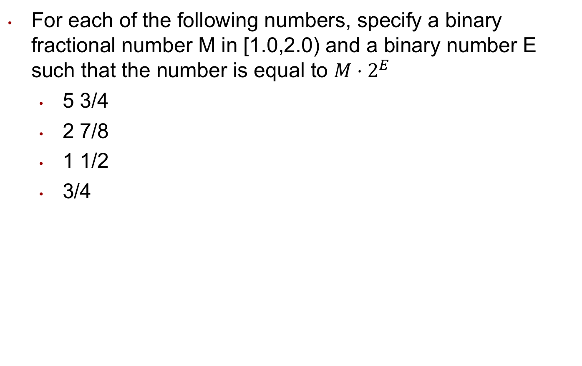
Exercise 2: Floating Point Numbers
For each of the following numbers, specify a binary fractional number M in [1.0,2.0) and a binary number E such that the number is equal to $M⋅2^{E}$
  5 3/4
  2 7/8
  1 1/2
  3/4
Notes:
Divide by 2 by shifting right (unsigned)
Multiply by 2 by shifting left
Numbers of form 0.111111…2 are just below 1.0
1/2 + 1/4 + 1/8 + … + 1/2^{i} + … ➙ 1.0

Slide 13
Exercise 2: Floating Point Numbers
For each of the following numbers, specify a binary fractional number M in [1.0,2.0) and a binary number E such that the number is equal to $M⋅2^{E}$
  5 3/4
  2 7/8
  1 1/2
  3/4
M = 1.0111
E = 2
M = 1.0111
E = 1
M = 1.1000
E = 0
M = 1.1000
E = -1
Notes:
Divide by 2 by shifting right (unsigned)
Multiply by 2 by shifting left
Numbers of form 0.111111…2 are just below 1.0
1/2 + 1/4 + 1/8 + … + 1/2^{i} + … ➙ 1.0

Slide 14
One Way To View Floats
Sign bit
Window into two consecutive powers of two
  [0.5, 1], [1, 2], [2, 4], …, [2¹²⁷, 2¹²⁸]
Offset dividing the window into 2²³ buckets
  Finer grained near zero
Credit to Fabien Sanglard: https://fabiensanglard.net/floating_point_visually_explained/

Slide 15
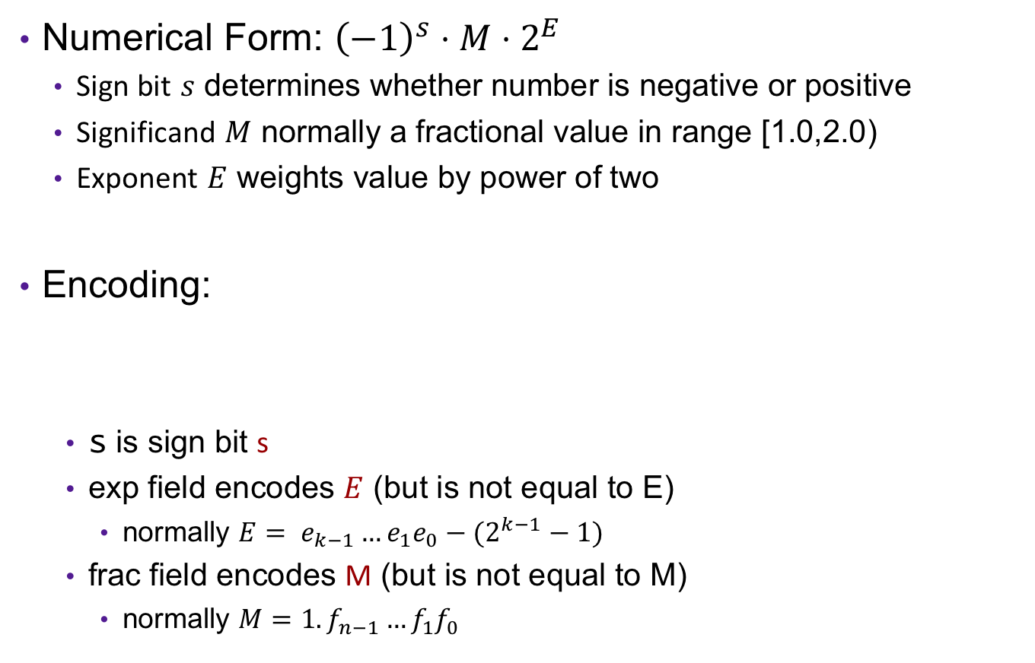
Floating Point Representation
Numerical Form: ${\left(−1\right)}^{s}⋅M⋅2^{E}$
  Sign bit $s$ determines whether number is negative or positive
  Significand $M$ normally a fractional value in range [1.0,2.0)
  Exponent $E$ weights value by power of two
Encoding:
  s is sign bit s
  exp field encodes $E$ (but is not equal to E)
    normally $E= e_{k−1}…e_{1}e_{0}−(2^{k−1}−1)$
  frac field encodes M (but is not equal to M)
    normally $M=1.f_{n−1}…f_{1}f_{0}$
$$s$$ | $$\exp{=e_{k−1}…e_{1}e_{0}}$$ | $$frac=f_{n−1}…f_{1}f_{0}$$
Float (32 bits):
k = 8, n = 23
bias = 127
Double (64 bits)
k=11, n = 52
bias = 1023
bias
Notes:
Normalize demo: 1.0 hex->interpretation on board, then 1.25, then demo exponent changes with bigger and smaller values

Slide 16


IEEE 754 single-precision binary floating-point format
$${\left(−1\right)}^{b_{31}} × 2^{{\left(b_{30}b_{29}…b_{23}\right)}_{2}−127} × {\left(1.b_{22}b_{21}…b_{0}\right)}_{2}$$

Slide 17
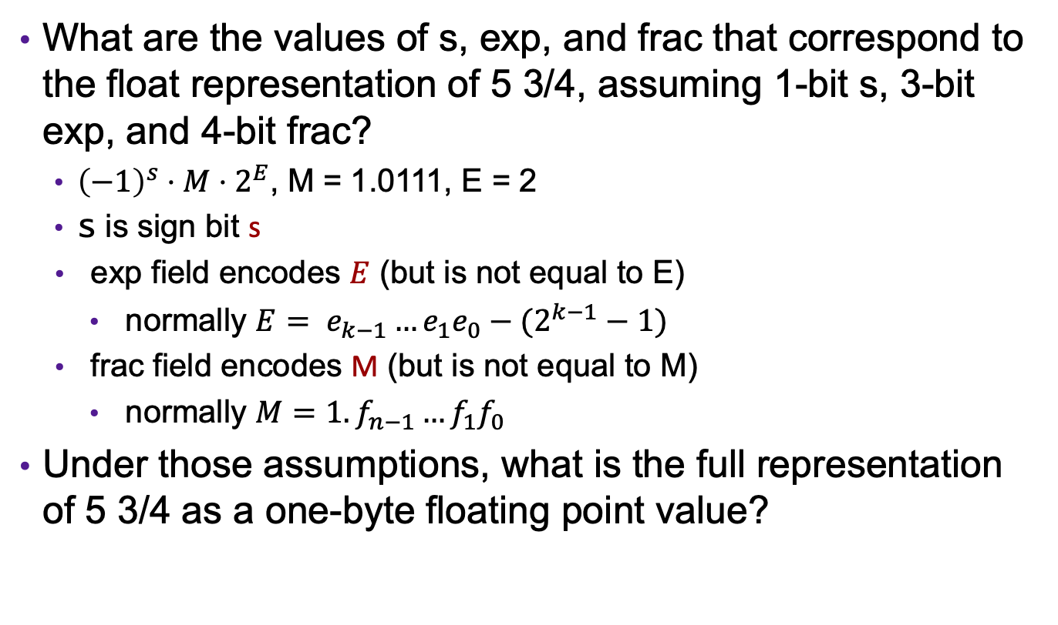
Exercise 3: Floating Point Representations
What are the values of s, exp, and frac that correspond to the float representation of 5 3/4, assuming 1-bit s, 3-bit exp, and 4-bit frac?
  ${\left(−1\right)}^{s}⋅M⋅2^{E}$, M = 1.0111, E = 2
  s is sign bit s
exp field encodes $E$ (but is not equal to E)
  normally $E= e_{k−1}…e_{1}e_{0}−(2^{k−1}−1)$
frac field encodes M (but is not equal to M)
  normally $M=1.f_{n−1}…f_{1}f_{0}$
Under those assumptions, what is the full representation of 5 3/4 as a one-byte floating point value?
$$s$$ | $$\exp{=e_{k−1}…e_{1}e_{0}}$$ | $$frac=f_{n−1}…f_{1}f_{0}$$

Slide 18
Exercise 3: Floating Point Representations
What are the values of s, exp, and frac that correspond to the float representation of 5 3/4, assuming 1-bit s, 3-bit exp, and 4-bit frac?
  ${\left(−1\right)}^{s}⋅M⋅2^{E}$, M = 1.0111, E = 2
  s is sign bit s
exp field encodes $E$ (but is not equal to E)
  normally $E= e_{k−1}…e_{1}e_{0}−(2^{k−1}−1)$
frac field encodes M (but is not equal to M)
  normally $M=1.f_{n−1}…f_{1}f_{0}$
Under those assumptions, what is the full representation of 5 3/4 as a one-byte floating point value?
$$s$$ | $$\exp{=e_{k−1}…e_{1}e_{0}}$$ | $$frac=f_{n−1}…f_{1}f_{0}$$
s = 0
exp = 101
frac = 0111
01010111
= 0x57

Slide 19

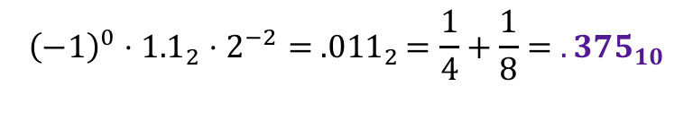
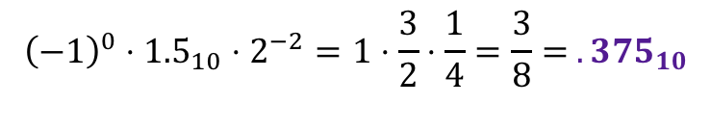
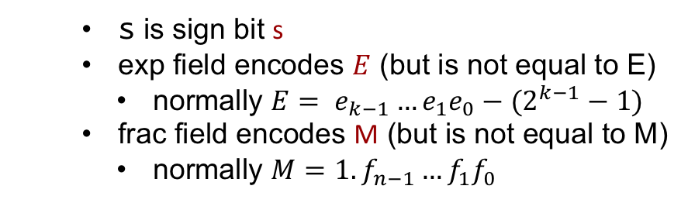
Example: Floats
What fractional number is represented by the bytes 0x3ec00000? Assume big-endian order.
$$s$$ | $$\exp{=e_{k−1}…e_{1}e_{0}}$$ | $$frac=f_{n−1}…f_{1}f_{0}$$
  s is sign bit s
  exp field encodes $E$ (but is not equal to E)
    normally $E= e_{k−1}…e_{1}e_{0}−(2^{k−1}−1)$
  frac field encodes M (but is not equal to M)
    normally $M=1.f_{n−1}…f_{1}f_{0}$
Float (32 bits):
k = 8, n = 23
bias = 127
$${\left(−1\right)}^{s}⋅M⋅2^{E}$$
0011 1110 1100 0000 0000 0000 0000 0000
s=0
exp=125
frac = 10000000000000000000000₂
s=0
E = -2
M = 1.10000000000000000000000₂ = 1.5₁₀
$${\left(−1\right)}^{0}⋅{1.5}_{10}⋅2^{−2}=1⋅\frac{3}{2}⋅\frac{1}{4}=\frac{3}{8}= {.375}_{10}$$
$${\left(−1\right)}^{0}⋅{1.1}_{2}⋅2^{−2}= {.011}_{2}=\frac{1}{4}+\frac{1}{8}= {.375}_{10}$$
Notes:
.375

Slide 20
C Float Demo

Slide 21

Exercise 4: Floats
What fractional number is represented by the bytes 0x423c0000? Assume big-endian order.
$$s$$ | $$\exp{=e_{k−1}…e_{1}e_{0}}$$ | $$frac=f_{n−1}…f_{1}f_{0}$$
  s is sign bit s
  exp field encodes $E$ (but is not equal to E)
    normally $E= e_{k−1}…e_{1}e_{0}−(2^{k−1}−1)$
  frac field encodes M (but is not equal to M)
    normally $M=1.f_{n−1}…f_{1}f_{0}$
Float (32 bits):
k = 8, n = 23
bias = 127
$${\left(−1\right)}^{s}⋅M⋅2^{E}$$
0100 0010 0011 1100 0000 0000 0000 0000
s=0
exp=132
frac = 01111000000000000000000₂
s=0
E = 5
M = 1.01111000000000000000000₂
$${\left(−1\right)}^{0}⋅{1.011110}_{2}⋅2^{5}= {101111.0}_{2}== {47}_{10}$$
Notes:
.375

Slide 22

Limitation so far…
What is the smallest non-negative number that can be represented?
What we like the smallest non-negative number to be?
0000 0000 0000 0000 0000 0000 0000 0000
s=0
exp=0
frac = 00000000000000000000000₂
s=0
E = -127
M = 1.00000000000000000000000₂
$${\left(−1\right)}^{0}⋅{1.0}_{2}⋅2^{−127}=2^{−127}$$
Notes:
.375

Slide 23
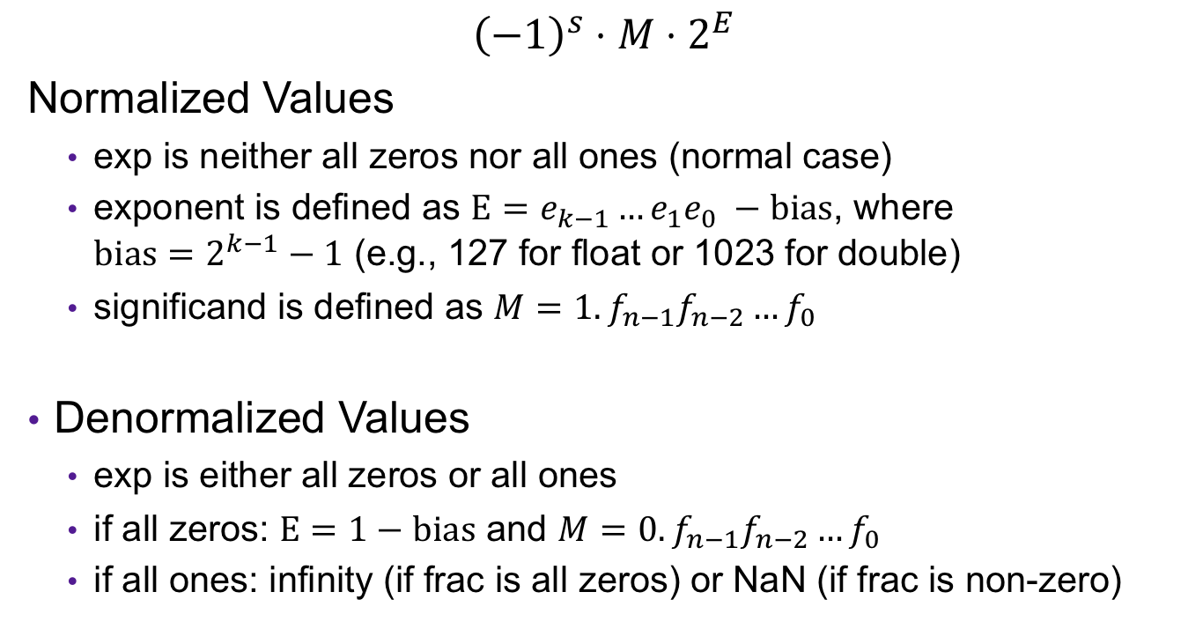
Normalized and Denormalized
s | exp | frac
$${\left(−1\right)}^{s}⋅M⋅2^{E}$$
Normalized Values
  exp is neither all zeros nor all ones (normal case)
  exponent is defined as $E=e_{k−1}…e_{1}e_{0} −bias$, where $bias=2^{k−1}−1$ (e.g., 127 for float or 1023 for double)
  significand is defined as $M=1.f_{n−1}f_{n−2}…f_{0}$
Denormalized Values
  exp is either all zeros or all ones
  if all zeros: $E=1−bias$ and $M=0.f_{n−1}f_{n−2}…f_{0}$
  if all ones: infinity (if frac is all zeros) or NaN (if frac is non-zero)
Notes:
Can represent smaller fractional values

Slide 24
Visualization: Floating Point Encodings
−∞
+∞
−Normalized
−Denorm
+Denorm
+Normalized
NaN
NaN
−0
+0

Slide 25
Exercise 5: Limits of Floats
s | exp | frac
1 | 8-bits | 23-bits
What is the difference between the largest (non-infinite) positive number that can be represented as a (normalized) float and the second-largest?

Slide 26
Exercise 5: Limits of Floats
s | exp | frac
1 | 8-bits | 23-bits
What is the difference between the largest (non-infinite) positive number that can be represented as a (normalized) float and the second-largest?
Any number between these two gets rounded.
0111 1111 0111 1111 1111 1111 1111 1111
s=0
E = 127
M = 1.11111111111111111111111₂
$${largest=1.11111111111111111111111}_{2}⋅2^{127}$$
$${second_largest=1.11111111111111111111110}_{2}⋅2^{127}$$
$diff={0.00000000000000000000001}_{2}⋅2^{127}=1_{2}⋅2^{127−23}=2^{104}$

Slide 27
Correctness
Example 1: Is (x + y) + z = x + (y + z)?
  Ints: Yes!
  Floats:
    (2^30 + -2^30) + 3.14 ➙ 3.14
    2^30 + (-2^30 + 3.14) ➙ 0.0
Notes:
Source: xkcd.com/571

Slide 28
Floating Point in C
C Guarantees Two Levels
  float single precision (32 bits)
  double double precision (64 bits)
Conversions/Casting
  Casting between int, float, and double changes bit representation
  double/float → int
    Truncates fractional part
    Like rounding toward zero
    Not defined when out of range or NaN: Generally sets to TMin
  int → double
    Exact conversion,
  int → float
    Will round
Notes:
all ints are representable as floats as long as int has ≤ 53 bit size

Slide 29
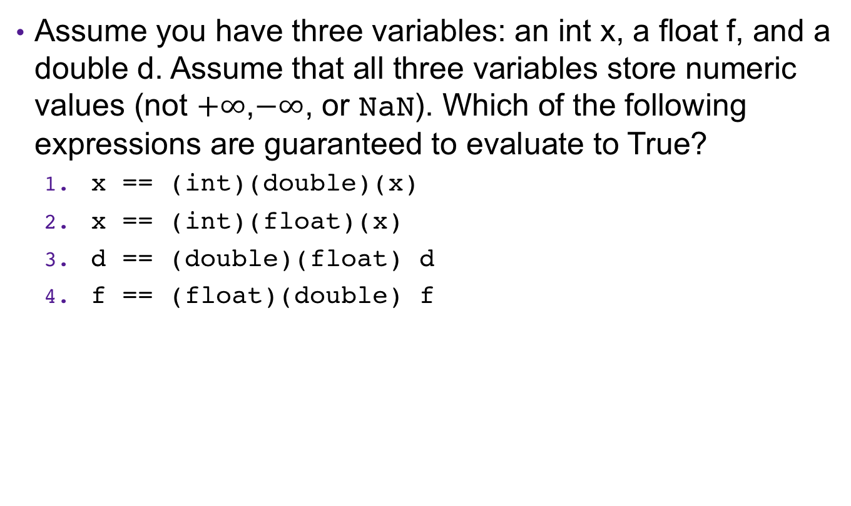
Exercise 6: Casting with Floats
Assume you have three variables: an int x, a float f, and a double d. Assume that all three variables store numeric values (not $+∞$,$−∞$, or NaN). Which of the following expressions are guaranteed to evaluate to True?
  x == (int)(double)(x)
  x == (int)(float)(x)
  d == (double)(float) d
  f == (float)(double) f

Slide 30
Exercise 6: Casting with Floats
Assume you have three variables: an int x, a float f, and a double d. Assume that all three variables store numeric values (not $+∞$,$−∞$, or NaN). Which of the following expressions are guaranteed to evaluate to True?
  x == (int)(double)(x)
  x == (int)(float)(x)
  d == (double)(float) d
  f == (float)(double) f
True
False
False
True

Slide 31
Floating Point Operations
All the bitwise and logical operations still work
Float arithmetic operations done by separate hardware unit (FPU)

Slide 32
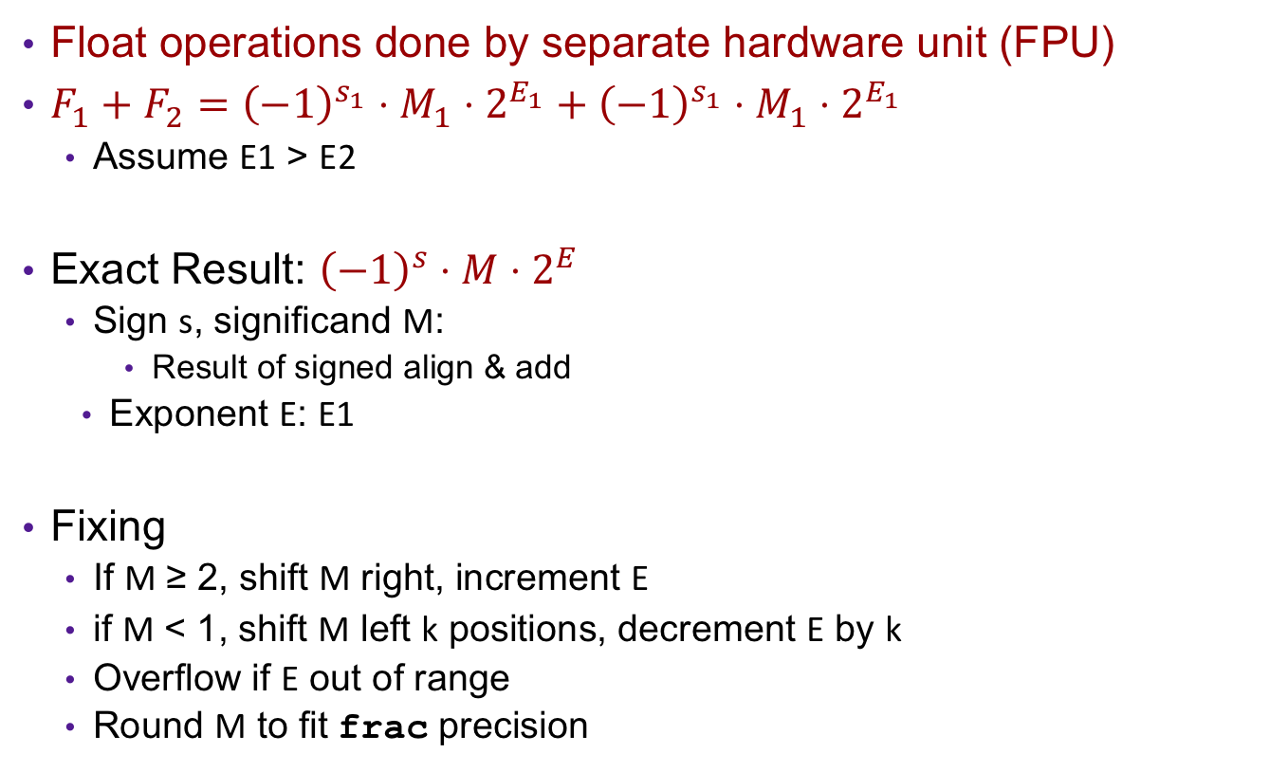
Floating Point Addition
Float operations done by separate hardware unit (FPU)
$F_{1}+F_{2}={\left(−1\right)}^{s_{1}}⋅M_{1}⋅2^{E_{1}}+{\left(−1\right)}^{s_{1}}⋅M_{1}⋅2^{E_{1}}$
  Assume E1 > E2
Exact Result: ${\left(−1\right)}^{s}⋅M⋅2^{E}$
  Sign s, significand M:
    Result of signed align & add
  Exponent E: E1
Fixing
  If M ≥ 2, shift M right, increment E
  if M < 1, shift M left k positions, decrement E by k
  Overflow if E out of range
  Round M to fit frac precision
Get binary points lined up
E1–E2
(–1)^{s1} M1
+
(–1)^{s2} M2
(–1)^{s} M

Slide 33
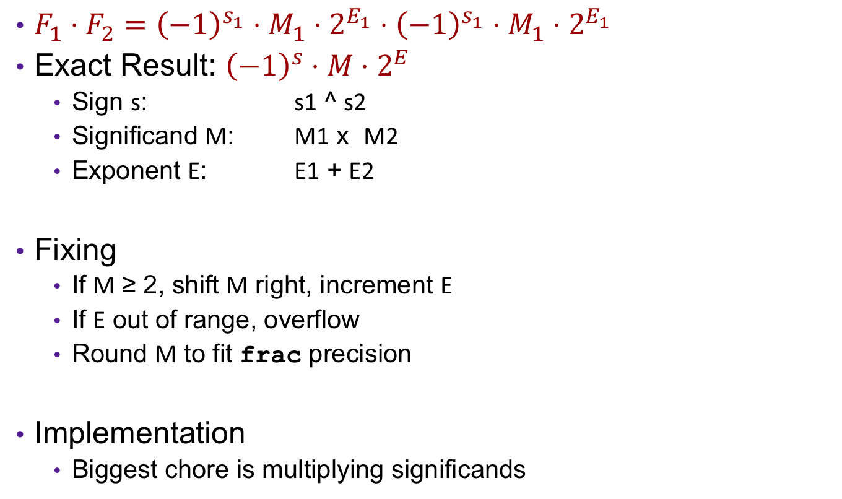
FP Multiplication
$F_{1}⋅F_{2}={\left(−1\right)}^{s_{1}}⋅M_{1}⋅2^{E_{1}}⋅{\left(−1\right)}^{s_{1}}⋅M_{1}⋅2^{E_{1}}$
Exact Result: ${\left(−1\right)}^{s}⋅M⋅2^{E}$
  Sign s: s1 ^ s2
  Significand M: M1 x M2
  Exponent E: E1 + E2
Fixing
  If M ≥ 2, shift M right, increment E
  If E out of range, overflow
  Round M to fit frac precision
Implementation
  Biggest chore is multiplying significands

Slide 34
Exercise 7: Feedback
Rate how well you think this recorded lecture worked
  Better than an in-person class
  About as well as an in-person class
  Less well than an in-person class, but you still learned something
  Total waste of time, you didn't learn anything
How much time did you spend on this video lecture (including time spent on exercises)?
Are there particular questions you’d like me to discuss in the problem session?
Do you have any other comments or feedback?

