Slide 1
Lecture 3: Representing Signed Integers
CS 105
Notes:
https://www.youtube.com/watch?v=lKTsv6iVxV4

Slide 2
Memory: A (very large) array of bytes
bytes
Memory is an array of bits
A byte is a unit of eight bits
An index into the array is an address, location, or pointer
  Often expressed in hexadecimal
We speak of the value in memory at an address
  The value may be a single byte …
  … or a multi-byte quantity starting at that address
00110111
1
1
1
0
1
1
0
3
0
11010001
1
0
0
0
1
0
1
2
1
01010011
1
1
0
0
1
0
1
1
0
01101100
0
0
1
1
0
1
0
1
0

Slide 3
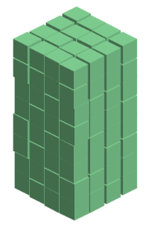
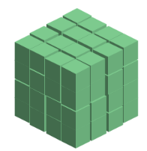
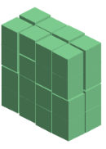
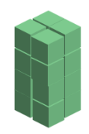




Base-2 Integers (aka Binary Numbers)
128 (2⁷) | 64 (2⁶) | 32 (2⁵) | 16 (2⁴) | 8 (2³) | 4 (2²) | 2 (2¹) | 1 (2⁰)
0 | 0 | 0 | 0 | 0 | 1 | 0 | 1
0 | 0 | 1 | 0 | 1 | 1 | 1 | 1
1 | 1 | 1 | 1 | 1 | 1 | 1 | 1
Notes:
Range is 0 to 2^w - 1

Slide 4
Representing Signed Integers
Option 1: sign-magnitude
  One bit for sign; interpret rest as magnitude
Notes:
We have positive and negative zero.
What happens when we try to add positive and negative values?
Need to treat negative and positive numbers differently.

Slide 5
Representing Signed Integers
Option 2: one’s-complement
  Complement all bits
Notes:
We have positive and negative zero.
Try 5 + -5 or 3 + -3
Try 5 + -3
Try 6 + -2
Pattern: add carry bit back around and you get the right answer
Still has a sign bit

Slide 6
Representing Signed Integers
Option 3: excess-K
  Choose a positive K in the middle of the unsigned range
  SignedValue(w) = UnsignedValue(w) – K
Notes:
Consistent math for positive and negative values.
Different representation of 5 between signed and unsigned representations.
Zero is represented strangely (all ones).

Slide 7

Representing Signed Integers
Option 3: two’s complement
  Most used, like one’s complement, but with one zero value
  Like unsigned, except the high-order contribution is negative
  $Signed\left(x\right)=−x_{w−1}⋅2^{w−1}+\sum_{i=0}^{w−2}{x_{i}⋅2^{i}}$
Notes:
Like ones complement, but shift everything down and add -8
To get a negative: flip all bits and add one
Add 5 + -5 (always get a two)
6 + -2
-8 4 2 1

Slide 8
Two’s Complement Signed Integers
“Signed” does not mean “negative”
High order bit is the sign bit
  To negate, complement all the bits and add 1
Arithmetic is the same as unsigned—same circuitry
(Error conditions and comparisons are different)
Notes:
-1 is all 1’s
Sign extension

Slide 9
Example: Three-bit integers

Slide 10
Example: Three-bit integers

Slide 11
Important Signed Numbers
w | 8 | 16 | 32 | 64
Max | 0x7F | 0x7FFF | 0x7FFFFFFF | 0x7FFFFFFFFFFFFFFF
Min | 0x80 | 0x8000 | 0x80000000 | 0x8000000000000000
0 | 0x00 | 0x0000 | 0x00000000 | 0x0000000000000000
-1 | 0xFF | 0xFFFF | 0xFFFFFFFF | 0xFFFFFFFFFFFFFFFF

Slide 12
Exercise 1: Signed Integers
Assume an 8 bit (1 byte) signed integer representation using two’s complement:
  What is the binary representation for 47?
  What is the binary representation for -47?
  What is the number represented by 10000110?
  What is the number represented by 00100101?
Notes:
47 = 0x2F = 0b0000 0000 0010 1111
-47 = oxFFD1 = 0b1111 1111 1101 0001

Slide 13
Exercise 1: Signed Integers
Assume an 8 bit (1 byte) signed integer representation using two’s complement:
  What is the binary representation for 47?
  What is the binary representation for -47?
  What is the number represented by 10000110?
  What is the number represented by 00100101?
00101111
11010001
-122
37
Notes:
47 = 0x2F = 0b0000 0000 0010 1111
-47 = oxFFD1 = 0b1111 1111 1101 0001

Slide 14
Casting between Numeric Types
Casting from shorter to longer types preserves the value
Casting from longer to shorter types drops the high-order bits (modulus)
Casting between signed/unsigned types preserves the bits (it just changes the interpretation)
Implicit casting occurs in assignments and parameter lists. In mixed expressions, signed values are implicitly cast to unsigned
    Source of many errors!
Notes:
Note: casting part of signed demo

Slide 15
Exercise 2: Casting
Assume you have a machine with 6-bit integers/3-bit shorts
Assume variables: int x = -17; short sy = -3;
Complete the following table
Expression | Decimal | Binary
x | -17
sy | -3
(unsigned) x
(int) sy
(short) x

Slide 16
Exercise 2: Casting
Assume you have a machine with 6-bit integers/3-bit shorts
Assume variables: int x = -17; short sy = -3;
Complete the following table
Expression | Decimal | Binary
x | -17
sy | -3
(unsigned) x
(int) sy
(short) x
101111
101
47
101111
-3
111101
-1
111

Slide 17
When to Use Unsigned
Rarely
When doing multi-precision arithmetic, or when you need an extra bit of range … but be careful!
unsigned i;
for (i = cnt-2; i >= 0; i--){
a[i] += a[i+1];
}

Slide 18
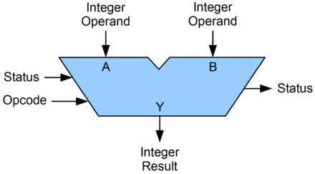
Arithmetic Logic Unit (ALU)
A circuit that performs bitwise operations and arithmetic on integer binary types
Status examples:
Carry-out
Zero
Negative
Overflow
parity
Opcode examples:
Add, Subtract
Increment, Decrement
AND, OR, XOR
Shift, Rotate

Slide 19
Bitwise vs Logical Operations in C
Bitwise Operators &, |, ~, ^
  View arguments as bit vectors
  operations applied bit-wise in parallel
Logical Operators &&, ||, !
  View 0 as “False”
  View anything nonzero as “True”
  Always return 0 or 1
  Short-circuit termination
Shift operators <<, >>
  Left shift fills with zeros
  For signed integers, right shift is arithmetic (fills with high-order bit)

Slide 20
Exercise 3: Bitwise vs Logical Operations
Assume signed char data type (one byte)
  ~(-30)
  !(-30)
  120 & 85
  120 | 85
  120 && 85
  120 || 85
  -106 << 4
  -106 << 2
  -106 >> 4
  -106 >> 2
Notes:
0xBE, 0xFF, 0x41
0x41, 0x7D
0x00, 0x01, 0x01
0x01, 0x01

Slide 21
Exercise 3: Bitwise vs Logical Operations
Assume signed char data type (one byte)
  ~(-30)
  !(-30)
  120 & 85
  120 | 85
  120 && 85
  120 || 85
  -106 << 4
  -106 << 2
  -106 >> 4
  -106 >> 2
= ~11100010 = 00011101 = 29
= !11100010 = 00000000 = 0
= 01111000 & 01010101 = 01010000 = 80
= 01111000 | 01010101 = 01111101 = 125
= 01111000 && 01010101 = 00000001 = 1
= 01111000 || 01010101 = 00000001 = 1
= 10010110 << 4 = 01100000 = 96
= 10010110 << 2 = 01011000 = 88
= 10010110 >> 4 = 11111001 = -7
= 10010110 >> 2 = 11100101 = -27
Notes:
0xBE, 0xFF, 0x41
0x41, 0x7D
0x00, 0x01, 0x01
0x01, 0x01

Slide 22
Addition/Subtraction Example
Compute 5 + -3 assuming all ints are stored as
four-bit signed values
1
1
0 1 0 1
+ 1 1 0 1
0
0
1
0
= 2 (Base-10)
Exactly the same as unsigned numbers!
… but with different error cases

Slide 23
Addition/Subtraction with Overflow
Compute 5 + 3 assuming all ints are stored as
four-bit signed values
1
1
1
0 1 0 1
+ 0 0 1 1
1
0
0
0
= -8 (Base-10)

Slide 24



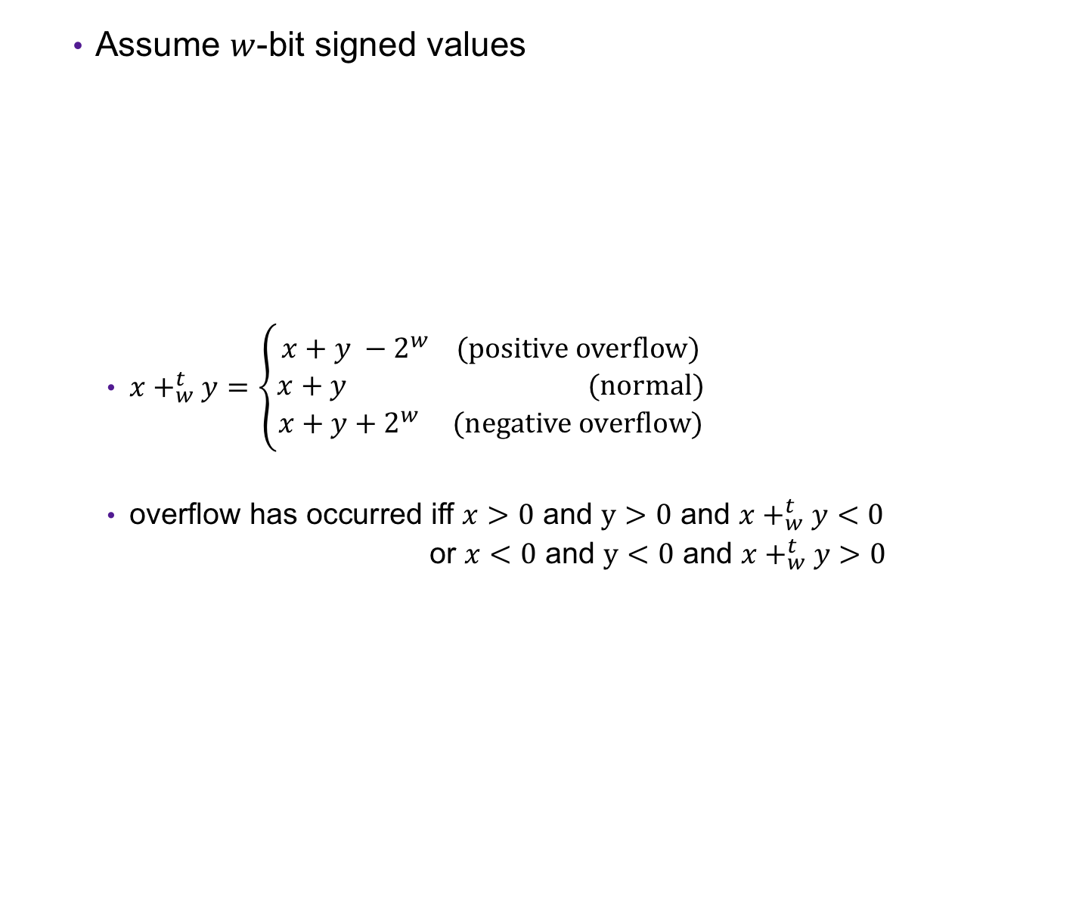



Error Cases
Assume $w$-bit signed values
  $x+_{w}^{t}y=\left\{\begin{aligned}x+y −2^{w} (positive overflow) \\ x+y (normal) \\ x+y+2^{w} (negative overflow)\end{aligned}\right.$
  overflow has occurred iff $x>0$ and $y>0$ and $x+_{w}^{t}y<0$
  or $x<0$ and $y<0$ and $x+_{w}^{t}y>0$
$${−2⋅2}^{w−1}$$
$${−2}^{w−1}$$
$$0$$
$$2^{w−1}$$
$${2⋅2}^{w−1}$$
[ )
representable values
( )
Possible values of $x+y$

Slide 25
Exercise 4: Binary Addition
Given the following 5-bit signed values, compute their sum and indicate whether an overflow occurred
x | y | x+y | overflow?
00010 | 00101
01100 | 00100
10100 | 10001

Slide 26
Exercise 4: Binary Addition
Given the following 5-bit signed values, compute their sum and indicate whether an overflow occurred
x | y | x+y | overflow?
00010 | 00101
01100 | 00100
10100 | 10001
00111
no
10000
yes
00101
yes

Slide 27
Multiplication Example
Compute 3 x 2 assuming all ints are stored as
four-bit signed values
0 0 1 1
x 0 0 1 0
0 0 0 0
0 0 1 1 0
+ _
0 1 1 0
= 6 (Base-10)
Exactly like unsigned multiplication!
… except with different error cases

Slide 28
Multiplication Example
Compute 5 x 2 assuming all ints are stored as
four-bit signed values
0 1 0 1
x 0 0 1 0
0 0 0 0
0 1 0 1 0
+ _
1 0 1 0
= -6 (Base-10)

Slide 29






Error Cases
Assume $w$-bit unsigned values
$x∗_{w}^{t}y=U2T(\left(x⋅y\right) mod 2^{w})$
$${−2}^{2(w−1)}$$
$${−2}^{w−1}$$
$$0$$
$$2^{w−1}$$
$${ 2}^{2(w−1)}$$
[ )
representable values
[ )
Possible values of $x∗y$

Slide 30
Exercise 5: Binary Multiplication
Given the following 3-bit signed values, compute their product and indicate whether an overflow occurred
x | y | x*y | overflow?
100 | 101
010 | 011
111 | 010

Slide 31
Exercise 5: Binary Multiplication
Given the following 3-bit signed values, compute their product and indicate whether an overflow occurred
x | y | x*y | overflow?
100 | 101
010 | 011
111 | 010
100
yes
110
yes
110
no

Slide 32
Exercise 6: Feedback
Rate how well you think this recorded lecture worked
  Better than an in-person class
  About as well as an in-person class
  Less well than an in-person class, but you still learned something
  Total waste of time, you didn't learn anything
How much time did you spend on this video lecture (including time spent on exercises)?
Do you have any particular questions you’d like me to address in the problem session?
Do you have any other comments or feedback?

