Slide 1
Lecture 2: Representing Integers
CS 105

Slide 2
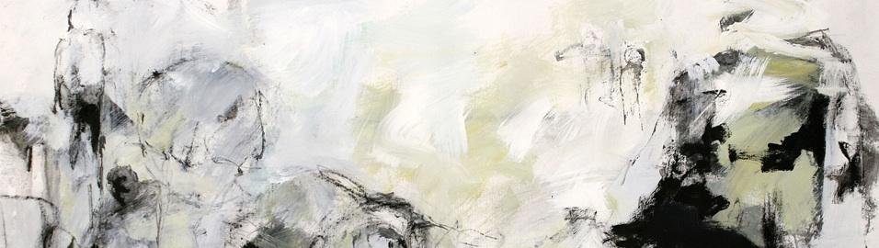



Abstraction

Slide 3
Memory: A (very large) array of bytes
bytes
Memory is an array of bits
A byte is a unit of eight bits
An index into the array is an address, location, or pointer
  Often expressed in hexadecimal
We speak of the value in memory at an address
  The value may be a single byte …
  … or a multi-byte quantity starting at that address
00110111
1
1
1
0
1
1
0
3
0
11010001
1
0
0
0
1
0
1
2
1
01010011
1
1
0
0
1
0
1
1
0
01101100
0
0
1
1
0
1
0
1
0

Slide 4


Representing Integers
Arabic Numerals: 47
Roman Numerals: XLVII
Brahmi Numerals:
Tally Marks: IIII IIII IIII IIII IIII IIII IIII IIII IIII II

Slide 5
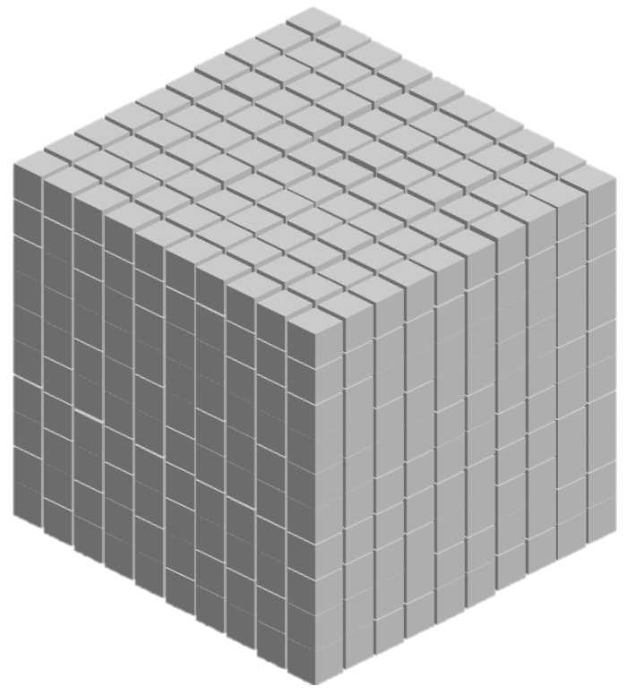
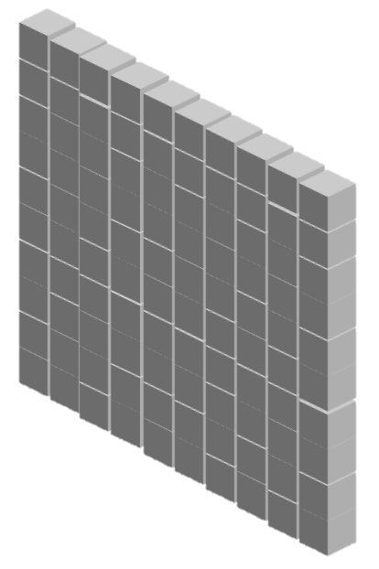

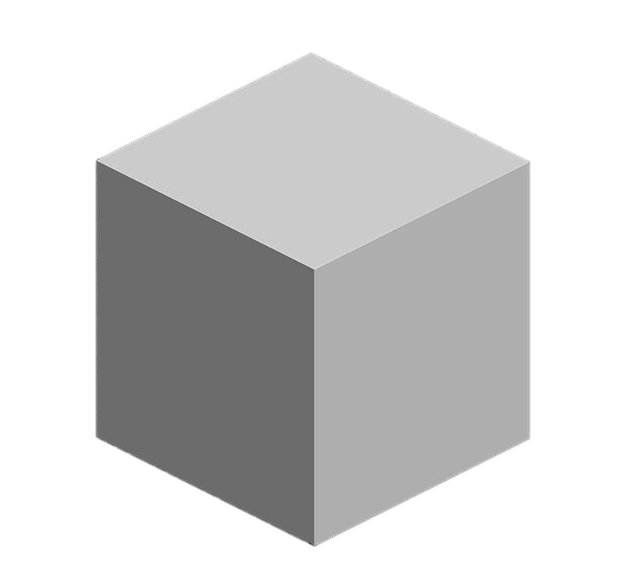
Base-10 Integers
1000 (10³) | 100 (10²) | 10 (10¹) | 1 (10⁰)
0 | 0 | 0 | 5
0 | 0 | 4 | 7
1 | 8 | 8 | 7

Slide 6
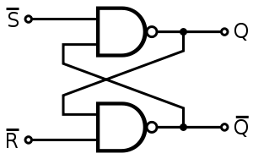
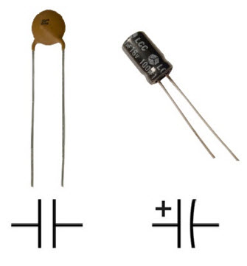
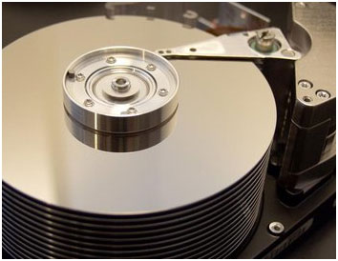
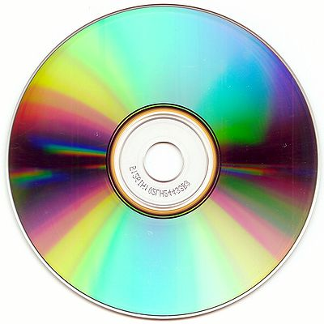
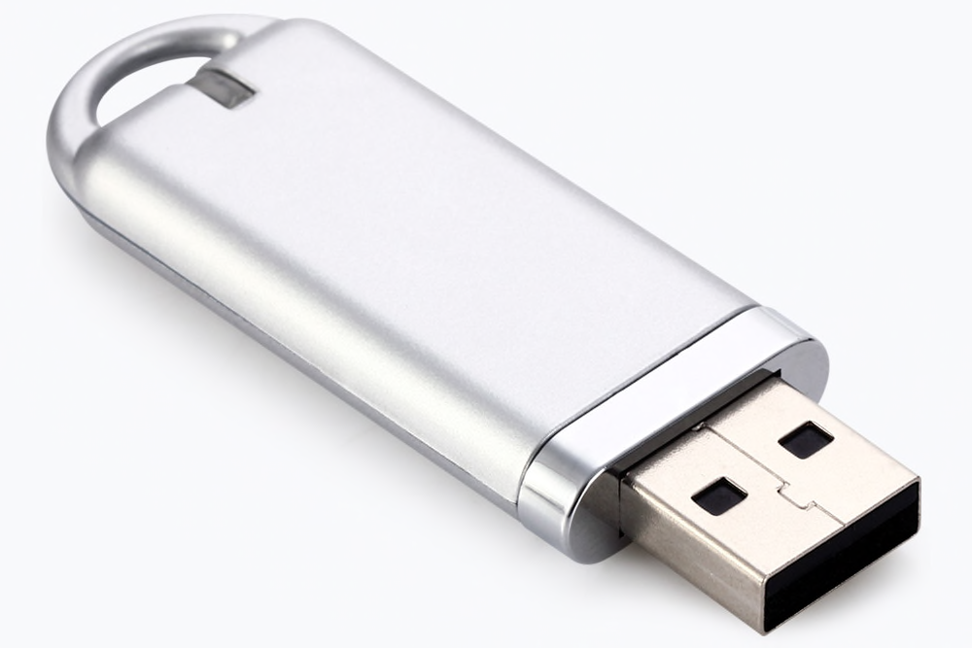
Storing bits
Static random access memory (SRAM): stores each bit of data in a flip-flop, a circuit with two stable states
Dynamic Memory (DRAM): stores each bit of data in a capacitor, which stores energy in an electric field (or not)
Magnetic Disk: regions of the platter are magnetized with either N-S polarity or S-N polarity
Optical Disk: stores bits as tiny indentations (pits) or not (lands) that reflect light differently
Flash Disk: electrons are stored in one of two gates separated by oxide layers

Slide 7
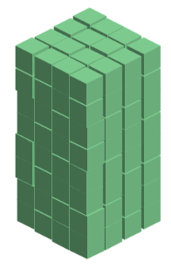
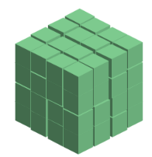
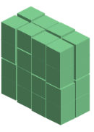
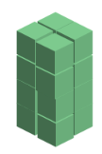



Base-2 Integers (aka Binary Numbers)
128 (2⁷) | 64 (2⁶) | 32 (2⁵) | 16 (2⁴) | 8 (2³) | 4 (2²) | 2 (2¹) | 1 (2⁰)
0 | 0 | 0 | 0 | 0 | 1 | 0 | 1
0 | 0 | 1 | 0 | 1 | 1 | 1 | 1
1 | 1 | 1 | 1 | 1 | 1 | 1 | 1

Slide 8
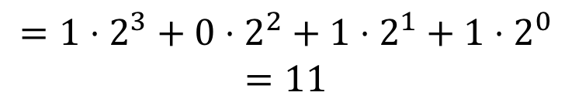
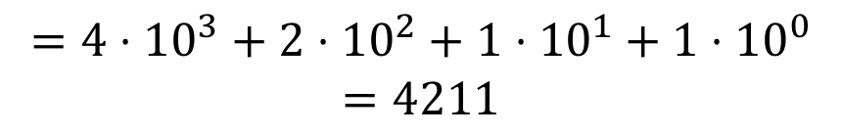
Binary Numbers
Decimal (Base-10):
Binary (Base-2):
4211
$$=4⋅{10}^{3}+2⋅{10}^{2}+1⋅{10}^{1}+1⋅{10}^{0}$$
$$=4211$$
1011
$$=1⋅2^{3}+0⋅2^{2}+1⋅2^{1}+1⋅2^{0}$$
$$=11$$

Slide 9
Exercise 1: Binary Numbers
Consider the following four-bit binary values. What is the (base-10) integer interpretation of these values?
  0001
  1010
  0111
  1111

Slide 10
Exercise 1: Binary Numbers
Consider the following four-bit binary values. What is the (base-10) integer interpretation of these values?
  0001
  1010
  0111
  1111
$$=0⋅2^{3}+0⋅2^{2}+0⋅2^{1}+1⋅2^{0}=1$$
$$=1⋅2^{3}+0⋅2^{2}+1⋅2^{1}+0⋅2^{0}=8+2=10$$
$$=0⋅2^{3}+1⋅2^{2}+1⋅2^{1}+1⋅2^{0}=4+2+1=7$$
$$=1⋅2^{3}+1⋅2^{2}+1⋅2^{1}+1⋅2^{0}=8+4+2+1=15$$

Slide 11
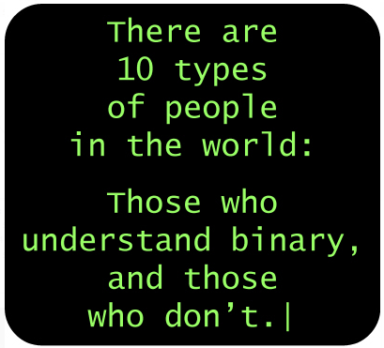
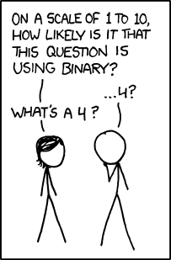
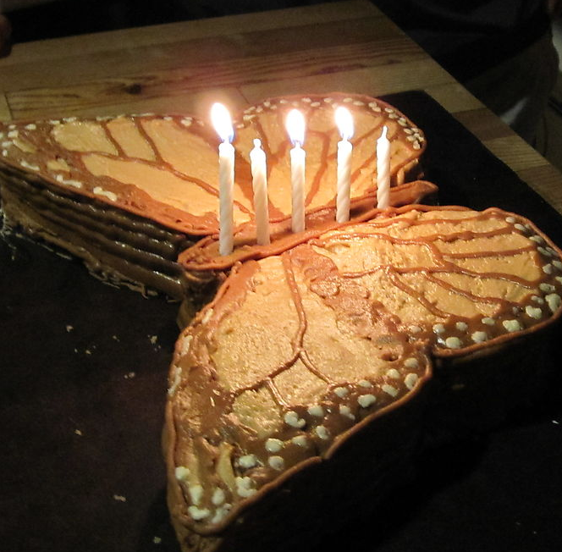
Binary Numbers

Slide 12
Exercise 2: Binary Number Range
What are the max number and min number that can be represented by a w-bit binary number?
  w = 3
  w = 4
  w = 8

Slide 13

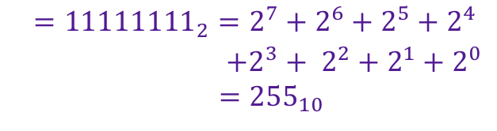
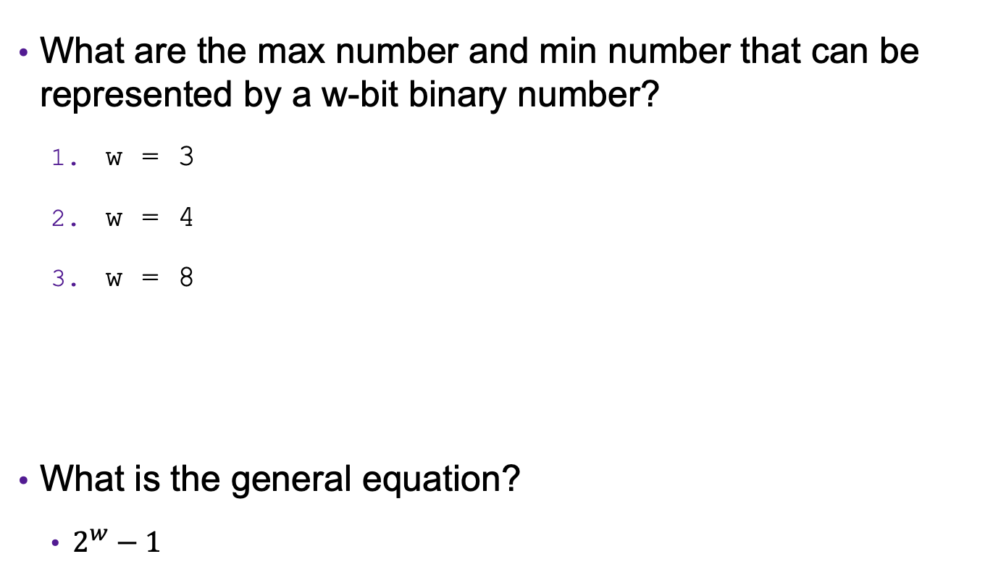



Exercise 2: Binary Number Range
What are the max number and min number that can be represented by a w-bit binary number?
  w = 3
  w = 4
  w = 8
What is the general equation?
  $2^{w}−1$
$$\min{={000}_{2}=0_{10}}$$
$${\max{={111}_{2}=2^{2}+2^{1}+2^{0}=7}}_{10}$$
$$\min{={0000}_{2}=0_{10}}$$
$${\max{={1111}_{2}=2^{3}+2^{2}+2^{1}+2^{0}=15}}_{10}$$
$$\min{={00000000}_{2}=0_{10}}$$
$$max$$
$${{\begin{aligned}={11111111}_{2}={2^{7}+2^{6}+2^{5}+2}^{4} \\ +{2^{3}+ 2}^{2}+2^{1}+2^{0} \\ ={255}_{10}\end{aligned}}}_{ }$$

Slide 14
Unsigned Integers in C
C Data Type | Size (bytes)
unsigned char | 1
unsigned short | 2
unsigned int | 4
unsigned long | 8
For x86_64
Unsigned -> Cannot represent negative numbers.
Notes:
Note: unsigned demo

Slide 15
ASCII characters
https://www.ascii-code.com/
Char | Dec | Binary
! | 33 | 00100001
" | 34 | 00100010
# | 35 | 00100011
$ | 36 | 00100100
% | 37 | 00100101
& | 38 | 00100110
' | 39 | 00100111
( | 40 | 00101000
) | 41 | 00101001
* | 42 | 00101010
+ | 43 | 00101011
, | 44 | 00101100
- | 45 | 00101101
. | 46 | 00101110
/ | 47 | 00101111
0 | 48 | 00110000
Char | Dec | Binary
1 | 49 | 00110001
2 | 50 | 00110010
3 | 51 | 00110011
4 | 52 | 00110100
5 | 53 | 00110101
6 | 54 | 00110110
7 | 55 | 00110111
8 | 56 | 00111000
9 | 57 | 00111001
: | 58 | 00111010
; | 59 | 00111011
< | 60 | 00111100
= | 61 | 00111101
> | 62 | 00111110
? | 63 | 00111111
@ | 64 | 01000000
Char | Dec | Binary
A | 65 | 01000001
B | 66 | 01000010
C | 67 | 01000011
D | 68 | 01000100
E | 69 | 01000101
F | 70 | 01000110
G | 71 | 01000111
H | 72 | 01001000
I | 73 | 01001001
J | 74 | 01001010
K | 75 | 01001011
L | 76 | 01001100
M | 77 | 01001101
N | 78 | 01001110
O | 79 | 01001111
P | 80 | 01010000
Char | Dec | Binary
Q | 81 | 01010001
R | 82 | 01010010
S | 83 | 01010011
T | 84 | 01010100
U | 85 | 01010101
V | 86 | 01010110
W | 87 | 01010111
X | 88 | 01011000
Y | 89 | 01011001
Z | 90 | 01011010
[ | 91 | 01011011
\ | 92 | 01011100
] | 93 | 01011101
^ | 94 | 01011110
_ | 95 | 01011111
` | 96 | 01100000
Char | Dec | Binary
a | 97 | 01100001
b | 98 | 01100010
c | 99 | 01100011
d | 100 | 01100100
e | 101 | 01100101
f | 102 | 01100110
g | 103 | 01100111
h | 104 | 01101000
i | 105 | 01101001
j | 106 | 01101010
k | 107 | 01101011
l | 108 | 01101100
m | 109 | 01101101
n | 110 | 01101110
o | 111 | 01101111
p | 112 | 01110000

Slide 16
Hexidecimal Numbers (Base 16)
00101100 00110101 00110000 11100001
Dec | Hex
0
1
2
3
4
5
6
7
8
9
10
11
12
13
14
15
0
1
2
3
4
5
6
7
8
9
2
c
3
5
3
0
e
1
0x2c3530e1
How many binary digits can you represent with a single hexadecimal (base 16) digit?
a
b
c
d
e
f

Slide 17
Exercise 3: Hexidecimal Numbers
Consider the following hexidecimal values. What is the representation of each value in (1) binary and (2) decimal?
  0x0a
  0x11
  0x2f

Slide 18






Exercise 3: Hexidecimal Numbers
Consider the following hexidecimal values. What is the representation of each value in (1) binary and (2) decimal?
  0x0a
  0x11
  0x2f
$$={00001010}_{2}$$
$$={10}_{10}$$
$$={00010001}_{2}$$
$$={17}_{10}$$
$$={00101111}_{2}$$
$$={47}_{10}$$

Slide 19
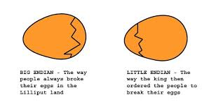
Endianness
47 vs 74

Slide 20
Endianness
Big Endian: low-order bits go on the right (47)
  I tend to think in big endian numbers, so examples in class will generally use this representation
  Networks generally use big endian (aka network byte order)
Little Endian: low-order bits go on the left (74)
  Most modern machines use this representation
I will try to always be clear about whether I'm using a big endian or little endian representation
When in doubt, ask!

Slide 21
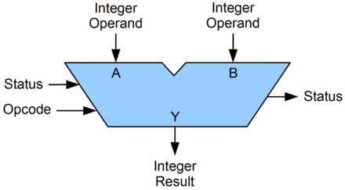
Arithmetic Logic Unit (ALU)
A circuit that performs bitwise operations and arithmetic on integer binary types
Status examples:
Carry-out
Zero
Negative
Overflow
parity
Opcode examples:
Add, Subtract
Increment, Decrement
AND, OR, XOR
Shift, Rotate

Slide 22
Bitwise vs Logical Operations in C
Bitwise Operators &, |, ~, ^
  View arguments as bit vectors
  operations applied bit-wise in parallel
Logical Operators &&, ||, !
  View 0 as “False”
  View anything nonzero as “True”
  Always return 0 or 1
  Short-circuit termination
Shift operators <<, >>
  Left shift fills with zeros
  For unsigned integers, right shift is logical (fills with zeros)

Slide 23
Exercise 4: Bitwise vs Logical Operations
Assume unsigned char data type (one byte). What do each of the following expressions evaluate to (interpreted as unsigned integers and expressed base-10)?
  ~226
  !226
  120 & 85
  120 | 85
  120 && 85
  120 || 85
  81 << 4
  81 << 2
  81 >> 4
  81 >> 2
Notes:
0xBE, 0xFF, 0x41
0x41, 0x7D
0x00, 0x01, 0x01
0x01, 0x01

Slide 24
Exercise 4: Bitwise vs Logical Operations
Assume unsigned char data type (one byte). What do each of the following expressions evaluate to (interpreted as unsigned integers and expressed base-10)?
  ~226
  !226
  120 & 85
  120 | 85
  120 && 85
  120 || 85
  81 << 4
  81 << 2
  81 >> 4
  81 >> 2
= ~11100010
= 00011101
= 29
= !11100010 = 00000000 = 0
= 01111000 & 01010101
= 01010000 = 80
= 01111000 | 01010101 = 01111101 = 125
= 01111000 && 01010101 = 00000001 = 1
= 01111000 || 01010101 = 00000001 = 1
= 01010001 << 4
= 00010000 = 16
= 01010001 << 2 = 01000100 = 68
= 01010001 >> 4 = 00000101 = 5
= 01010001 >> 2 = 00010100 = 20
Notes:
0xBE, 0xFF, 0x41
0x41, 0x7D
0x00, 0x01, 0x01
0x01, 0x01

Slide 25
Example: Using Bitwise Operations
What do these operations do?
x << 2
"multiply by 4"
x & 1
“x is odd”
(x + 7) & 0xFFFFFFF8
“round up to a multiple of 8”
Notes:
Note: int demo

Slide 26
Addition Example
Compute 5 + 6 assuming all ints are stored as
eight-bit (1 byte) unsigned values
1
0 0 0 0 0 1 0 1
+ 0 0 0 0 0 1 1 0
0
0
0
0
1
0
1
1
= 11 (Base-10)
Like you learned in grade school, only binary!
… and with a finite number of digits

Slide 27
Addition Example with Overflow
Compute 200 + 100 assuming all ints are stored as
eight-bit (1 byte) unsigned values
1
1
1 1 0 0 1 0 0 0
+ 0 1 1 0 0 1 0 0
0
0
1
0
1
1
0
0
= 44 (Base-10)
Like you learned in grade school, only binary!
… and with a finite number of digits

Slide 28

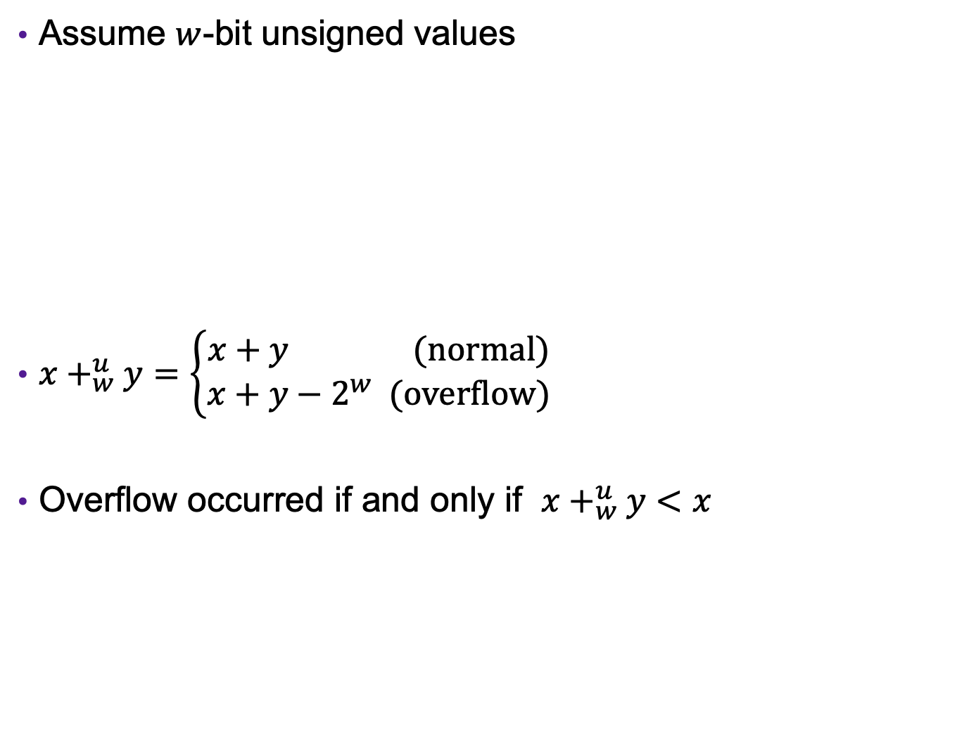



Error Cases
Assume $w$-bit unsigned values
$x+_{w}^{u}y=\left\{\begin{aligned}x+y (normal) \\ x+y−2^{w} (overflow)\end{aligned}\right.$
Overflow occurred if and only if $x+_{w}^{u}y<x$
$$0$$
$$2^{w}$$
$${2⋅2}^{w}$$
[ )
representable values
[ )
Possible values of $x+y$

Slide 29
Exercise 5: Binary Addition
Given the following 5-bit unsigned values, compute their sum and indicate whether an overflow occurred
x | y | x+y | overflow?
00010 | 00101
01100 | 00100
10100 | 10001

Slide 30
Exercise 5: Binary Addition
Given the following 5-bit unsigned values, compute their sum and indicate whether an overflow occurred
x | y | x+y | overflow?
00010 | 00101
01100 | 00100
10100 | 10001
00111
no
10000
no
00101
yes

Slide 31
Multiplication Example
Compute 5 x 6 assuming all ints are stored as
eight-bit (1 byte) unsigned values
0 0 0 0 0 1 0 1
x 0 0 0 0 0 1 1 0
0 0 0 0 0 0 0 0
0 0 0 0 0 1 0 1 0
0 0 0 0 0 1 0 1 0 0
+ _
0 0 0 1 1 1 1 0
= 30 (Base-10)
Like you learned in grade school, only binary!
… and with a finite number of digits

Slide 32
Multiplication Example
Compute 200 x 3 assuming all ints are stored as
eight-bit (1 byte) unsigned values
1 1 0 0 1 0 0 0
x 0 0 0 0 0 0 1 1
1 1 0 0 1 0 0 0
1 1 0 0 1 0 0 0 0
+ _
1 0
0 1 0 1 1 0 0 0
= 88 (Base-10)
Like you learned in grade school, only binary!
… and with a finite number of digits

Slide 33



Error Cases
Assume $w$-bit unsigned values
$x∗_{w}^{u}y=\left(x⋅y\right) mod 2^{w}$
$$0$$
$$2^{w}$$
$${2^{w}⋅2}^{w}$$
[ )
representable values
[ )
Possible values of $x∗y$

Slide 34
Exercise 6: Binary Multiplication
Given the following 3-bit unsigned values, compute their product and indicate whether an overflow occurred
x | y | x*y | overflow?
100 | 101
010 | 011
111 | 010

Slide 35
Exercise 6: Binary Multiplication
Given the following 3-bit unsigned values, compute their product and indicate whether an overflow occurred
x | y | x*y | overflow?
100 | 101
010 | 011
111 | 010
100
yes
110
no
110
yes

Slide 36
Multiplying with Shifts
Multiplication is slow
Bit shifting is kind of like multiplication, and is often faster
What is “x << 3”?
  x * 8 = x << 3
How could you perform “x * 10” with shifts and addition?
  x * 10 = x << 3 + x << 1
Most compilers will automatically replace multiplications with shifts where possible

Slide 37
Exercise 7: Feedback
Rate how well you think this recorded lecture worked
  Better than an in-person class
  About as well as an in-person class
  Less well than an in-person class, but you still learned something
  Total waste of time, you didn't learn anything
How much time did you spend on this video lecture (including time spent on exercises)?
Do you have any particular questions you’d like me to address in this week’s problem session?
Do you have any comments or feedback?

