Slide 1
Lecture 1: Introduction to Computer Systems
CS 105

Slide 2
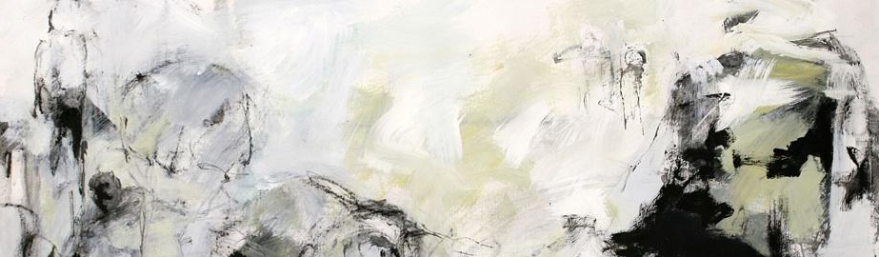



Abstraction
Correctness
Performance
Security
Notes:
This course is about understanding abstractions
How do low-level hardware and software details affect correctness, performance, and security
There are a couple of layers lower than what we’ll talk about in this class
Architecture
Integrated circuits

Slide 3
Correctness
Example 1: Is “x² ≥ 0”?
  Floats: Yes!
  Ints: ???
  DEMO
Notes:
Source: xkcd.com/571

Slide 4
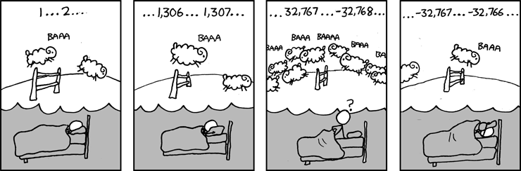
Correctness
Example 1: Is “x² ≥ 0”?
  Floats: Yes!
  Ints: ???
    40000 * 40000 ➙ 1600000000
    50000 * 50000 ➙ ??
Example 2: Is “(x + y) + z = x + (y + z)”?
  Ints: Yes!
  Floats: ???
  DEMO
Source: xkcd.com/571
Notes:
Source: xkcd.com/571

Slide 5
Correctness
Example 1: Is “x² ≥ 0”?
  Floats: Yes!
  Ints: ???
    40000 * 40000 ➙ 1600000000
    50000 * 50000 ➙ ??
Example 2: Is “(x + y) + z = x + (y + z)”?
  Ints: Yes!
  Floats:
    (2^30 + -2^30) + 3.14 ➙ 3.14
    2^30 + (-2^30 + 3.14) ➙ ??
Source: xkcd.com/571
Notes:
Source: xkcd.com/571

Slide 6
Computer Arithmetic
Does not generate random values
  Arithmetic operations have important mathematical properties
Cannot assume all “usual” mathematical properties
  Due to finiteness of representations
  Integer operations satisfy “ring” properties
    Commutativity, associativity, distributivity
  Floating point operations satisfy “ordering” properties
    Monotonicity, values of signs
Observation
  Need to understand which abstractions apply in which contexts
  Important issues for compiler writers and serious application programmers

Slide 7
Performance
How do these function compare asymptotically?
void copyij(int src[2048][2048],
int dst[2048][2048]){
int i,j;
for (i = 0; i < 2048; i++){
for (j = 0; j < 2048; j++){
dst[i][j] = src[i][j];
}
}
}
void copyji(int src[2048][2048],
int dst[2048][2048]){
int i,j;
for (j = 0; j < 2048; j++){
for (i = 0; i < 2048; i++){
dst[i][j] = src[i][j];
}
}
}
4.3ms
81.8ms
Hierarchical memory organization
Performance depends on access patterns
  Including how step through multi-dimensional array
Notes:
2.0 GHz Intel Core i7 Haswell

Slide 8
Real-World Performance
Constant factors matter too!
And even exact op count does not predict performance
  Easily see 10:1 performance range depending on how code written
  Must optimize at multiple levels: algorithm, data representations, procedures, and loops
Must understand system to optimize performance
  How programs compiled and executed
  How to measure program performance and identify bottlenecks
  How to improve performance without destroying code modularity and generality

Slide 9
Security
void admin_stuff(int authenticated){
if(authenticated){
// do admin stuff
}
}
int dontTryThisAtHome(char * user_input, int size) {
char data[size];
int ret = memcpy(*user_input, data);
return ret;
}
Notes:
Max stack size: ulimit -s

Slide 10
Let’s start at the beginning… Bits

Slide 11

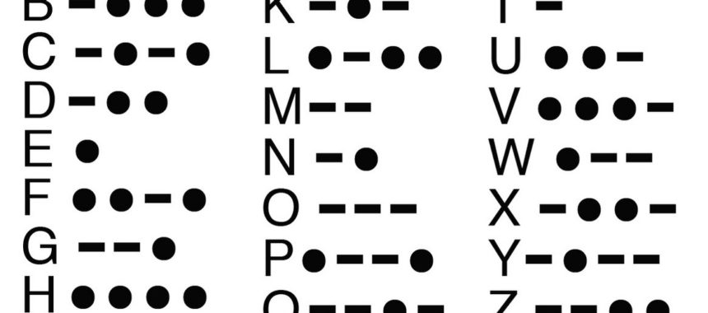




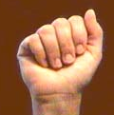
Bits
a bit is a binary digit that can have two possible values
can be physically represented with a two-state device
Notes:
We know how to build this.
We can also build ternary computers (mostly build in the Soviet Union)

Slide 12
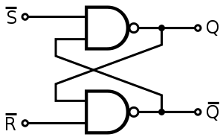
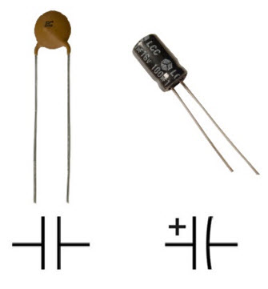
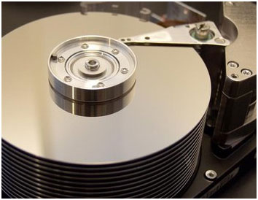
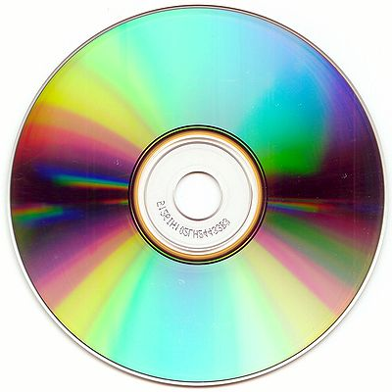

Storing bits
Static random-access memory (SRAM): stores each bit of data in a flip-flop, a circuit with two stable states
Dynamic Memory (DRAM): stores each bit of data in a capacitor, which stores energy in an electric field (or not)
Magnetic Disk: regions of the platter are magnetized with either N-S polarity or S-N polarity
Optical Disk: stores bits as tiny indentations (pits) or not (lands) that reflect light differently
Flash Disk: electrons are stored in one of two gates separated by oxide layers

Slide 13
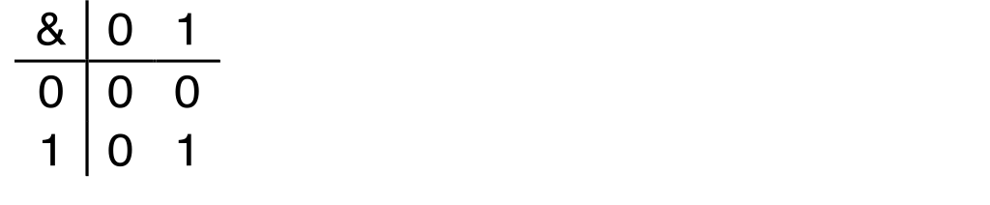
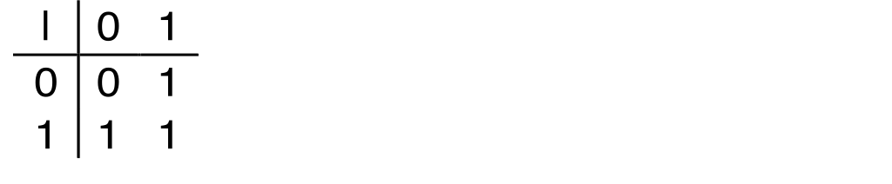
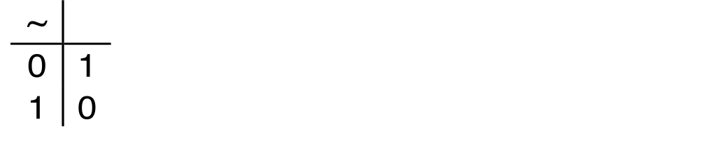
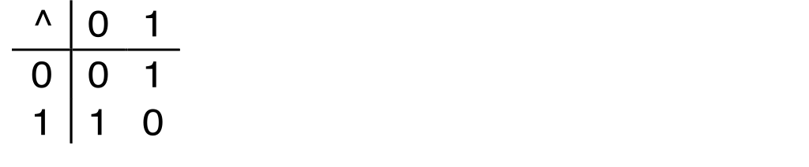
Boolean Algebra
Developed by George Boole in 19th Century
Algebraic representation of logic---encode “True” as 1 and “False” as 0
And
Or
Not
Exclusive-Or (Xor)

Slide 14
Exercise 1: Boolean Operations
Evaluate each of the following expressions
  1 | (~1)
  ~( 1 | 1)
  (~1) & 1
  ~( 1 ^ 1)

Slide 15
Exercise 1: Boolean Operations
Evaluate each of the following expressions
  1 | (~1)
  ~( 1 | 1)
  (~1) & 1
  ~( 1 ^ 1)
  = 1 | 0 = 1
  = ~1 = 0
  = 0 & 1 = 0
  = ~0 = 1

Slide 16
Bytes and Memory
Memory is an array of bits
1
1
1
0
1
1
0
0
1
0
0
0
1
0
1
1
1
1
0
0
1
0
1
0
0
0
1
1
0
1
1
0
Notes:
Hard to build something that lets you toggle each bit individually
Also, why would we want to?
Most of our operations work on groups of bits.

Slide 17
Bytes and Memory
bytes
Memory is an array of bits
A byte is a unit of eight bits
An index into the array is an address, location, or pointer
  Often expressed in hexadecimal
We speak of the value in memory at an address
  The value may be a single byte …
  … or a multi-byte quantity starting at that address
00110111
1
1
1
0
1
1
0
3
0
11010001
1
0
0
0
1
0
1
2
1
01010011
1
1
0
0
1
0
1
1
0
01101100
0
0
1
1
0
1
0
1
0
Notes:
A float sometimes takes up four bytes

Slide 18
General Boolean algebras
Bitwise operations on bytes
How does this map to set operations?
01101001
& 01010101
01000001
01101001
| 01010101
01111101
01101001
^ 01010101
00111100
~ 01010101
10101010
01000001
01111101
00111100
10101010
Notes:
Intersection, Union, Complement

Slide 19
Exercise 2 : Bitwise Operations
Assume:
a = 01101100
b = 10101010
What are the results of evaluating the following Boolean operations?
  ~a
  ~b
  a & b
  a | b
  a ^ b

Slide 20
Exercise 2 : Bitwise Operations
Assume:
a = 01101100
b = 10101010
What are the results of evaluating the following Boolean operations?
  ~a
  ~b
  a & b
  a | b
  a ^ b
  = ~01101100 = 10010011
  = ~10101010 = 01010101
  = 01101100 & 10101010 = 00101000
  = 01101100 | 10101010 = 11101110
  = 01101100 ^ 10101010 = 11000110

Slide 21
Bitwise vs Logical Operations in C
Bitwise Operators &, |, ~, ^
  View arguments as bit vectors
  operations applied bit-wise in parallel
Logical Operators &&, ||, !
  View 0 as “False”
  View anything nonzero as “True”
  Always return 0 or 1
  With short circuiting

Slide 22
Exercise 3: Bitwise vs Logical Operations
~01000001
~00000000
~~01000001
!01000001
!00000000
!!01000001
01101001 & 01010101
01101001 | 01010101
01101001 && 01010101
01101001 || 01010101
Notes:
0xBE, 0xFF, 0x41
0x41, 0x7D
0x00, 0x01, 0x01
0x01, 0x01

Slide 23
Exercise 3: Bitwise vs Logical Operations
~01000001
~00000000
~~01000001
!01000001
!00000000
!!01000001
01101001 & 01010101
01101001 | 01010101
01101001 && 01010101
01101001 || 01010101
10111110
11111111
01000001
00000000
00000001
00000001
01000001
01111101
00000001
00000001
Notes:
0xBE, 0xFF, 0x41
0x41, 0x7D
0x00, 0x01, 0x01
0x01, 0x01

Slide 24
Bit Shifting
Left Shift: x << y
  Shift bit-vector x left y positions
  Throw away extra bits on left
  Fill with 0’s on right
Right Shift: x >> y
  Shift bit-vector x right y positions
  Throw away extra bits on right
  Logical shift: Fill with 0’s on left
  Arithmetic shift: Replicate most significant bit on left
Undefined Behavior if you shift amount < 0 or ≥ word size
Choice between logical and arithmetic depends on the type of data
Notes:
Arithmetic Shift operations can be used for dividing or multiplying

Slide 25
Example: Bit Shifting
01101001 << 4
01101001 >>_{l} 2
01101001 >>_{a} 4
10010000
00011010
00000110
Notes:
Note: Shift demo

Slide 26
Exercise 4: Bit Shifting
10101010 << 4
10101010 >>_{l} 4
10101010 >>_{a} 4
10100000
00001010
11111010
Notes:
Note: Shift demo

Slide 27
Bits and Bytes Require Interpretation
00000000 00110101 00110000 00110001
might be interpreted as
  The integer 3,485,745₁₀
  A floating-point number close to 4.884569 x 10⁻³⁹
  The string “105”
  A portion of an image or video
  An address pointing to another place in memory
  Or… some user-defined type

Slide 28
Information is Bits + Context

