Slide 1
binary trees
David Kauchak
CS 62 – Fall 2026

Slide 2
Admin
OnDiskSort
Lab tomorrow
  Quiz at the beginning
  Review
Autocomplete assignment out tomorrow (start early)

Slide 3
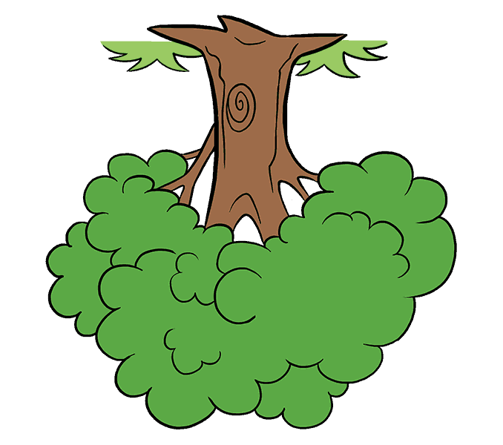
Trees
2
14
10
root
3
1
9
7
leaves
2
4
8
16

Slide 4
Trees
A set of nodes based on a parent-child relationship
  Each node has one parent
  Root has no parent
2
14
10
3
1
9
7
2
4
8
16

Slide 5
Another example
B
F
C
E
A
D

Slide 6
Another example: the lone wolf
12

Slide 7
Another example: the twig
D
B
A
F

Slide 8
Binary tree
2
14
10
Each parent has at most 2 children
3
1
9
7
2
8
16

Slide 9
Tree terminology
Edge:
one of the lines
Defined by a parent and child,
(C,F)
F
C
A
G
H
B
E
E
F
E

Slide 10
Tree terminology
Sibling: two nodes that share the same parent
E and F are siblings
F
C
A
G
H
B
E
E
F
E

Slide 11
Tree terminology
Subtree: a node and all of the nodes below it
subtree rooted at C
F
C
A
G
H
B
E
E
F
E

Slide 12
Tree terminology
Leaf: node without any children
Internal node: non-leaf node
F
C
A
G
H
B
E
E
F
E

Slide 13
Tree terminology
Simple path: a series of distinct nodes with edges between successive nodes
F-C-H-E
F
C
A
G
H
B
E
E
F
E

Slide 14
Tree terminology
Simple path: a series of distinct nodes with edges between successive nodes
F-C-H-E
Path length: number of edges on path
F
C
A
G
H
B
E
E
F
E
How long is this path?

Slide 15
Tree terminology
Simple path: a series of distinct nodes with edges between successive nodes
F-C-H-E
Path length: number of edges on path
F
C
A
G
H
B
E
E
F
E
3: (F,C), (C,H), (H,E)

Slide 16
Tree terminology
Height of a node: length of longest path from the node to a leaf
F
C
A
G
H
B
E
What is the height of C?
E
F
E

Slide 17
Tree terminology
Height of a node: length of longest path from the node to a leaf
F
C
A
G
H
B
E
What is the height of C?
E
F
E
2

Slide 18
Tree terminology
Height of a node: length of longest path from the node to a leaf
F
C
A
G
H
B
E
What is the height of C?
E
F

Slide 19
Tree terminology
Height of a node: length of longest path from the node to a leaf
F
C
A
G
H
B
E
What is the height of C?
E
F
2

Slide 20
Tree terminology
Height of the tree: height of the root (longest path from root to a leaf)
F
C
A
G
H
B
E
What is the height of the tree?
E
F
E

Slide 21
Tree terminology
Height of the tree: height of the root (longest path from root to a leaf)
F
C
A
G
H
B
E
What is the height of the tree?
E
F
E
3

Slide 22
Tree terminology
What is the height of the tree?
D
B
A
F

Slide 23
Tree terminology
What is the height of the tree?
D
B
3
A
F

Slide 24
Tree terminology
Ancestors: the “ancestors” of a node are any nodes along the path from that node to the root (including the root)
F
C
A
G
H
B
E
E
F
E
The ancestors of G: C and F

Slide 25
Tree terminology
Ancestors: the “ancestors” of a node are any nodes along the path from that node to the root (including the root)
F
C
A
G
H
B
E
E
F
E
What are the ancestors of B?

Slide 26
Tree terminology
Ancestors: the “ancestors” of a node are any nodes along the path from that node to the root (including the root)
F
C
A
G
H
B
E
E
F
E
The ancestors of B: A and F

Slide 27
Tree terminology
Ancestors: the “ancestors” of a node are any nodes along the path from that node to the root (including the root)
F
C
A
G
H
B
E
E
F
E
What are the ancestors of F?

Slide 28
Tree terminology
Ancestors: the “ancestors” of a node are any nodes along the path from that node to the root (including the root)
F
C
A
G
H
B
E
E
F
E
The ancestors of F: none

Slide 29
Tree terminology
Descendant: the descendants of a node X are all nodes that have X as an ancestor (i.e., all nodes blow a given node)
F
C
A
G
H
B
E
E
F
E
The descendants of C: E, G, F, H, E

Slide 30
Tree terminology
Degree of node: number of children
Degree of tree (arity): max degree of any of the nodes
F
C
A
G
H
B
E
What is the degree of the tree?
E
F
E

Slide 31
Tree terminology
Degree of node: number of children
Degree of tree (arity): max degree of any of the nodes
F
C
A
G
H
B
E
What is the degree of the tree?
2
E
E
F

Slide 32
Tree terminology
Degree of node: number of children
Degree of tree (arity): max degree of any of the nodes
2
14
10
3
1
9
7
What is the degree of the tree?
2
4
8
16

Slide 33
Tree terminology
Degree of node: number of children
Degree of tree (arity): max degree of any of the nodes
2
14
10
3
1
9
7
What is the degree of the tree?
3
16
2
4
8

Slide 34
Tree terminology
Level/depth of node:
Root is 0
Level(child) = 1 + level(parent)
(also: length of path from root to node)
F
C
A
G
H
B
E
What is the depth of G?
E
F
E

Slide 35
Tree terminology
Level/depth of node:
Root is 0
Level(child) = 1 + level(parent)
(also: length of path from root to node)
F
C
A
G
H
B
E
What is the depth of G?
E
F
E
2

Slide 36
Worksheet problem #1

Slide 37
Tree terminology (almost there!)
Full tree: a binary tree where every node has 0 or 2 children
Complete: All levels except the last are completely filled and all nodes on the last level are on the left

Slide 38
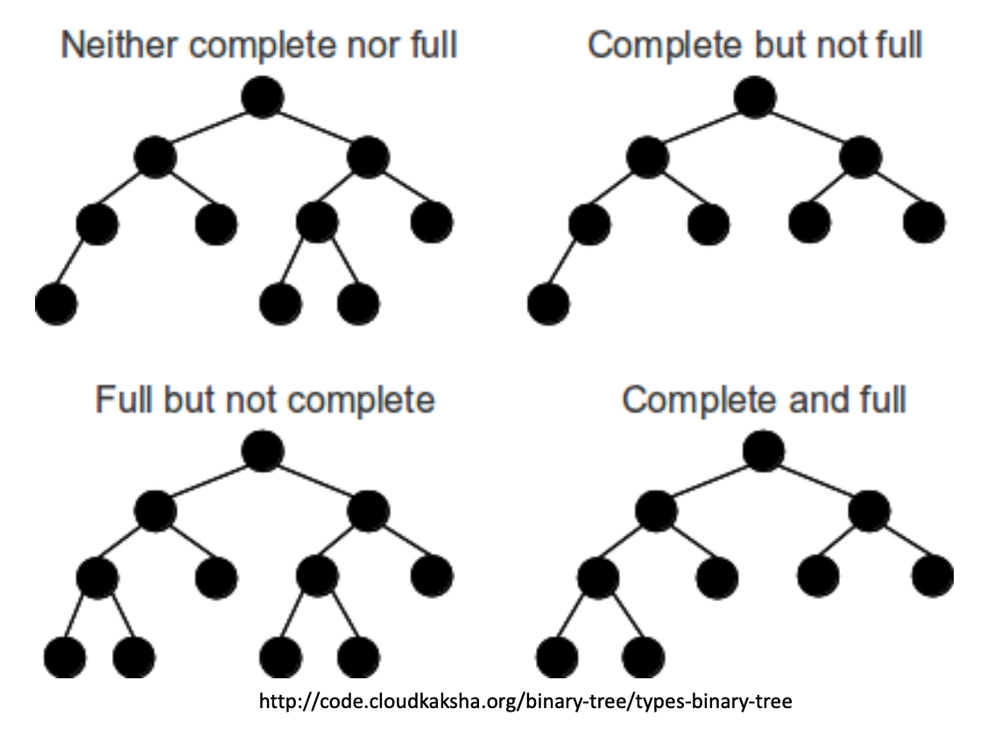
Full + Complete

Slide 39
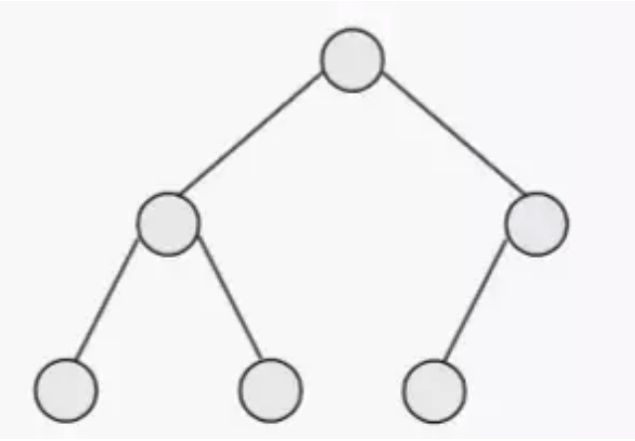

Full + Complete: worksheet #2
12
Full tree: a binary tree where every node has 0 or 2 children
Complete: All levels except the last are completely filled and all nodes on the last level are on the left

Slide 40
Full + Complete?
12
Complete
Full + Complete
Neither

Slide 41
Nodes in a binary tree
F
What is the most nodes we can have at a level k?
C
A
Level = 2
G
H
B
E
E
F

Slide 42
Nodes in a binary tree
F
What is the most nodes we can have at a level k?
C
A
Level = 2
G
H
B
E
At most 2^{k} nodes (when every node above it has two children)
E
F

Slide 43
Nodes in a binary tree
F
What is the most nodes we can have in a tree of height h?
C
A
G
H
B
E
E
F

Slide 44
Nodes in a binary tree
F
What is the most nodes we can have in a tree of height h?
C
A
G
H
B
E
$$1+2+4+8+…+2h=2^{h+1}−1$$
When the tree is full and complete!

Slide 45
Bounding the nodes in a binary tree
If we have n nodes in the tree, what is the smallest height we can have?
F
C
A
G
H
B
E
$$1+2+4+8+…+2h=2^{h+1}−1$$
When the tree is full and complete!

Slide 46

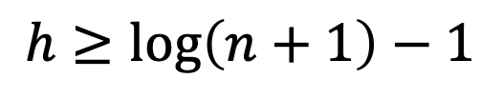
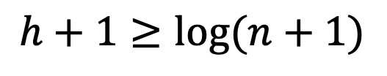


Bounding the nodes in a binary tree
$$n≤2^{h+1}−1$$
full+ complete binary tree
F
$$n+1≤2^{h+1}$$
C
A
$$2^{h+1}≥n+1$$
$$h+1≥log⁡(n+1)$$
G
H
B
E
$$h≥\log\left(n+1\right)−1$$

Slide 47
Nodes in a binary tree
F
What is the smallest number of nodes we can have in a tree of height h?
C
A
G
H
B
E
E
F

Slide 48
Nodes in a binary tree
D
B
For a tree of height h, what is the fewest nodes we can have in the tree?
A
h+1 (the twig!)
F

Slide 49
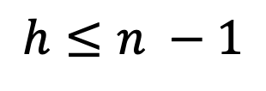
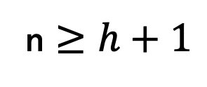
Nodes in a binary tree
D
B
Given a tree of n nodes, what is the largest h can be?
A
n $≥h+1$
$$h≤n −1$$
F

Slide 50
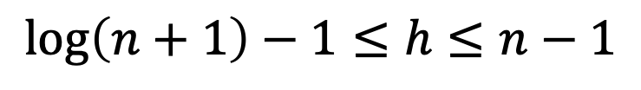
Nodes in a binary tree
F
C
A
G
H
B
E
$$\log\left(n+1\right)−1≤h≤n−1$$
Height is somewhere between log(n) of nodes and n nodes

Slide 51
Implementing a binary tree
How do we do it?

Slide 52
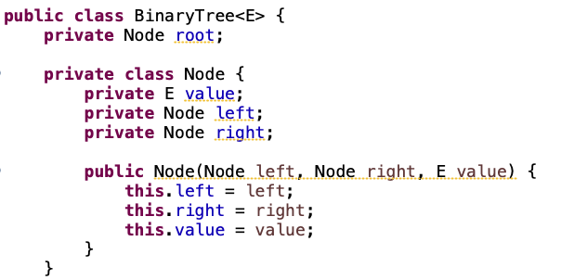
Implementing a binary tree

Slide 53
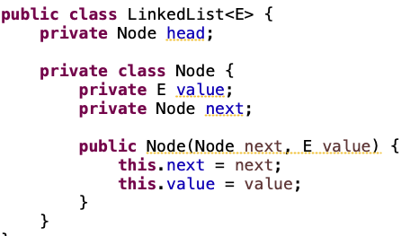
Recursive data structure!

Slide 54
Tree traversals
Inorder(node):
Inorder(left)
visit node (e.g., print)
Inorder(right)
F
C
A
G
H
B
E
E
F
What would be printed out?

Slide 55
Tree traversals
Inorder(node):
Inorder(left)
visit node (e.g., print)
Inorder(right)
F
C
A
G
H
B
E
E
F
E G F C H F B A E

Slide 56
Tree traversals
Postorder(node):
Postorder(left)
Postorder(right)
visit node (e.g., print)
F
C
A
G
H
B
E
E
F
What would be printed out?

Slide 57
Tree traversals
Postorder(node):
Postorder(left)
Postorder(right)
visit node (e.g., print)
F
C
A
G
H
B
E
E
F
E F G H C B E A F

Slide 58
Tree traversals
Preorder(node):
visit node (e.g., print)
Preorder(left)
Preorder(right)
F
C
A
G
H
B
E
E
F
What would be printed out?

Slide 59
Tree traversals
Preorder(node):
visit node (e.g., print)
Preorder(left)
Preorder(right)
F
C
A
G
H
B
E
E
F
F C G E F H A B E

Slide 60
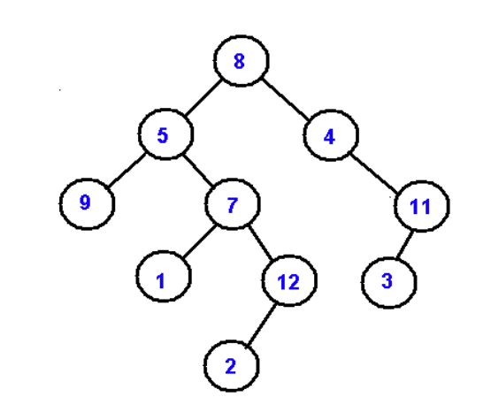
in-order, post-order, pre-order
Inorder(node):
Inorder(left)
visit node (e.g., print)
Inorder(right)
Postorder(node):
Postorder(left)
Postorder(right)
visit node (e.g., print)
Preorder(node):
visit node (e.g., print)
Preorder(left)
Preorder(right)

