Slide 1
Hashtables 2
David Kauchak
CS 62 – Fall 2026

Slide 2
Admin
Assignment 6 out (OnDiskSort)
Drop two lowest quizzes

Slide 3
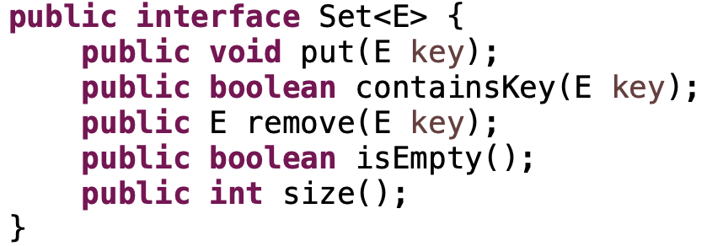
Sets
An unordered collection
Things can be added and removes
Check if things are in the set

Slide 4
Why not just arrays?
array must be as large as the universe of keys
universe of keys - U
Array

Slide 5
Why not just arrays?
array must be as large as the universe of keys
universe of keys - U
space of actual keys used is often much, much smaller than the universe of keys
actual
keys, n
Array

Slide 6
Hashtables
Using an array is still a good idea
Key idea: need to translate from the key into an index in the array
Array
null
null
null
null
null
5
null
7
null
null
null
null
null
null
null
m

Slide 7
Hash function, h
A hash function is a function that maps the universe of keys to a restricted range (e.g., the size of an array)
universe of keys - U
hash function, h: U ➔m
m << |U|

Slide 8
Hash function, h
A hash function is a function that maps the universe of keys to a restricted range (e.g., the size of an array)
universe of keys - U
hash function, h: U ➔m
m << |U|

Slide 9
Hash function, h
A hash function is a function that maps the universe of keys to a restricted range (e.g., the size of an array)
universe of keys - U
hash function, h: U ➔m
m << |U|

Slide 10
Collisions
A collision occurs when h(x) = h(y), but x ≠ y
A good hash function will minimize the number of collisions
Because the number of hashtable (array) entries is less than the possible keys (i.e. m < |U|) collisions are inevitable!
We need to handle collisions!
Collision resolution techniques?

Slide 11
Collision resolution by chaining
Hashtable consists of an array of linked lists
When a collision occurs, the element is added to linked list at that location
If two entries x ≠ y have the same hash value h(x) = h(y), then table[h(x)] will contain a linked list with both values
null
null
null
null
null
null
null
null
null
null
null
null

Slide 12
Open addressing
Keeping around an array of linked lists can be inefficient and a hassle
Like to keep the hashtable as just an array of elements (no pointers)
How do we deal with collisions?
  compute another slot in the hashtable to examine

Slide 13
Hash functions with open addressing
Hash function must define a probe sequence which is the list of slots to examine when calling put or containsKey
The hash function takes an additional parameter i which is the number of collisions that have already occurred
h(key, i)
h(k, 0): first place to look
h(k, 1): if there is a collision in the first place, where to look next
h(k, 2): If both first and second places are full, where to look next
…
Notes:
If we didn’t do this, we wouldn’t visit all of the entries in the table!

Slide 14
Hash functions with open addressing
Hash function must define a probe sequence which is the list of slots to examine when calling put or containsKey
The hash function takes an additional parameter i which is the number of collisions that have already occurred
The probe sequence must be a permutation of every hashtable entry. Why?
{ h(k,0), h(k,1), h(k,2), …, h(k, m-1) } is a permutation of
{ 0, 1, 2, 3, …, m-1 }
Notes:
If we didn’t do this, we wouldn’t visit all of the entries in the table!

Slide 15
Hash functions with open addressing
Hash function must define a probe sequence which is the list of slots to examine when calling put or containsKey
The hash function takes an additional parameter i which is the number of collisions that have already occurred
The probe sequence must be a permutation of every hashtable entry. Why?
If not, we wouldn’t explore all the possible locations in the table!
Notes:
If we didn’t do this, we wouldn’t visit all of the entries in the table!

Slide 16
Probe sequence
h(k, 0)

Slide 17
Probe sequence
h(k, 1)

Slide 18
Probe sequence
h(k, 2)

Slide 19
Probe sequence
h(k, 3)

Slide 20
Probe sequence
h(k, …)
must visit all locations
…

Slide 21
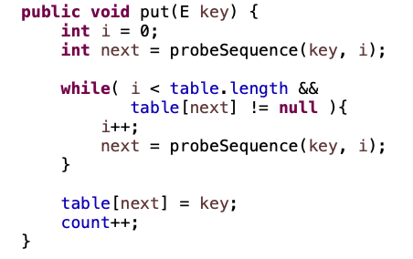
Open addressing: put
What does this code do?

Slide 22
Open addressing: put
get the first entry to check

Slide 23
Open addressing: put
as long as we haven’t check all entries and the entry isn’t empty

Slide 24
Open addressing: put
get the next entry to check

Slide 25
Open addressing: put
put the key into the table (assumes table wasn’t full)

Slide 26
Open addressing
containsKey?
remove?

Slide 27
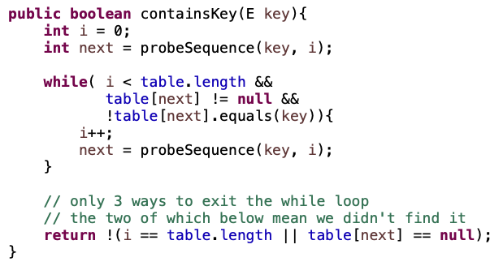
Open addressing: containsKey

Slide 28
Open addressing: containsKey
very similar to put!
also need to check if we’ve found the key

Slide 29
Open addressing: containsKey
return false if we searched the whole table or we got to a null entry

Slide 30
Open addressing: remove
Two options:
  mark node as “deleted” (rather than null)
    modify containsKey to continue looking if a “deleted” node is seen
    modify put to fill in “deleted” entries
    increases search times!
  if a lot of deleting will happen, use chaining

Slide 31
Probing schemes
Linear probing – if a collision occurs, go to the next slot
  h’(k,i) = (h(k) + i) mod m
  Does it meet our requirement that it visits every slot?
  for example, m = 7 and h(k) = 4
h(k,0) = 4
h(k,1) = 5
h(k,2) = 6
h(k,3) = 0
h(k,3) = 1

Slide 32
Linear probing: put
h( , 0)

Slide 33
Linear probing: put
h( , 1)

Slide 34
Linear probing: put
h( , 2)

Slide 35
Linear probing: put
h( , 3)

Slide 36
Linear probing: put
h( , 3)

Slide 37
Linear probing
Problem:
  primary clustering – long runs of occupied slots tend to build up and these tend to grow
any value here results in an increase in the cluster
become more and more probable for a value to end up in that range

Slide 38
Quadratic probing
h(k,i) = (h(k) + c₁i + c₂i²) mod m
Rather than a linear sequence, we probe based on a quadratic function
Problems/challenges:
  must pick constants and m so that we have a proper probe sequence
  if h(x) = h(y), then h(x,i) = h(y,i) for all i
  secondary clustering

Slide 39
Double hashing
Probe sequence is determined by a second hash function
h(k,i) = (h₁(k) + i(h₂(k))) mod m
Problems/challenges:
  h₂(k) must visit all possible positions in the table

Slide 40
Running time of put and containsKey for open addressing
Depends on the hash function/probe sequence
Worst case?
  O(n) – probe sequence visits every full entry first before finding an empty

Slide 41
Running time of put and containsKey for open addressing
Average case?
We have to make at least one probe

Slide 42
Running time of put and containsKey for open addressing
Average case?
What is the probability that the first probe will not be successful (assume uniform hashing function)?
n/m = α

Slide 43
Running time of put and containsKey for open addressing
Average case?
What is the probability that the first two probed slots will not be successful?
~α²
why ‘~’?

Slide 44
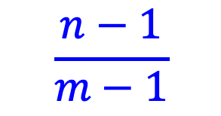
Running time of put and containsKey for open addressing
Average case?
What is the probability that the first two probed slots will not be successful?
~α²
$$\frac{n−1}{m−1}$$
Technically, second probe is:
Notes:
For largish, n and m, this is close to alpha

Slide 45
Running time of put and containsKey for open addressing
Average case?
What is the probability that the first three probed slots will not be successful?
~α³

Slide 46
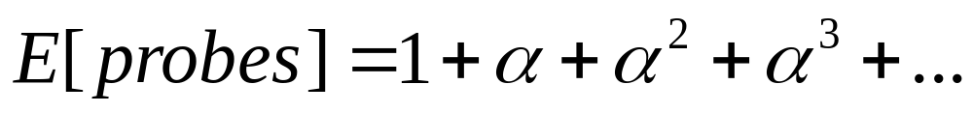
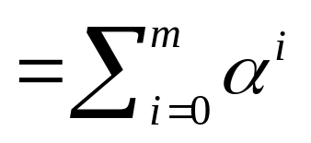
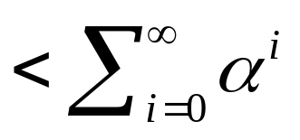
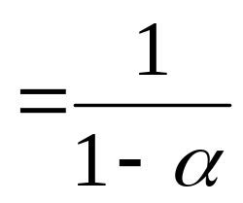
Running time of insert and search for open addressing
Average case: expected number of probes
  sum of the probability of making 1 probe, 2 probes, 3 probes, …

Slide 47
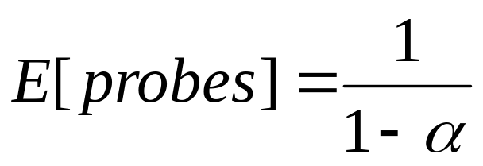
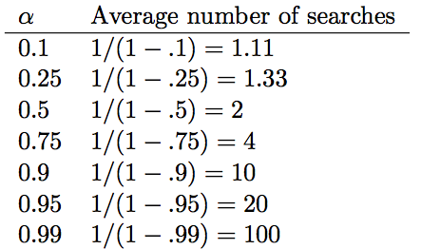
Average number of probes

Slide 48
How big should a hashtable be?
A good rule of thumb is the hashtable should be around half full
What happens when the hashtable gets full?
  Copy: Create a new table and copy the values over
    results in one expensive put
    simple to implement
  Amortized copy: When a certain ratio is hit, grow the table, but copy the entries over a few at a time with every insert
    no single put is expensive and can guarantee per put performance
    more complicated to implement

Slide 49
Java implementations
HashSet:
https://docs.oracle.com/javase/8/docs/api/java/util/HashSet.html
HashMap: https://docs.oracle.com/javase/8/docs/api/java/util/HashMap.html

Slide 50
To the code… Abstract classes
A blend of a traditional class and an interface
Some method implementations are defined
Others, have only the method header defined (called ”abstract” methods)
Cannot instantiate an abstract class: must inherit from them and implement the abstract methods
For example: https://github.com/pomonaCS62-fa2026/LectureCode/blob/main/Hashtables/OpenAddressedHashtable.java

Slide 51
Abstract classes in Java already
AbstractList:
https://docs.oracle.com/javase/8/docs/api/java/util/AbstractList.html
AbstractSet:
https://docs.oracle.com/javase/8/docs/api/java/util/AbstractSet.html

Slide 52
To the code…
https://github.com/pomonaCS62-fa2026/LectureCode/tree/main/Hashtables

