Slide 1
Safety And Electronics
Mobile Robotics
Anthony J. Clark

Slide 2
Today
Safety
Component specifications
Review requirements
Wiring diagrams
Coding with Toit

Slide 3
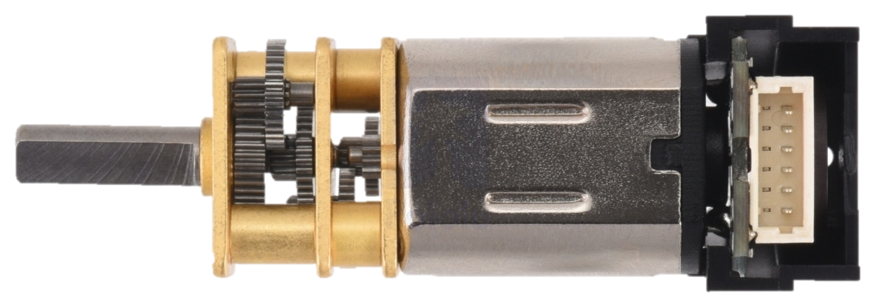
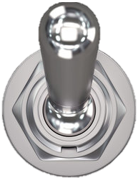
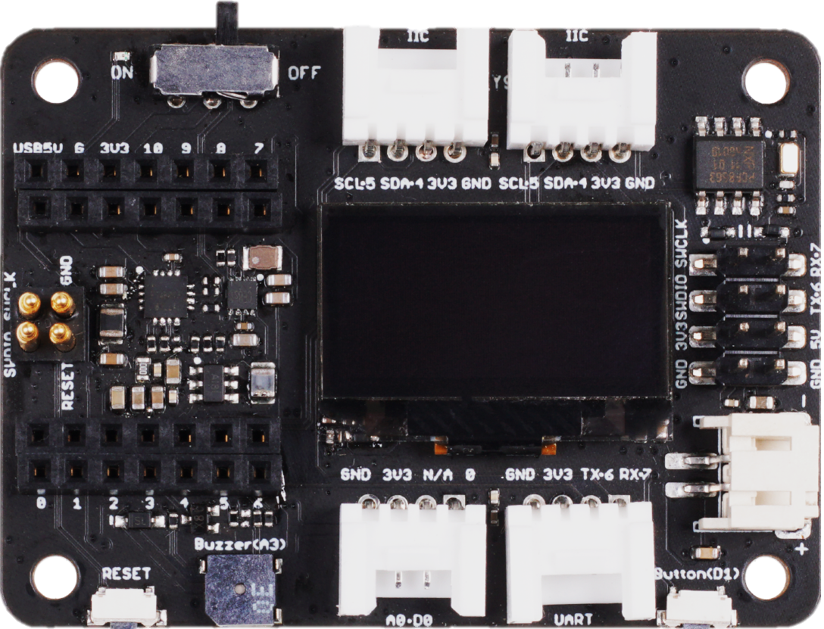
M1
M2
GND
VCC
C1
C2
C2
C1
VCC
GND
M2
M1
GND
GND
BAT
VCC
BAT
GPIO 1
USB 5V
BENBL
BOUT2
BAT
GPIO 2
GND
BAT
BPHASE
BOUT1
GPIO 3
3.3 V
AENBL
AOUT2
GPIO 4
GPIO 9
APHASE
AOUT1
I²C SDA
GPIO 8
MODE
VMM
I²C SCL
GPIO 7
GPIO 43
GPIO 44
BAT
GND
BAT
GND
GND

Slide 4
Basic Circuit Theory: Ohm’s Law
V (V)
Voltage
I (A)
Current
R (Ω)
Resistance
P = IV
Notes:
voltage “pushes” electrons through conductive material
Some materials are better at conducting current than others.
The amount of electron flow is called current
Resistors are specially formulated to resist the flow of electrons
Voltage -> pressure
Current -> flow rate
Resistance -> limiter

Slide 6
Battery Safety
Warning: Lithium-ion batteries may explode or burn due to improper use. Using these batteries for purposes not intended by the manufacturer, including outside a battery pack and/or without a BMS, may cause severe injury and damage. We are not responsible for any injuries caused by lithium-ion batteries - use at your own risk.
Li-Ion Wholesale

Slide 7
Selected Battery Safety Tips
Charging and discharging
Never completely discharge batteries (3.2V for this class)
Never charge batteries to more than their full charge voltage (4.2V)
Do not charge unattended or leave in the charger unattended
Storing and transporting
Do not store li-ion batteries fully charged for an extended period (i.e., weeks)
Store batteries at 3.5 to 3.7V
Store and transport batteries in a packed, non-conductive, and safe container
Fire safety
If a rechargeable battery catches fire, the FAA recommends pouring water or soda on the battery and surrounding areas - ideally, use a foam extinguisher to quell the fire

Slide 8
Selected Electronics Safety Practices
Always check for loose wires and debris before powering your circuit
Always disconnect power before adding connections
Keep an eye on your battery's voltage level
Keep an eye on the heat being generated by your components
Be careful with static electricity (you can accidentally fry a component)
Read the entire list of safety tips on the course website

Slide 9
Today
Safety
Component specifications
Microcontroller: ESP32-S3
Peripheral: Expansion Board
Motors: Micro Metal Gearmotors
Motor Driver: DRV8835
Breadboard
Power System: Battery, Switch, Voltage Tester

Slide 10
Specifications
Processor | ESP32-S3R8 Xtensa LX7 dual-core, 32-bit processor that operates at up to 240 MHz
Wireless | Complete 2.4GHz Wi-Fi subsystem BLE: Bluetooth 5.0, Bluetooth mesh
Memory | On-chip 8M PSRAM & 8MB Flash
Interface | 1x UART, 1x IIC, 1x IIS, 1x SPI, 11x GPIOs (PWM), 9x ADC, 1x User LED, 1x Charge LED 1x Reset button, 1x Boot button
Dimensions | 21 x 17.8mm
Power | Input voltage (Type-C): 5V Input voltage (BAT): 4.2V
 | Circuit operating Voltage (ready to operate): - Type-C: 5V@19mA - BAT: 3.8V@22mA
 | Charging battery current: 100mA
Low Power Consumption Model | Modem-sleep Model: 3.8V/25 mA Light-sleep Model: 3.8V/2 mA Deep Sleep Model: 3.8V/14 μA
Wi-Fi Enabled Power Consumption | Active Model: ~ 100 mA
BLE Enabled Power Consumption | Active Model: ~ 85 mA
Working Temperature | -40°C ~ 65°C
GPIO Pin Limits | About 20 mA

Slide 11
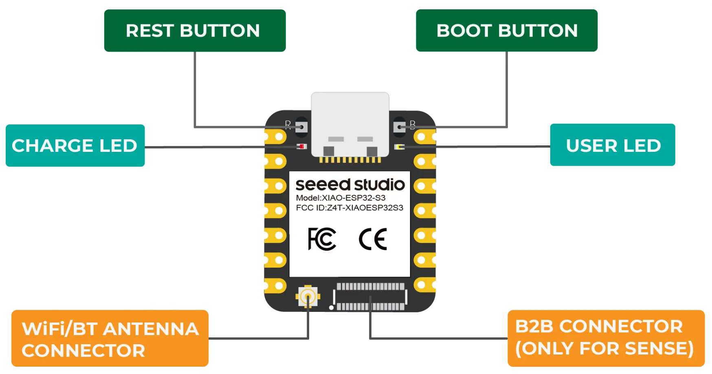
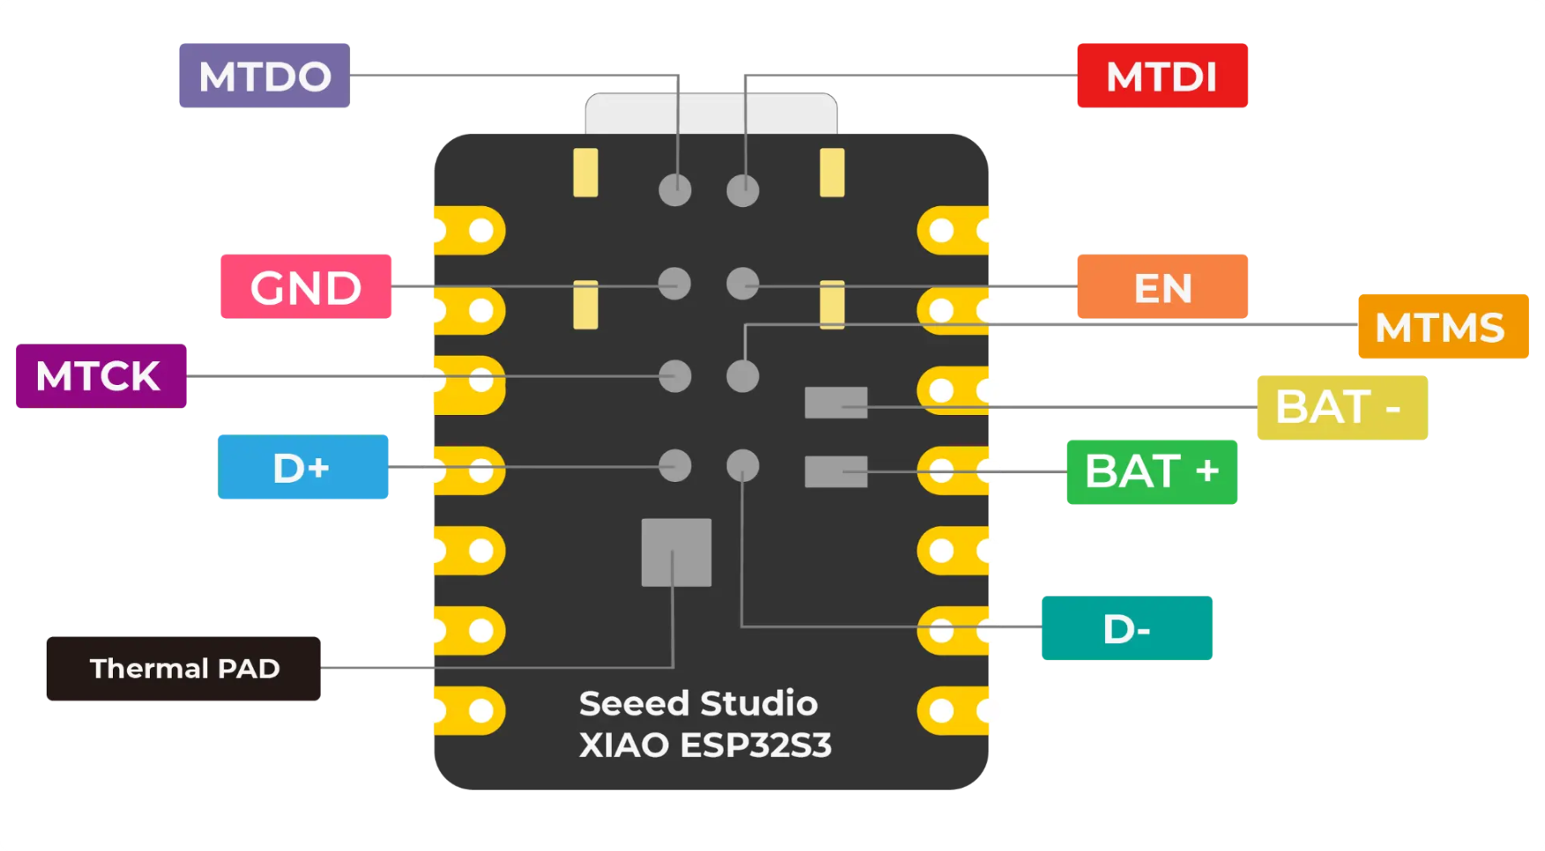
Getting Started with Seeed Studio XIAO ESP32S3 (Sense) | Seeed Studio Wiki
High-Performance Dev Board with Wi-Fi and BLE - XIAO ESP32S3

Slide 12
Getting Started with Seeed Studio XIAO ESP32S3 (Sense) | Seeed Studio Wiki
High-Performance Dev Board with Wi-Fi and BLE - XIAO ESP32S3

Slide 13
#define USB_VID 0x2886
#define USB_PID 0x0056
static const uint8_t LED_BUILTIN = 21;
#define BUILTIN_LED LED_BUILTIN // backward compatibility
#define LED_BUILTIN LED_BUILTIN // allow testing #ifdef LED_BUILTIN
static const uint8_t TX = 43;
static const uint8_t RX = 44;
static const uint8_t SDA = 5;
static const uint8_t SCL = 6;
static const uint8_t SS = 44;
static const uint8_t MOSI = 9;
static const uint8_t MISO = 8;
static const uint8_t SCK = 7;
static const uint8_t A0 = 1;
static const uint8_t A1 = 2;
static const uint8_t A2 = 3;
static const uint8_t A3 = 4;
static const uint8_t A4 = 5;
static const uint8_t A5 = 6;
static const uint8_t A8 = 7;
static const uint8_t A9 = 8;
static const uint8_t A10 = 9;
static const uint8_t D0 = 1;
static const uint8_t D1 = 2;
static const uint8_t D2 = 3;
static const uint8_t D3 = 4;
static const uint8_t D4 = 5;
static const uint8_t D5 = 6;
static const uint8_t D6 = 43;
static const uint8_t D7 = 44;
static const uint8_t D8 = 7;
static const uint8_t D9 = 8;
static const uint8_t D10 = 9;
static const uint8_t T1 = 1;
static const uint8_t T2 = 2;
static const uint8_t T3 = 3;
static const uint8_t T4 = 4;
static const uint8_t T5 = 5;
static const uint8_t T6 = 6;
static const uint8_t T7 = 7;
static const uint8_t T8 = 8;
static const uint8_t T9 = 9;
Arduino Pin Configuration (useful when Seeed Studio documentation is lacking)

Slide 14
Specifications
Operating voltage | 5V / 3.7V Lithium Battery
Charging current | 460mA (Max)
RTC timer precision | ± 1.5S/DAY(25°C)
RTC battery | CR1220
Display | 0.96" OLED display
Display Current | 15 mA
Expandable memory | MicroSD card
Grove Interface | Grove IIC*2, Grove UART*1, A0/D0 Grove*1
Other External Equipment | Passive buzzer, user button, 5V servo connector
Expansion Board Base for XIAO | Seeed Studio Wiki
Seeed Studio XIAO Expansion board for XIAO Series with Grove OLED - IIC, Uart, Analog/Digital - Seeed Studio

Slide 15
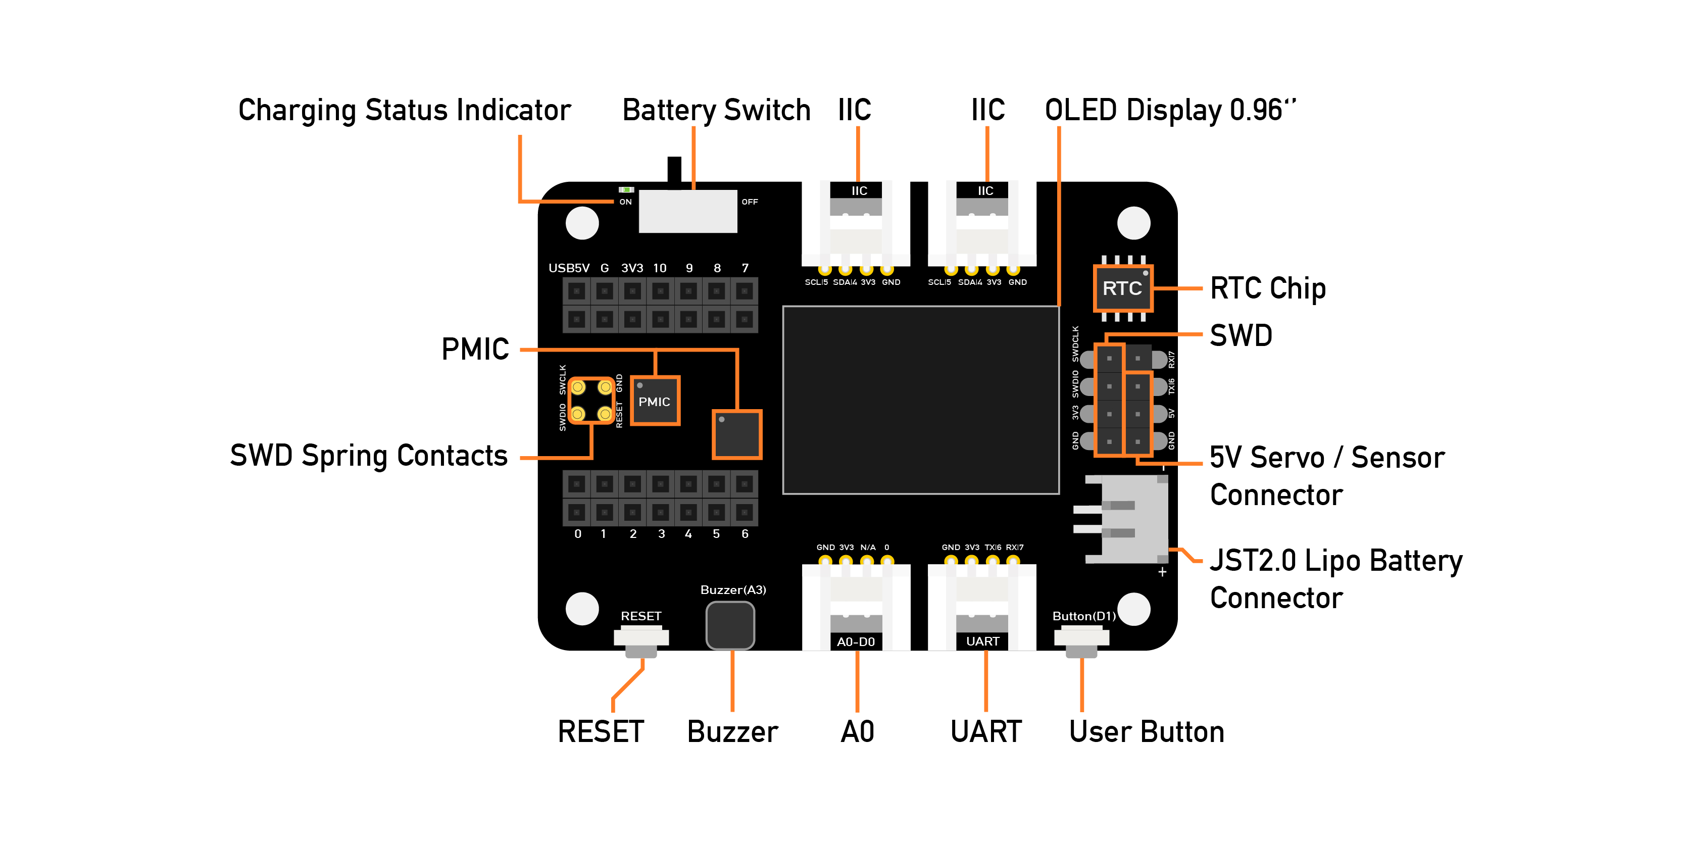
Expansion Board Base for XIAO | Seeed Studio Wiki
Seeed Studio XIAO Expansion board for XIAO Series with Grove OLED - IIC, Uart, Analog/Digital - Seeed Studio

Slide 16
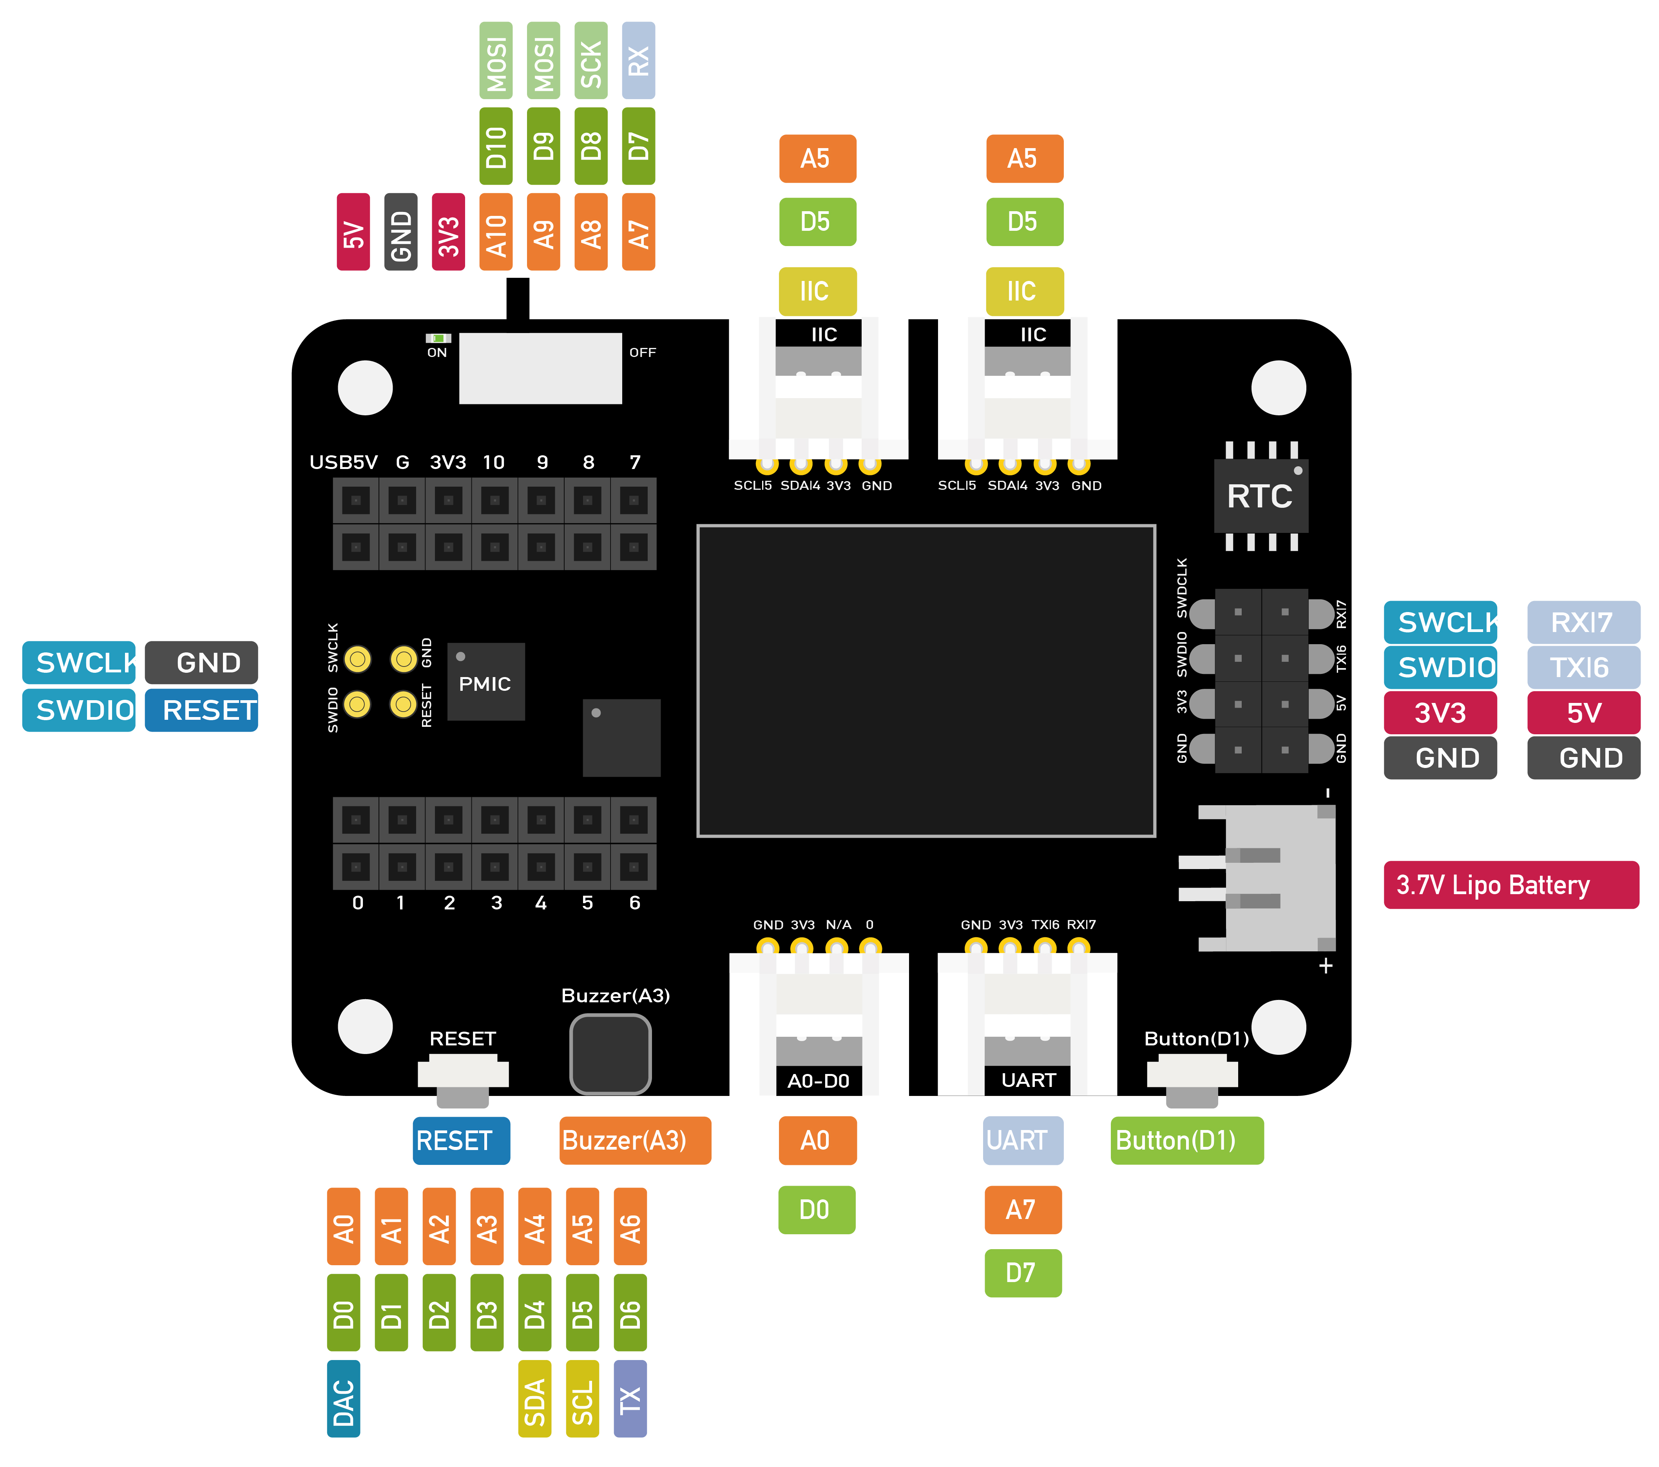

Slide 17
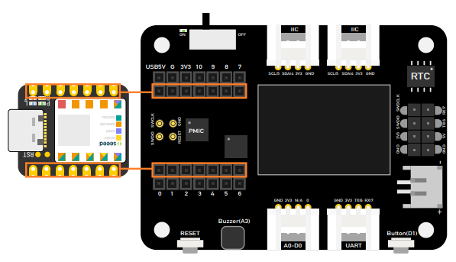
Expansion Board Base for XIAO | Seeed Studio Wiki
Seeed Studio XIAO Expansion board for XIAO Series with Grove OLED - IIC, Uart, Analog/Digital - Seeed Studio

Slide 18
Battery
Expansion Board Base for XIAO | Seeed Studio Wiki
Seeed Studio XIAO Expansion board for XIAO Series with Grove OLED - IIC, Uart, Analog/Digital - Seeed Studio

Slide 19
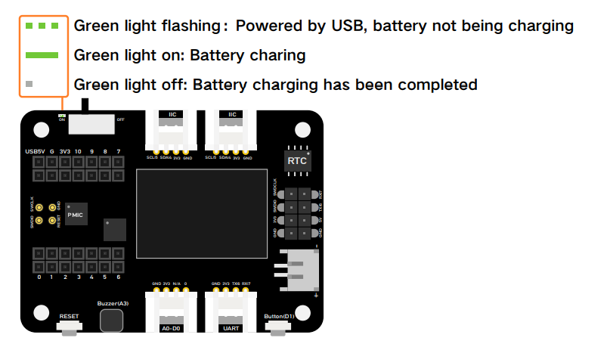
Expansion Board Base for XIAO | Seeed Studio Wiki
Seeed Studio XIAO Expansion board for XIAO Series with Grove OLED - IIC, Uart, Analog/Digital - Seeed Studio

Slide 20
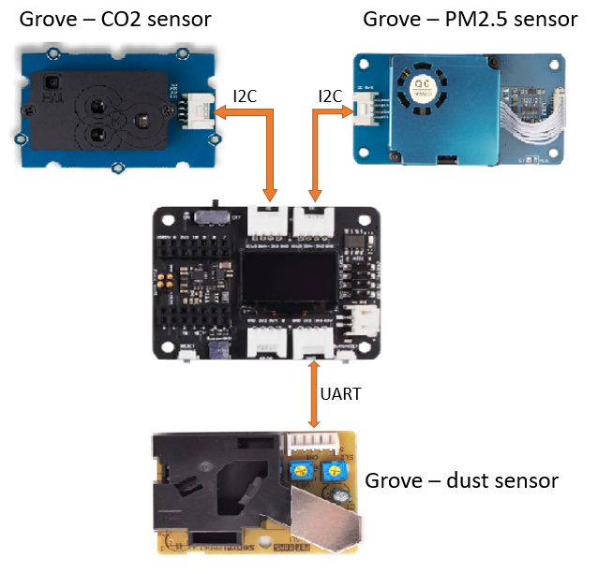
Expansion Board Base for XIAO | Seeed Studio Wiki
Seeed Studio XIAO Expansion board for XIAO Series with Grove OLED - IIC, Uart, Analog/Digital - Seeed Studio

Slide 21
Specifications
Rated Voltage | 6.0V
Motor Speed | 15000 RPM
Gear Reduction Ratio | 50:1
Reducer Length | 9.0 mm
No-Load Speed | 310 rpm@6V
No-Load Current | 60 mA
Rated Torque | 0.35 kg.cm
Rated Speed | 180 rpm@6V
Current Rating | 170 mA
Instant Torque | 0.8 kg.cm
Hall Feedback Resolution | 700
Weight | 18 g
Micro DC Geared motor w/Encoder - 6V 310RPM 50:1 - DFRobot

Slide 22
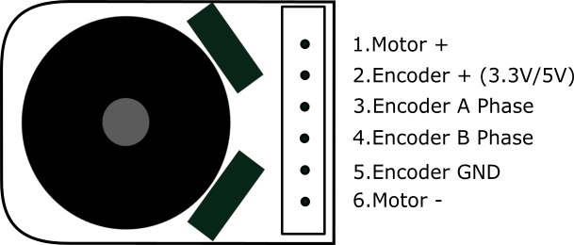
Micro DC Geared motor w/Encoder - 6V 310RPM 50:1 - DFRobot

Slide 23
Notes:
Can’t use GPIO pins directly
H-Bridge (4 switches)

Slide 24
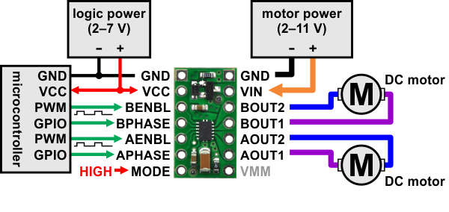
Datasheet from TI (PDF)
Pololu - DRV8835 Dual Motor Driver Carrier

Slide 25
Specifications
Motor driver: | DRV8835
Motor channels: | 2
Minimum operating voltage: | 0 V
Maximum operating voltage: | 11 V
Continuous output current per channel: | 1.2 A²
Peak output current per channel: | 1.5 A
Continuous paralleled output current: | 2.4 A²
Maximum PWM frequency: | 250 kHz
Minimum logic voltage: | 2 V
Maximum logic voltage: | 7 V
Reverse voltage protection?: | Y
2. Typical results with VIN=5 V, VCC=5 V, and 100% duty cycle at room temperature.
Pololu - DRV8835 Dual Motor Driver Carrier

Slide 26
PIN | Default State | Description
VIN |  | Reverse-protected motor power supply input. While the driver can operate from a motor supply of 0 V to 11 V, the reverse-protection circuit will start negatively affecting performance below a few volts, and 1.5 V is the lower limit of where it can be used. Power can be supplied directly to VMM to bypass the reverse-protection circuit.
VCC |  | 1.8 V to 7 V logic power supply connection. Logic supply current draw is typically only a few milliamps at most, so in many applications this pin can optionally be dynamically powered by a microcontroller digital output.
VMM |  | This pin gives access to the motor power supply after the reverse-voltage protection MOSFET (see the board schematic below). It can be used to supply reverse-protected power to other components in the system. It is generally intended as an output, but it can also be used to supply board power (such as in cases where the motor supply voltage is too low for the reverse-protection circuit).
GND |  | Ground connection points for the motor and logic power supplies. The control source and the motor driver must share a common ground.
AOUT1 |  | The motor A half-bridge 1 output.
AOUT2 |  | The motor A half-bridge 2 output.
BOUT1 |  | The motor B half-bridge 1 output.
BOUT2 |  | The motor B half-bridge 2 output.
AIN1/APHASE | LOW | A logic input control for motor channel A.
AIN2/AENABLE | LOW | A logic input control for motor channel A.
BIN1/BPHASE | LOW | A logic input control for motor channel B.
BIN2/BENABLE | LOW | A logic input control for motor channel B.
MODE | LOW | Logic input that determines the control interface. Logic low on this pin results in IN/IN mode while logic high results in PHASE/ENABLE mode.

Slide 27
Simplified drive/brake operation with MODE=1 (PHASE/ENABLE)
xPHASE | xENABLE | xOUT1 | xOUT2 | operating mode
0 | PWM | PWM | L | forward/brake at speed PWM %
1 | PWM | L | PWM | reverse/brake at speed PWM %
X | 0 | L | L | brake low (outputs shorted to ground)
Pololu - DRV8835 Dual Motor Driver Carrier

Slide 28
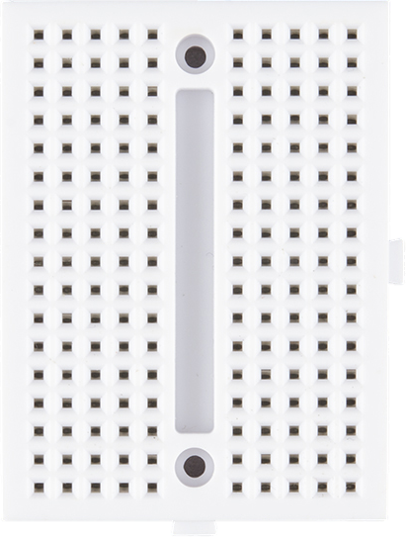

Slide 30
Specifications
Max Continuous Discharging Current: | 10A
Typical Capacity | 3500 mAh (3350mAh minimum)
Style | BUTTON top
Approximate Nominal Dimensions (including button) | 69.1mm length x 18.6 mm diameter
Maximum Dimensions (including button) | 69.6mm length x 19.0mm diameter
Discharge cut-off voltage | 2.5V (approximate)
Voltage | 3.6V
Full Charge Voltage | 4.2V
Charge Current | 1.675A standard
Protection Cutoff Current | 15-20A
Protection IC | Ricoh
MOSFETS Quantity | 3
Origin | Cell made in Korea or China, button top manufactured in China, Protection IC made in Japan. Assembled in China.
Cell Certifications | UN38.3 test report, IEC62133, CB Scheme, UL1642
Battery Assembly Certifications | UL2054, CE, UN38.3 test report, IEC 62133-2: 2017, RoHS, REACH, CB Scheme. cTÜVus mark, UL 62368-1:2019 R10.21 CSA C22.2 NO. 62368-1:19
Protected 3500mAh 10A 18650 Button Top Battery

Slide 31
Electrical Requirements
 | Voltage | Current | Power
Battery | 3.6 V | 10 A (max) | 36 W
USB | 5 V | 500 mA (USB 2.0) | 2.5 W
 | Voltage | Current | Power
Microcontroller | 3.3 V (or 5 V USB) | 150 mA (with WiFi) | 495 mW
Expansion Board | 3.7 V (battery) | 15 mA (with display) | 56 mW
Motor Driver Control | 3.7 V (battery) (up to 11 V) | <1.2 A> (per channel max) | <8.88 mW> (max)
Motor Driver Logic | 3.3 V (2 to 7 V) | negligible | 0
Left Motor | 3.7 V (battery) (up to 6 V) | 150 mA (full speed estimate) | 560 mW
Right Motor | 3.7 V (battery) (up to 6 V) | 150 mA (full speed estimate) | 560 mW
Left Encoder | 3.3 V (2.7 V to 18 V) | negligible | 0
Right Encoder | 3.3 V (2.7 V to 18 V) | negligible | 0
Total |  | ~500 mA | ~1.8 W
You always want to give yourself a safety margin for “spikes”

Slide 32
M1
M2
GND
VCC
C1
C2
C2
C1
VCC
GND
M2
M1
GND
GND
BAT
VCC
BAT
GPIO 1
USB 5V
BENBL
BOUT2
BAT
GPIO 2
GND
BAT
BPHASE
BOUT1
GPIO 3
3.3 V
AENBL
AOUT2
GPIO 4
GPIO 9
APHASE
AOUT1
I²C SDA
GPIO 8
MODE
VMM
I²C SCL
GPIO 7
GPIO 43
GPIO 44
BAT
GND
BAT
GND
GND

Slide 33
M1
M2
GND
VCC
C1
C2
C2
C1
VCC
GND
M2
M1
GND
GND
BAT
VCC
BAT
GPIO 1
USB 5V
BENBL
BOUT2
BAT
GPIO 2
GND
BAT
BPHASE
BOUT1
GPIO 3
3.3 V
AENBL
AOUT2
GPIO 4
GPIO 9
APHASE
AOUT1
I²C SDA
GPIO 8
MODE
VMM
I²C SCL
GPIO 7
GPIO 43
GPIO 44
BAT
GND
BAT
GND
GND

Slide 34
M1
M2
GND
VCC
C1
C2
C2
C1
VCC
GND
M2
M1
GND
GND
BAT
VCC
BAT
GPIO 1
USB 5V
BENBL
BOUT2
BAT
GPIO 2
GND
BAT
BPHASE
BOUT1
GPIO 3
3.3 V
AENBL
AOUT2
GPIO 4
GPIO 9
APHASE
AOUT1
I²C SDA
GPIO 8
MODE
VMM
I²C SCL
GPIO 7
GPIO 43
GPIO 44
BAT
GND
BAT
GND
GND

Slide 35
M1
M2
GND
VCC
C1
C2
C2
C1
VCC
GND
M2
M1
GND
GND
BAT
VCC
BAT
GPIO 1
USB 5V
BENBL
BOUT2
BAT
GPIO 2
GND
BAT
BPHASE
BOUT1
GPIO 3
3.3 V
AENBL
AOUT2
GPIO 4
GPIO 9
APHASE
AOUT1
I²C SDA
GPIO 8
MODE
VMM
I²C SCL
GPIO 7
GPIO 43
GPIO 44
BAT
GND
BAT
GND
GND

Slide 36
M1
M2
GND
VCC
C1
C2
C2
C1
VCC
GND
M2
M1
GND
GND
BAT
VCC
BAT
GPIO 1
USB 5V
BENBL
BOUT2
BAT
GPIO 2
GND
BAT
BPHASE
BOUT1
GPIO 3
3.3 V
AENBL
AOUT2
GPIO 4
GPIO 9
APHASE
AOUT1
I²C SDA
GPIO 8
MODE
VMM
I²C SCL
GPIO 7
GPIO 43
GPIO 44
BAT
GND
BAT
GND
GND

Slide 37
Time to Wire

Slide 38
Hello Toit

Slide 39
M1
M2
GND
VCC
C1
C2
C2
C1
VCC
GND
M2
M1
GND
GND
BAT
VCC
BAT
GPIO 1
USB 5V
BENBL
BOUT2
BAT
GPIO 2
GND
BAT
BPHASE
BOUT1
GPIO 3
3.3 V
AENBL
AOUT2
GPIO 4
GPIO 9
APHASE
AOUT1
I²C SDA
GPIO 8
MODE
VMM
I²C SCL
GPIO 7
GPIO 43
GPIO 44
BAT
GND
BAT
GND
GND

Slide 40
M1
M2
GND
VCC
C1
C2
C2
C1
VCC
GND
M2
M1
GND
GND
BAT
VCC
BAT
GPIO 1
USB 5V
BENBL
BOUT2
BAT
GPIO 2
GND
BAT
BPHASE
BOUT1
GPIO 3
3.3 V
AENBL
AOUT2
GPIO 4
GPIO 9
APHASE
AOUT1
I²C SDA
GPIO 8
MODE
VMM
I²C SCL
GPIO 7
GPIO 43
GPIO 44
BAT
GND
BAT
GND
GND

Slide 41
M1
M2
GND
VCC
C1
C2
C2
C1
VCC
GND
M2
M1
GND
GND
BAT
VCC
BAT
GPIO 1
USB 5V
BENBL
BOUT2
BAT
GPIO 2
GND
BAT
BPHASE
BOUT1
GPIO 3
3.3 V
AENBL
AOUT2
GPIO 4
GPIO 9
APHASE
AOUT1
I²C SDA
GPIO 8
MODE
VMM
I²C SCL
GPIO 7
GPIO 43
GPIO 44
BAT
GND
BAT
GND
GND

Slide 42
M1
M2
GND
VCC
C1
C2
C2
C1
VCC
GND
M2
M1
GND
GND
BAT
VCC
BAT
GPIO 1
USB 5V
BENBL
BOUT2
BAT
GPIO 2
GND
BAT
BPHASE
BOUT1
GPIO 3
3.3 V
AENBL
AOUT2
GPIO 4
GPIO 9
APHASE
AOUT1
I²C SDA
GPIO 8
MODE
VMM
I²C SCL
GPIO 7
GPIO 43
GPIO 44
BAT
GND
BAT
GND
GND

Slide 43
Toit Motor Control

Slide 44
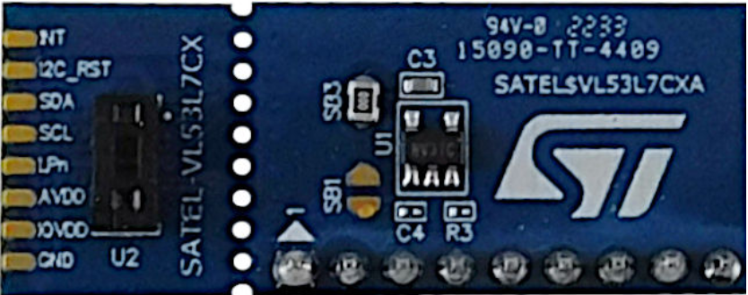
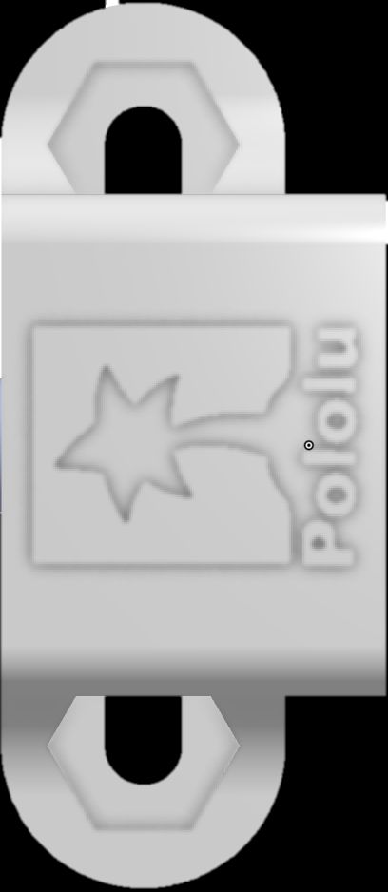
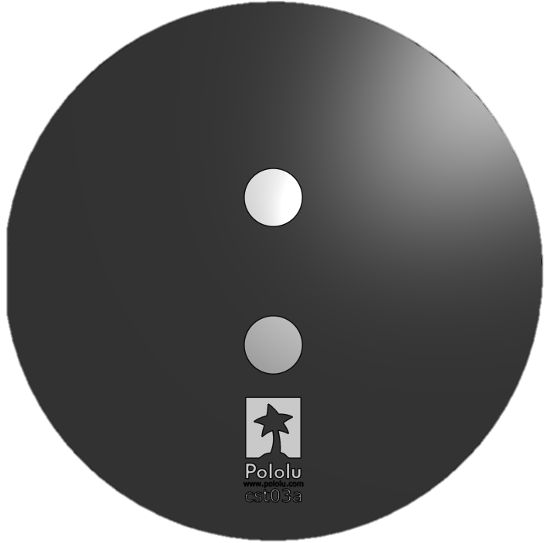
Parts
Wheel

