Slide 1
Neural networks
David Kauchak
CS159 – Spring 2024

Slide 2
Admin
Assignment 5

Slide 3
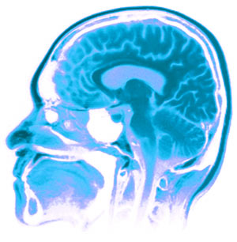
Neural Networks
Neural Networks try to mimic the structure and function of our nervous system
People like biologically motivated approaches

Slide 4
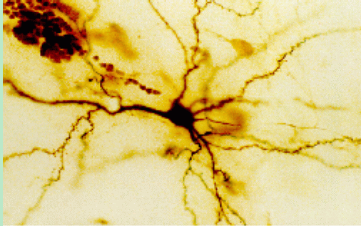
Our Nervous System
Neuron
What do you know?

Slide 5
Our nervous system: the computer science view
the human brain is a large collection of interconnected neurons
a NEURON is a brain cell
  they collect, process, and disseminate electrical signals
  they are connected via synapses
  they FIRE depending on the conditions of the neighboring neurons

Slide 6
Artificial Neural Networks
Node (Neuron)
Edge (synapses)
our approximation

Slide 7
Node A
Weight w
Node B
(neuron)
(neuron)
W is the strength of signal sent between A and B.
If A fires and w is positive, then A stimulates B.
If A fires and w is negative, then A inhibits B.

Slide 8
…
Neurons often have many, many connected input neurons
If a neuron is stimulated enough, then it also fires
How much stimulation is required is determined by its threshold

Slide 9
A Single Neuron/Perceptron
Input x₁
Each input contributes:
x_{i} * w_{i}
Weight w₁
Weight w₂
Input x₂
Output y
threshold function
Input x₃
Weight w₃
Weight w₄
Input x₄

Slide 10
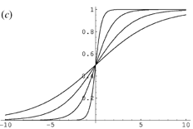
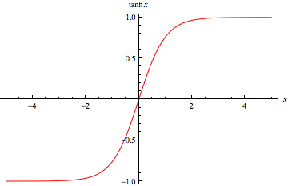
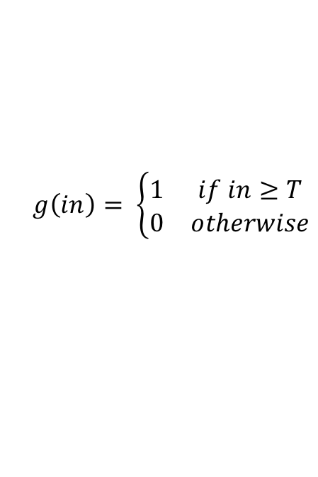
Activation functions
hard threshold:
sigmoid
tanh x
$$g\left(in\right)= \left\{\begin{matrix}1 & if in≥T \\ 0 & otherwise\end{matrix}\right.$$
why other threshold functions?
Notes:
Allow us to model more than just 0/1 outputs
Differentiable! (this will come into play in a minute)

Slide 11
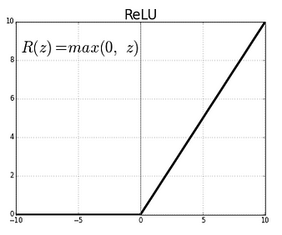
Many other activation functions
Rectified Linear Unit
Softmax (for probabilities)

Slide 12
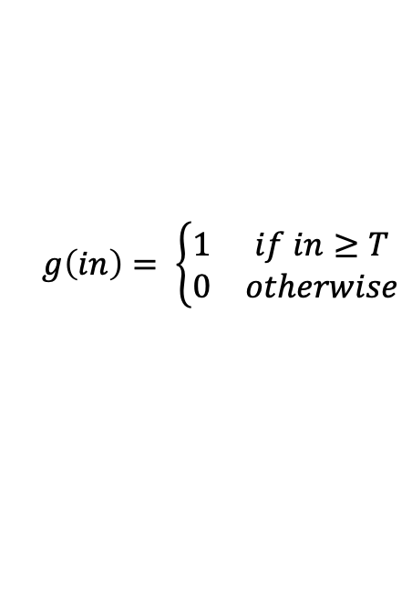
A Single Neuron/Perceptron
1
$$g\left(in\right)= \left\{\begin{matrix}1 & if in≥T \\ 0 & otherwise\end{matrix}\right.$$
1
1
-1
?
0
1
Threshold of 1
0.5
1

Slide 13
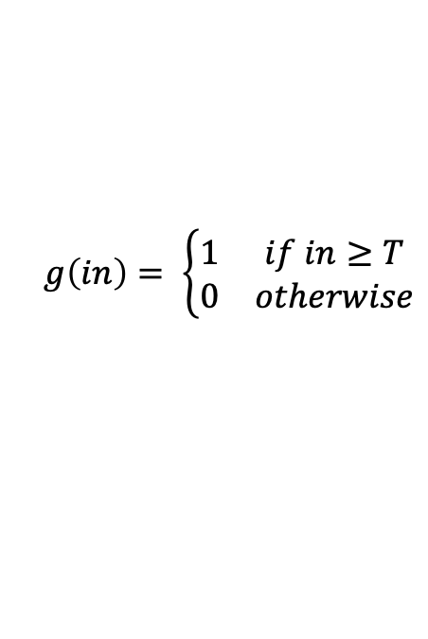
A Single Neuron/Perceptron
1
$$g\left(in\right)= \left\{\begin{matrix}1 & if in≥T \\ 0 & otherwise\end{matrix}\right.$$
1
1
-1
?
0
1
Threshold of 1
0.5
1
1*1 + 1*-1 + 0*1 + 1*0.5 = 0.5

Slide 14
A Single Neuron/Perceptron
1
$$g\left(in\right)= \left\{\begin{matrix}1 & if in≥T \\ 0 & otherwise\end{matrix}\right.$$
1
1
-1
0
Weighted sum is 0.5, which is not larger than the threshold
0
1
Threshold of 1
0.5
1

Slide 15
A Single Neuron/Perceptron
1
$$g\left(in\right)= \left\{\begin{matrix}1 & if in≥T \\ 0 & otherwise\end{matrix}\right.$$
1
0
-1
?
0
1
Threshold of 1
0.5
1
1*1 + 0*-1 + 0*1 + 1*0.5 = 1.5

Slide 16
A Single Neuron/Perceptron
1
$$g\left(in\right)= \left\{\begin{matrix}1 & if in≥T \\ 0 & otherwise\end{matrix}\right.$$
1
0
-1
1
Weighted sum is 1.5, which is larger than the threshold
0
1
Threshold of 1
0.5
1

Slide 17
Neural network
inputs
Individual perceptrons/neurons
Notes:
- often we view a slice of them

Slide 18
Neural network
some inputs are provided/entered
inputs
Notes:
- often we view a slice of them

Slide 19
Neural network
inputs
each perceptron computes and calculates an answer
Notes:
- often we view a slice of them

Slide 20
Neural network
inputs
those answers become inputs for the next level
Notes:
- often we view a slice of them

Slide 21
Neural network
inputs
finally get the answer after all levels compute
Notes:
- often we view a slice of them

Slide 22
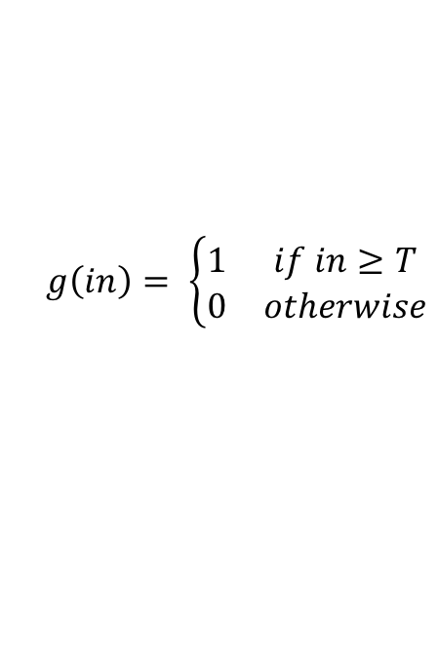
Computation (assume threshold 0)
0.5
0
0
0.5
1
-1
-0.5
1
1
0.5
1
$$g\left(in\right)= \left\{\begin{matrix}1 & if in≥T \\ 0 & otherwise\end{matrix}\right.$$

Slide 23
Computation
-0.05-0.02= -0.07
0.05
0.483
0.483*0.5+0.495=0.7365
-1
0.03
0.5
-0.02
0.676
0.01
1
1
0.495
-0.03+0.01=-0.02

Slide 24
Neural networks
Different kinds/characteristics of networks
inputs
inputs
inputs
inputs
How are these different?

Slide 25
Hidden units/layers
inputs
inputs
hidden units/layer
Feed forward networks

Slide 26
Hidden units/layers
inputs
Can have many layers of hidden units of differing sizes
To count the number of layers, you count all but the inputs
…

Slide 27
Hidden units/layers
inputs
inputs
2-layer network
3-layer network

Slide 28
Alternate ways of visualizing
Sometimes the input layer will be drawn with nodes as well
inputs
inputs
2-layer network
2-layer network

Slide 29
Multiple outputs
inputs
0
1
Can be used to model multiclass datasets or more interesting predictors, e.g. images

Slide 30
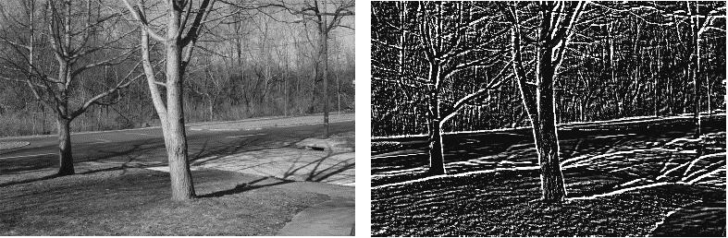
Multiple outputs
input
output
(edge detection)

Slide 31
Neural networks
inputs
Recurrent network
Output is fed back to input
Can support memory!
Good for temporal data

Slide 32
History of Neural Networks
McCulloch and Pitts (1943) – introduced model of artificial neurons and suggested they could learn
Hebb (1949) – Simple updating rule for learning
Rosenblatt (1962) - the perceptron model
Minsky and Papert (1969) – wrote Perceptrons
Bryson and Ho (1969, but largely ignored until 1980s--Rosenblatt) – invented back-propagation learning for multilayer networks

Slide 33
Training the perceptron
First wave in neural networks in the 1960’s
Single neuron
Trainable: its threshold and input weights can be modified
If the neuron doesn’t give the desired output, then it has made a mistake
Input weights and threshold can be changed according to a learning algorithm

Slide 34
Examples - Logical operators
AND – if all inputs are 1, return 1, otherwise return 0
OR – if at least one input is 1, return 1, otherwise return 0
NOT – return the opposite of the input
XOR – if exactly one input is 1, then return 1, otherwise return 0

Slide 35
AND
x₁ | x₂ | x₁ and x₂
0 | 0 | 0
0 | 1 | 0
1 | 0 | 0
1 | 1 | 1
Notes:
We have the truth table for AND

Slide 36
AND
x₁ | x₂ | x₁ and x₂
0 | 0 | 0
0 | 1 | 0
1 | 0 | 0
1 | 1 | 1
Input x₁
W₁ = ?
T = ?
Output y
Input x₂
W₂ = ?
Notes:
And here we have the node for AND
Assume that all inputs are either 1 or 0, “on” or “off”
When they are activated, they become “on”
So what weights do we need to assign to these two links and what threshold do we need to put in this unit in order to represent an AND gate?

Slide 37
AND
x₁ | x₂ | x₁ and x₂
0 | 0 | 0
0 | 1 | 0
1 | 0 | 0
1 | 1 | 1
Input x₁
W₁ = 1
T = 2
Output y
Output is 1 only if
all inputs are 1
Input x₂
W₂ = 1
Inputs are either 0 or 1

Slide 38
AND
Input x₁
W₁ = ?
W₂ = ?
Input x₂
T = ?
Output y
Input x₃
W₃ = ?
W₄ = ?
Input x₄
Notes:
We can extend this to take more inputs
What are the new weights and thresholds?

Slide 39
AND
Input x₁
W₁ = 1
W₂ = 1
Input x₂
T = 4
Output y
Output is 1 only if
all inputs are 1
Input x₃
W₃ = 1
W₄ = 1
Input x₄
Inputs are either 0 or 1

Slide 40
OR
x₁ | x₂ | x₁ or x₂
0 | 0 | 0
0 | 1 | 1
1 | 0 | 1
1 | 1 | 1

Slide 41
OR
x₁ | x₂ | x₁ or x₂
0 | 0 | 0
0 | 1 | 1
1 | 0 | 1
1 | 1 | 1
Input x₁
W₁ = ?
T = ?
Output y
Input x₂
W₂ = ?
Notes:
What about for an OR gate?
What weights and thresholds would serve to create an OR gate?

Slide 42
OR
x₁ | x₂ | x₁ or x₂
0 | 0 | 0
0 | 1 | 1
1 | 0 | 1
1 | 1 | 1
Input x₁
W₁ = 1
T = 1
Output y
Output is 1 if at
least 1 input is 1
Input x₂
W₂ = 1
Inputs are either 0 or 1

Slide 43
OR
Input x₁
W₁ = ?
W₂ = ?
Input x₂
T = ?
Output y
Input x₃
W₃ = ?
W₄ = ?
Input x₄
Notes:
Similarly, we can expand it to take more inputs

Slide 44
NOT
x₁ | not x₁
0 | 1
1 | 0

Slide 45
OR
Input x₁
W₁ = 1
W₂ = 1
Input x₂
T = 1
Output y
Output is 1 if at
least 1 input is 1
Input x₃
W₃ = 1
W₄ = 1
Input x₄
Inputs are either 0 or 1

Slide 46
NOT
x₁ | not x₁
0 | 1
1 | 0
W₁ = ?
Input x₁
T = ?
Output y
Notes:
Now it gets a little bit trickier, what weight and threshold might work to create a NOT gate?

Slide 47
NOT
W₁ = -1
Input x₁
T = 0
Output y
Input is either 0 or 1
If input is 1, output is 0.
If input is 0, output is 1.

Slide 48
How about…
x₁ | x₂ | x₃ | x₁ and x₂
0 | 0 | 0 | 1
0 | 1 | 0 | 0
1 | 0 | 0 | 1
1 | 1 | 0 | 0
0 | 0 | 1 | 1
0 | 1 | 1 | 1
1 | 0 | 1 | 1
1 | 1 | 1 | 0
Input x₁
w₁ = ?
w₂ = ?
Input x₂
Output y
T = ?
Input x₃
w₃ = ?

Slide 49
Training neural networks
Learn individual node parameters (e.g. threshold)
Learn the individual weights between nodes

Slide 50
Positive or negative?
NEGATIVE

Slide 51
Positive or negative?
NEGATIVE

Slide 52
Positive or negative?
POSITIVE

Slide 53
Positive or negative?
NEGATIVE

Slide 54
Positive or negative?
POSITIVE

Slide 55
Positive or negative?
POSITIVE

Slide 56
Positive or negative?
NEGATIVE

Slide 57
Positive or negative?
POSITIVE

Slide 58
A method to the madness
blue = positive
yellow triangles = positive
all others negative
How did you figure this out (or some of it)?

Slide 59
Training a neuron (perceptron)
x₁ | x₂ | x₃ | x₁ and x₂
0 | 0 | 0 | 1
0 | 1 | 0 | 0
1 | 0 | 0 | 1
1 | 1 | 0 | 0
0 | 0 | 1 | 1
0 | 1 | 1 | 1
1 | 0 | 1 | 1
1 | 1 | 1 | 0
Input x₁
w₁ = ?
w₂ = ?
Input x₂
Output y
T = ?
Input x₃
w₃ = ?
start with some initial weights and thresholds
show examples repeatedly to NN
update weights/thresholds by comparing NN output to actual output

Slide 60
Perceptron learning algorithm
repeat until you get all examples right:
for each “training” example:
  calculate current prediction on example
  if wrong:
    update weights and threshold towards getting this example correct

Slide 61
Perceptron learning
1
Weighted sum is 0.5, which is not equal or larger than the threshold
1
predicted
1
-1
0
0
actual
1
Threshold of 1
1
0.5
1
What could we adjust to make it right?

Slide 62
Perceptron learning
1
1
predicted
1
-1
0
0
actual
1
Threshold of 1
1
0.5
1
This weight doesn’t matter, so don’t change

Slide 63
Perceptron learning
1
1
predicted
1
-1
0
0
actual
1
Threshold of 1
1
0.5
1
Could increase any of these weights

Slide 64
Perceptron learning
1
1
predicted
1
-1
0
0
actual
1
Threshold of 1
1
0.5
1
Could decrease the threshold

Slide 65
Perceptron learning
A few missing details, but not much more than this
Keeps adjusting weights as long as it makes mistakes
Run through the training data multiple times until convergence, some number of iterations, or until weights don’t change (much)

Slide 66
XOR
x₁ | x₂ | x₁ or x₂
0 | 0 | 0
0 | 1 | 1
1 | 0 | 1
1 | 1 | 0

Slide 67
XOR
x₁ | x₂ | x₁ xor x₂
0 | 0 | 0
0 | 1 | 1
1 | 0 | 1
1 | 1 | 0
Input x₁
W₁ = ?
T = ?
Output y
Input x₂
W₂ = ?
Notes:
What about for an OR gate?
What weights and thresholds would serve to create an OR gate?

Slide 68
Perceptron learning
A few missing details, but not much more than this
Keeps adjusting weights as long as it makes mistakes
Run through the training data multiple times until convergence, some number of iterations, or until weights don’t change (much)
If the training data is linearly separable the perceptron learning algorithm is guaranteed to converge to the “correct” solution (where it gets all examples right)

Slide 69
Linearly Separable
x₁ | x₂ | x₁ and x₂
0 | 0 | 0
0 | 1 | 0
1 | 0 | 0
1 | 1 | 1
x₁ | x₂ | x₁ or x₂
0 | 0 | 0
0 | 1 | 1
1 | 0 | 1
1 | 1 | 1
x₁ | x₂ | x₁ xor x₂
0 | 0 | 0
0 | 1 | 1
1 | 0 | 1
1 | 1 | 0
A data set is linearly separable if you can separate one example type from the other with a line (plane)
Which of these are linearly separable?

Slide 70
Which of these are linearly separable?
x₁ | x₂ | x₁ and x₂
0 | 0 | 0
0 | 1 | 0
1 | 0 | 0
1 | 1 | 1
x₁ | x₂ | x₁ or x₂
0 | 0 | 0
0 | 1 | 1
1 | 0 | 1
1 | 1 | 1
x₁ | x₂ | x₁ xor x₂
0 | 0 | 0
0 | 1 | 1
1 | 0 | 1
1 | 1 | 0
x₁
x₁
x₁
x₂
x₂
x₂

Slide 71
Perceptrons
1969 book by Marvin Minsky and Seymour Papert
The problem is that they can only work for classification problems that are linearly separable
Insufficiently expressive
“Important research problem” to investigate multilayer networks although they were pessimistic about their value

Slide 72
XOR
?
Input x₁
T = ?
?
?
Output = x₁ xor x₂
T = ?
?
?
Input x₂
T = ?
x₁ | x₂ | x₁ xor x₂
0 | 0 | 0
0 | 1 | 1
1 | 0 | 1
1 | 1 | 0
?

Slide 73
XOR
1
Input x₁
T = 1
1
-1
Output = x₁ xor x₂
T = 1
-1
1
Input x₂
T = 1
x₁ | x₂ | x₁ xor x₂
0 | 0 | 0
0 | 1 | 1
1 | 0 | 1
1 | 1 | 0
1
Notes:
-

Slide 74
Training
?
Input x₁
?
?
Output = x₁ xor x₂
b=?
?
?
?
b=?
Input x₂
x₁ | x₂ | x₁ xor x₂
0 | 0 | 0
0 | 1 | 1
1 | 0 | 1
1 | 1 | 0
b=?
How do we learn the weights?

Slide 75
Training multilayer networks
perceptron learning: if the perceptron’s output is different than the expected output, update the weights
gradient descent: compare output to label and adjust based on loss function
Any other problem with these for general NNs?
w
w
w
w
w
w
w
w
w
w
w
w
perceptron/
linear model
neural network

Slide 76
Learning in multilayer networks
Challenge: for multilayer networks, we don’t know what the expected output/error is for the internal nodes!
how do we learn these weights?
w
w
w
w
w
w
w
w
w
expected output?
w
w
w
perceptron/
linear model
neural network

Slide 77
Backpropagation: intuition
Gradient descent method for learning weights by optimizing a loss function
calculate output of all nodes
calculate the weights for the output layer based on the error
“backpropagate” errors through hidden layers

Slide 78
Backpropagation: intuition
We can calculate the actual error here

Slide 79
Backpropagation: intuition
Key idea: propagate the error back to this layer

Slide 80
Backpropagation: intuition
“backpropagate” the error:
Assume all of these nodes were responsible for some of the error
How can we figure out how much they were responsible for?

Slide 81
Backpropagation: intuition
w₂
w₁
w₃
error
error for node is ~ w_{i} * error

Slide 82
Backpropagation: intuition
w₅
w₄
w₆
w₃ * error
Calculate as normal using this as the error

Slide 83
Mind reader game
https://web.media.mit.edu/~guysatat/MindReader/index.html

