Slide 1
Lecture 25: TCP
CS 105 Fall 2024

Slide 2
Review: Networked Systems
Client Application
Server Application
Operating System
Operating System
Hardware
Network
Hardware

Slide 3
Review: The Network Stack
User-Level Application
Application
Operating System
Transport
Network
Hardware (NIC)
Data Link
Physical

Slide 4
Transport Layer Protocols
User Datagram Protocol (UDP)
Transmission Control Protocol (TCP)
unreliable, unordered delivery
connectionless
best-effort, segments might be lost, delivered out-of-order, duplicated
reliability (if required) is the responsibility of the app
reliable, in-order delivery
connection setup
flow control
congestion control
Notes:
flow control = don't overwhelm the receiver
congestion control = don't swamp the network
Note: neither guarantees latency or bandwidth

Slide 5
Transport-Layer Segment Formats
UDP
TCP
Source Port #
Dest. Port #
Source Port #
Dest. Port #
application message (payload)
sequence number
acknowledgement number
HL
U
A
P
R
S
F
receive window
checksum
U data pointer
options
application message (payload)
Notes:
S,A,F flags used to manage connection
sequence number and acknowledgement number (+ A flag) are used to implement reliable transport

Slide 6
Sockets Interface
1. Start server
socket
bind
socket
listen
Connection
request
connect
accept
Client / Server
Session
write
read
Await connection
request from
next client
read
write
close
EOF
read
close

Slide 7
Sockets Interface
1. Start server
socket
bind
2. Start client
socket
listen
Connection
request
connect
accept
Client / Server
Session
write
read
Await connection
request from
next client
read
write
close
EOF
read
close

Slide 8
accept Illustrated
listenfd(3)
Client
Server
1. Server blocks in accept, waiting for connection request on listening descriptor listenfd
clientfd
Connection
request
listenfd(3)
Client
Server
2. Client makes connection request by calling and blocking in connect
clientfd
listenfd(3)
3. Server returns connfd from accept. Client returns from connect. Connection is now established between clientfd and connfd
Client
Server
clientfd
connfd(4)

Slide 9
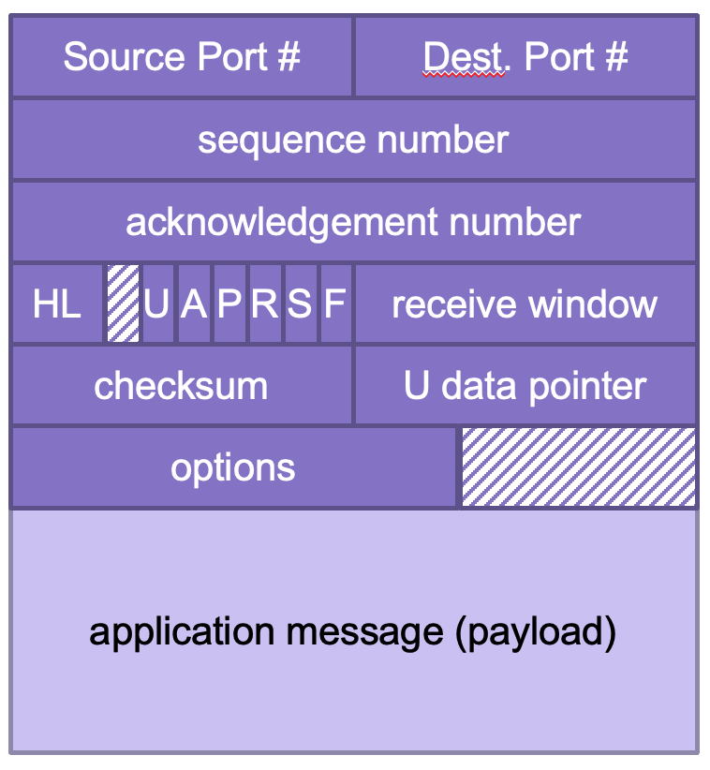
TCP Connections
TCP is connection-oriented
A connection is initiated with a three-way handshake
Recall: server will typically create a new socket to handle the new connection
SYN
SYN, ACK
ACK
…
Notes:
demo handshake in wireshark with loopback

Slide 10
Sockets Interface
1. Start server
socket
bind
2. Start client
socket
listen
Connection
request
connect
accept
3. Exchange
data
Client / Server
Session
write
read
Await connection
request from
next client
read
write
close
EOF
read
close

Slide 11
Reliable Transport
SYN
Each SYN segment will include a randomly chosen sequence number
Sequence number of each segment is incremented by data length
Receiver sends ACK segments acknowledging latest sequence number received
Sender maintains copy of all sent but unacknowledged segments; resends if ACK does not arrive within timeout
Timeout is dynamically adjusted to account for round-trip delay
SYN, ACK
ACK
data (Seq = 47)
ACK 47
data (Seq = 48)
ACK 48
data (Seq = 49)
Send Timeout
data (Seq = 49)
ACK 49
Notes:
demo sequence numbers in wireshark

Slide 12
Pipelined Protocols
Pipelining allows sender to send multiple "in-flight", yet-to-be-acknowledged packets
increases throughput
needs buffering at sender and receiver

Slide 13
Example: Window Size = 4
sender can have up to 4 unacknowledged messages
when ACK for first message is received, it can send another message
data (Seq = 47)
data (Seq = 48)
data (Seq = 49)
data (Seq = 50)
ACK 47
ACK 48
ACK 49
ACK 50
data (Seq = 51)
data (Seq = 52)
data (Seq = 53)
data (Seq = 54)

Slide 14
Pipelined Protocols
Pipelining allows sender to send multiple "in-flight", yet-to-be-acknowledged packets
increases throughput
needs buffering at sender and receiver
what should we do if a packet goes missing in the middle?

Slide 15
TCP Fast Retransmit
Receiver always acks the last id it successfully received
Sender detects loss without waiting for timeout, resends missing packet
data (Seq = 47)
data (Seq = 48)
data (Seq = 49)
data (Seq = 50)
ACK 47
ACK 47
ACK 47
data (Seq = 51)
data (Seq = 48)
data (Seq = 49)
ACK 47
ACK 51
ACK 51

Slide 16
Exercise: TCP Sequence Numbers
Consider the sequence of transmitted messages shown on the right
What will be the next ACK number sent by the server?
What will be the next Seq number sent by the client?
data (Seq = 13)
data (Seq = 14)
data (Seq = 15)
data (Seq = 16)
ACK 13
ACK 13
data (Seq = 17)

Slide 17
Pipelined Protocols
Pipelining allows sender to send multiple "in-flight", yet-to-be-acknowledged packets
increases throughput
needs buffering at sender and receiver
what should we do if a packet goes missing in the middle?
how big should the window be?

Slide 18
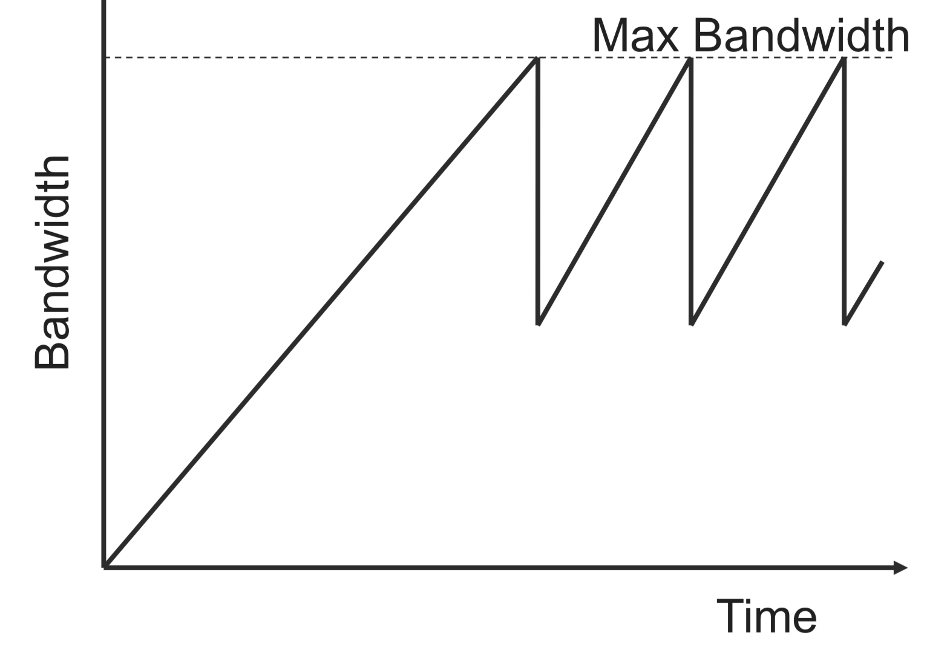
TCP Congestion Control
TCP operates under a principle of additive increase-multiplicative decrease
window size++ every RTT if no packets lost
window size/2 if a packet is dropped

Slide 19
TCP Fairness
Goal: if k TCP sessions share same bottleneck link of bandwidth R, each should have average rate of R/k
R
Loss: decreases throughput proportional to current bandwidth
Connection 2 Throughput
Congestion avoidance: increases throughput linearly (evenly)
Connection 1 Throughput
R

Slide 20
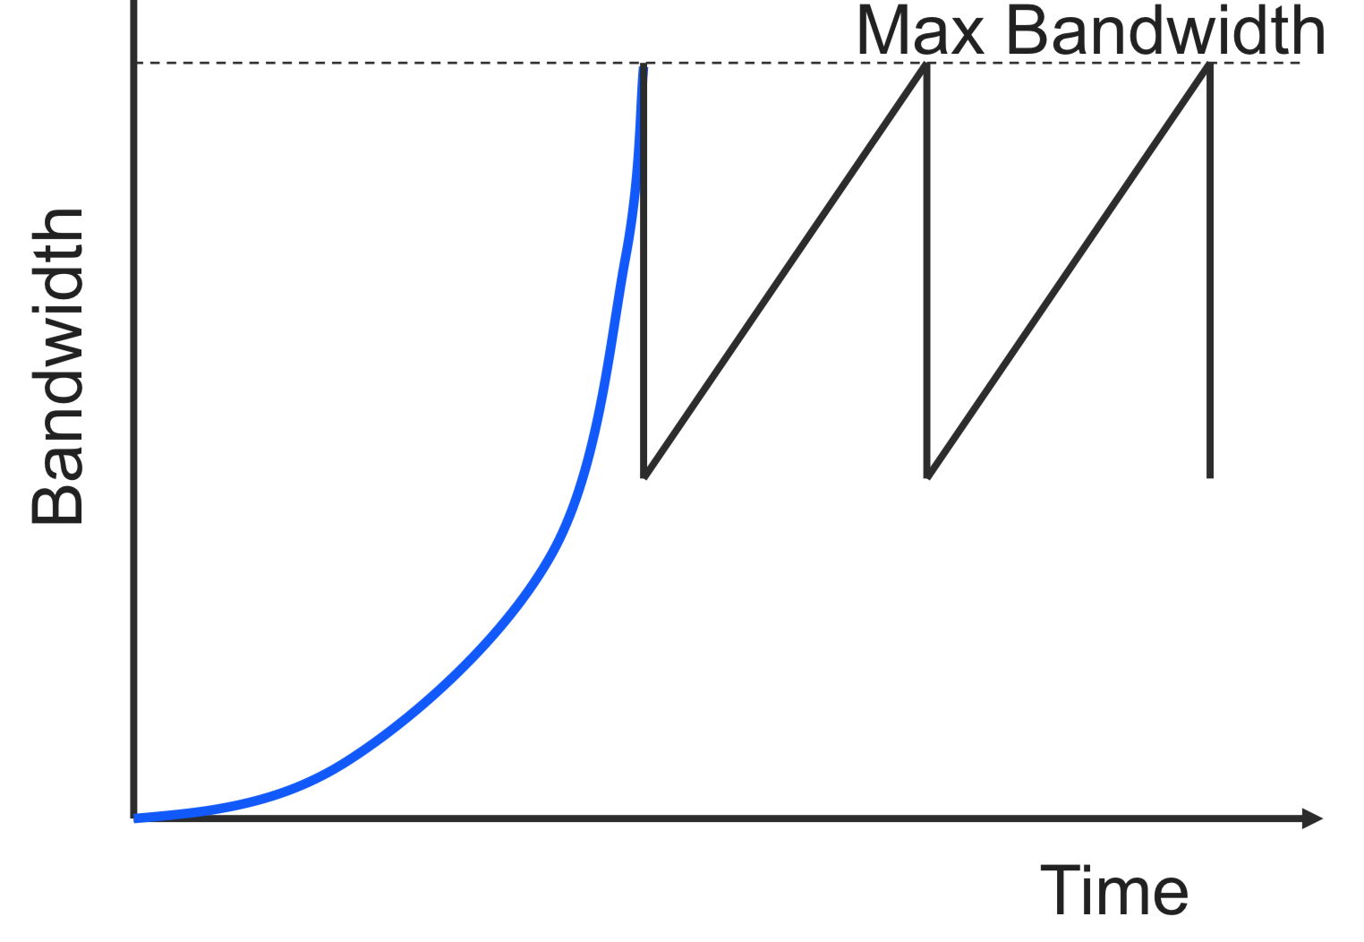
TCP Slow Start
Problem: linear increase takes a long time to build up a decent window size, and most transactions are small
Solution: allow window size to increase exponentially until first loss

Slide 21
Exercise: TCP Window Size
Assume someone changes the code of their TCP client by modifying the congestion avoidance as follows: instead of increasing the window size by 1 each time an ACK is received, they double the window size each time an ACK is received (like in the slow-start phase).
What would be the pros and cons of this modification?

Slide 22
Sockets Interface
1. Start server
socket
bind
2. Start client
socket
listen
Connection
request
connect
accept
3. Exchange
data
Client / Server
Session
write
read
Await connection
request from
next client
read
write
4. Disconnect client
EOF
5. Drop client
close
read
close

Slide 23
TCP Connections
TCP is connection-oriented
A connection is initiated with a three-way handshake
Recall: server will typically create a new socket to handle the new connection
FIN works (mostly) like SYN but to teardown a connection
SYN
SYN, ACK
ACK
…
FIN
ACK
Notes:
demo in wireshark

Slide 24
TCP Summary
Reliable, in-order message delivery
Connection-oriented, three-way handshake
Transmission window for better throughput
timeouts based on link parameters (e.g., RTT, variance)
Congestion control
Linear increase, exponential backoff
Fast adaptation
Exponential increase in the initial phase

