Slide 1
Lecture 24: Networking (cont’d)
CS 105 Fall 2024

Slide 2
Review: Networked Systems
Client Application
Server Application
Operating System
Operating System
Hardware
Network
Hardware

Slide 3
Review: Encapsulation
Client Application
HTTP
Data!
Server Application
Port = 4747
Port = 80
Operating System
TCP
HTTP
Data!
Operating System
TCP
Data!
Hardware
Hardware

Slide 4
Ports
A port is a 16-bit integer that identifies a process
  Ephemeral port: Assigned automatically by client kernel when client makes a connection request.
  Well-known port: Associated with some type of service on server
Example well-known ports corresponding services:
  echo server: 7/echo
  ssh servers: 22/ssh
  email server: 25/smtp
  web servers: 80/http
  secure web servers: /https
If you are implementing a networked system, you implement both server code and client code (and hard-code the server port into the client code)

Slide 5
Transport-Layer Header Formats
UDP
TCP
Source Port #
Dest. Port #
Source Port #
Dest. Port #
application message (payload)
sequence number
acknowledgement number
HL
U
A
P
R
S
F
receive window
checksum
U data pointer
options
application message (payload)
Notes:
S,A,F flags used to manage connection
sequence number and acknowledgement number (+ A flag) are used to implement reliable transport

Slide 6
Review: Encapsulation
Client Application
Server Application
Port = 4747
Port = 80
Operating System
IP
TCP
HTTP
Data!
Operating System
IP
TCP
Data!
Hardware
Hardware
IP = 123.25.129.217
IP = 8.0.0.8

Slide 7
Internet Protocol (IP)
Initiated by the DoD in 60s-70s
Currently transitioning (very slowly) from IPv4 to IPv6
Example address: 128.84.12.43
interoperable
network dynamically routes packets from source to destination
IHL
TOS
total length
v
Dest. Port #
identification
fs
offset
TTL
protocol
header checksum
source address
destination address
options
application message (payload)
Notes:
v = version (4 or 6)
IHL = header length in 32-bit words (usually 5 unless options present)
TOS: type of service (?)
total length = total length in bytes
id/flags/offset used for fragmentation/reassembly
TTL = time to live (decrementd each hop
Protocol = TCP, UDP, ICMP

Slide 8
Aside: IPv4 and IPv6
The original Internet Protocol, with its 32-bit addresses, is known as Internet Protocol Version 4 (IPv4)
1996: Internet Engineering Task Force (IETF) introduced Internet Protocol Version 6 (IPv6) with 128-bit addresses
  Intended as the successor to IPv4
As of April 2023, majority of Internet traffic still carried by IPv4
  38-44% of users access Google services using IPv6.
We will focus on IPv4, but will show you how to write networking code that is protocol-independent.
Notes:
https://www.google.com/intl/en/ipv6/statistics.html

Slide 9
Review: Encapsulation
Client Application
Server Application
HTTP
Data!
Port = 4747
Port = 80
Operating System
IP
TCP
HTTP
Data!
Operating System
IP
TCP
HTTP
Data!
IP
TCP
Data!
Hardware
Hardware
eth
IP
TCP
HTTP
Data!
IP = 123.25.129.217
IP = 8.0.0.8
eth
IP
TCP
HTTP
Data!
Router
Router
WIFI
IP
Router
TCP
HTTP
Data!
Router
Router

Slide 10
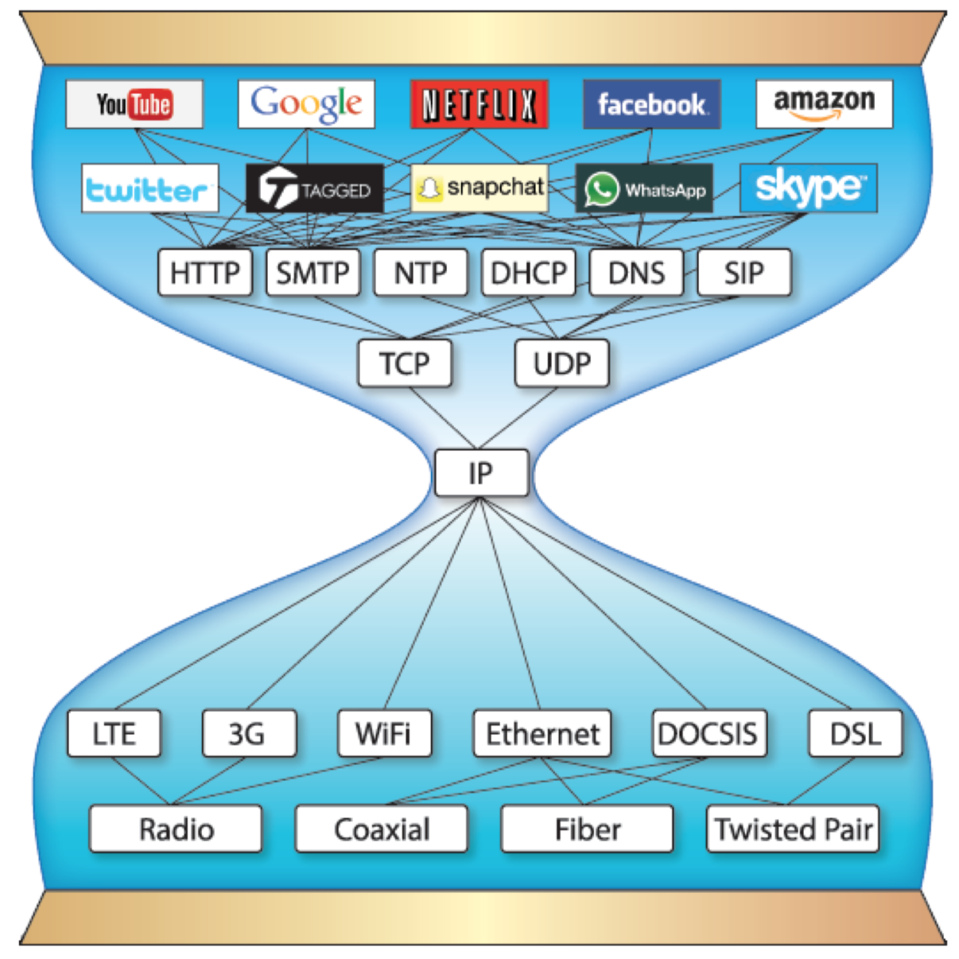
The Network Stack
User-Level Application
Application
Operating System
Transport
Network
Hardware (NIC)
Data Link
Physical

Slide 11
Sockets
What is a socket?
  IP address + port
  To the operating system, a socket is an endpoint of communication
  To an application, a socket is a file descriptor that lets the application read/write from/to the network
    Recall: All Unix I/O devices, including networks, are modeled as files
Clients and servers communicate with each other by reading from and writing to socket descriptors
The main distinction between regular file I/O and socket I/O is how the application “opens” the socket descriptors
Client
Server
clientfd
serverfd

Slide 12
Sockets Interface
1. Start server
socket
bind
socket
listen
Connection
request
connect
accept
Client / Server
Session
write
read
Await connection
request from
next client
read
write
close
EOF
read
close

Slide 13
Sockets Interface: socket
Clients and servers use the socket function to create a socket descriptor:
Example:
Protocol specific! Best practice is to use getaddrinfo to generate the parameters automatically, so that code is protocol independent.
int socket(int domain, int type, int protocol)
int clientfd = socket(AF_INET, SOCK_STREAM, 0);
Indicates that we are using 32-bit IPV4 addresses
Indicates that the socket will be the end point of a TCP connection

Slide 14
Sockets Interface: bind
A server uses bind to ask the kernel to associate the server’s socket address with a socket descriptor:
Clients don’t have to do this
The process can then read bytes that arrive on the connection whose endpoint is addr by reading from descriptor sockfd.
Similarly, writes to sockfd are transferred along connection whose endpoint is addr.
Best practice is to use getaddrinfo to supply the arguments addr and addrlen.
int bind(int sockfd, SA* addr, socklen_t addrlen);

Slide 15
Socket Address Structures
Internet-specific socket address:
  Must cast (struct sockaddr_in *) to (struct sockaddr *) for functions that take socket address arguments.
struct sockaddr_in {
uint16_t sin_family; /* Protocol family (always AF_INET) */
uint16_t sin_port; /* Port num in network byte order */
struct in_addr sin_addr; /* IP addr in network byte order */
unsigned char sin_zero[8]; /* Pad to sizeof(struct sockaddr) */
};
sin_port
sin_addr
AF_INET
0
0
0
0
0
0
0
0
sa_family
sin_family
Family Specific

Slide 16
Sockets Interface: listen
By default, kernel assumes that descriptor from socket function is an active socket that will be on the client end of a connection.
A server calls the listen function to tell the kernel that a descriptor will be used by a server rather than a client:
Converts sockfd from an active socket to a listening socket that can accept connection requests from clients.
backlog is a hint about the number of outstanding connection requests that the kernel should queue up before starting to refuse requests.
int listen(int sockfd, int backlog);

Slide 17
Sockets Interface: accept
Servers wait for connection requests from clients by calling accept:
Waits for connection request to arrive on the connection bound to listenfd, then fills in client’s socket address in addr and size of the socket address in addrlen.
Returns a connected descriptor that can be used to communicate with the client via Unix I/O routines.
Process can read and write to this connected descriptor to get/send messages over the network
int accept(int listenfd, SA *addr, int *addrlen);

Slide 18
Connected vs. Listening Descriptors
Listening descriptor
  End point for client connection requests
  Created once and exists for lifetime of the server
Connected descriptor
  End point of the connection between client and server
  A new descriptor is created each time the server accepts a connection request from a client
  Exists only as long as it takes to service client
Why the distinction?
  Allows for concurrent servers that can communicate over many client connections simultaneously
    E.g., Each time we receive a new request, we fork a child to handle the request

Slide 19
Sockets Interface
1. Start server
socket
bind
2. Start client
socket
listen
Connection
request
connect
accept
Client / Server
Session
write
read
Await connection
request from
next client
read
write
close
EOF
read
close

Slide 20
Sockets Interface: connect
A client establishes a connection with a server by calling connect:
Attempts to establish a connection with server at socket address addr
  If successful, then clientfd is now ready for reading and writing.
  Resulting connection is characterized by socket pair
  (x:y, addr.sin_addr:addr.sin_port)
    x is client address
    y is ephemeral port that uniquely identifies client process on client host
Best practice is to use getaddrinfo to supply the arguments addr and addrlen.
int connect(int clientfd, SA* addr, socklen_t addrlen);

Slide 21
accept Illustrated
listenfd(3)
Client
Server
1. Server blocks in accept, waiting for connection request on listening descriptor listenfd
clientfd
Connection
request
listenfd(3)
Client
Server
2. Client makes connection request by calling and blocking in connect
clientfd
listenfd(3)
3. Server returns connfd from accept. Client returns from connect. Connection is now established between clientfd and connfd
Client
Server
clientfd
connfd(4)

Slide 22
Exercise: Connection Setup
Consider the network operations we've discussed thus far: socket, bind, listen, accept, connect. What sequence are these operations called in if a client wants to send one message to the server?
client
server
  socket
  connect
  socket
  bind
  listen
  accept

Slide 23
Sockets Interface
1. Start server
socket
bind
2. Start client
socket
listen
Connection
request
connect
accept
3. Exchange
data
Client / Server
Session
write
read
Await connection
request from
next client
read
write
close
EOF
read
close

Slide 24
Communicating over a channel
Consider the network operations we've discussed thus far: socket, bind, listen, accept, connect. What sequence are these operations called in if a client wants to send one message to the server?
client
server
  socket
  connect
  write
  socket
  bind
  listen
  accept
  read

Slide 25
Sockets Interface
1. Start server
socket
bind
2. Start client
socket
listen
Connection
request
connect
accept
3. Exchange
data
Client / Server
Session
write
read
Await connection
request from
next client
read
write
4. Disconnect client
EOF
5. Drop client
close
read
close

Slide 26
The Network Stack
User-Level Application
Application
Operating System
Transport
Network
Hardware (NIC)
Data Link
Physical

