Slide 1
Lecture 15: OS and Processes
CS 105 Fall 2024

Slide 2
Intro to Operating Systems
the operating system is a piece of software that manages a computer's resources for its users and their applications
Examples: OSX, Windows, Ubuntu, iOS, Android, Chrome OS
OS is divided into two pieces: user-mode and kernel-mode
core OS functionality is implemented by the OS kernel
resource allocation
isolation
communication
access control
multiprocessing
virtual memory
reliable networking
virtual machines
user interface
file I/O
device management
process control

Slide 3
Operating System Modes
Kernel Mode
User Mode
unrestricted access to hardware
mediates all hardware access (access control)
can execute privileged instructions
must ask kernel to access hw (system call)
attempts to execute privileged instructions cause exceptions
Operating system mode is set in hardware, can't be changed by user-level code

Slide 4
Operating System Goals
Reliability: they operating system should do what you want
Availability: the operating system should respond to user input
Security: the system should not be (easily) corrupted by an attacker
Portability: the operating system should be easy to move to new hardware platforms
Performance: the operating system should impose minimal overhead, the UI should be responsive
Adoption: people should use the operating system

Slide 5
Processes
A program is a file containing code + data that describes a computation
A process is an instance of a running program.
One of the most profound ideas in computer science
Not the same as “program” or “processor”
Memory
Stack
Heap
Data
Code
CPU
Registers
Notes:
a process is alive, same program can be run twice at the same time (two processes)

Slide 6
Linux Process Hierarchy
[0]
init [1]
Daemon
e.g. httpd
…
…
…
Login shell
Login shell
Child
Child
Child
each process has a unique process id (pid)
Grandchild
Grandchild
Note: you can view the hierarchy using the Linux pstree command

Slide 7
pstree on the course vm
[ebac2018@pom-itb-cs2 ~]$ pstree
systemd─┬─NetworkManager───2*[{NetworkManager}]
…
├─attacklab-repor
├─attacklab-reque
├─attacklab-resul
├─attacklab.pl
…
├─crond
├─cupsd
…
├─sshd─┬─sshd───sshd───bash───pstree
│ └─28*[sshd───sshd───sftp-server]
├─systemd-journal
├─systemd-logind
├─systemd-udevd
…
└─xdg-permission-───2*[{xdg-permission-}]

Slide 8
Creating Processes
Parent process creates a new running child process by calling fork
int fork(void)
Returns 0 to the child process, child’s PID to parent process
Child is almost identical to parent:
Child get an identical (but separate) copy of the parent’s virtual address space.
Child gets identical copies of the parent’s open file descriptors
Child has a different PID than the parent
fork is interesting (and often confusing) because it is called once but returns twice

Slide 9
fork Example
Call once, return twice
Duplicate but separate address space
x has a value of 1 when fork returns in parent and child
Subsequent changes to x are independent
Shared open files
stdout is the same in both parent and child
int main(){
pid_t id;
int x = 1;
id = fork();
if (id == 0) { /* Child */
printf("child : x=%d\n", ++x);
return 0;
}
/* Parent */
printf("parent: x=%d\n", --x);
return 0;
}
id=0
, x=2
child: x=2
Child Process (pid: 52)
printf
x=1
id=52
parent: x=0
, x=0
main
fork
printf
Original Process (pid:47)
Notes:
Two problems: 1) how do we ever run new programs? 2) how do we run more than one program?

Slide 10
execve: Loading and Running Programs
int execve(char *filename, char *argv[], char *envp[])
Loads and runs in the current process:
Executable file filename
Can be object file or script file beginning with #!interpreter (e.g., #!/bin/bash)
…with argument list argv
By convention argv[0]==filename
…and environment variable list envp
“name=value” strings (e.g., USER=droh)
getenv, putenv, printenv
Overwrites code, data, and stack
Retains PID, open files and signal context
Called once and never returns
…except if there is an error

Slide 11
execve Example
int main(int argc, char** argv){
printf("0\n");
pid_t id = fork();
if(id == 0){ // if child
execve("hello", NULL, NULL);
} else { // if parent
printf("1\n");
}
printf("2\n");
return 0;
}
int main(int argc, char** argv){
printf("Hello!\n");
return 0;
}
hello.c
exec.c
id=0
hello
Child (pid = 49)
execve
printf
0
1
2
id=49
Parent (pid = 47)
main
printf
fork
printf
printf
Notes:
Two problems: 1) how do we ever run new programs? 2) how do we run more than one program?

Slide 12
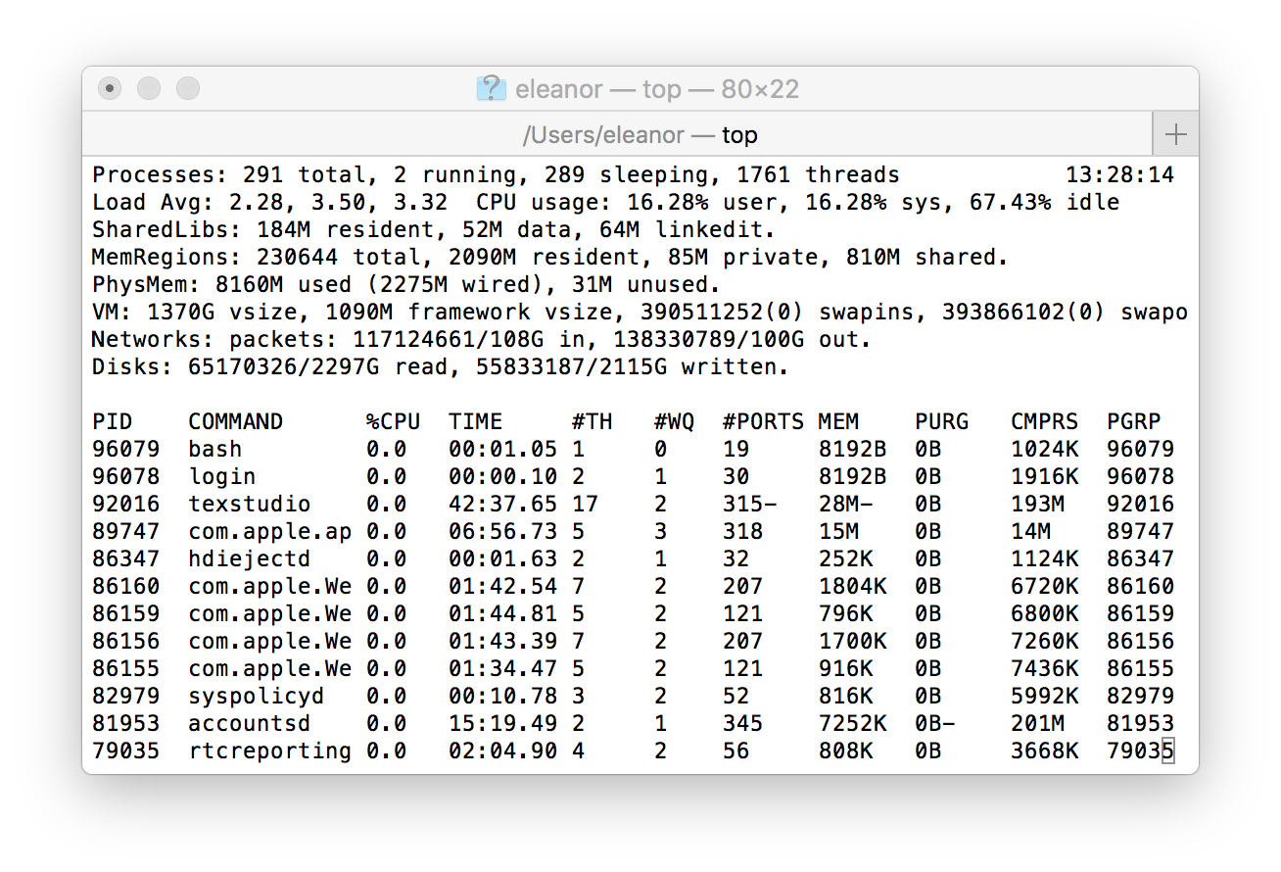
Multiprocessing
Computer runs many processes simultaneously
Running program “top” on Mac
Identified by Process ID (PID)
Notes:
Applications for one or more users
Web browsers, email clients, editors, …
Background tasks
Monitoring network & I/O devices

Slide 13
Multiprocessing: The Illusion
Memory
Memory
Memory
Stack
Stack
Stack
Heap
Heap
…
Heap
Data
Data
Data
Code
Code
Code
CPU
CPU
CPU
Registers
Registers
Registers
Process provides each program with two key abstractions:
Logical control flow
Each program seems to have exclusive use of the CPU
Provided by kernel mechanism called context switching
Private address space
Each program seems to have exclusive use of main memory.
Provided by kernel mechanism called virtual memory
Notes:
Each process has its own registers, memory, I/O resources, "thread of control"

Slide 14
Multiprocessing: The (Traditional) Reality
Memory
Stack
Stack
Stack
Heap
Heap
…
Heap
Data
Data
Data
Code
Code
Code
Saved registers
Saved registers
Saved registers
CPU
Registers
Single processor executes multiple processes concurrently
Process executions interleaved (multitasking)
Register values for nonexecuting processes saved in memory
Address spaces managed by virtual memory system

Slide 15
Context Switching
Processes are managed by a shared chunk of memory-resident kernel code
Important: the kernel code is not a separate process, but rather code and data structures that the OS uses to manage all processes
Control flow passes from one process to another via a context switch
Process A
Process B
user code
Time
kernel code
context switch
user code
kernel code
context switch
user code

Slide 16
Process Control Block (PCB)
To implement a context switch, OS maintains a PCB for each process containing:
process table, which contains information about the process (id, user, privilege level, arguments, status)
location of executable on disk
file table
register values (general-purpose registers, float registers, pc, eflags…)
memory state
scheduling information
... and more!

Slide 17
Multiprocessing: The (Traditional) Reality
Memory
Stack
Stack
Stack
Heap
Heap
…
Heap
Data
Data
Data
Code
Code
Code
Saved registers
Saved registers
Saved registers
CPU
Registers
Save current registers to memory (in PCB)

Slide 18
Multiprocessing: The (Traditional) Reality
Memory
Stack
Stack
Stack
Heap
Heap
…
Heap
Data
Data
Data
Code
Code
Code
Saved registers
Saved registers
Saved registers
CPU
Registers
Save current registers to memory (in PCB)
Schedule next process for execution

Slide 19
Multiprocessing: The (Traditional) Reality
Memory
Stack
Stack
Stack
Heap
Heap
…
Heap
Data
Data
Data
Code
Code
Code
Saved registers
Saved registers
Saved registers
CPU
Registers
Save current registers to memory (in PCB)
Schedule next process for execution
Load saved registers and switch address space

Slide 20
Multiprocessing: The (Modern) Reality
Memory
Stack
Stack
Stack
Heap
Heap
…
Heap
Data
Data
Data
Code
Code
Code
Saved registers
Saved registers
Saved registers
CPU
CPU
Registers
Registers
Multicore processors
Multiple CPUs on single chip
Share main memory (and some of the caches)
Each can execute a separate process
Scheduling of processors onto cores done by kernel

Slide 21
Exercise: Context Switching
A hardware designer argues that there are now enough on-chip transistors to build a CPU with 1024 integer registers and 512 floating point registers. As a result, the compiler should almost never need to store anything on the stack. As a new operating systems expert, would you recommend building this new design.

Slide 22
Process Life Cycle
Init
interrupt, yield
fork
Runnable
Running
scheduled

Slide 23
Exceptions
An exception is a transfer of control to the OS kernel in response to some event (i.e., change in processor state)
User code
Kernel code
Event
I_current
Exception
I_next
Exception processing
by exception handler
Return to I_current
Return to I_next
Abort

Slide 24
Exception Tables
Exception
numbers
Each type of event has a unique exception number k
k = index into exception table (a.k.a. interrupt vector)
Handler k is called each time exception k occurs
Code for
exception handler 0
Exception
Table
Code for
exception handler 1
0
1
Code for
exception handler 2
2
...
n-1
...
Code for
exception handler n-1

Slide 25
Synchronous Exceptions
Caused by events that occur as a result of executing an instruction:
Traps
Intentional
Examples: system calls, breakpoint traps, special instructions
Returns control to “next” instruction
Faults
Unintentional but possibly recoverable
Examples: page faults (recoverable), protection faults (unrecoverable), floating point exceptions
Either re-executes faulting (“current”) instruction or aborts
Aborts
Unintentional and unrecoverable
Examples: illegal instruction, divide-by-zero, parity error, machine check
Aborts current program

Slide 26
Interrupts (Asynchronous Exceptions)
Caused by events external to the process
Indicated by setting the processor’s interrupt pin
Handler returns to “next” instruction
Examples:
Timer interrupt
Every few ms, an external timer chip triggers an interrupt
Used by the kernel to take back control from user programs
I/O interrupt from external device
Hitting Ctrl-C at the keyboard
Arrival of a packet from a network
Arrival of data from a disk

Slide 27
fork Example
Call once, return twice
Duplicate but separate address space
x has a value of 1 when fork returns in parent and child
Subsequent changes to x are independent
Shared open files
stdout is the same in both parent and child
Concurrent execution
Can’t predict execution order of parent and child
int main(){
pid_t pid;
int x = 1;
pid = Fork();
if (pid == 0) { /* Child */
printf("child : x=%d\n", ++x);
return 0;
}
/* Parent */
printf("parent: x=%d\n", --x);
return 0;
}
x=2 2
Child
printf
x=1
x=0 0
Parent
main
fork
printf
Exercise: What are all the possible outputs of this program?
Notes:
What are the possible outputs?
e.g.,
linux> ./fork
parent: x=0
child : x=2

Slide 28
Modeling fork with Process Graphs
A process graph is a useful tool for capturing the partial ordering of statements in a concurrent program:
Each vertex is the execution of a statement
a -> b means a happens before b
Edges can be labeled with current value of variables
printf vertices can be labeled with output
Each graph begins with a vertex with no inedges
Any topological sort of the graph corresponds to a feasible total ordering.
Total ordering of vertices where all edges point from left to right

Slide 29
Interpreting Process Graphs
Original graph:
Relabeled graph:
x=2 2
Child
printf
x=1
x=0 0
Parent
main
fork
printf
Feasible total ordering:
e
a
b
e
c
a
b
c
Infeasible total ordering:
a
e
b
c

Slide 30
fork Example: Two consecutive forks
Bye
void fork1()
{
printf("L0\n");
fork();
printf("L1\n");
fork();
printf("Bye\n");
}
printf
L1
Bye
printf
fork
printf
Bye
printf
L0
L1
Bye
printf
fork
printf
fork
printf
Which of these outputs are feasible?
L0
L1
Bye
Bye
L1
Bye
Bye
L0
Bye
L1
Bye
L1
Bye
Bye
Notes:
1 Feasible
2. Infeasible

Slide 31
Exercise: Forks and Feasible Schedules
For each of the following programs, draw the process graph and then determine which of the possible outputs are feasible
void fork2(){
printf("L0\n");
if (fork() != 0) {
printf("L1\n");
if (fork() != 0) {
printf("L2\n");
}
}
printf("Bye\n");
}
void fork3(){
printf("L0\n");
if (fork() == 0) {
printf("L1\n");
if (fork() == 0) {
printf("L2\n");
}
}
printf("Bye\n");
}
L0
L1
Bye
Bye
L2
Bye
L0
Bye
L1
Bye
Bye
L2
L0
Bye
L1
L2
Bye
Bye
L0
Bye
L1
Bye
Bye
L2

Slide 32
Process Life Cycle
Init
interrupt, yield
fork
Runnable
Running
scheduled
process or
I/O completion
wait, I/O operation
Stopped

Slide 33
Reaping Children
Reaping
Performed by parent on terminated child (using wait or waitpid)
Parent is given exit status information
Kernel then deletes zombie child process
int wait(int* child_status)
Suspends current process until any one of its children terminates
Return value is the pid of the child process that terminated
If child_status != NULL, then the integer it points to will be set to a value that indicates reason the child terminated and the exit status
int waitpid(pid_t pid, int* child_status, int opt)
Suspends current process child with pid terminates

Slide 34
wait Example
void fork6() {
int child_status;
if (fork() == 0) {
printf("HC: hello from child\n");
exit(0);
} else {
printf("HP: hello from parent\n");
wait(&child_status);
printf("CT: child has terminated\n");
}
printf("Bye\n");
}
HC
exit
printf
CT
Bye
HP
fork
printf
wait
printf
Feasible output:
HC
HP
CT
Bye
Infeasible output:
HP
CT
Bye
HC

Slide 35
Reaping Children
What if parent doesn’t reap?
If any parent terminates without reaping a child, then the orphaned child will be reaped by init process (pid == 1)
So, only need explicit reaping in long-running processes
e.g., shells and servers

Slide 36
Process Life Cycle
Init
Terminated
interrupt, yield
fork
return from main,
exit, terminated
Runnable
Running
scheduled
process or
I/O completion
wait, I/O operation
Stopped

Slide 37
Terminating Processes
Process becomes terminated for one of three reasons:
Returning from the main routine
Calling the exit function
Receiving a signal whose default action is to terminate
void exit(int status)
Terminates with an exit status of status
Convention: normal return status is 0, nonzero on error
Another way to explicitly set the exit status is to return an integer value from the main routine
exit is called once but never returns.

