Slide 1
Lecture 12: Optimization
CS 105 Fall 2024

Slide 2
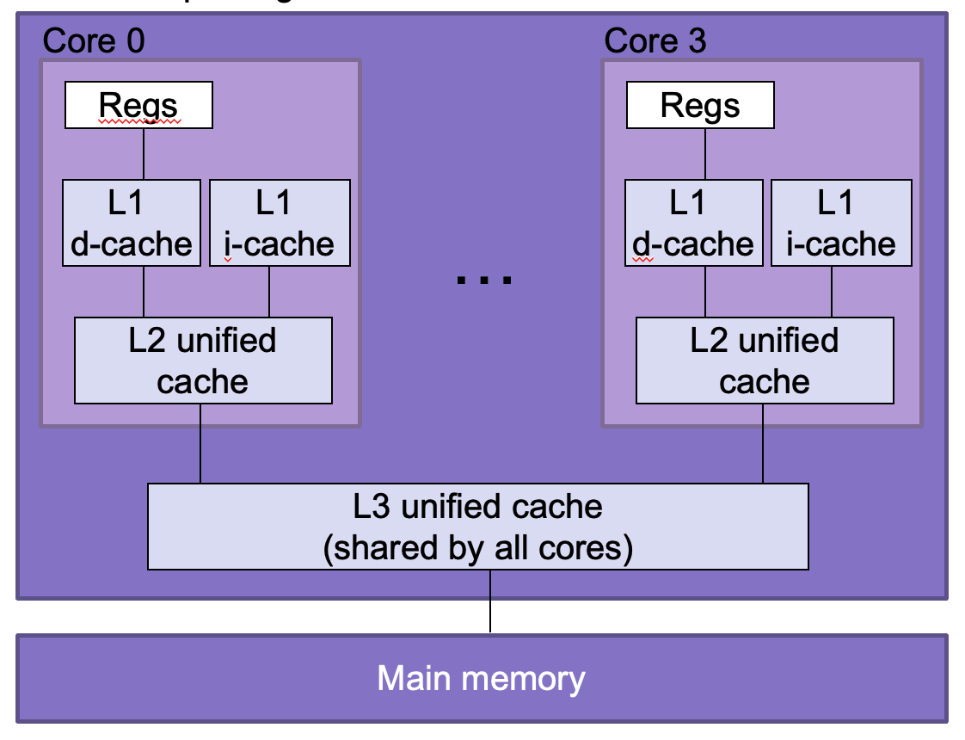
Under the Abstraction Barrier
#include<stdio.h>
int main(int argc,
char ** argv){
printf("Hello world!\n");
return 0;
}
pushq %rbp
movq %rsp, %rbp
subq $32, %rsp
leaq L_.str(%rip), %rax
movl $0, -4(%rbp)
movl %edi, -8(%rbp)
movq %rsi, -16(%rbp)
movq %rax, %rdi
movb $0, %al
callq _printf
xorl %ecx, %ecx
movl %eax, -20(%rbp)
movl %ecx, %eax
addq $32, %rsp
popq %rbp
retq
55
48 89 e5
48 83 ec 20
48 8d 05 25 00 00 00
c7 45 fc 00 00 00 00
89 7d f8
48 89 75 f0
48 89 c7
b0 00
e8 00 00 00 00
31 c9
89 45 ec
89 c8
48 83 c4 20
5d
c3

Slide 3
Techniques for Improving Performance
Use better algorithms/data structures
Compile to efficient byte code
Write code that compiles to efficient byte code
Parallelize your execution

Slide 4
Optimizing Compilers
Provide efficient mapping of program to machine code
register allocation
code selection and ordering (scheduling)
eliminating minor inefficiencies
Compiler optimization flags
-O0, -O1, -O2, -O3, -Os, -Og
Seldom improve asymptotic efficiency
up to programmer to select best overall algorithm
big-O savings are (often) more important than constant factors
but constant factors also matter

Slide 5
Eliminating Dead Code (-O0)
int dead_code(int input){
if(47 > 0){
return input;
} else {
return -1 *input;
}
}
int dead_code(int input){
return input;
}
dead_code:
movl %edi, %eax
ret

Slide 6
Code Motion (-O1)
Reduce frequency with which computation is performed
For example, move code out of a loop
void set_row(int* a, int* b,
int i, int n) {
for (int j = 0; j < n; j++) {
a[n*i+j] = b[j];
}
}
void set_row(int* a, int* b,
int i, int n) {
int ni = n*i;
for (int j = 0; j < n; j++){
a[ni+j] = b[j];
}
}
set_row:
testl %ecx, %ecx
jle .L1
imull %ecx, %edx
addl %edx, %ecx
.L3:
movl (%rsi), %r8d
movslq %edx, %rax
movl %r8d, (%rdi,%rax,4)
addl $1, %edx
addq $4, %rsi
cmpl %ecx, %edx
jne .L3
.L1:
rep ret

Slide 7
Factoring out Subexpressions (-O1)
Share common subexpressions
Gcc will do this with –O1
/* Sum neighbors of i,j */
up = val[(i-1)*n + j ];
down = val[(i+1)*n + j ];
left = val[i*n + j-1];
right = val[i*n + j+1];
sum = up + down + left + right;
long inj = i*n + j;
up = val[inj - n];
down = val[inj + n];
left = val[inj - 1];
right = val[inj + 1];
sum = up + down + left + right;
3 multiplications
1 multiplication
imulq %rcx, %rsi
addq %rdx, %rsi
movq %rsi, %rax
subq %rcx, %rax
leaq (%rsi,%rcx), %rcx
# i*n
# i*n+j
# i*n+j-n
# i*n+j+n

Slide 8
Loop Elimination (-O1)
int loop_while(int a){
int b = 4;
int i = 0;
int result = 0;
while (i < 16) {
result += a;
a -= b;
i += b;
}
return result;
}
int loop_while(int a){
return 4*a-24;
}
loop_while:
leal -24(,%rdi,4), %eax
ret

Slide 9
Reduction in Strength (-O2)
Replace costly operation with simpler one
For example, replace multiplication with shift or addition
void set_matrix(long* a, long* b,
long n){
for (long i = 0; i < n; i++) {
long ni = n*i;
for (long j = 0; j < n; j++){
a[ni + j] = b[j];
}
}
}
void set_matrix(long* a, long* b,
long n){
int ni = 0;
for (long i = 0; i < n; i++) {
for (long j = 0; j < n; j++){
a[ni + j] = b[j];
}
ni += n;
}
}
set_matrix:
xorl %r8d, %r8d
testq %rdx, %rdx
leaq 0(,%rdx,8), %r9
jle .L1
.L6: xorl %eax, %eax
.L3: movq (%rsi,%rax,8), %rcx
movq %rcx, (%rdi,%rax,8)
addq $1, %rax
cmpq %rax, %rdx
jne .L3
addq $1, %r8
addq %r9, %rdi
cmpq %r8, %rdx
jne .L6
.L1: rep ret

Slide 10
Machine Independent Optimization
Compilers optimize assembly code
Dead code elimination
Code motion
Factoring out common subexpressions
Loop elimination
Reduction in Strength

Slide 11
Case Study: Vector Data Type
/* data structure for vectors */
typedef struct {
long len;
data_t* data;
} vec;
data_t will vary by example
int
double
/* get length of vector */
long vec_length(vec* v) {
return v->len;
}
/* get address of vector element */
data_t* get_vec_elem(vec* v, long idx) {
if (idx >= v->len){
return NULL;
}
return &(v->data[idx]);
}

Slide 12
Benchmark Computation
void combine1(vec* v, data_t* dest){
*dest = IDENT;
for(long i = 0; i < vec_length(v); i++) {
data_t* val = get_vec_elem(v, i);
*dest = *dest OP *val;
}
}
Sum or product of vector elements
IDENT/OP may be 0/+ or 1/*
Metric: CPE, cycles per element
Time = CPE * n + Overhead

Slide 13
Benchmark Performance
void combine1(vec* v, data_t* dest){
*dest = IDENT;
for(long i = 0; i < vec_length(v); i++) {
data_t* val = get_vec_elem(v, i);
*dest = *dest OP *val;
}
}
Method | Integer |  | Double FP
Operation | Add | Mult | Add | Mult
Combine1 –O0 | 22.68 | 20.02 | 19.98 | 20.18
Combine1 –O1 | 10.12 | 10.12 | 10.17 | 11.14
Question: how could you optimize this code to get even better performance?

Slide 14
Limitations of Optimizing Compilers
Must not cause any change in program behavior
Often prevents optimizations that would only affect behavior under pathological conditions.
Data ranges may be more limited than variable type suggests
Compiler cannot know run-time inputs
When in doubt, the compiler must be conservative

Slide 15
Limitations of Optimizing Compilers
void mystery1(int* xp,
int* yp){
*xp = *xp + *yp;
*yp = *xp - *yp;
*xp = *xp – *yp;
}
void mystery2(int* xp,
int* yp){
int temp = *xp;
*xp = *yp;
*yp = temp;
}
?
Exercise: What do each of these programs do? Do they do the same thing?
Notes:
Exercise: Figure out what these functions do and whether they do the same thing
Potential problem: xp and yp might be different aliases for the same value
i.e., xp == yp

Slide 16
Comparing Programs
void mystery1(int* xp,
int* yp){
*xp = *xp + *yp;
*yp = *xp - *yp;
*xp = *xp – *yp;
}
void mystery2(int* xp,
int* yp){
int temp = *xp;
*xp = *yp;
*yp = temp;
}
temp
13
47
47
60
13
13
xp
xp
47
47
13
13
yp
yp

Slide 17
Comparing Programs
void mystery1(int* xp,
int* yp){
*xp = *xp + *yp;
*yp = *xp - *yp;
*xp = *xp – *yp;
}
void mystery2(int* xp,
int* yp){
int temp = *xp;
*xp = *yp;
*yp = temp;
}
temp
13
26
0
13
13
13
xp, yp
xp, yp

Slide 18
Optimization Blocker 1
Aliasing: Two different references to a single location
Easy to happen in C
Develop habit of introducing local variables
To accumulate within loops, for example
Your way of telling the compiler not to check for aliasing

Slide 19
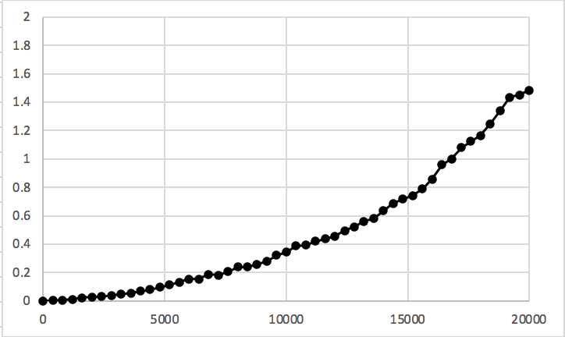
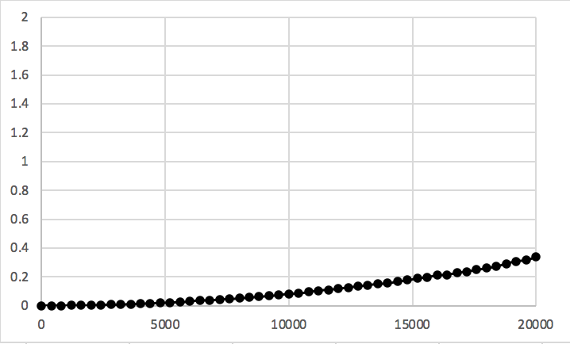
Example: Summing Matrix Rows
/* Sum rows of nxn matrix a, store
in vector sums */
void sum_rows1(int* a, int* sums,
int n) {
for (int i = 0; i < n; i++) {
sums[i] = 0;
for (long j = 0; j < n; j++){
sums[i] += a[i*n + j];
}
}
}
/* Sum rows of nxn matrix a, store
in vector sums */
void sum_rows2(int* a, int* sums,
int n) {
for (int i = 0; i < n; i++) {
int val = 0;
for (long j = 0; j < n; j++){
val += a[i*n + j];
}
sums[i] = val;
}
}
# sum_rows1 inner loop
.L4:
movl (%rax), %edx
addl %edx, (%rsi,%r10,4)
addq $4, %rax
decq %rcx
jne .L3
# sum_rows2 inner loop
.L10:
addl (%rdx), %eax
addq $4, %rdx
decq %rcx
jne .L3

Slide 20
Limitations of Optimizing Compilers
Must not cause any change in program behavior
Often prevents optimizations that would only affect behavior under pathological conditions.
Data ranges may be more limited than variable type suggests
Compiler cannot know run-time inputs
When in doubt, the compiler must be conservative
Most analysis is performed only within procedures
Whole-program analysis is too expensive in most cases
Newer versions of gcc do inter-procedural analysis within files

Slide 21
Exercise 2: Procedure Calls
Consider the following two functions. What do each of these programs do? Do they do the same thing?
long f1();
long f2(){
return f1() + f1();
}
?
long f1();
long f2(){
return 2*f1();
}
Notes:
problem: f1 might have side-effects
update global variables
write to file/network
UI feature

Slide 22
Optimization Blocker 2
Compiler treats procedure calls as black boxes
Unknown side-effects
strlen may not always return the same value
Alternatives:
Do your own code motion (necessary here)
Use inline keyword when declaring functions
gcc will optimize within a single file with –O1

Slide 23
Example: Lowering Case
void lower(char* s){
int i;
for (i = 0; i < strlen(s); i++){
if (s[i] >= 'A' && s[i] <= 'Z'){
s[i] -= ('A' - 'a');
}
}
}
void lower(char* s){
int i;
int len = strlen(s);
for (i = 0; i < len; i++){
if (s[i] >= 'A' && s[i] <= 'Z'){
s[i] -= ('A' - 'a');
}
}
}

Slide 24
Machine Independent Optimization
Compilers optimize assembly code
Dead code elimination
Code motion
Factoring out common subexpressions
Loop elimination
Reduction in Strength
Optimization blockers:
Aliasing
Use local variables
Procedure calls
Move them yourself

Slide 25
Exercise: Code-Level Optimizations
void combine1(vec* v, data_t* dest){
*dest = IDENT;
for(long i = 0; i < vec_length(v); i++) {
data_t* val = get_vec_elem(v, i);
*dest = *dest OP *val;
}
}
Method | Integer |  | Double FP
Operation | Add | Mult | Add | Mult
Combine1 –O0 | 22.68 | 20.02 | 19.98 | 20.18
Combine1 –O1 | 10.12 | 10.12 | 10.17 | 11.14
Exercise: how could you optimize this code to get even better performance?

Slide 26
Exercise: Code-Level Optimizations
void combine2(vec* v, data_t*
dest){
data_t x = IDENT;
long length = vec_length(v);
for(long i=0; i<length; i++){
data_t* val=get_vec_elem(v,i);
x = x OP val;
}
*dest = x;
}
void combine1(vec* v, data_t*
dest){
*dest = IDENT;
for(long i=0;i<vec_length(v);
i++){
data_t* val=get_vec_elem(v,i);
*dest = *dest OP *val;
}
}
void combine2(vec* v, data_t*
dest){
data_t x = IDENT;
long length = vec_length(v);
data_t *d=get_vec_elem(v,0);
for(long i=0; i<length; i++){
x = x OP d[i];
}
*dest = x;
}
void combine2(vec* v, data_t*
dest){
data_t x = IDENT;
for(long i=0; i<vec_length(v);
i++){
data_t* val=get_vec_elem(v,i);
x = x OP *val;
}
*dest = x;
}
Accumulate in temporary variable
Move vec_length out of loop
Avoid extra bounds check on each cycle

Slide 27
Code-Level Optimizations
void combine2(vec* v, data_t* dest){
data_t x = IDENT;
long length = vec_length(v);
data_t* d = get_vec_element(v,0);
for(long i = 0; i < length; i++){
x = x OP d[i];
}
*dest = x;
}
Method | Integer |  | Double FP
Operation | Add | Mult | Add | Mult
Combine1 –O0 | 22.68 | 20.02 | 19.98 | 20.18
Combine1 –O1 | 10.12 | 10.12 | 10.17 | 11.14
Combine2 | 1.27 | 3.01 | 3.01 | 5.01

Slide 28
Loop Unrolling
int psum1(int a[],int sums[],int n){
int i;
sums[0] = a[0];
for(i = 1; i < n; i++){
sums[i] = sums[i-1] + a[i];
}
}
int psum2(int a[],int sums[],int n){
int i;
sums[0] = a[0];
for(i = 1; i < n-1; i+=2){
sums[i] = sums[i-1] + a[i];
sums[i+1] = sums[i] + a[i+1];
}
if (i < n){ // handle odd #iterations
sums[i] = sum[i-1] + a[i];
}
}
Notes:
Note: it would be better to store sums[i-1]+a[i] in a local variable to reduce memory accesses
Note: unroll and jam at O3, general unroll-loops not

Slide 29
Combine with Unrolling
void unroll2_combine(vec* v, data_t* dest){
long length = vec_length(v);
long limit = length-1;
data_t* d = get_vec_element(v,0);
data_t x = IDENT;
/* Combine 2 elements at a time */
for(long i = 0; i < limit; i+=2) {
x = (x OP d[i]) OP d[i+1];
}
/* Finish any remaining elements */
for (; i < length; i++) {
x = x OP d[i];
}
*dest = x;
}
Method | Integer |  | Double FP
Operation | Add | Mult | Add | Mult
Combine1 –O0 | 22.68 | 20.02 | 19.98 | 20.18
Combine1 –O1 | 10.12 | 10.12 | 10.17 | 11.14
Combine2 | 1.27 | 3.01 | 3.01 | 5.01
Unroll 2 | 1.01 | 3.01 | 3.01 | 5.01
Latency Bound | 1.00 | 3.00 | 3.00 | 5.00

Slide 30
Reassociation
x = (x OP d[i]) OP d[i+1];
x = x OP (d[i] OP d[i+1]);
1
d₀
d₀
d₁
*
d₁
*
d₂
d₃
1
*
d₂
*
d₄
d₅
*
*
d₃
*
d₆
d₇
*
*
d₄
*
*
*
d₅
*
*
d₆
*
d₇
*
Notes:
What changed: Ops in the next iteration can be started early (no dependency)

Slide 31
Effect of Reassociation
Method | Integer |  | Double FP
Operation | Add | Mult | Add | Mult
Combine1 –O0 | 22.68 | 20.02 | 19.98 | 20.18
Combine1 –O1 | 10.12 | 10.12 | 10.17 | 11.14
Combine2 | 1.27 | 3.01 | 3.01 | 5.01
Unroll 2 | 1.01 | 3.01 | 3.01 | 5.01
Unroll 2a | 1.01 | 1.51 | 1.51 | 2.51
Latency Bound | 1.00 | 3.00 | 3.00 | 5.00
Throughput Bound | 0.50 | 1.00 | 1.00 | 0.50
Nearly 2x speedup for Int *, FP +, FP *
Reason: Breaks sequential dependency
2 func. units for FP *
2 func. units for load
x = x OP (d[i] OP d[i+1]);
pipelined processor
4 func. units for int +
2 func. units for load

Slide 32
Separate Accumulators
void unroll2a_combine(vec_ptr v,
data_t* dest)
{
long length = vec_length(v);
long limit = length-1;
data_t* d = get_vec_element(v,0);
data_t x0 = IDENT;
data_t x1 = IDENT;
long i;
/* Combine 2 elements at a time */
for (i = 0; i < limit; i+=2) {
x0 = x0 OP d[i];
x1 = x1 OP d[i+1];
}
/* Finish any remaining elements */
for (; i < length; i++) {
x0 = x0 OP d[i];
}
*dest = x0 OP x1;
}
1
d₀
1
d₁
*
d₂
*
d₃
*
d₄
*
d₅
*
d₆
*
d₇
*
*
*
Two independent streams of operation

Slide 33
Effect of Separate Accumulators
Method | Integer |  | Double FP
Operation | Add | Mult | Add | Mult
Combine1 –O0 | 22.68 | 20.02 | 19.98 | 20.18
Combine1 –O1 | 10.12 | 10.12 | 10.17 | 11.14
Combine2 | 1.27 | 3.01 | 3.01 | 5.01
Unroll 2 | 1.01 | 3.01 | 3.01 | 5.01
Unroll 2a | 1.01 | 1.51 | 1.51 | 2.51
Unroll 2x2 | 0.81 | 1.51 | 1.51 | 2.51
Latency Bound | 1.00 | 3.00 | 3.00 | 5.00
Throughput Bound | 0.50 | 1.00 | 1.00 | 0.50
x0 = x0 OP d[i];
x1 = x1 OP d[i+1];
Int + makes use of two load units
for Int *, FP +, FP *, speedup similar to unroll with reassociation

Slide 34
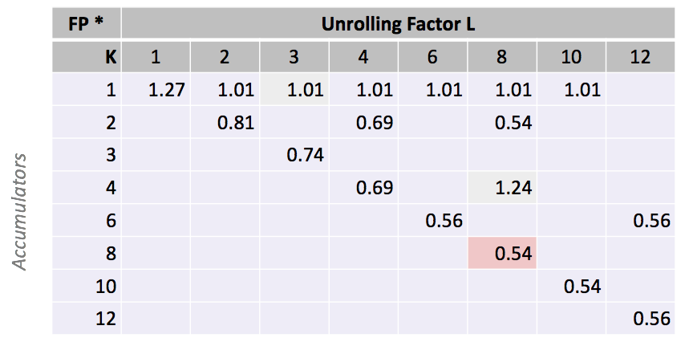
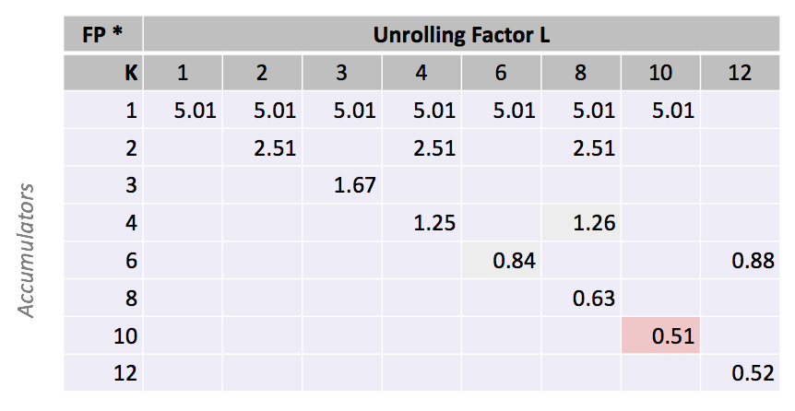
Machine-Dependent Optimization
Integer Addition
Float Multiplication

Slide 35
Machine-Dependent Optimization
Method | Integer |  | Double FP
Operation | Add | Mult | Add | Mult
Combine1 –O0 | 22.68 | 20.02 | 19.98 | 20.18
Combine1 –O1 | 10.12 | 10.12 | 10.17 | 11.14
Combine2 | 1.27 | 3.01 | 3.01 | 5.01
Unroll 2 | 1.01 | 3.01 | 3.01 | 5.01
Unroll 2a | 1.01 | 1.51 | 1.51 | 2.51
Unroll 2x2 | 0.81 | 1.51 | 1.51 | 2.51
Optimal Unrolling | 0.54 | 1.01 | 1.01 | 0.51
Latency Bound | 1.00 | 3.00 | 3.00 | 5.00
Throughput Bound | 0.50 | 1.00 | 1.00 | 0.50
Method | Integer |  | Double FP
Operation | Add | Mult | Add | Mult
Best | 0.54 | 1.01 | 1.01 | 0.52
Latency Bound | 1.00 | 3.00 | 3.00 | 5.00
Throughput Bound | 0.50 | 1.00 | 1.00 | 0.50
Limited only by throughput of hardware
Up to 42X improvement over original, unoptimized code

