Slide 1
Lecture 2: Representing Integers
CS 105 Fall 2026

Slide 2
Review: Bits Require Interpretation
10001100 00001100 10101100 00000000
might be interpreted as
  The integer 3,485,745
  A floating point number close to 4.884569 x 10⁻³⁹
  The string “105”
  A portion of an image or video
  An address in memory

Slide 3


Representing Integers
Arabic Numerals: 47
Roman Numerals: XLVII
Brahmi Numerals:
Tally Marks: IIII IIII IIII IIII IIII IIII IIII IIII IIII II

Slide 4
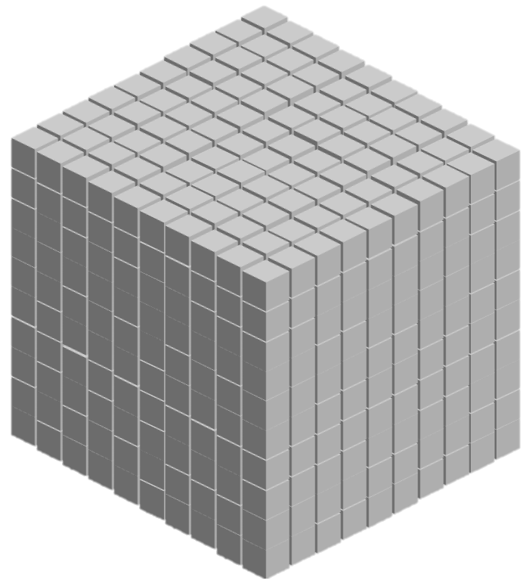
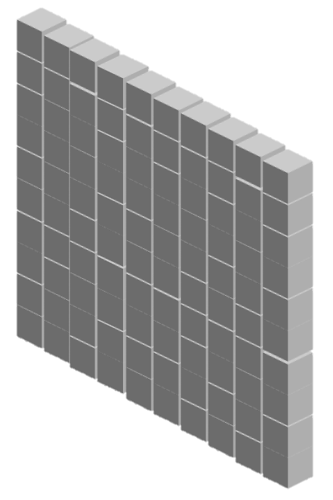


Base-10 Integers
1000 (10³) | 100 (10²) | 10 (10¹) | 1 (10⁰)
0 | 0 | 0 | 5
0 | 0 | 4 | 7
1 | 8 | 8 | 7

Slide 5
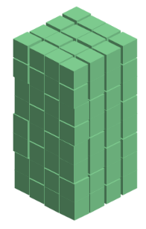
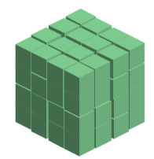
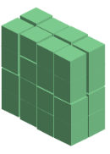
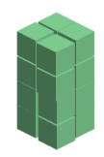



Base-2 Integers (aka Binary Numbers)
128 (2⁷) | 64 (2⁶) | 32 (2⁵) | 16 (2⁴) | 8 (2³) | 4 (2²) | 2 (2¹) | 1 (2⁰)
0 | 0 | 0 | 0 | 0 | 1 | 0 | 1
0 | 0 | 1 | 0 | 1 | 1 | 1 | 1
1 | 1 | 1 | 1 | 1 | 1 | 1 | 1

Slide 6
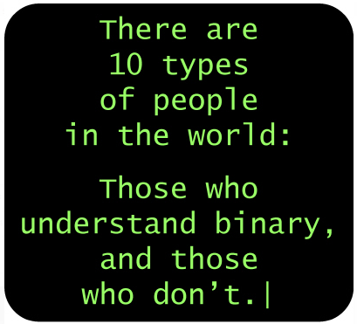
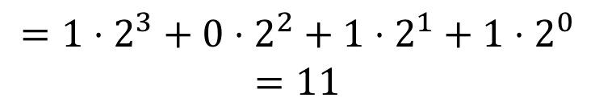
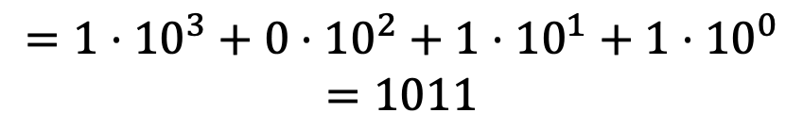
Binary Numbers
Decimal (Base-10):
Binary (Base-2):
1011
$$=1⋅{10}^{3}+0⋅{10}^{2}+1⋅{10}^{1}+1⋅{10}^{0}$$
$$=1011$$
1011
$$=1⋅2^{3}+0⋅2^{2}+1⋅2^{1}+1⋅2^{0}$$
$$=11$$

Slide 7
Exercise 1: Binary Numbers
Consider the following four-bit binary values. What is the (base-10) integer interpretation of these values?
  0001
  1010
  0111
  1111
1
10
7
15

Slide 8
Hexidecimal Numbers
00101100 00110101 00110000 11100001
Dec | Hex
0
1
2
3
4
5
6
7
8
9
10
11
12
13
14
15
0
1
2
3
4
5
6
7
8
9
2
c
3
5
3
0
e
1
0x2c3530e1
a
b
c
d
e
f

Slide 9
Exercise 2: Hexidecimal Numbers
Consider the following hexidecimal values. What is the representation of each value in binary?
  0x0a
  0x11
  0x2f
00001010 (10)
00010001 (17)
00101111 (47)

Slide 10
Addition Example
Compute 5 + 6 assuming all ints are stored as eight-bit (1 byte) unsigned values
1
0 0 0 0 0 1 0 1
+ 0 0 0 0 0 1 1 0
0
0
0
0
1
0
1
1
= 11 (Base-10)
Like you learned in grade school, only binary!
… and with a finite number of digits

Slide 11
Addition Example with Overflow
Compute 200 + 100 assuming all ints are stored as eight-bit (1 byte) unsigned values
1
1
1 1 0 0 1 0 0 0
+ 0 1 1 0 0 1 0 0
0
0
1
0
1
1
0
0
= 44 (Base-10)
Like you learned in grade school, only binary!
… and with a finite number of digits

Slide 12

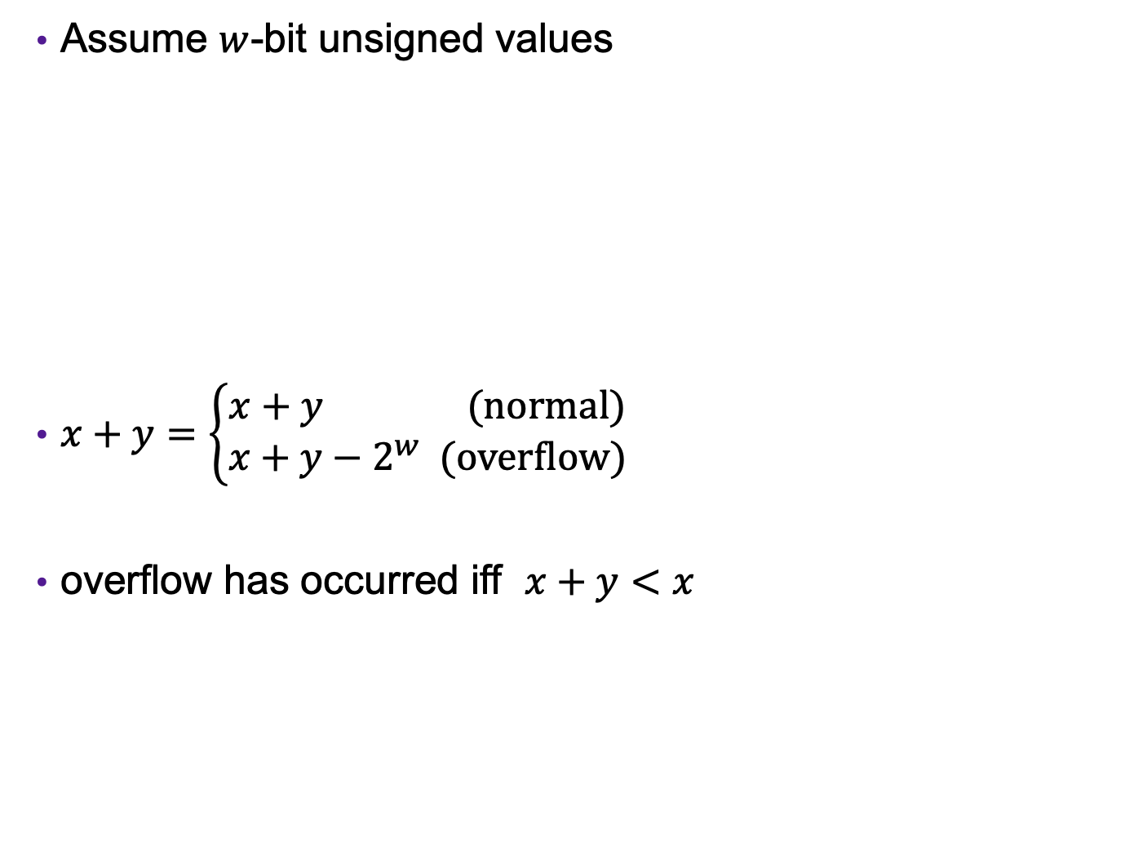



Error Cases (Unsigned Ints)
Assume $w$-bit unsigned values
$x+y=\left\{\begin{aligned}x+y (normal) \\ x+y−2^{w} (overflow)\end{aligned}\right.$
overflow has occurred iff $x+y<x$
$$0$$
$$2^{w}−1$$
$${2⋅(2}^{w}−1)$$
[ ]
representable values
[ ]
Possible values of $x+y$
modular addition

Slide 13
Exercise 3: Binary Addition
Given the following 5-bit unsigned values, compute their sum and indicate whether or not an overflow occurred
x | y | x+y | overflow?
00010 | 00101
01100 | 00100
10100 | 10001
x+y | overflow?
00111
no
10000
no
00101
yes

Slide 14
Multiplication Example
Compute 5 x 6 assuming all ints are stored as eight-bit (1 byte) unsigned values
0 0 0 0 0 1 0 1
x 0 0 0 0 0 1 1 0
0 0 0 0 0 0 0 0
0 0 0 0 0 1 0 1 0
0 0 0 0 0 1 0 1 0 0
+ _
0 0 0 1 1 1 1 0
= 30 (Base-10)
Like you learned in grade school, only binary!
… and with a finite number of digits

Slide 15
Multiplication Example
Compute 200 x 3 assuming all ints are stored as eight-bit (1 byte) unsigned values
1 1 0 0 1 0 0 0
x 0 0 0 0 0 0 1 1
1 1 0 0 1 0 0 0
1 1 0 0 1 0 0 0 0
+ _
1 0
0 1 0 1 1 0 0 0
= 88 (Base-10)
Like you learned in grade school, only binary!
… and with a finite number of digits

Slide 16
Exercise (4): Binary Multiplication
Given the following 3-bit unsigned values, compute their product and indicate whether or not an overflow occurred
x | y | x*y | overflow?
100 | 101
010 | 011
111 | 010
x*y | overflow?
100
yes
110
no
110
yes

Slide 17
What about positive/negative integers?

Slide 18
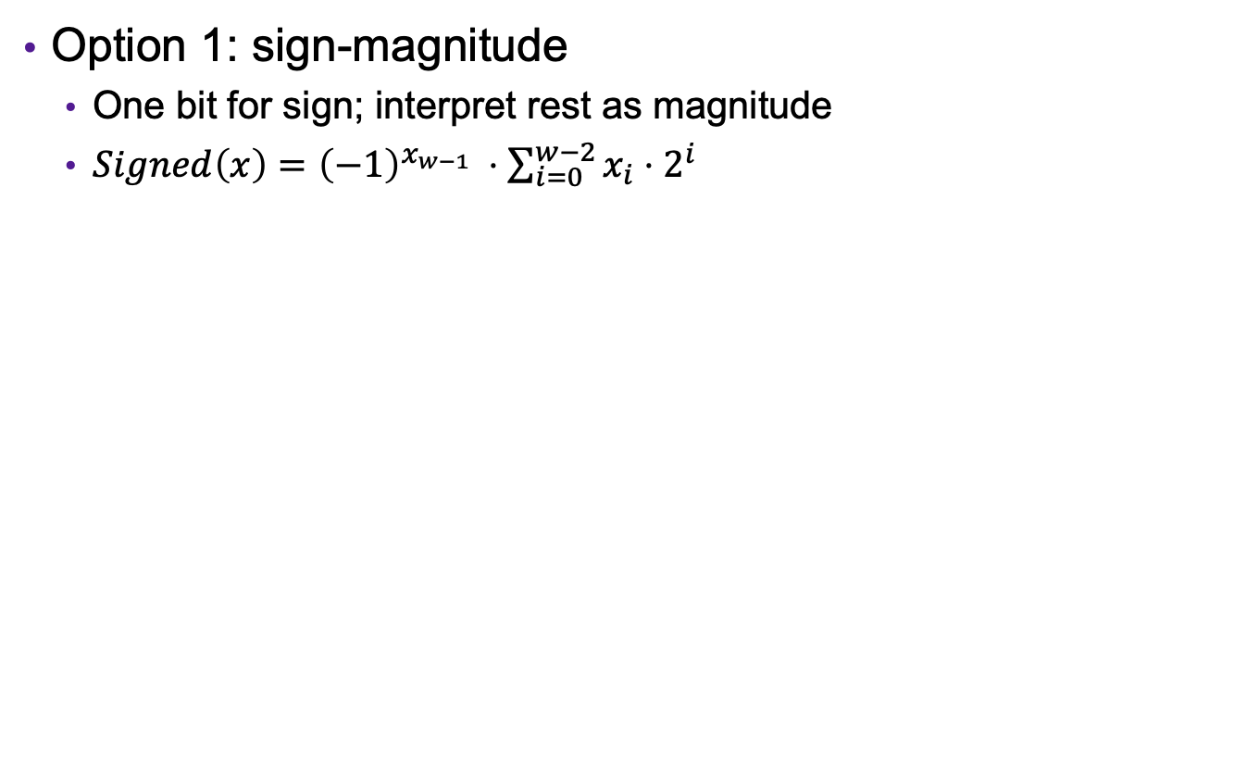
Representing Signed Integers
Option 1: sign-magnitude
  One bit for sign; interpret rest as magnitude
  $Signed\left(x\right)={{\left(−1\right)}^{x_{w−1}}}_{ }⋅\sum_{i=0}^{w−2}{x_{i}⋅2^{i}}$
+/- | 64 (2⁶) | 32 (2⁵) | 16 (2⁴) | 8 (2³) | 4 (2²) | 2 (2¹) | 1 (2⁰)
-
0 | 0 | 0 | 0 | 0 | 1 | 0 | 1
1 | 0 | 0 | 0 | 0 | 1 | 0 | 1
1 | 1 | 1 | 1 | 1 | 1 | 1 | 1
Notes:
Issues: two zeros, arithmetic is different for pos vs neg (and weird around zero), e.g, try 5+1 vs -5+1 vs. -5 + 6

Slide 19
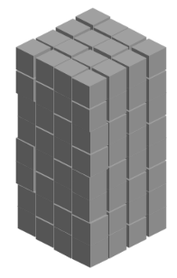

Representing Signed Integers
Option 2: excess-K
  Choose a positive K in the middle of the unsigned range
  $Signed\left(x\right)=\sum_{i=0}^{w−1}{x_{i}⋅2^{i} }−2^{w−1}$
128 (2⁷) | 64 (2⁶) | 32 (2⁵) | 16 (2⁴) | 8 (2³) | 4 (2²) | 2 (2¹) | 1 (2⁰) | -128
0 | 0 | 0 | 0 | 0 | 1 | 0 | 1
1 | 0 | 0 | 0 | 0 | 1 | 0 | 1
1 | 1 | 1 | 1 | 1 | 1 | 1 | 1
Notes:
issue: zero no longer zero -> multiplication is weird

Slide 20

Representing Signed Integers
Option 3: two’s complement
  Like unsigned, except the high-order contribution is negative
  $Signed\left(x\right)=−x_{w−1}⋅2^{w−1}+\sum_{i=0}^{w−2}{x_{i}⋅2^{i}}$
-128 (-2⁷) | 64 (2⁶) | 32 (2⁵) | 16 (2⁴) | 8 (2³) | 4 (2²) | 2 (2¹) | 1 (2⁰)
0 | 0 | 0 | 0 | 0 | 1 | 0 | 1
1 | 0 | 0 | 0 | 0 | 1 | 0 | 1
1 | 1 | 1 | 1 | 1 | 1 | 1 | 1

Slide 21
Important Signed Integers
 | 8 | 16 | 32 | 64
TMax | 0x7F | 0x7FFF | 0x7FFFFFFF | 0x7FFFFFFFFFFFFFFF
TMin | 0x80 | 0x8000 | 0x80000000 | 0x8000000000000000
0 | 0x00 | 0x0000 | 0x00000000 | 0x0000000000000000
-1 | 0xFF | 0xFFFF | 0xFFFFFFFF | 0xFFFFFFFFFFFFFFFF

Slide 22
Exercise 4: (Signed) Binary Numbers
Consider the following one-byte binary values. What is the (signed) integer interpretation of these values?
  01101001
  10010111
  01000010
  10111110
What is the one-byte binary representation of the following integers?
  47
  -47
105
-105
66
-66
00101111
11010001
-x == -x+1-1 == -1-x+1 == 111…1-x+1 = ~x+1

Slide 23
Integers in C
C Data Type | Size (bytes)
unsigned char | 1
unsigned short | 2
unsigned int | 4
unsigned long | 8
C Data Type | Size (bytes)
char | 1
short | 2
int | 4
long | 8
Notes:
Note: unsigned demo

Slide 24
Addition Example
Compute 5 + -3 assuming all ints are stored as four-bit signed values
1
1
0 1 0 1
+ 1 1 0 1
0
0
1
0
= 2 (Base-10)
Exactly the same as unsigned numbers!
… but with different error cases

Slide 25
Addition/Subtraction with Overflow
Compute 5 + 6 assuming all ints are stored as four-bit signed values
1
0 1 0 1
+ 0 1 1 0
1
0
1
1
= -5 (Base-10)

Slide 26
Exercise (5): (Signed) Binary Addition
Given the following 5-bit signed values, compute their sum and indicate whether or not an overflow occurred
x | y | x+y | overflow?
00010 | 00101
01100 | 00100
10100 | 10001
x+y | overflow?
00101
no
10000
yes
00101
yes

Slide 27
Multiplication Example
Compute 3 x 2 assuming all ints are stored as four-bit signed values
0 0 1 1
x 0 0 1 0
0 0 0 0
0 0 1 1 0
+ _
0 1 1 0
= 6 (Base-10)
Exactly like unsigned multiplication!
… except with different error cases

Slide 28
Multiplication Example
Compute 5 x 2 assuming all ints are stored as four-bit signed values
0 1 0 1
x 0 0 1 0
0 0 0 0
0 1 0 1 0
+ _
1 0 1 0
= -6 (Base-10)

Slide 29
Exercise 5: (Signed) Binary Multiplication
Given the following 3-bit signed values, compute their product and indicate whether or not an overflow occurred
x | y | x*y | overflow?
100 | 101
010 | 011
111 | 010
x*y | overflow?
100
yes
110
yes
110
no

Slide 30
Casting between Numeric Types
Casting from shorter to longer types preserves the value
Casting from longer to shorter types drops the high-order bits
Casting between signed/unsigned types preserves the bits (it just changes the interpretation)
Implicit casting occurs in assignments and parameter lists. In mixed expressions, signed values are implicitly cast to unsigned
    Source of many errors!
Notes:
Note: casting part of signed demo

Slide 31
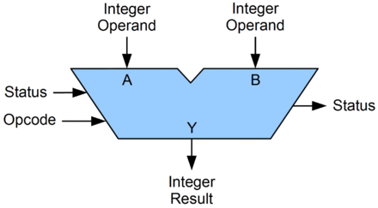
Arithmetic Logic Unit (ALU)
circuit that performs bitwise operations and arithmetic on integer binary types

Slide 32
Review: Bitwise vs Logical Operations
Bitwise Operators &, |, ~, ^
  View arguments as bit vectors
  operations applied bit-wise in parallel
Logical Operators &&, ||, !
  View 0 as “False”
  View anything nonzero as “True”
  Always return 0 or 1
  Early termination
Shift operators <<, >>
  Left shift fills with zeros
  For unsigned integers, right shift is logical (fills with zeros)

Slide 33
Exercise 6: Bitwise vs Logical Operations
What is the binary representation of each of the following expressions? Assume signed char data type (one byte).
  ~(-30)
  -30 & 22
  -30 && 22
  22 << 1
  22 >> 1
  -30 >> 1
= ~(11100010) = 00011101 = 29
= 11100010 & 00010110 = 00000010 = 2
= 11100010 && 00010110 = 00000001 = 1
= 00010110 << 1 = 00101100 = 44
= 00010110 >> 1 = 00001011 = 11
= 11100010 >> 1 = 11110001 = -15

Slide 34
Multiplying with Shifts
Multiplication is slow
Bit shifting is kind of like multiplication, and is often faster
  x * 8 = x << 3
  x * 10 = x << 3 + x << 1
Most compilers will automatically replace multiplications with shifts where possible

Slide 35
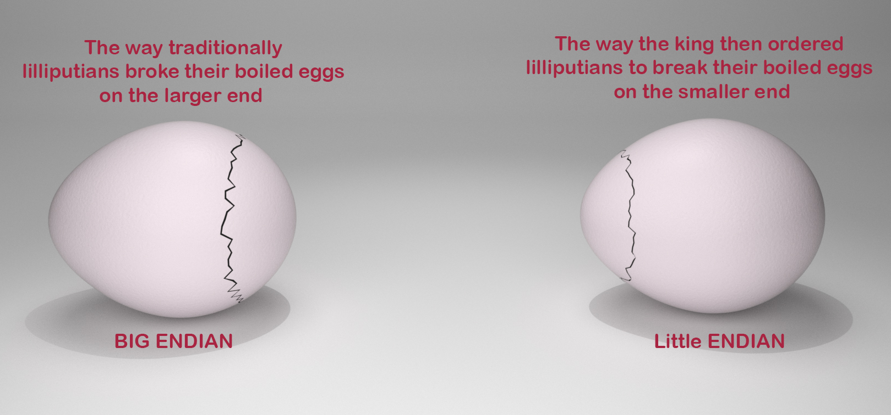
Endianness
47 vs 74

Slide 36
Endianness
Big Endian: low-order bits go on the right (47)
  I tend to think in big endian numbers, so examples in class will generally use this representation
  Networks generally use big endian (aka network byte order)
Little Endian: low-order bits go on the left (74)
  Most modern machines use this representation
I will try to always be clear about whether I'm using a big endian or little endian representation
When in doubt, ask!

