Slide 1
Lecture 2: Representing Integers
CS 105 Fall 2024

Slide 2
Review: Memory
bytes
Memory is an array of bits
A byte is a unit of eight bits
An index into the array is an address, location, or pointer
Often expressed in hexadecimal
We speak of the value in memory at an address
The value may be a single byte …
… or a multi-byte quantity starting at that address
00110111
1
1
1
0
1
1
0
3
0
11010001
1
0
0
0
1
0
1
2
1
01010011
1
1
0
0
1
0
1
1
0
01101100
0
0
1
1
0
1
0
1
0

Slide 3
Review: Bits Require Interpretation
10001100 00001100 10101100 00000000
might be interpreted as
The integer 3,485,745
A floating point number close to 4.884569 x 10⁻³⁹
The string “105”
A portion of an image or video
An address in memory

Slide 4
Representing Integers
Arabic Numerals: 47
Roman Numerals: XLVII
Brahmi Numerals:
Tally Marks: IIII IIII IIII IIII IIII IIII IIII IIII IIII II

Slide 5
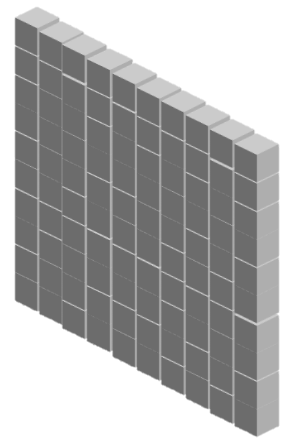
Base-10 Integers
1000 (10³) | 100 (10²) | 10 (10¹) | 1 (10⁰)
0 | 0 | 0 | 5
0 | 0 | 4 | 7
1 | 8 | 8 | 7

Slide 6
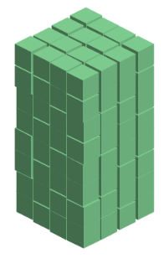
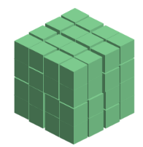
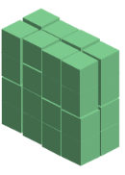
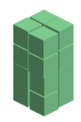
Base-2 Integers (aka Binary Numbers)
128 (2⁷) | 64 (2⁶) | 32 (2⁵) | 16 (2⁴) | 8 (2³) | 4 (2²) | 2 (2¹) | 1 (2⁰)
0 | 0 | 0 | 0 | 0 | 1 | 0 | 1
0 | 0 | 1 | 0 | 1 | 1 | 1 | 1
1 | 1 | 1 | 1 | 1 | 1 | 1 | 1

Slide 7
Exercise 1: Binary Numbers
Consider the following four-bit binary values. What is the (base-10) integer interpretation of these values?
0001
1010
0111
1111
1
10
7
15

Slide 8
Representing Signed Integers
Option 1: sign-magnitude
One bit for sign; interpret rest as magnitude
$Signed\left(x\right)={{\left(−1\right)}^{x_{w−1}}}_{ }⋅\sum_{i=0}^{w−2}{x_{i}⋅2^{i}}$
+/- | 64 (2⁶) | 32 (2⁵) | 16 (2⁴) | 8 (2³) | 4 (2²) | 2 (2¹) | 1 (2⁰)
-
0 | 0 | 0 | 0 | 0 | 1 | 0 | 1
1 | 0 | 0 | 0 | 0 | 1 | 0 | 1
1 | 1 | 1 | 1 | 1 | 1 | 1 | 1
Notes:
Issues: two zeros, arithmetic is different for pos vs neg (and weird around zero), e.g, try 5+1 vs -5+1 vs. -5 + 6

Slide 9
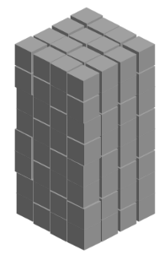
Representing Signed Integers
Option 2: excess-K
Choose a positive K in the middle of the unsigned range
$Signed\left(x\right)=\sum_{i=0}^{w−1}{x_{i}⋅2^{i} }−2^{w−1}$
128 (2⁷) | 64 (2⁶) | 32 (2⁵) | 16 (2⁴) | 8 (2³) | 4 (2²) | 2 (2¹) | 1 (2⁰) | -128
0 | 0 | 0 | 0 | 0 | 1 | 0 | 1
1 | 0 | 0 | 0 | 0 | 1 | 0 | 1
1 | 1 | 1 | 1 | 1 | 1 | 1 | 1
Notes:
issue: zero no longer zero -> multiplication is weird

Slide 10
Representing Signed Integers
Option 3: two’s complement
Like unsigned, except the high-order contribution is negative
$Signed\left(x\right)=−x_{w−1}⋅2^{w−1}+\sum_{i=0}^{w−2}{x_{i}⋅2^{i}}$
-128 (-2⁷) | 64 (2⁶) | 32 (2⁵) | 16 (2⁴) | 8 (2³) | 4 (2²) | 2 (2¹) | 1 (2⁰)
0 | 0 | 0 | 0 | 0 | 1 | 0 | 1
1 | 0 | 0 | 0 | 0 | 1 | 0 | 1
1 | 1 | 1 | 1 | 1 | 1 | 1 | 1

Slide 11
Exercise 2: (Signed) Binary Numbers
Consider the following four-bit binary values. What is the (base-10) signed integer interpretation of these values?
0001
1010
0111
1111
1
-6
7
-1

Slide 12
Signed Integer Trivia
Base-10 | unsigned | signed
7 | 111
6 | 110
5 | 101
4 | 100
3 | 011 | 011
2 | 010 | 010
1 | 001 | 001
0 | 000 | 000
-1 |  | 111
-2 |  | 110
-3 |  | 101
-4 |  | 100
For signed ints:
high-order (left-most) bit is 0 for pos values, 1 for neg
000…0 is 0
111…1 is -1
same representation as unsigned for numbers that can be represented with both
~x+1 == -1*x

Slide 13
Integers in C
C Data Type | Size (bytes)
unsigned char | 1
unsigned short | 2
unsigned int | 4
unsigned long | 8
C Data Type | Size (bytes)
char | 1
short | 2
int | 4
long | 8
Notes:
Note: unsigned demo

Slide 14
ASCII characters
Char | Dec | Binary
! | 33 | 00100001
" | 34 | 00100010
# | 35 | 00100011
$ | 36 | 00100100
% | 37 | 00100101
& | 38 | 00100110
' | 39 | 00100111
( | 40 | 00101000
) | 41 | 00101001
* | 42 | 00101010
+ | 43 | 00101011
, | 44 | 00101100
- | 45 | 00101101
. | 46 | 00101110
/ | 47 | 00101111
0 | 48 | 00110000
Char | Dec | Binary
1 | 49 | 00110001
2 | 50 | 00110010
3 | 51 | 00110011
4 | 52 | 00110100
5 | 53 | 00110101
6 | 54 | 00110110
7 | 55 | 00110111
8 | 56 | 00111000
9 | 57 | 00111001
: | 58 | 00111010
; | 59 | 00111011
< | 60 | 00111100
= | 61 | 00111101
> | 62 | 00111110
? | 63 | 00111111
@ | 64 | 01000000
Char | Dec | Binary
A | 65 | 01000001
B | 66 | 01000010
C | 67 | 01000011
D | 68 | 01000100
E | 69 | 01000101
F | 70 | 01000110
G | 71 | 01000111
H | 72 | 01001000
I | 73 | 01001001
J | 74 | 01001010
K | 75 | 01001011
L | 76 | 01001100
M | 77 | 01001101
N | 78 | 01001110
O | 79 | 01001111
P | 80 | 01010000
Char | Dec | Binary
Q | 81 | 01010001
R | 82 | 01010010
S | 83 | 01010011
T | 84 | 01010100
U | 85 | 01010101
V | 86 | 01010110
W | 87 | 01010111
X | 88 | 01011000
Y | 89 | 01011001
Z | 90 | 01011010
[ | 91 | 01011011
\ | 92 | 01011100
] | 93 | 01011101
^ | 94 | 01011110
_ | 95 | 01011111
` | 96 | 01100000
Char | Dec | Binary
a | 97 | 01100001
b | 98 | 01100010
c | 99 | 01100011
d | 100 | 01100100
e | 101 | 01100101
f | 102 | 01100110
g | 103 | 01100111
h | 104 | 01101000
i | 105 | 01101001
j | 106 | 01101010
k | 107 | 01101011
l | 108 | 01101100
m | 109 | 01101101
n | 110 | 01101110
o | 111 | 01101111
p | 112 | 01110000

Slide 15
Casting between Numeric Types
Casting from shorter to longer types preserves the value
Casting from longer to shorter types drops the high-order bits
Casting between signed/unsigned types preserves the bits (it just changes the interpretation)
Implicit casting occurs in assignments and parameter lists. In mixed expressions, signed values are implicitly cast to unsigned
Source of many errors!
Notes:
Note: casting part of signed demo

Slide 16
Exercise 3: Casting
Assume you have a machine with 6-bit integers/3-bit shorts
Assume variables: int x = -17; short sy = -3;
Complete the following table
Expression | Decimal | Binary
x | -17
sy | -3
(unsigned int) x
(int) sy
(short) x

Slide 17
When to Use Unsigned
Rarely
When doing multi-precision arithmetic, or when you need an extra bit of range … but be careful!
for (unsigned int i = cnt-2; i >= 0; i--){
a[i] += a[i+1];
}

Slide 18
Hexidecimal Numbers
00101100 00110101 00110000 11100001
Dec | Hex
0
1
2
3
4
5
6
7
8
9
10
11
12
13
14
15
0
1
2
3
4
5
6
7
8
9
2
c
3
5
3
0
e
1
0x2c3530e1
a
b
c
d
e
f

Slide 19
Exercise 3: Hexidecimal Numbers
Consider the following hexidecimal values. What is the representation of each value in binary?
0x0a
0x11
0x2f
00001010 (10)
00010001 (17)
00101111 (47)

Slide 20
Endianness
47 vs 74

Slide 21
Endianness
Big Endian: low-order bits go on the right (47)
I tend to think in big endian numbers, so examples in class will generally use this representation
Networks generally use big endian (aka network byte order)
Little Endian: low-order bits go on the left (74)
Most modern machines use this representation
I will try to always be clear about whether I'm using a big endian or little endian representation
When in doubt, ask!

Slide 22
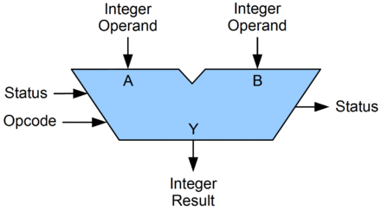
Arithmetic Logic Unit (ALU)
circuit that performs bitwise operations and arithmetic on integer binary types

Slide 23
Bitwise vs Logical Operations (in C)
Bitwise Operators &, |, ~, ^
View arguments as bit vectors
operations applied bit-wise in parallel
Logical Operators &&, ||, !
View 0 as “False”
View anything nonzero as “True”
Always return 0 or 1
Early termination
Shift operators <<, >>
Left shift fills with zeros
For unsigned integers, right shift is logical (fills with zeros)
For signed integers, right shift is arithmetic (fills with high-order bit)

Slide 24
Exercise 4: Bitwise vs Logical Operations
What is the binary representation of each of the following expressions? Assume signed char data type (one byte).
~(-30)
-30 & 22
-30 && 22
22 << 1
22 >> 1
-30 >> 1
= ~(11100010) = 00011101 = 29
= 11100010 & 00010110 = 00000010 = 2
= 11100010 && 00010110 = 00000001 = 1
= 00010110 << 1 = 00101100 = 44
= 00010110 >> 1 = 00001011 = 11
= 11100010 >> 1 = 11110001 = -15

Slide 25
Multiplying with Shifts
Multiplication is slow
Bit shifting is kind of like multiplication/division, and is often faster
x * 8 = x << 3
x * 10 = x << 3 + x << 1
Most compilers will automatically replace multiplications with shifts where possible
Notes:
Hint about rounding errors with division

Slide 26
Arithmetic Operations (in C)
Basic Math Operators +, -, *, /
division is integer division (rounds towards zero)
Modulus Operator %
Increment/Decrement operators ++, --
x++ is the same as x = x+1 or x += 1
x-- is the same as x = x-1 or x -= 1

Slide 27
Addition Example
Compute 5 + -3 assuming all ints are stored as four-bit signed values
1
1
0 1 0 1
+ 1 1 0 1
0
0
1
0
= 2 (Base-10)
Like you learned in grade school, only binary!
… and with a finite number of digits

Slide 28
Addition/Subtraction with Overflow
Compute 5 + 6 assuming all ints are stored as four-bit signed values
1
0 1 0 1
+ 0 1 1 0
1
0
1
1
= -5 (Base-10)

Slide 29
Error Cases
Assume $w$-bit signed values
$x+_{w}^{t}y=\left\{\begin{aligned}x+y −2^{w} (positive overflow) \\ x+y (normal) \\ x+y+2^{w} (negative overflow)\end{aligned}\right.$
overflow has occurred iff $x>0$ and $y>0$ and $x+_{w}^{t}y<0$
or $x<0$ and $y<0$ and $x+_{w}^{t}y>0$
$${−2⋅2}^{w−1}$$
$${−2}^{w−1}$$
$$0$$
$$2^{w−1}−1$$
$${2⋅(2}^{w−1}−1)$$
[ ]
representable values
[ ]
Possible values of $x+y$

Slide 30
Exercise 5: Binary Addition
Given the following 5-bit signed values, compute their sum and indicate whether or not an overflow occurred
x | y | x+y | overflow?
00010 | 00101
01100 | 00100
10100 | 10001
x+y | overflow?
00101
no
10000
yes
00101
yes

Slide 31
Multiplication Example
Compute 3 x 2 assuming all ints are stored as four-bit signed values
0 0 1 1
x 0 0 1 0
0 0 0 0
0 0 1 1 0
+ _
0 1 1 0
= 6 (Base-10)
Like you learned in grade school, only binary!
… and with a finite number of digits

Slide 32
Multiplication Example
Compute 5 x 2 assuming all ints are stored as four-bit signed values
0 1 0 1
x 0 0 1 0
0 0 0 0
0 1 0 1 0
+ _
1 0 1 0
= -6 (Base-10)

Slide 33
Error Cases
Assume $w$-bit unsigned values
$x∗_{w}^{t}y=U2T(\left(x⋅y\right) mod 2^{w})$
$${−2}^{2(w−1)}$$
$${−2}^{w−1}$$
$$0$$
$$2^{w−1}−1$$
$${ 2}^{2(w−1)}$$
[ ]
representable values
[ )
Possible values of $x∗y$

Slide 34
Exercise 6: Binary Multiplication
Given the following 3-bit signed values, compute their product and indicate whether or not an overflow occurred
x | y | x*y | overflow?
100 | 101
010 | 011
111 | 010
x*y | overflow?
100
yes
110
yes
110
no

